Slide 1
Customer Shopping Behaviour Analysis
1.Project Overview
This project analyzes customer shopping behavior using transactional data from 3,900 purchases across various product categories. The goal is to uncover insights into spending patterns, customer segments, product preferences, and subscription behavior to guide strategic business decisions .
2.Dataset Summary
- Rows: 3,900
- Columns: 18
- Key Features:
- Customer demographics (Age, Gender, Location, Subscription Status)
- Purchase details (Item Purchased, Category, Purchase Amount, Season, Size, Color)
-Shopping behavior (Discount Applied, Promo Code Used, Previous Purchases, Frequency of Purchases, Review Rating, Shipping Type)

Slide 2
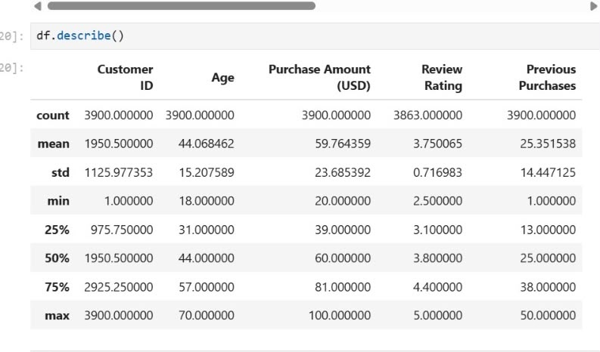
Missing Data: 37 values in Review Rating column
3. Exploratory Data Analysis using Python
We began with data preparation and cleaning in Python:
• Data Loading: Imported the dataset using pandas.
• Initial Exploration: Used df. Info() to check structure and describe() for summary statistics .

Slide 3
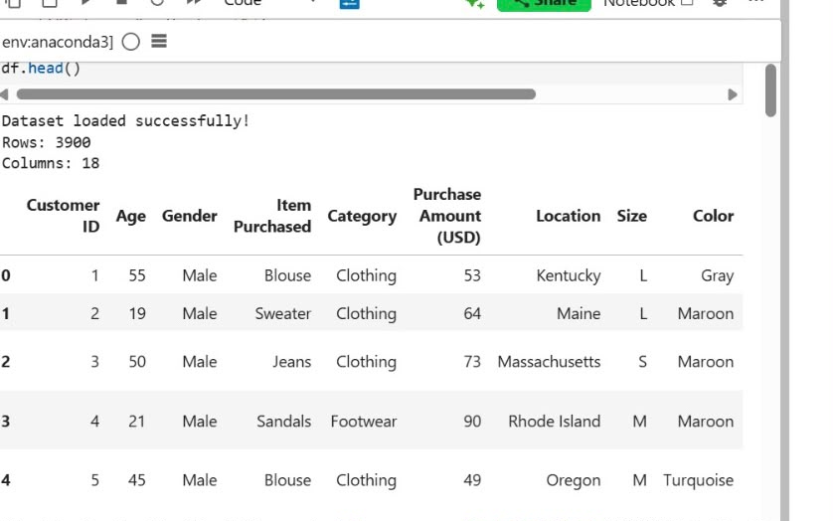
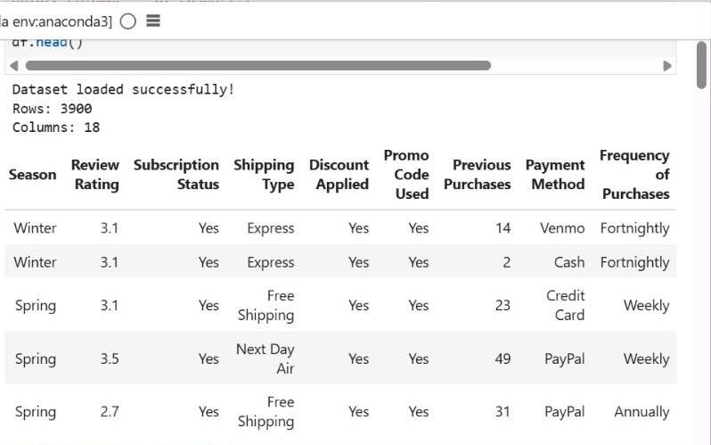
df.head() to inspect the data set :
• Missing Data Handling : Checked for null values and imputed missing values in the Review Rating column using the median rating of each product category.
• Column Standardization: Renamed columns to snake case for better readability and documentation.

Slide 4
• Feature Engineering:
• Created age_group column by binning customer ages.
• Created purchase_frequency_days column from purchase data
• Data Consistency Check: Verified if discount_applied and promo_code_used were redundant; dropped promo_code_used.
• Database Integration: Connected Python script to My SQL and loaded the cleaned
DataFrame into the database for SQL analysis.
4. Data Analysis using SQL
We performed structured analysis in My SQL to answer key business questions:
1. Revenue by Gender - Compared total revenue generated by male vs. female customers.

Slide 5
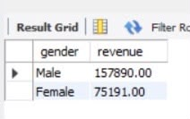
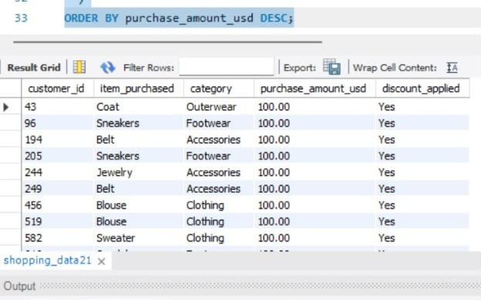
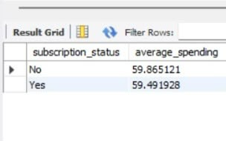
2. High Spending Discount Users : Identified customers who used a discount and still spent more than the average purchase amount
3. Spending of Subscriber & Non Subscriber :subscribed customers spend more on average than non-subscribed customer

Slide 6
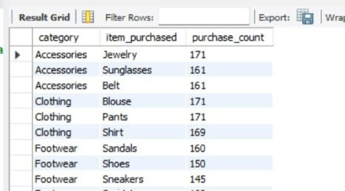
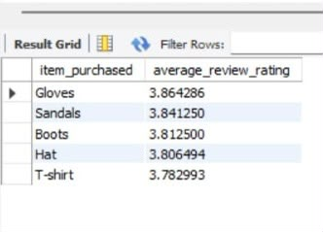
4.Most Purchased Items : Identified top 3 purchased products in each category.
Highest Rated Products : Identified top 5 products with the highest average review rating.

Slide 7
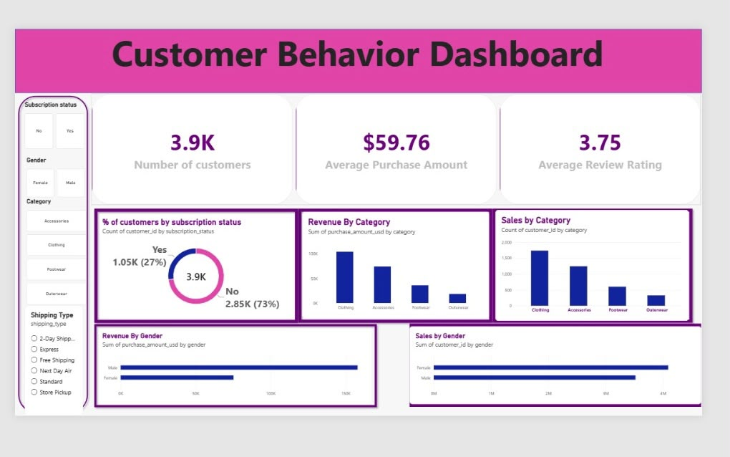
5.Dashboard in Power BI
Finally, we built an interactive dashboard in Power Bl to present insights visually.

Slide 8
6. Business Recommendations
• Boost Subscriptions - Promote exclusive benefits for subscribers.
• Customer Loyalty Programs - Reward repeat buyers to move them into the "Loyal" segment.
• Review Discount Policy - Balance sales boosts with margin control.
• Product Positioning - Highlight top-rated and best-selling products in campaigns.
• Targeted Marketing - Focus efforts on high-revenue age groups and express-shipping users

