Slide 1

Predicting Serie A: Comparing FiveThirtyEight predictions with a simpler method
Stefano Biguzzi-Velcich
DATA 698 Capstone Project
Notes:
The purpose of my Capstone project was to determine a simple method to predicting soccer games that is comparable to 538’s more complex method.
538 has the best, if not, only soccer prediction algorithm on the internet. The only issue is the base data they use to create their model is not free and their model is not public knowledge.
The goal was to create an algorithm that predicted games with similar accuracy that could be used to create a betting tool in the future.

Slide 2
Prediction Process
Model Goals
1
Calculate Lambdas
2
Simulate Games
3
Predict Outcome
4
Notes:
The process to predict games happens in four parts
First there is the model building stage, which predicts the number of goals for a given game
Second, I use the model coefficients to build a projected score for each team
Third, I simulate a Poisson distribution with the projected score of each team as the lambda of the distribution
And finally, I predict the outcome of each game based on the simulation

Slide 3
The Data
Notes:
One of the things I wanted to add to my model which I think might play a role in goals scored per game was the manager information. The idea behind this is that each manager has a philosophy to the game that might affect how offensive or defensive a team plays any given match, which could affect how many goals are scored.
I also wanted to consider the managerial experience, that is, the number of games a manager has coached. Presumably the more experienced managers could have more knowledge and therefore more success.
Combining these data points with team goals, team goals allowed, and FiveThirtyEight’s soccer power index would hopefully give me a good model to base my predictions on.
Data came from two sources, 538 and Transfermarkt.

Slide 4

Soccer Power Index
Team Goals
Expected Goals
Notes:
FiveThirtyEight has all the scoring data and Soccer Power Index, SPI, from 2015 to 5/02/2022.
SPI is a team rating that 538 assigns at the beginning of the season and updates after every game based on performance (the math behind these updates is unknown to the public).
From 538 I took the Soccer Power Index, the team goals, and team names.
From here I was able to create all the non-manager variable that I needed for my goal models

Slide 5

Manager Names
Manager Games
Manager Goals
Notes:
Transfermarkt is a website dedicated primarily to looking a soccer player transfers within teams, but it contains much more data now.
I used transfer market to manually collect manager data going back to the first games managed up until the last game managed in Serie A.
These data points were then used to create the manager variables that I wanted to use in my models.

Slide 6
Calculated Fields
League
Team Off Rating
Start with previous season Off rating then calculate cumulative mean of goals scored for current season
Team Def Rating
Start with previous season Def rating then calculate cumulative mean of goals allowed for current season
Manager
Manager Experience
Manager_{i} games / total manager games for each game
Manager Off Rating
Cumulative mean of manager team’s goals scored
Manager Def Rating
Cumulative mean of manager team’s goals allowed
Team
League Home Advantage
Historic goals scored for home team
League Away Disadvantage
Historic goals allowed for home team
Notes:
The calculated fields happened at the League level, the team level, and the manager level.
For the league I calculated home advantage and away disadvantage, which create a league specific home adjustment rating.
For the team specific variables, I calculated a team’s Off rating and Def rating per season.
And finally for the Manager level I calculated the managers experience rating, the manager’s Off rating, and manager’s Def rating.

Slide 7
Model
Notes:
To model goals, I wanted to use Poisson models because goals follow a Poisson distribution.

Slide 8
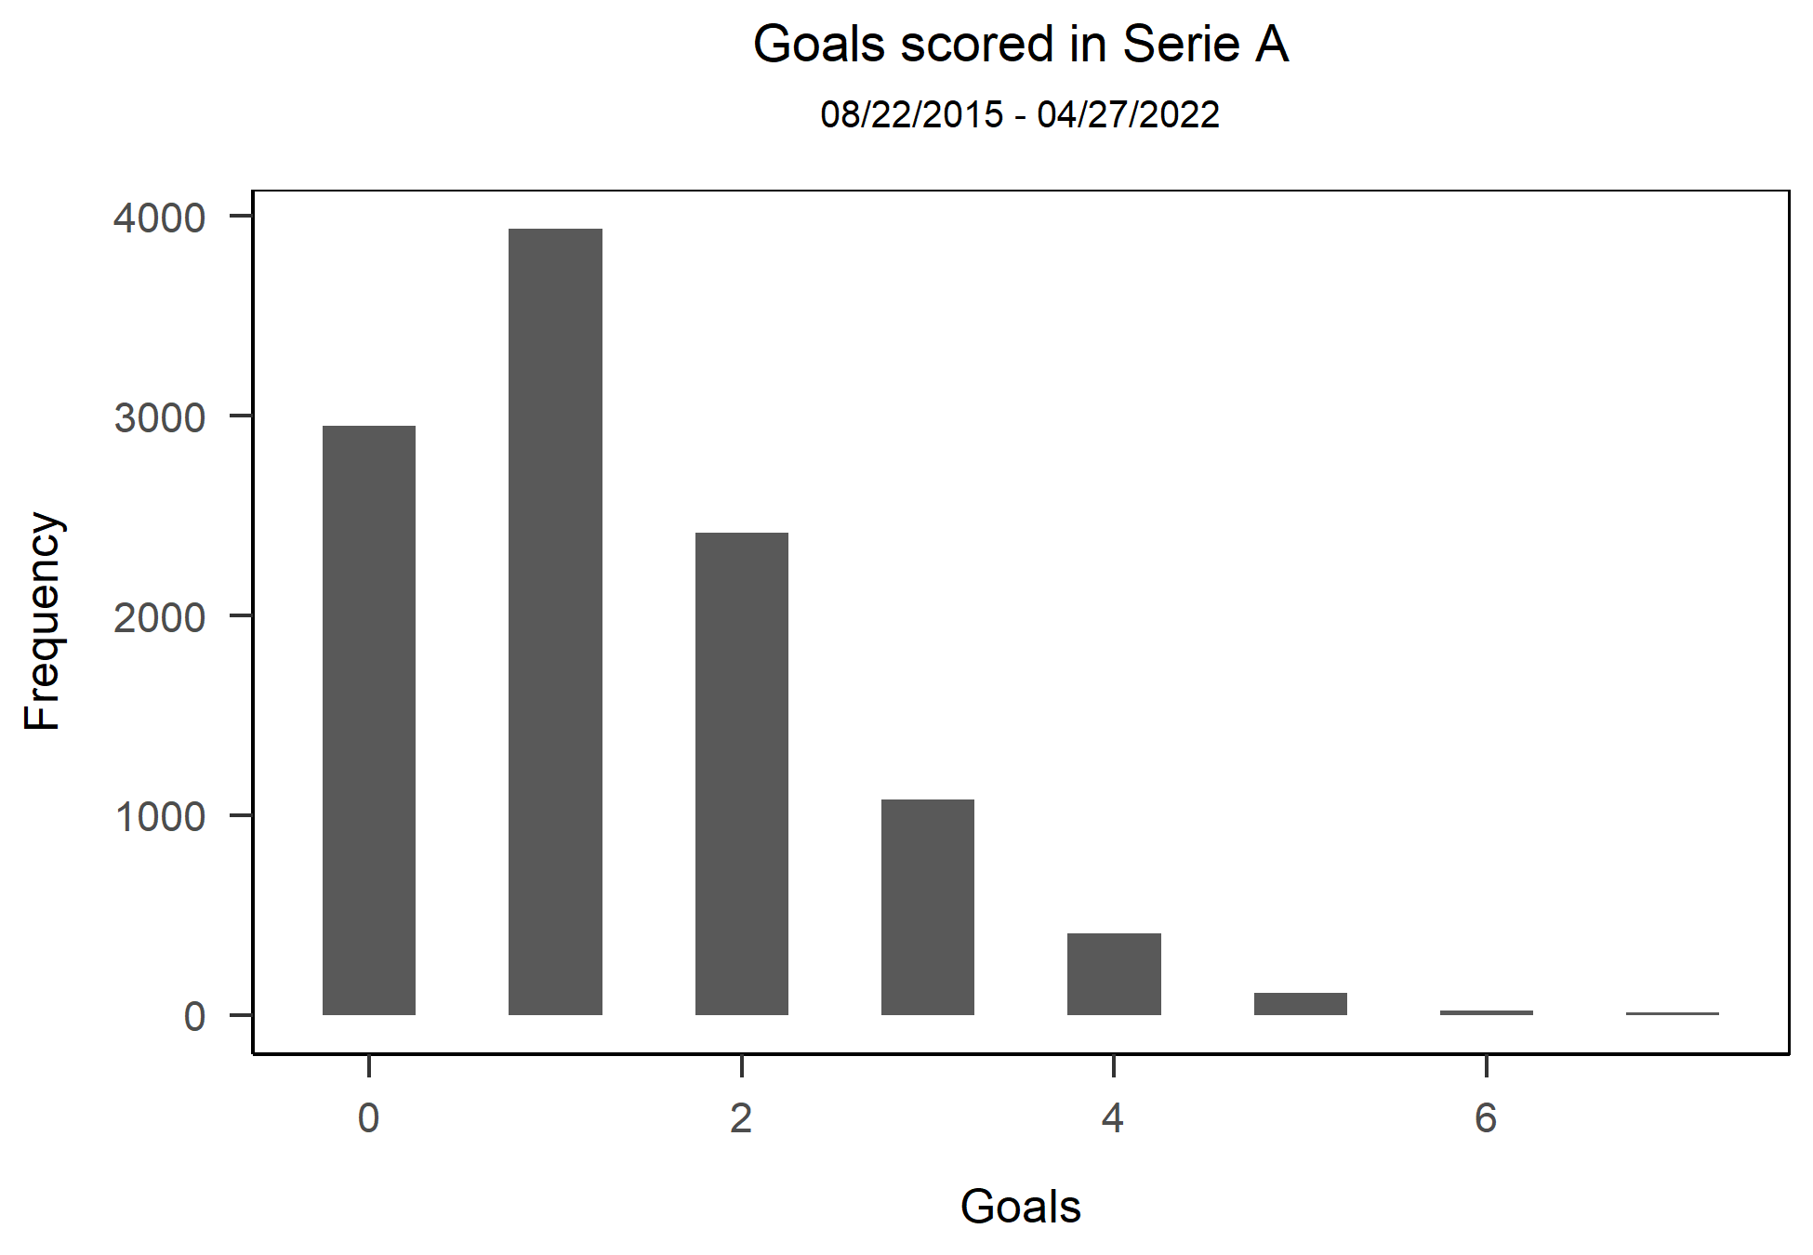
Goal Distribution
An event can occur any number of times during a time period.
Events occur independently.
The rate of occurrence is constant.
Notes:
Goals are considered Poisson as they fit all the criteria for such a distribution.
The Poisson distribution is a probability distribution that is used to show how many times an event is likely to occur over a specified period
The three criteria for a Poisson distribution are
(1) An event can occur any number of times during a time period.
(2) Events occur independently.
(3) The rate of occurrence is constant.
Following that logic, we can deduce that:
(1) Theoretically a team could score an infinite number of goals in each game
(2) Goal scoring events occur independently. One team scores on one end of the field, while the other team must score on the other end. And teams cannot score at the same time.
(3) The constant rate of goals scored in Serie A games from 2015 to 4/27 is around 1.32 per game per team.

Slide 9
Regular Model
Predictor | Estimate | P-Value
Intercept | -1.43 | < 0.001
Off Rating | 0.49 | < 0.001
Def Rating | 0.56 | < 0.001
Manager Experience | 0.12 | 0.085
Manager Off Rating | 0.09 | 0.058
Notes:
The first model I created was a Poisson model that used all the created variables in my dataset.
After eliminating all the insignificant variables, the model with the best prediction power produced the following results.
As we can see a lot of the goal variance is explained by the OFF rating of the team and the DEF rating of the opponent team.
Manager experience and manager offensive rating play a small role in explaining the number of goals.

Slide 10
Interaction Model
Predictor | Estimate | P-Value
Intercept | -0.85 | < 0.001
SPI Interaction | 1.06 | < 0.001
Manager Experience | 0.05 | 0.274
Notes:
The second model I created was an interaction model where I divide each opposing variable. For example, the SPI rating the first team divided by the SPI rating of the second team.
Again, I removed insignificant variables to create a model with the most predictive power.
Looking at the results, we see that the only important variable is the SPI rating from 538.
While the model with the best predictive power also uses manager experience, we can see that it plays a miniscule role in predicting goals with such a small coefficient.

Slide 11
Model Selection
Model | AIC | Success Rate
Regular Model | 10,019 | 37.73%
Interaction Model | 10,503 | 35.60%
Notes:
Comparing each model, we see that the model without the interaction terms predicted goals slightly better.
The AIC, a metric that estimates prediction error, was lower, and the success rate at predicting the correct score for a team was about 2% better.
I decided to use the non-interaction model to calculate the projected score for each team on any given game.

Slide 12
Calculate

Slide 13

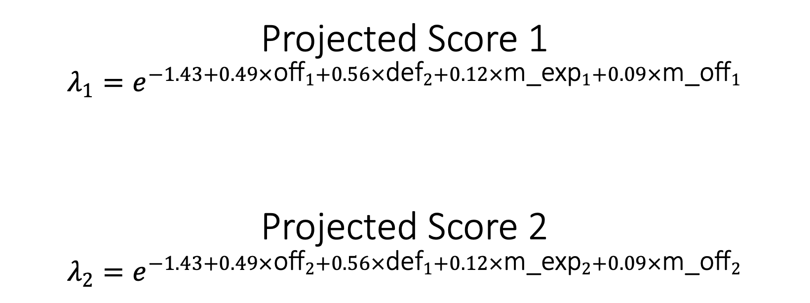
Calculate Lambdas
Projected Score 1
$$λ_{1}=e^{−1.43+0.49×{\text{off}}_{1}+0.56×{\text{def}}_{2}+0.12×{\text{m}\text{_}\text{exp}}_{1}+0.09×{\text{m}\text{_}\text{off}}_{1}}$$
Projected Score 2
$$λ_{2}=e^{−1.43+0.49×{\text{off}}_{2}+0.56×{\text{def}}_{1}+0.12×{\text{m}\text{_}\text{exp}}_{2}+0.09×{\text{m}\text{_}\text{off}}_{2}}$$
Notes:
The lambdas are the projected score for each team
The following formulas show how each team’s lambda is calculated using the regression model coefficients
Since a Poisson regression models the log of the expected count as a function of the predictor variables, to calculate the lambdas or the projected score for each team I had to convert the log prediction to a number prediction by raising each number by the numerical constant e.

Slide 14
Simulate
Notes:
The third step in the process is to simulate each team’s chances of scoring a n number of goals given their projected score over 10,000 times.

Slide 15

Simulating Games
Milan – 44% / Fiorentina – 29% / Tie – 27%
Milan | Fiorentina Projected Score - 1.08
Projected Score - 1.42 | 0 | 1 | 2 | 3 | 4 | 5+
0 | 8.49 | 8.63 | 4.82 | 1.89 | 0.47 | 0.13
1 | 11.84 | 12.92 | 7.10 | 2.52 | 0.53 | 0.21
2 | 8.11 | 9.23 | 4.30 | 1.80 | 0.41 | 0.18
3 | 3.76 | 3.85 | 2.21 | 0.88 | 0.23 | 0.05
4 | 1.35 | 1.37 | 0.89 | 0.26 | 0.09 | 0.01
5+ | 0.56 | 0.52 | 0.30 | 0.08 | 0.00 | 0.01
Notes:
Take for example the Milan – Fiorentina game played on 5/2/2022.
The projected score from my model was 1.42 goals for Milan and 1.08 goals for Fiorentina.
By putting the simulated distribution results into a matrix, I can then calculate how many times each score is likely to happen for a given game, as seen in the slide.
By adding up the bottom half of the matrix we arrive at team1’s, in this case, Milan’s chances of winning. That is all the simulation results where the final score was in Milan’s favor.
Adding the top half of the matrix we get to Fiorentina’s chances of winning the game
Finally, by adding the diagonal of the matrix we arrive at the tie chance.
As we can see in the table the game played on 5/2/2022 Milan had a 44% chance of winning, Fiorentina a 29% chance of winning, and there was a 27% chance of ending in a tie.
The game ended up finishing a 1-0 win for Milan, which was one of the top two outcomes from my simulation.

Slide 16
Predict

Slide 17
Predicting Results
team1 | team2 | observed | my outcome | 538 outcome
Cagliari | Hellas Verona | win2 | win2 | win2
Napoli | Sassuolo | win1 | win1 | win1
Sampdoria | Genoa | win1 | win1 | win1
Spezia | Lazio | win2 | win2 | win2
Juventus | Venezia | win1 | win1 | win1
Milan | Fiorentina | win1 | win1 | win1
Empoli | Torino | win2 | win2 | win2
Udinese | Inter Milan | win2 | win2 | win2
Roma | Bologna | tie | win1 | win1
Atalanta | Salernitana | tie | win1 | win1
* For the 2021/2022 season up to and including Matchday 35
Notes:
Finally, using the simulation method outlined in the previous slide and arrive at all the outcomes for a given week.
In this table we see that for Matchday 35 my model and FiveThirtyEight’s model both predicted the outcomes equally, with only 2 games predicted wrong.

Slide 18
Results

Slide 19
Wrong Predictions
team1 | Team2 | win1 | win2 | Tie | score1 | score2 | exp_score1 | exp_score2
My Projected Outcomes
Roma | Bologna | 52.47 | 22.35 | 25.18 | 0 | 0 | 0.95 | 1.31
Atalanta | Salernitana | 71.20 | 12.01 | 16.79 | 1 | 1 | 2.52 | 0.99
538 Projected Outcomes
Roma | Bologna | 51.02 | 22.33 | 26.00 | 0 | 0 | 0.95 | 1.31
Atalanta | Salernitana | 69.32 | 12.76 | 17.43 | 1 | 1 | 2.52 | 0.99
Notes:
However, if we look at the two games that were wrong, we see that one game was predicted wrong and one game we got unlucky.
The Roma vs Bologna game was wrong from both models as our predictions heavily favored Roma to win, but the game ended in a tie and looking at the expected goals for that game for each team, that was a fair outcome as both teams were expected to score about 1 goal.
On the other hand, the Atalanta game we got unlucky with our predictions as the game ended in a tie, but it really should have ended in a 2-1 or 3-1 win for Atalanta.
Soccer is one of the hardest games to predict because there is a lot of luck that factors into the outcome. This is true of many sports, but more so in soccer than others. These types of unlucky predictions will be common in any soccer prediction model.

Slide 20
Conclusion
Manager Relationship With Goals
Not as important as I thought, can see with both non-interaction model and the interaction model.
My method and FiveThirtyEight’s method produce similar results
Prediction Method | Success Rate*
My Method | 56%
FiveThirtyEight Method | 53%
Notes:
As we saw in both the Poisson regression models I created, neither the manager’s experience nor the manager’s Off or Def ratings were very predictive of goals.
The manager’s philosophy and their historic success don’t translate well to future game predictions.
On the other hand, I was able to create a similar model to FiveThirtyEight’s using only the calculated off and def rating of each team.
My model success rate for predicting correct games for the 2021/2022 season up to and including Matchday 35 was 56% to FiveThirtyEight’s 53%.

Slide 21
Future Projects
Refining model
Could develop a model with more granular player data
Next steps
Offensive and Defensive ratings could be used to create a betting tool for soccer
Look into creating a weighted mean for off and def rating
Compare model predictions with bookmaker odds to find potential value bets
Notes:
With this model I could create a betting tool for Italian soccer
By comparing the projection percentages with the Odds from different sportsbooks, the betting tool can hopefully find some value for any given week’s matchups.
This doesn’t just include final game outcome’s but also most likely score as seen in the simulation matrix
I can also refine the models in the future with the right resources.
Attempt a new weighted model which puts more weight on the last 5 games for a team rather than using a cumulative mean all the season’s goals.
I could also develop a model that uses more granular off and def rating for individual players in the starting lineup, starts and bench players. Weighing the ratings for the starters higher than the bench players. Could then average those player ratings together to get a team off and def rating for each game.

Slide 22
Q & A
THANK YOU!

