Slide 1

Presented By:
Bikash Shrestha
Dimpal Ruchal
Kushum Tamang
Sudip Rijal

Slide 2
Contents:
Introduction
Objectives
Scope
Context Diagram
Level-0 DFD
Level-1 DFD
Use case Diagram
ER Diagram
Conclusion
Reference

Slide 3
1. Introduction:
An online shopping system is a process in which people are being provided with the option of purchasing goods and services directly from the seller, all in a real-time environment.
The online shopping project deals with the online buying of the products by the customers.
Under this website many products and services can be ordered.

Slide 4
1.1 Objective:
To provide customers with a convenient, user-friendly, and secure way to purchase goods and services online, while also providing them with a wide selection of products.
To provide a product catalog that includes details such as product name, description, price and availability.
To provide a shopping cart that allows customers to add products to their cart and make modifications such as adding or removing products.

Slide 5
1.2 Scope:
This system can be implemented to any shop in the locality.
The system recommends a facility to accept the orders 24*7 and a home delivery system which can make customers happy.
An average company will not be very keen on spending loads of money on ledgers. Whereas these project will greatly reduce the costs which is using common and cheap office items like database and desktop application.

Slide 6
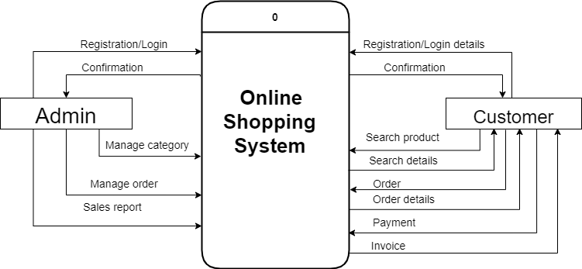
2. System Analysis: 2.1 Context diagram:
Figure 1: Context diagram of Online shopping system

Slide 7
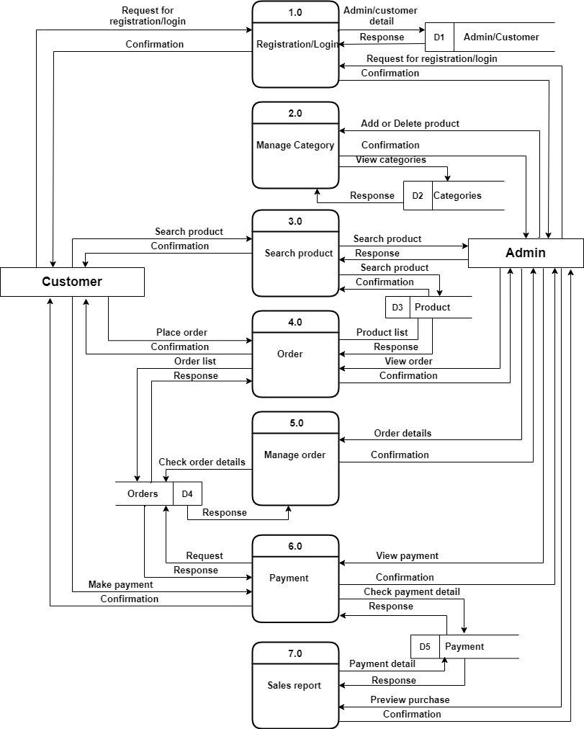
2.2 Level-0 DFD:
Figure 2: Level-0 DFD of Online shopping system

Slide 8
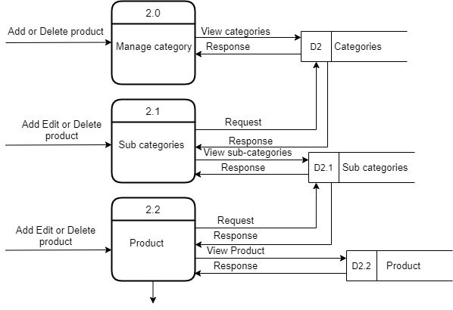
2.3 Level-1 DFD:
Figure 3: Level-1 DFD of Online shopping system

Slide 9
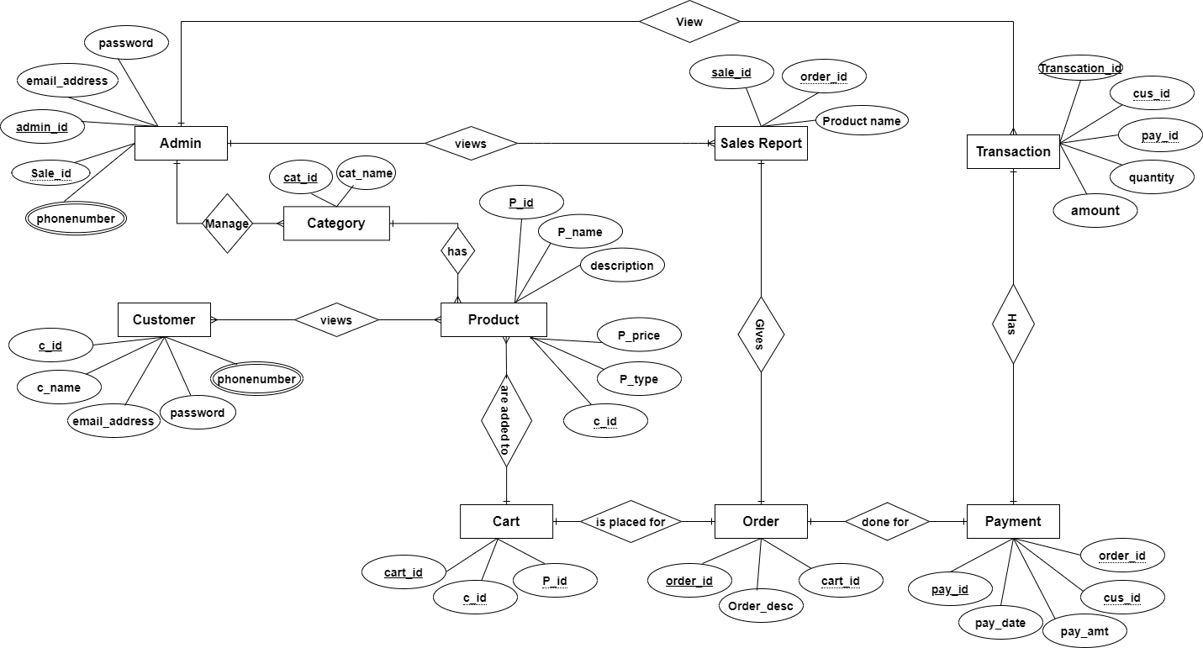
2.4 ER Diagram:
Figure 4: ER diagram of Online shopping system

Slide 10
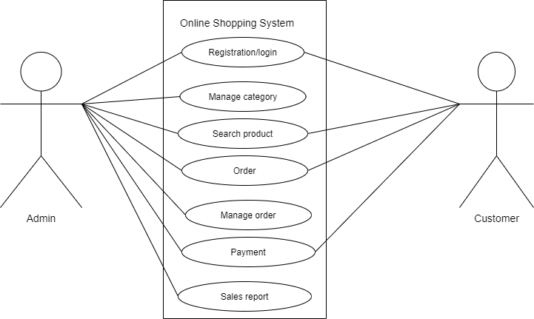
2.5 Use case diagram:
Figure 5: Use case diagram of Online shopping system

Slide 11
3. Conclusion:
The project “ONLINE SHOPPING SYSTEM” is done to develop online shopping system for selling of products over the internet.
This project help to enter transaction reports and to maintain customer records.
It is planned particularly that one can see all the updates of the versatile from any spot through on the web.
It is very easy, time saving and comfortable; can order items online than going to market for shopping.

Slide 12
4. Reference:
https://www.ukessays.com/essays/marketing/literature-review-of-online-purchase-intention-marketing-essay.php (visit date: 25 August 2022)
https://www.tutorialspoint.com/sdlc/sdlc_quick_guide.htm (visit date: 26 August 2022)
https://www.tutorialspoint.com/sdlc/sdlc_iterative_model.htm (visit date: 26 August 2022)
https://www.academia.edu/8213765/(visit date: 02 Nov 2022)

Slide 13


