Slide 1

Understanding Agentic Prompting
with emphasis on Claude
Bots 101
LLMs · Context Windows · Prompting · Claude Code
Conf. dr. Teodor-Stefan Bildea - 2026

Slide 2

PART 1
What Is an LLM?
Foundations · Tokens · Autocomplete · Hallucination

Slide 3

PART 1 / FOUNDATIONS
Where It Started — Machine Translation
Roots in neural machine translation research (2014–2017)
Key insight: mapping French → English means learning meaning and structure, not just words
The Transformer architecture (Attention Is All You Need, 2017) — every token attends to every other token
Think less like a database lookup, more like a system that absorbed language by reading everything humans ever wrote
Bonjour
Hello
Prompt
Code

Slide 4
PART 1 / FOUNDATIONS
Nobody Knows Why It Works
We can describe the math: matrix multiplications, attention heads, softmax probabilities
We cannot explain why token prediction produces apparent reasoning, creativity, and useful code
This is the interpretability problem — active research, no definitive answer yet
Treat the model empirically — if something fails, experiment, don't theorize.
?
INPUT
OUTPUT

Slide 5
PART 1 / TOKENS
Tokens, Not Words
The model never sees "Hello world" — it sees [9906, 1917] or similar token IDs
One token ≈ ¾ of a word on average — can be a whole word, punctuation, or a fragment like 'ing'
Non-English text tokenizes less efficiently — consuming more of the context window
"Hello world"
9906
1917
DateTime.Now.ToString("yyyy-MM-dd")
→ 10+ tokens
🔗 platform.openai.com/tokenizer
Counting is unreliable
Spelling is hard
No native ability to count tokens
Reversing a word: never saw individual letters

Slide 6
PART 1 / CORE MECHANIC
LLMs Are Autocomplete at Scale
Core mechanic: given a token sequence, predict the most probable next token — then repeat.
"Mary had a little ___"
lamb
98%
dog
1%
jetski
0.01%
"Fix my code" → No context = model fills ambiguity with the most probable continuation
Not retrieving facts. A pattern-completion engine trained on the sum of human-produced text.

Slide 7
PART 1 / HALLUCINATION
Hallucination Patterns in Code Contexts
Hallucination is not random noise — it is statistically plausible wrongness. It fits the surrounding context, which is what makes it hard to catch.
Invented API signatures
Version drift
Calls a method that almost exists with slightly wrong parameters
Uses an API from a different library version than you are running on
⚠ Compiles cleanly, throws at runtime
⚠ Very common with fast-moving ecosystems
Plausible-but-wrong logic
Confident gap-filling
Correct structure, subtle flaw — off-by-one, wrong condition, missing null check
Broad question + vague context = Claude invents the missing details as fact
⚠ Passes a quick read, fails in edge cases
⚠ The less context you give, the more it guesses
Ask Claude to explain its reasoning step by step — gaps in the explanation mean gaps in the code.

Slide 8

KEY TAKEAWAY / PART 1
Do not expect the model to understand an unclear question.
It will produce the most probable next token — not the correct answer.

Slide 9

PART 2
How Claude Works
Context Window · Compaction · Memory · Temperature

Slide 10

PART 2 / CONTEXT
The Context Window — Working Memory
Everything Claude knows fits in a fixed token window — not infinite
Long sessions with many file reads, commands, and turns fill it fast
Earlier context fades — a constraint set at session start may disappear
CLAUDE.md loads every session automatically, anchoring critical context before the first message
CONTEXT WINDOW

Slide 11

PART 2 / COMPACTION
Context Compaction
When the window fills, Claude Code summarises history to free space — then continues. You will see a notice in the UI.
Loss of detail
Mid-task drift
Specific file paths, constraints, decisions may not survive the summary
Steps already done may repeat; uncompleted steps may be skipped
Silent confidence
Diluted instructions
Claude continues without announcing what was lost
Early rules may weaken or disappear after compaction
✓ After compaction, re-anchor: "Summarise what has been done and what step we are on before continuing"

Slide 12
PART 2 / EXTERNAL MEMORY
Markdown Files as External Memory
The context window is temporary. Markdown files are permanent.
PLAN.md / TASK.md
Checklist with [ ] / [x] markers. After compaction: 'Read PLAN.md and continue from the first unchecked item.'
DECISIONS.md
Key decisions and rationale that would otherwise be lost in chat history
CLAUDE.md
Standing instructions loaded every session — the contract, not a verbal briefing.
If it matters beyond this conversation — write it to a file.

Slide 13
PART 2 / ARCHITECTURE
System Prompt, User Turn, Assistant Turn
SYSTEM
Claude Code's loaded context, persona, tools, and CLAUDE.md — before you type anything
USER
Your message — task, context, examples, constraints
ASSISTANT
Claude's response — then the cycle repeats
Claude is never a blank slate — context is loaded before your first message.

Slide 14
PART 2 / MEMORY
Not Stateless — But Not Stateful
Within a session
Across sessions
Full conversation context is retained
Claude starts completely fresh
Earlier decisions and file contents remembered
No memory unless explicitly provided
Context window holds the entire thread
Common mistake: assuming Claude recalls last session
→ Everything that must persist across sessions belongs in CLAUDE.md or a markdown file.

Slide 15
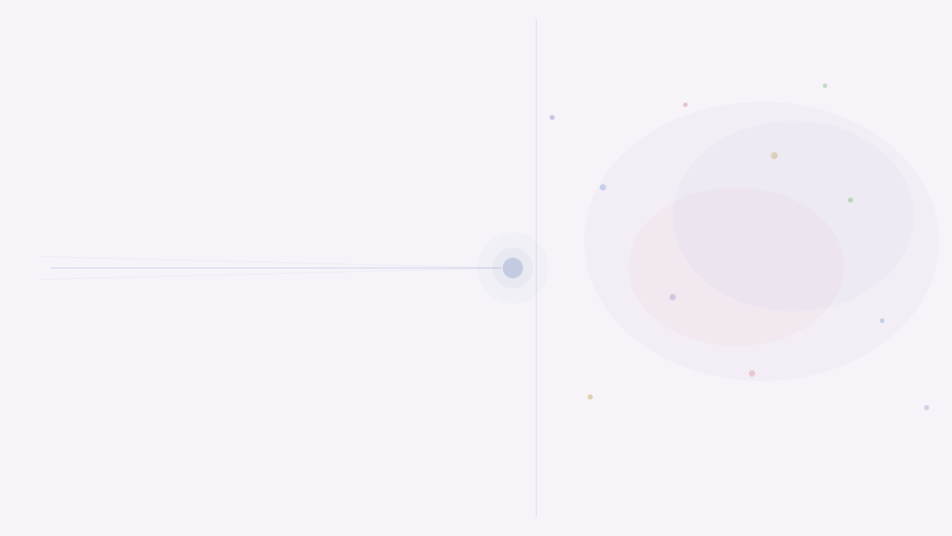
PART 2 / SETTINGS
Temperature and Determinism
Low Temperature/Effort
High Temperature/Effort
More deterministic output
More varied and creative output
Highest-probability tokens preferred
Lower-probability tokens explored
Better for code generation
Better for brainstorming
Claude Code default for coding tasks
Design and ideation tasks

Slide 16

PART 3
Writing Prompts
That Work
Anatomy · Persona · Few-Shot · Context Engineering

Slide 17
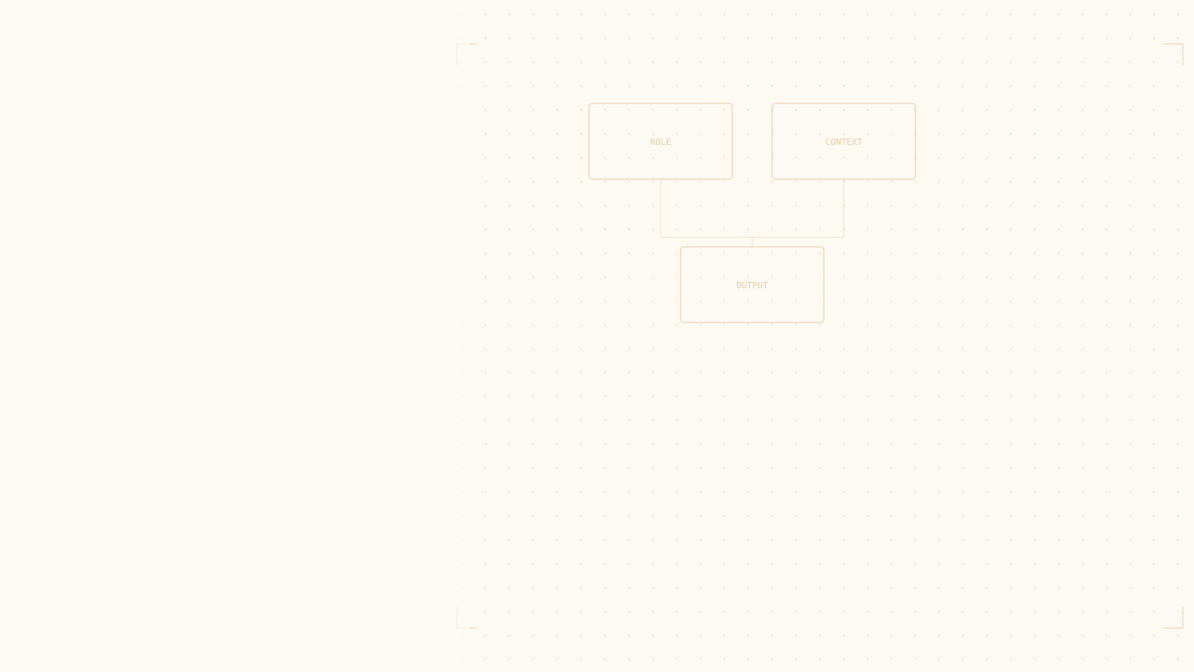
PART 3 / PROMPTING
The Anatomy of a Good Prompt
01 ROLE / CONTEXT
EXAMPLE
Who is Claude? What is the environment and project?
You are working on a .NET 8 API.
Refactor this method to be async.
Do not change the method signature.
Return only the updated method,
no explanation.
02 TASK
What exactly do you want? Be specific and unambiguous.
03 CONSTRAINTS
What must it avoid? What must not change?
04 OUTPUT FORMAT
Code only? With explanation? Specific length?

Slide 18
PART 3 / PERSONA
Persona Matters — Claude Adapts to the Role
Defining a persona activates a different slice of the model's training. Same code, same question — very different outputs.
PERSONA ASSIGNED
WHAT CLAUDE FOCUSES ON
Senior .NET Security Engineer
Input validation, SQL injection risk, auth surfaces, secrets in logs
Code Reviewer — Junior Dev Onboarding
Naming clarity, readability, edge cases, gentle suggestions
Performance Engineer — High-Throughput API
Allocations, blocking calls, N+1 queries, caching opportunities
💡 Add your standing persona to CLAUDE.md so Claude always starts with the right perspective.

Slide 19
PART 3 / TECHNIQUES
Show, Don't Just Tell — Few-Shot Prompting
Providing examples of desired input → output is one of the most powerful prompting techniques
Claude matches patterns from examples rather than interpreting vague instructions
In Claude Code: showing existing code patterns guides Claude to match your project style
✗ Vague
✓ With example
"Format the dates nicely"
Input: 20240315
→ Output: March 15, 2024

Slide 20
PART 3 / TECHNIQUES
Break Complex Tasks Down
A single "do everything" prompt forces many decisions at once — bad early choices cascade into bigger problems.
01
02
03
04
Identify
Plan
Apply
Verify
List all places the old pattern is used across the codebase
Propose the refactor plan — review and approve before any changes
Execute one module at a time, verifying each increment
Run tests, check boundaries, confirm nothing regressed

Slide 21

KEY TAKEAWAY / PART 3
Claude is a collaborator,
not an oracle.
It will be confident even when wrong. Review its output, push back, iterate — do not treat a first response as final.

Slide 22
PART 3 / CONTEXT ENGINEERING
Prompt Engineering vs. Context Engineering
Prompt Engineering
Context Engineering
Craft the perfect single request
Architect everything Claude can see when it acts
'Word this request better'
CLAUDE.md with standing project knowledge
'Find the right phrasing'
PLAN.md loaded before starting
'Add more detail to the question'
Use /clear to remove stale context
Explicit examples of what NOT to do
Output quality depends more on what Claude knows than on how cleverly you word the request.

Slide 23
THE CORE MENTAL MODEL
Claude is a token-prediction engine trained on human knowledge, guided by your instructions, operating within a context window.
The better your instructions match the task, the better the output.
It's not magic — it's very powerful autocomplete. Treat it like a collaborator, not a calculator.

