Slide 1
PDFgui: quick start

Slide 2
Installing PDFgui
Go to diffpy.org
Select pdfgui from the “Products” dropdown
Follow the instructions
If you don’t have Anaconda installed I recommend installing miniconda
If all else fails, install the windows executable version instead (diffpy-1.0-r3067.exe)

Slide 3
Getting the tutorial materials
The data are in a GitHub public repository at billingegroup/toscaland21_pdf_tutorial
If you have git on your machine (e.g., git bash on windows)
“git clone https://github.com/Billingegroup/toscaland21_pdf_tutorial.git” should do it
If you don’t want to do it using git, select to download the zipped version of the file

Slide 4
Running PDFgui
Open a terminal
E.g., type cmd into the search box on Windows
“cd” to where you are working
E.g., cd scratch/toscaland21

Slide 5
Installing structure viewer if you like
Download Vesta (or another preferred viewer)
Google for “vesta structure viewer” and select “download”
Download and extract the files, maybe to the programs directory or your computer
In PDFgui,
Edit -> preferences
Browse for the vestaXXX.exe file in your extracted download file
Click OK

Slide 6
Basic rules of PDFgui usage
Join diffpy-users Google group and ask questions there
Do it now! Google for diffpy-users and request to join
Every time you are in a happy-place, save your work into a project file (ctl-s)
This will save you a lot of time if (as sometimes happens) PDF gets stuck and has to be restarted.
Remember “ctl-s”

Slide 7
Workflow
Fits -> New fit, give it a name if you like
Select the fit
Data -> new data set
Browse for data file
If you have a cif file
Phases -> browse for the cif file
If you don’t have a cif yet
Pdfitc.org -> structuremining
Upload the pdf file and give as much info as you have about composition
Download your preferred result and extract the files
In pdfgui, browse for the cif file and select it

Slide 8
Some suggestions
Sanity checks
Plot your data, does it look ok?
Calculate your model before doing a full refinement and plot it, does it look ok, as you expect?
Check you refinement results, are the numbers ok? A good fit doesn’t necessarily mean a good model!
Check to see if refined parameters are highly correlated (>90%). It means that their refined numbers will be somewhat uncertain
SAVE YOUR PROJECT FREQUENTLY (ctl-s)

Slide 9
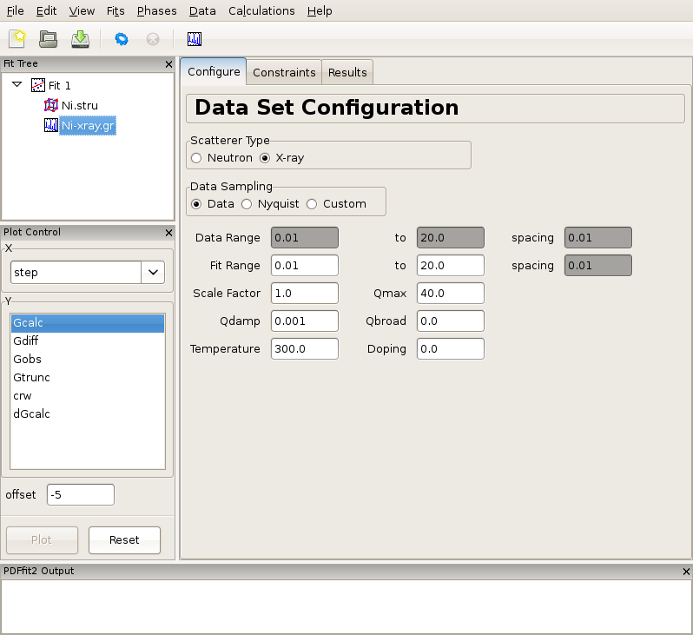
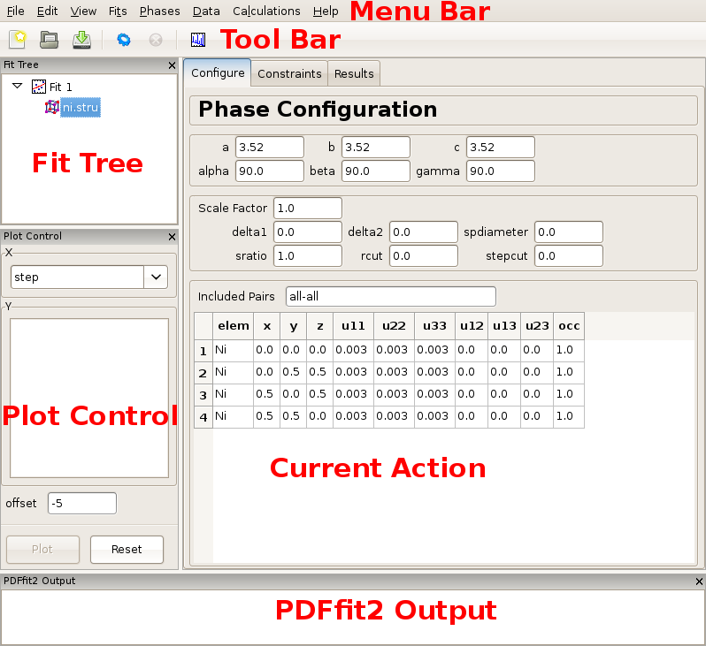
PDFgui: Layout
The layout can be somewhat customized to create comfortable work environment
Tabs to panes

Slide 10
Creating a simple fit using a preexisting structure file
Appearance of a PDFgui window after a PDF dataset is loaded.

Slide 11
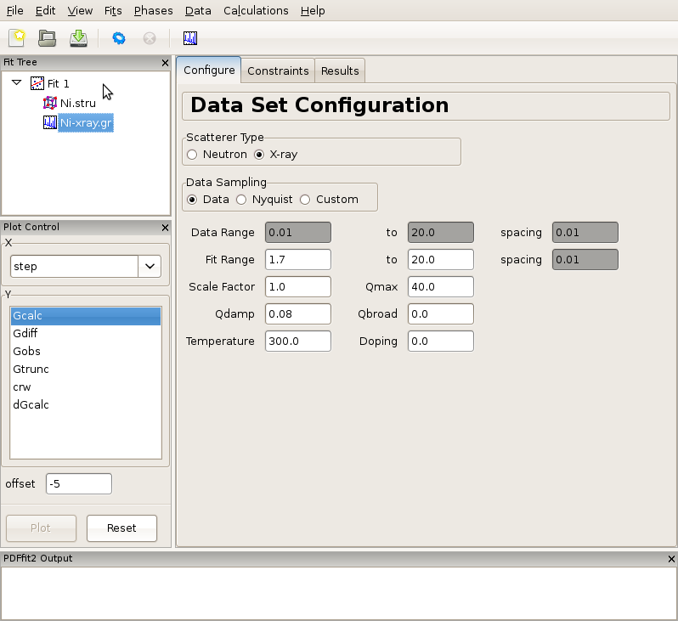
Creating a simple fit using a preexisting structure file
Adjusting data set related configuration.

Slide 12
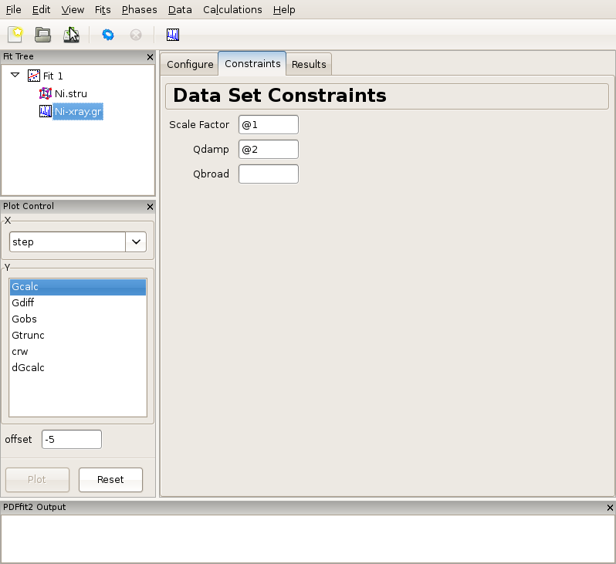
Creating a simple fit using a preexisting structure file
Setting up the refinement parameters and constraints: experimental parameters

Slide 13
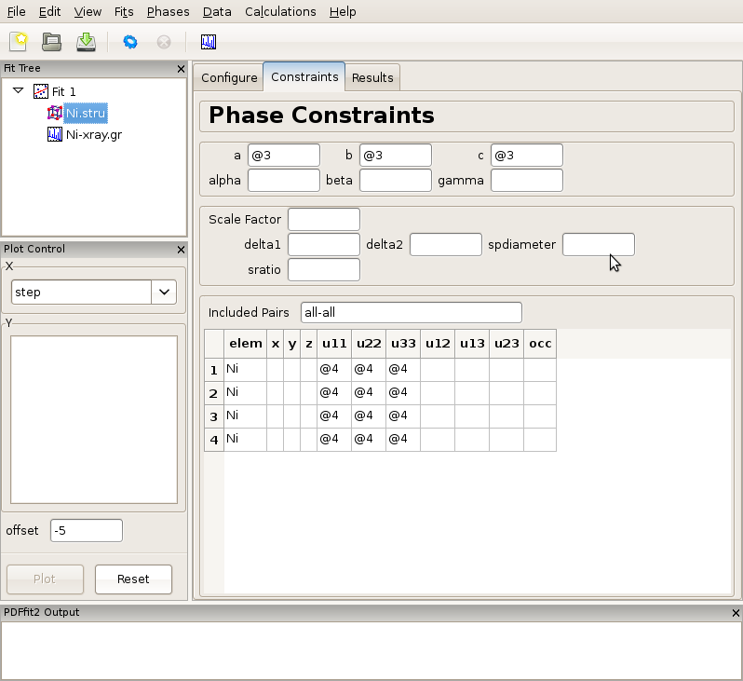
Creating a simple fit using a preexisting structure file
Setting up the refinement parameters and constraints: model structure

Slide 14
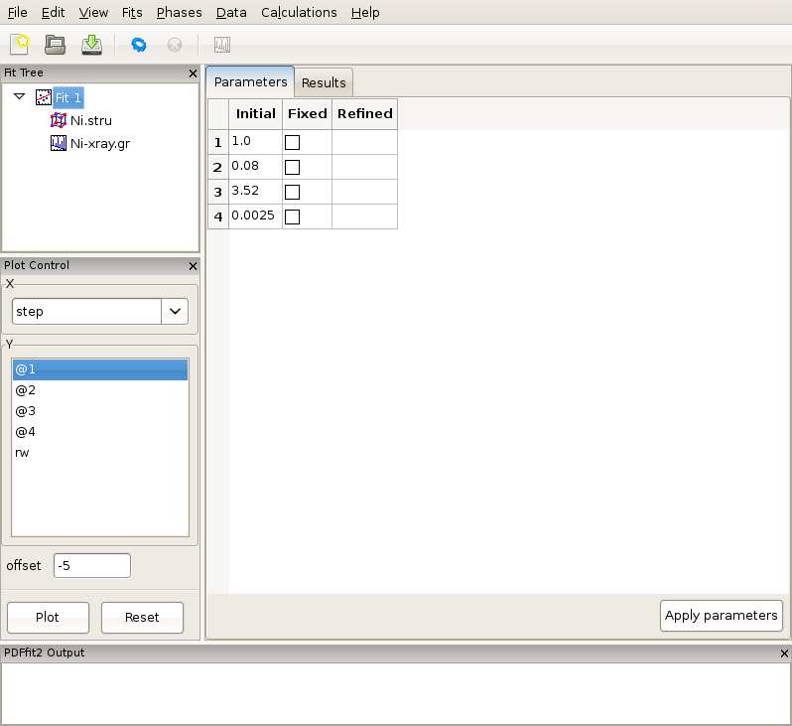
Creating a simple fit using a preexisting structure file
Reviewing the fit parameters and conditions

Slide 15
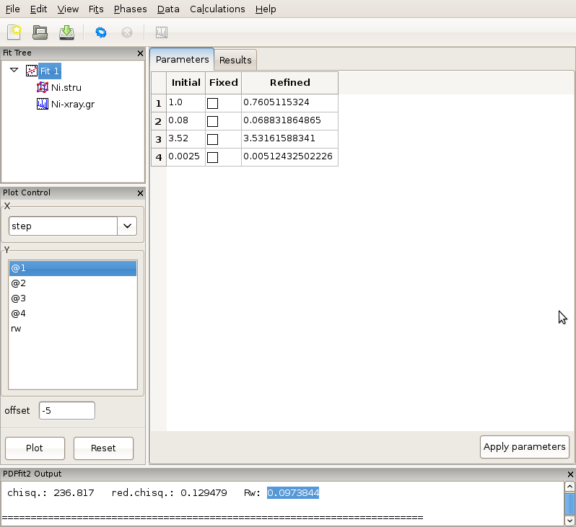
Creating a simple fit using a preexisting structure file
The refinement progress is displayed in the PDFfit2 Output panel.

Slide 16
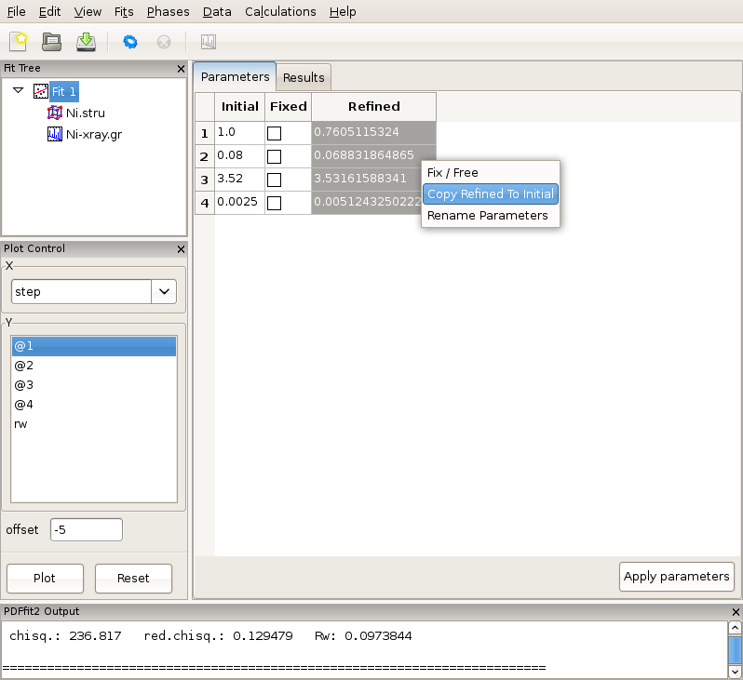
Creating a simple fit using a preexisting structure file
Updating the set of initial values of refined parameters.

Slide 17
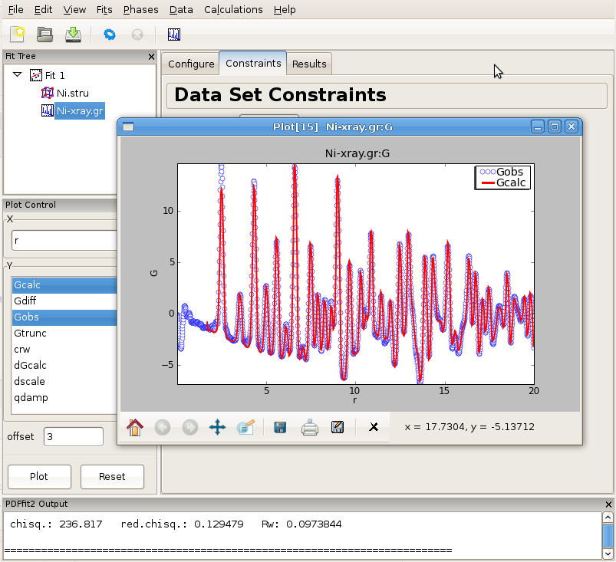
Creating a simple fit using a preexisting structure file
An example of PDFgui plotting capabilities: displaying a fit.

Slide 18
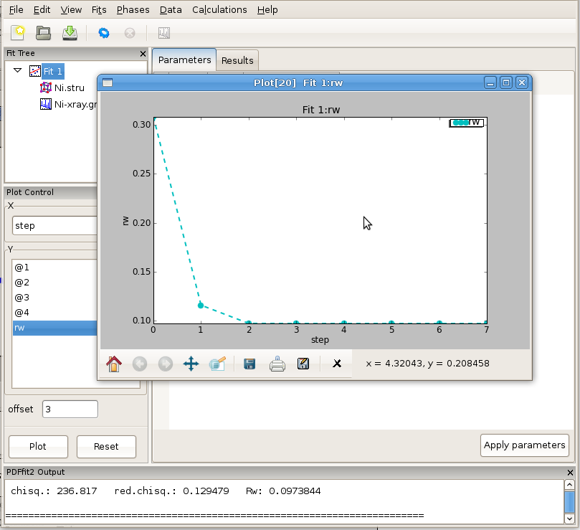
Creating a simple fit using a preexisting structure file
An example of PDFgui plotting capabilities: displaying a parameter.

Slide 19
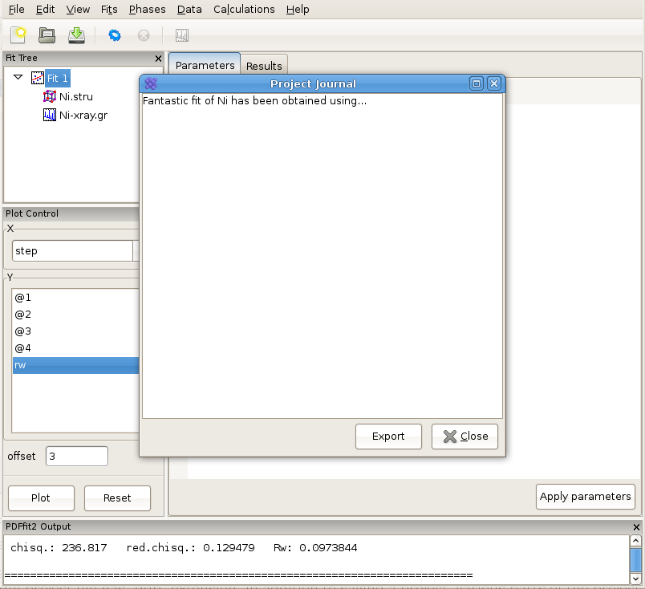
Creating a simple fit using a preexisting structure file
Using “Journal” feature can be a convenient way for taking notes.

Slide 20
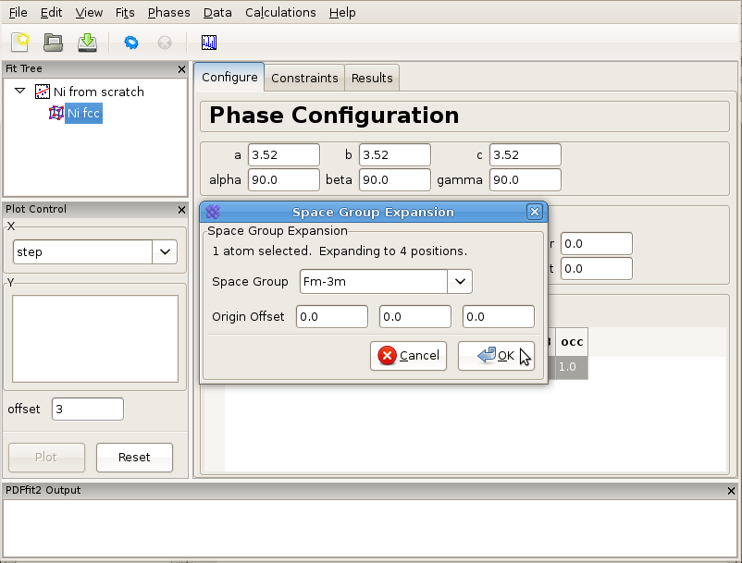
Building structure model using crystal symmetry
Expanding the unit cell using space group information.

Slide 21
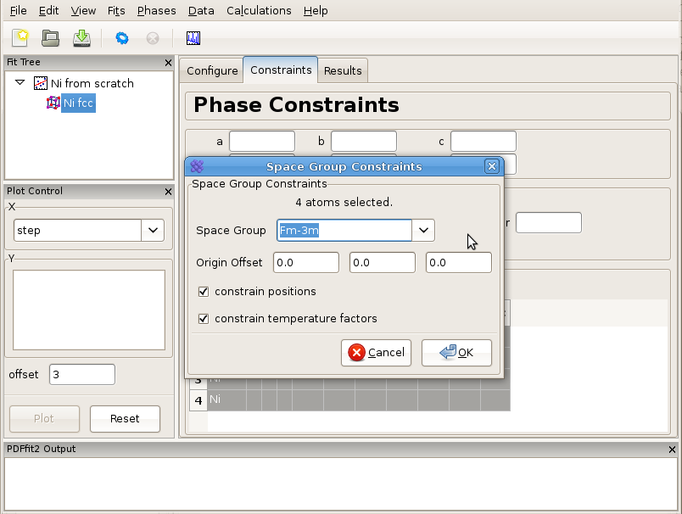
Building structure model using crystal symmetry
Setting up symmetry constraints to be used in a refinement.

Slide 22
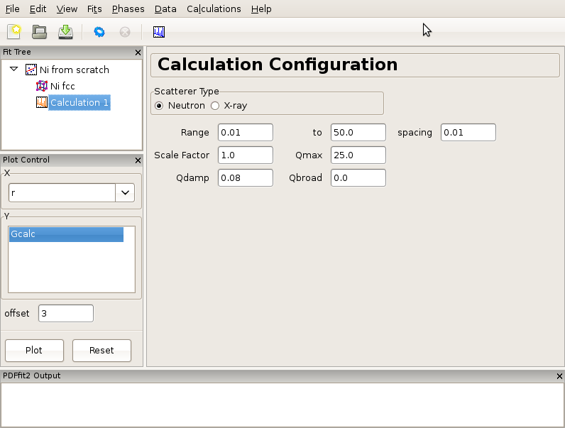
Calculating PDF from a structure
An example of the calculation configuration panel.

Slide 23
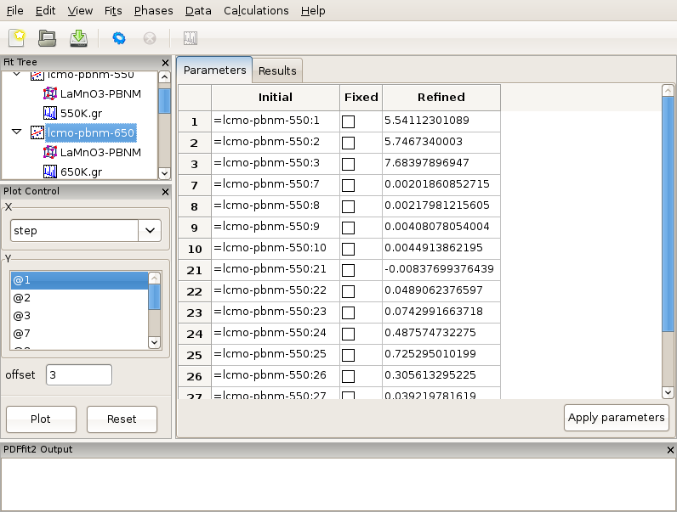
Multistage fitting
Sequential refinement where fits are chronologically linked

Slide 24
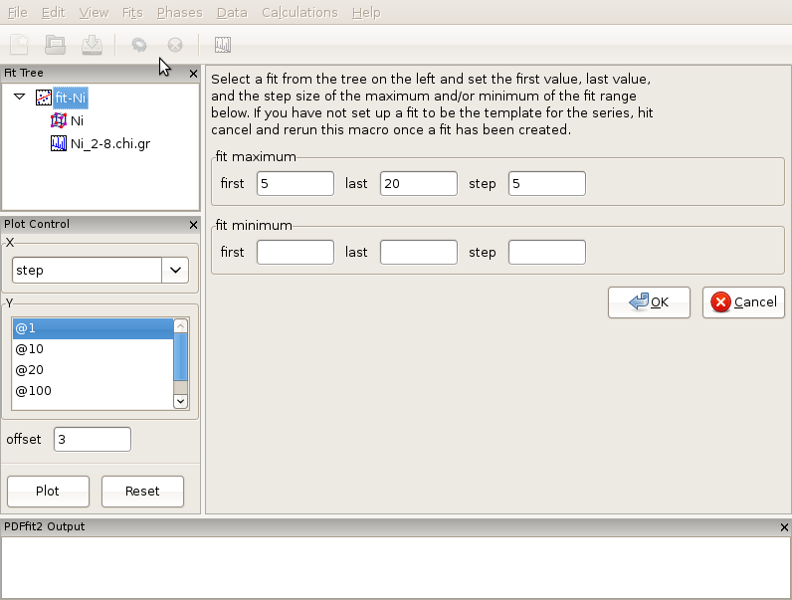
Sequential fitting of incremental r-series
Appearance of the setup panel for specifying an incremental r-series fit conditions.

Slide 25
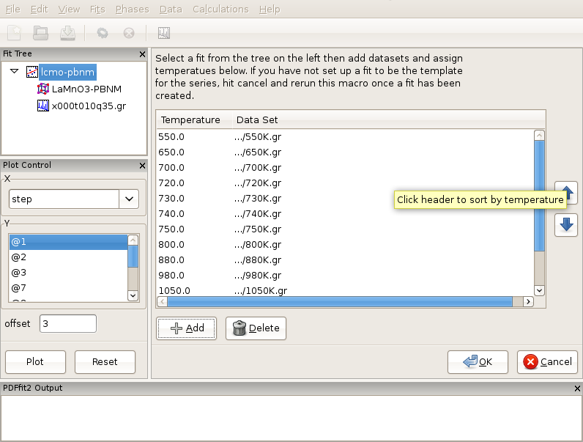
Sequential fitting of temperature series
Setting up a T-series sequential refinement for LaMnO₃.
Ordering by temperature will ensure that the fits are linked correctly.

Slide 26
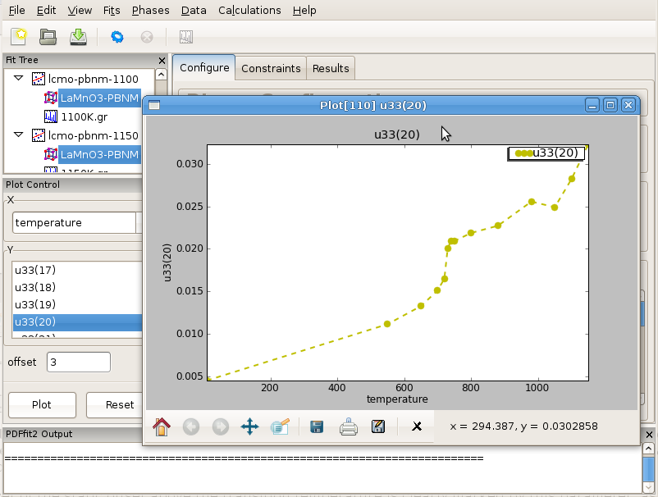
Sequential fitting of temperature series
Displaying refinement results as a function of external parameter: T-series refinement

Slide 27
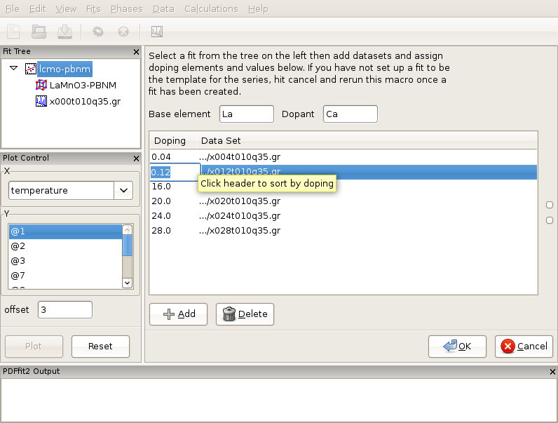
Sequential fitting of doping series
Loading of the Ca-doping data series of LaMnO₃ system.
Verify that proper doping assignment was carried out!

Slide 28
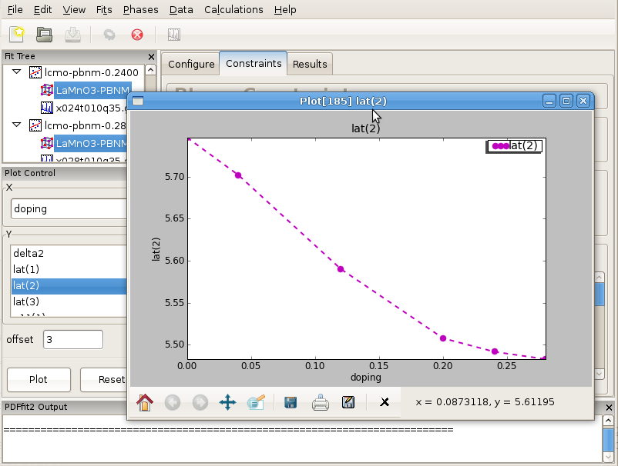
Sequential fitting of doping series
Displaying refinement results as a function of external parameter: doping series refinement

Slide 29
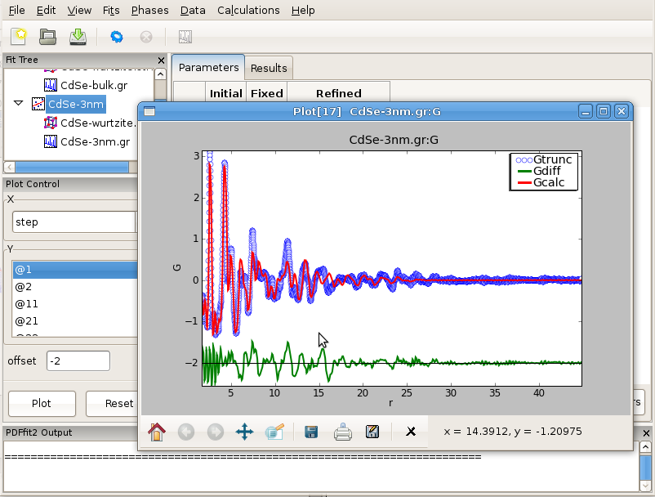
Nanoparticle structure
Fitting the structure of a nanoparticle: 3nm CdSe nanoparticle example

Slide 30
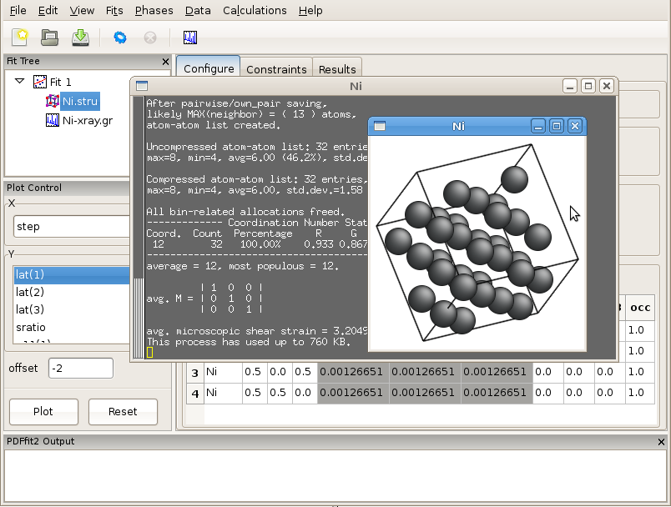
Displaying the structure
Using AtomEye functionality for 3D visualization of the initial and refined PDF structures structure.

Slide 31
PDFgui tutorial content
Plan is to cover up to 11 examples covering various aspects of PDFgui functionality
GOALS:
becoming familiar and comfortable with the program
building up basic expertise and awareness of various PDFgui capabilities
Examples:
Ni X-ray and neutron data refinement
Ni neutron-Xray corefinement
Ni/Si mixture refinement; phase analysis
Ni T-dependence sequential refinement
LaMnO₃ T-dependence sequential refinement – complex system example
LaMnO₃ 800K data fitting - r-dependent sequential refinement example
Nanoparticle examples: CeO₂ and CdSe systems
La₂CuO₄ doping-dependent sequential refinement example

Slide 32
Live PDFgui Demo (time permitting)

