Slide 1



1. Single-site critical phenomena: dynamical optical hysteresis in the Kerr model. 2. A superconducting, ladder-type artificial atom, a transmon, strongly coupled to a waveguide
RWA approximation to the non-linear Kerr model
Storme, F. (2017). Dissipative phase transitions in open quantum lattice systems (Doctoral dissertation, Université Paris Diderot (Paris 7), Sorbonne Paris Cité).
Gasparinetti et al.(2019). Two-Photon Resonance Fluorescence of a Ladder-Type Atomic System. arXiv preprint arXiv:1901.00414.
Open System Dynamics with the Lindblad Master Equation:

Slide 2
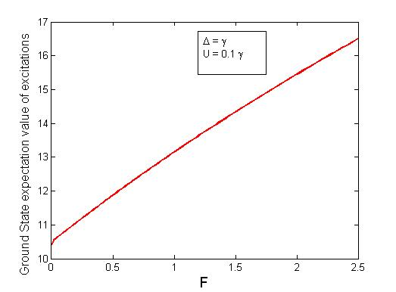
Single site critical phenomena: Exact Diagonalization

Slide 3
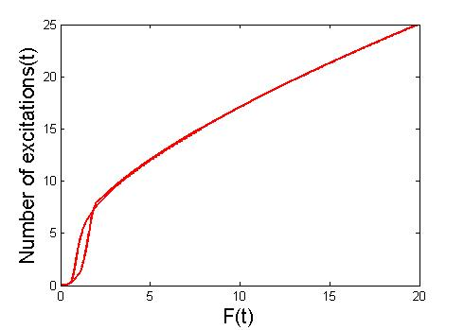
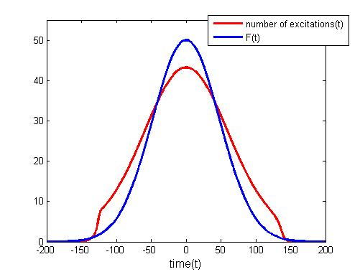
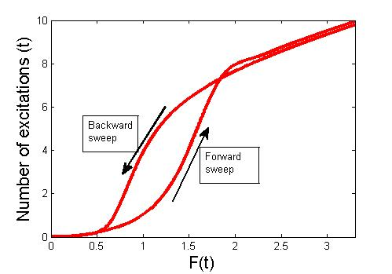

Slide 4
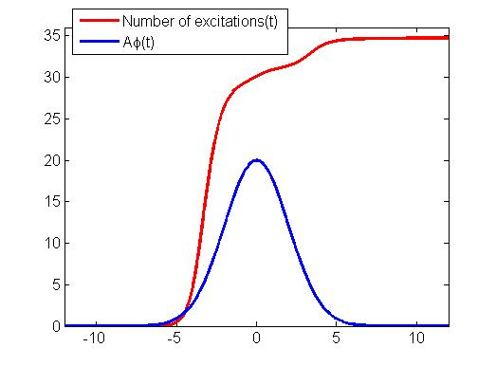
Photodetection
A=100 here

Slide 5
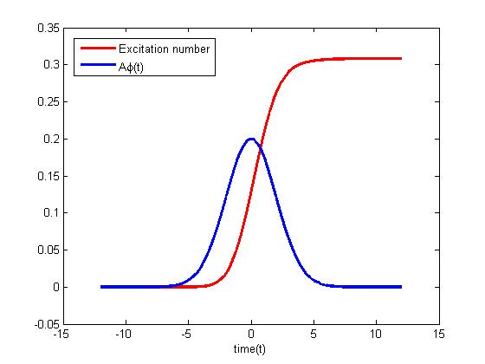
A=1 here and very little number amplification found

Slide 6
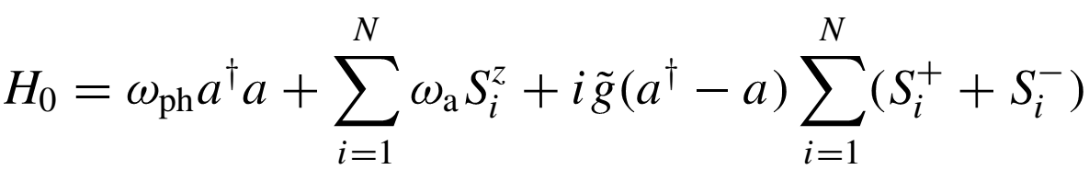
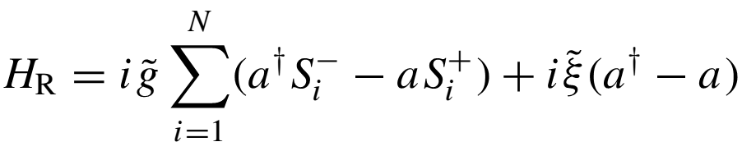
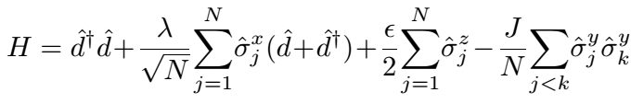
The Dicke, Jaynes Cummins Models
PHYSICAL REVIEW A98, 043802 (2018)
arxiv./1807.04617

Slide 7
