Slide 1



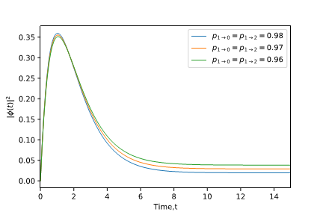

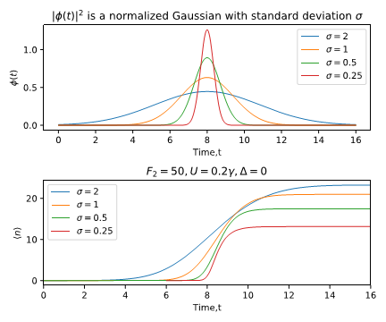
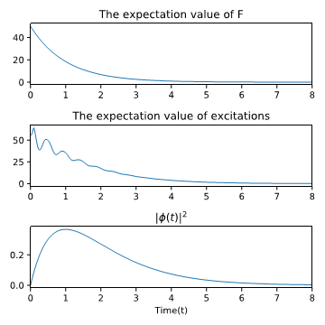

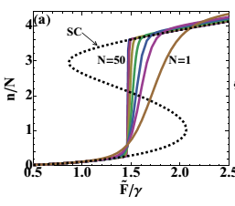
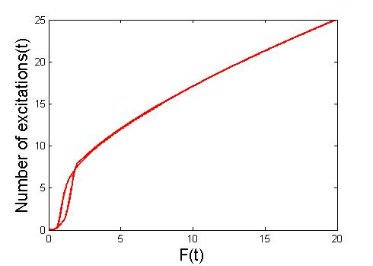
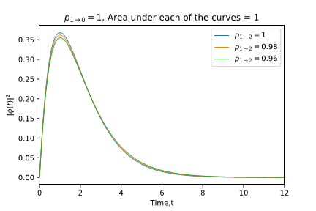

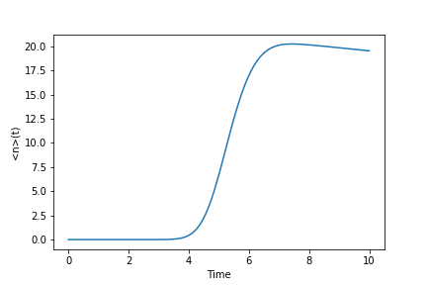
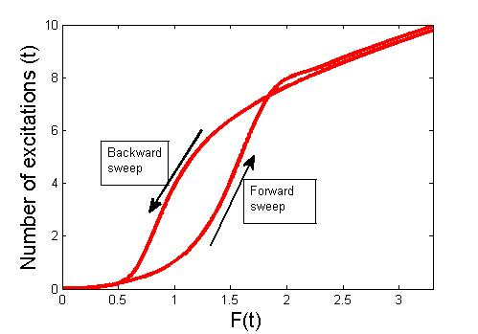
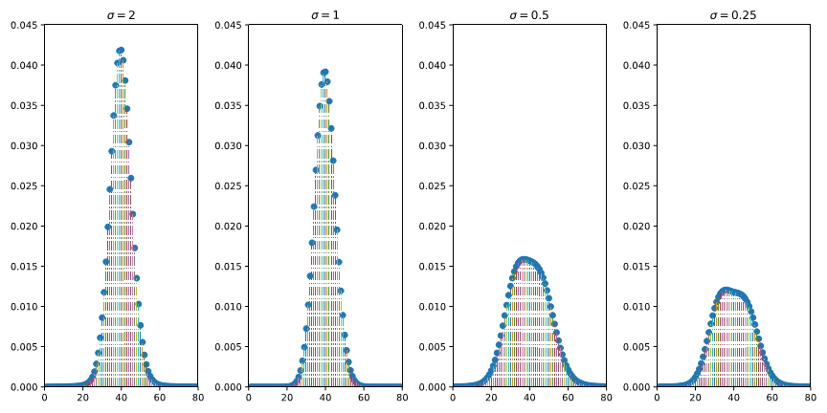
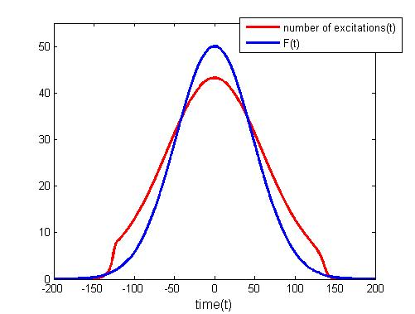

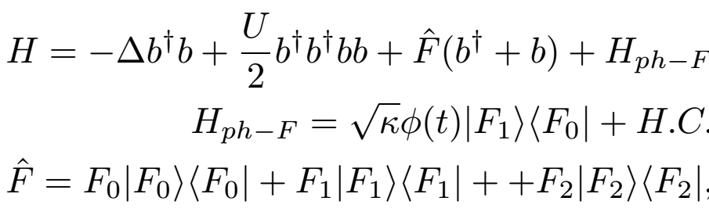
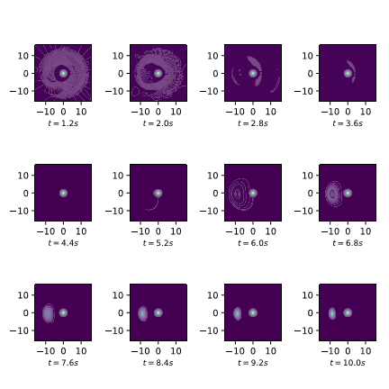
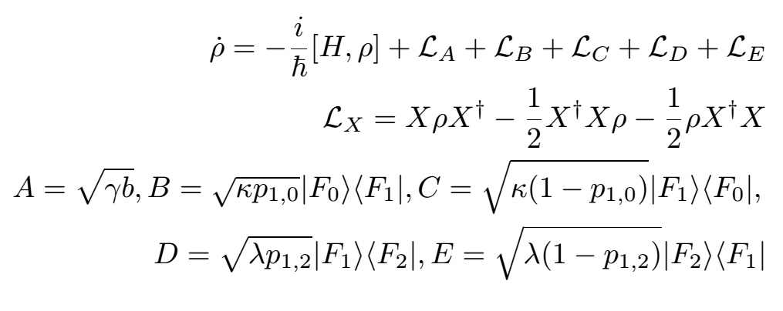
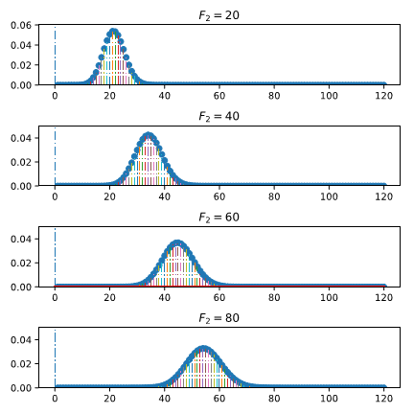
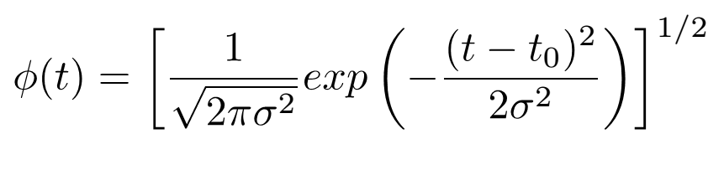
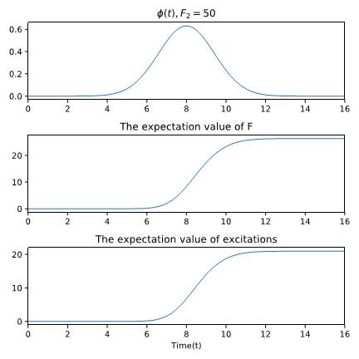
A Single Photon Detector Design based on a First Order Dissipative Phase Transition
Saumya Biswas, Steven J van Enk.
University of Oregon, Oregon Center for Optical, Molecular, and Quantum Science
Model
Effect of Photon Wave-function width on the average dynamics
Calculation of the modulus squared Photon Wave function
Effects of thermal fluctuations
A driven dissipative first order phase transition: Nonlinear Kerr Model
1. Single-site critical phenomena: dynamical optical hysteresis in the Kerr model.
2. A superconducting, ladder-type artificial atom, a transmon, strongly coupled to a waveguide
Storme, F. (2017). Dissipative phase transitions in open quantum lattice systems (Doctoral dissertation, Université Paris Diderot (Paris 7), Sorbonne Paris Cité).
Gasparinetti et al.(2019). Two-Photon Resonance Fluorescence of a Ladder-Type Atomic System. arXiv preprint arXiv:1901.00414.
The wigner function develops a bimodality close to the onset of the steady state in the average dynamics
Comparison of probability distribution of excitation numbers in the steady state for different widths of the photon wave-function
It
The calculated photon wave-function reveals the nature of the final equilibrium.
Properties of the steady state of the average dynamics
Effect of the values of F2
Comparison of probability distribution of excitation numbers in the steady state for different values of F2

