Slide 1
Start?

Slide 2



Brand for career success
Igor Sbitnev IBM-12/5

Slide 3
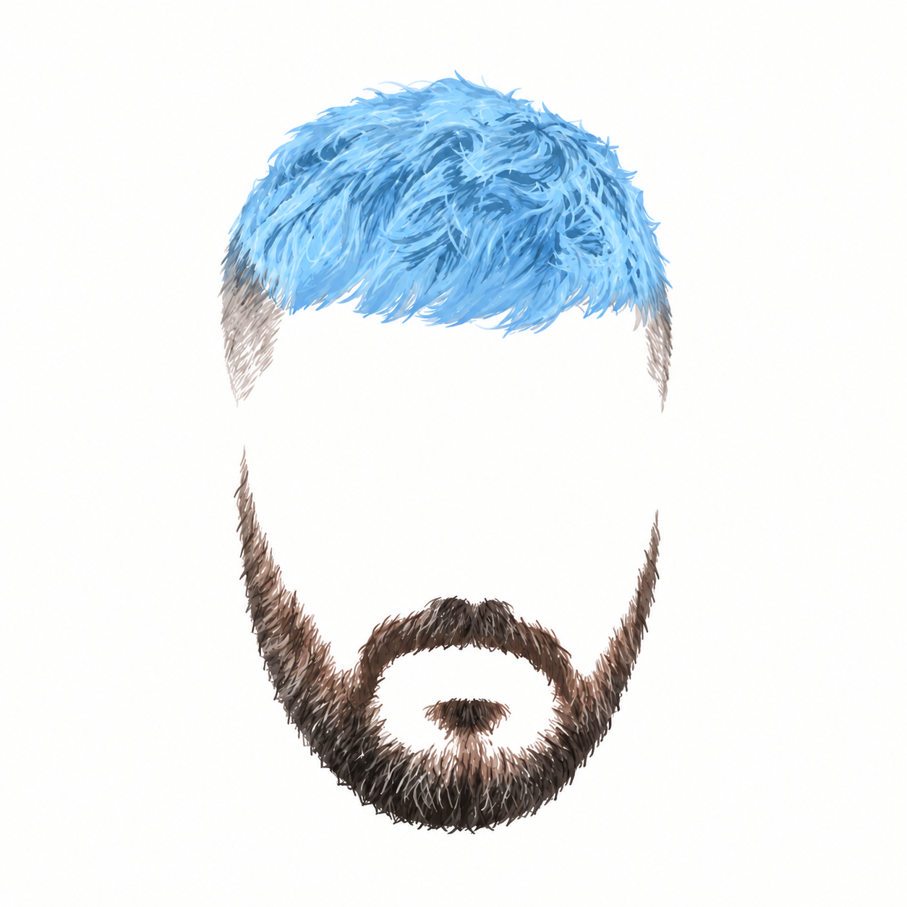
Who is?

Slide 4

Who is?

Slide 5

Who is?

Slide 6
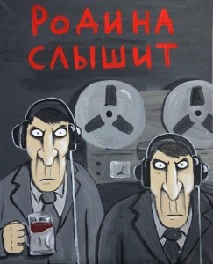

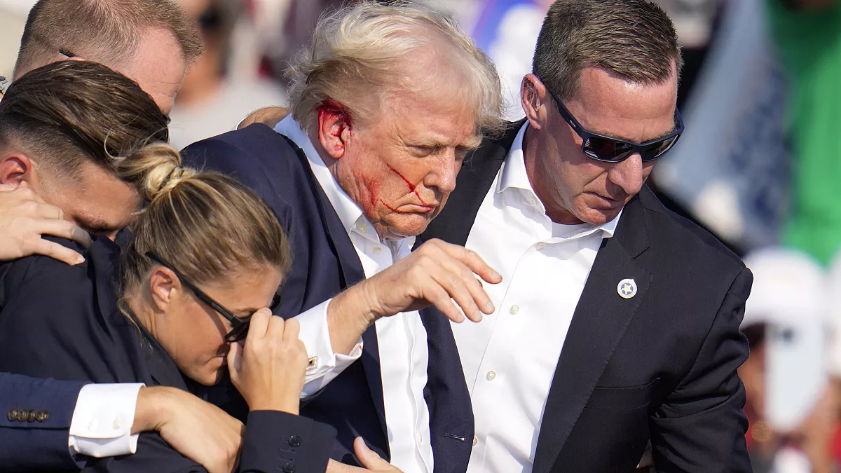
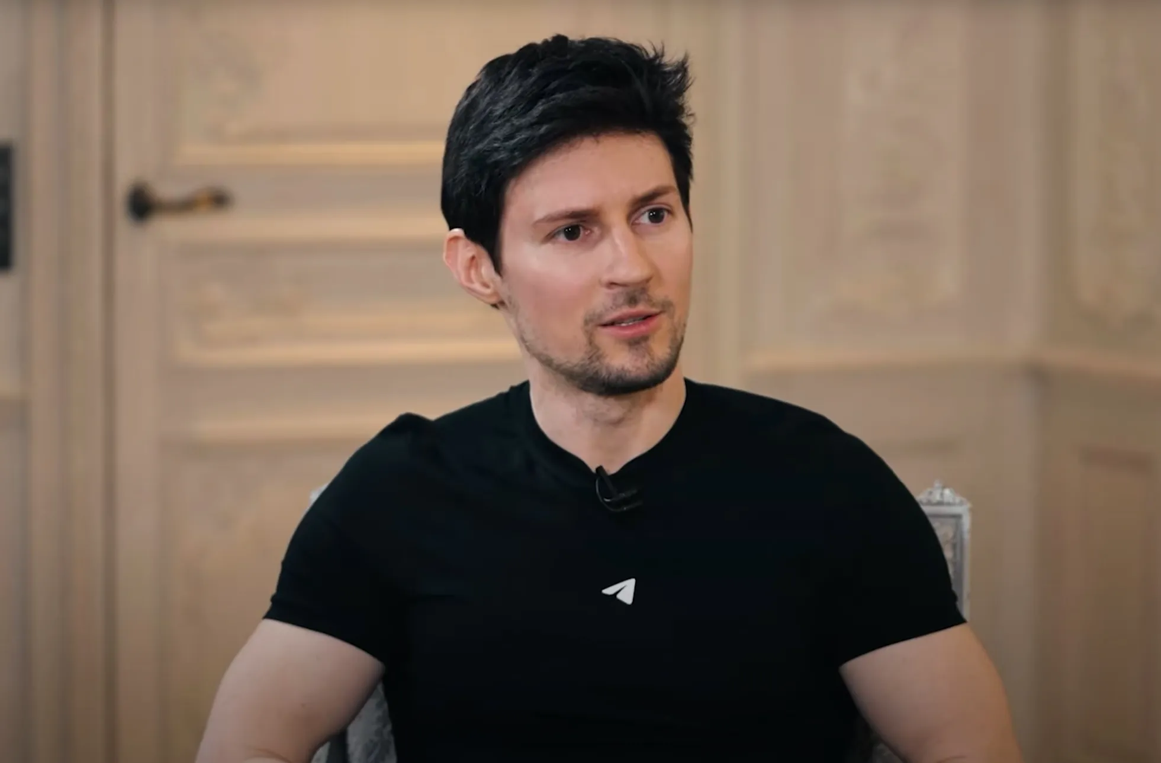
Brand … or not?
Assassination attempt on Trump in Pennsylvania
The Pavel Durov case in France

Slide 7
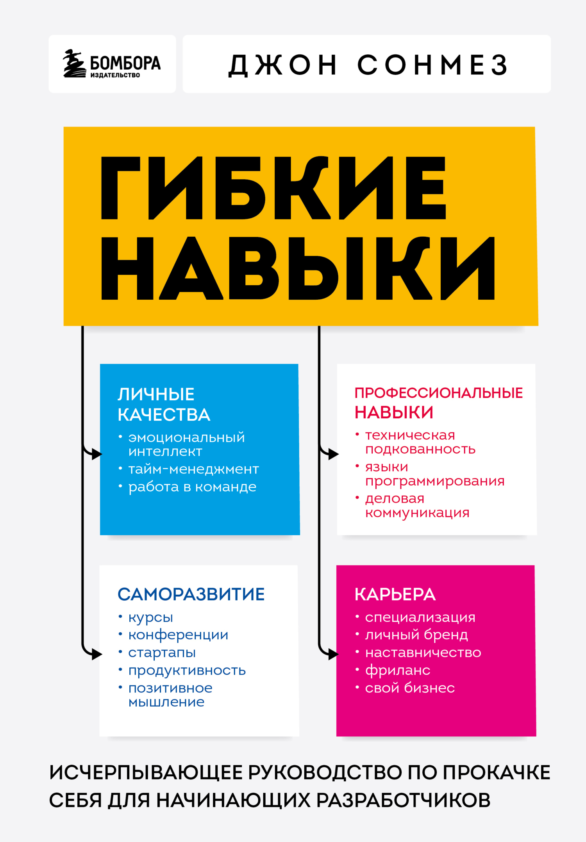






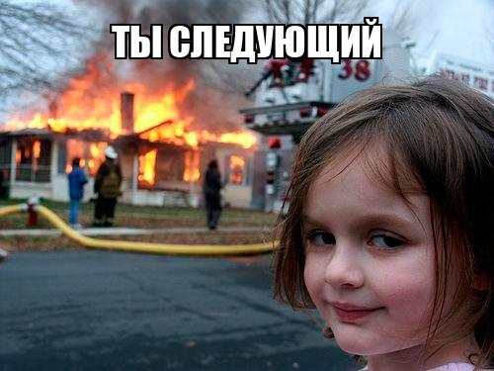

Brand => job
*
*
Best for programmers
*
**
Признаны экстремистскими организациями и запрещены в РФ
**

Slide 8
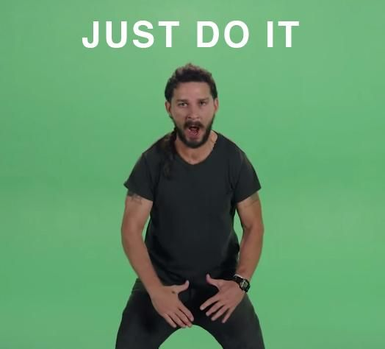
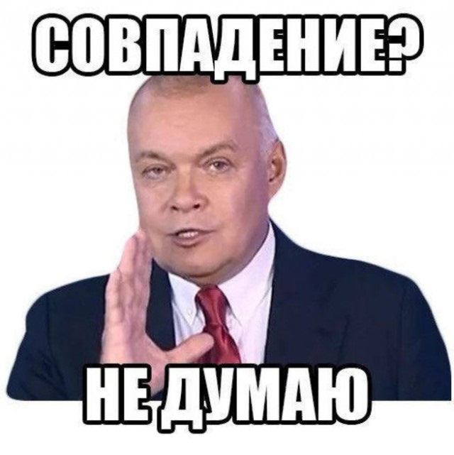
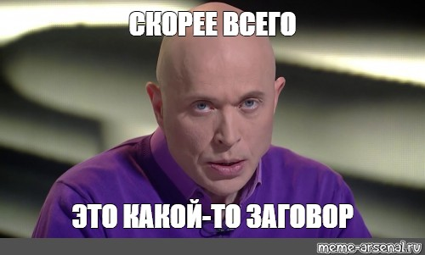
JUST DO IT
Practice
- Create telegram (or max)* channel
- Sub all people in group
- Networking
* Not recommend
Read backwards (прочитать наоборот) МАКС
-

Slide 9
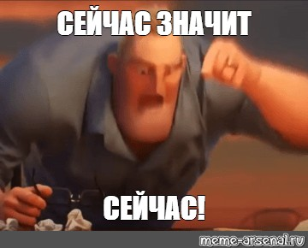
Do, I’m waiting
Now!!

Slide 10
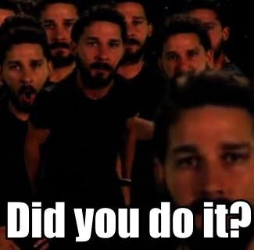

Slide 11
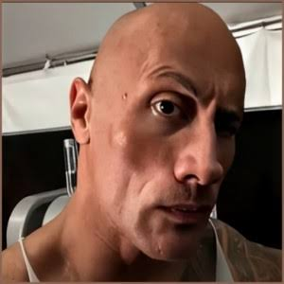

Slide 12
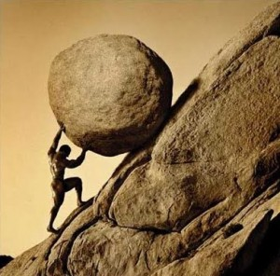
First post

Slide 13
