Slide 1

Text Classification Sarcasm Detection
UIUC: CS-410 Course Project

Slide 2
Introduction
Problem: Generate a model to detect the sarcasm from the list of tweets.
Approach: I have taken a language representation model BERT(Bi-directional Encoder Representations from Transformers) with pretrained deep bi-directional representations to train the model by using Google Tensorflow and Keras Deep learning APIs
Results: With this approach I have managed to achieve the training accuracy to ~91% and validation accuracy to ~76%, On the competition leaderboard F1 Score: 0.7472

Slide 3
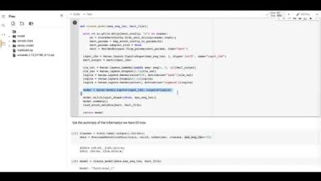
Code WalkThrough
Link: https://www.youtube.com/watch?v=dXuhx-kpfaE&feature=youtu.be

Slide 4
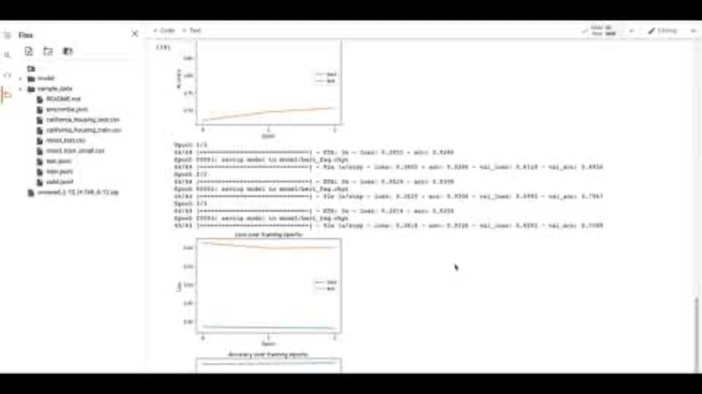
Demo
Link: https://youtu.be/Z3Yu8VzgWMw

Slide 5
Resources
https://github.com/google-research/bert
https://www.tensorflow.org/tutorials/text/classify_text_with_bert
https://towardsdatascience.com/bert-for-dummies-step-by-step-tutorial-fb90890ffe03
https://medium.com/atheros/text-classification-with-transformers-in-tensorflow-2-bert-2f4f16eff5ad

