Slide 1
Corticomuscular coherenence: looking for relations between features in EEG and EMG data during reaching tasks
Dr. Martina Coscia, Elvira Pirondini, Sean Bittner
Translational Neural Engineering Laboratory Center for Neuroprosthetics EPFL

Slide 2
Data collection
Explain experiments
Explain sampling of data
Expalin structure of data
SB: Are there slides from another presentation we can use for this

Slide 3
Measuring corticomuscular activity
Two popular methods for finding connections between EEG and EMG features.
Measuring coherence between signal spectra.
Using partial least squares to extract meaningful patterns.

Slide 4
Measuring corticomuscular coherence
Prevailing questions:
What is the best way to obtain group-level information across subjects and subject-level information across trials?
How do we compare reaches of different timescale?

Slide 5
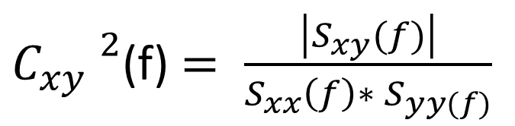
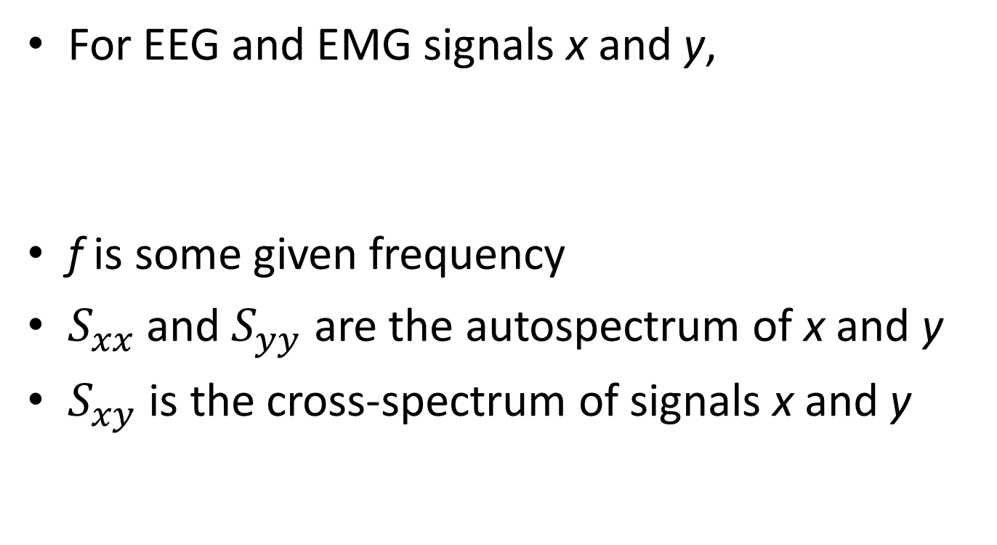
Magnitude squared coherence
For EEG and EMG signals x and y,
f is some given frequency
$S_{xx}$and $S_{yy}$ are the autospectrum of x and y
$S_{xy}$ is the cross-spectrum of signals x and y
${C_{xy} }^{2}$(f) $= \frac{\left|S_{xy}(f)\right|}{S_{xx}\left(f\right)∗ S_{yy(f)}}$

Slide 6
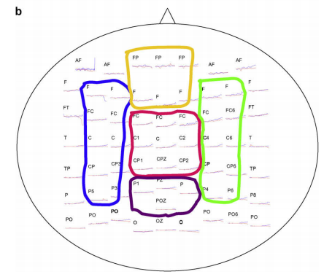
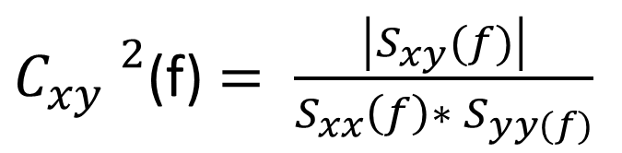
Magnitude squared coherence
${C_{xy} }^{2}$(f) $= \frac{\left|S_{xy}(f)\right|}{S_{xx}\left(f\right)∗ S_{yy(f)}}$
Combining across electrodes
Advantages:
Obtain consistent region-level information
Individual electrode information can be inconsistent across trials and subjects due to placement.
Disadvantages:
Phase lag can cancel activity from other electrodes
Functional corticomuscular connection during reaching is weakened following stroke, Fang et. al.

Slide 7
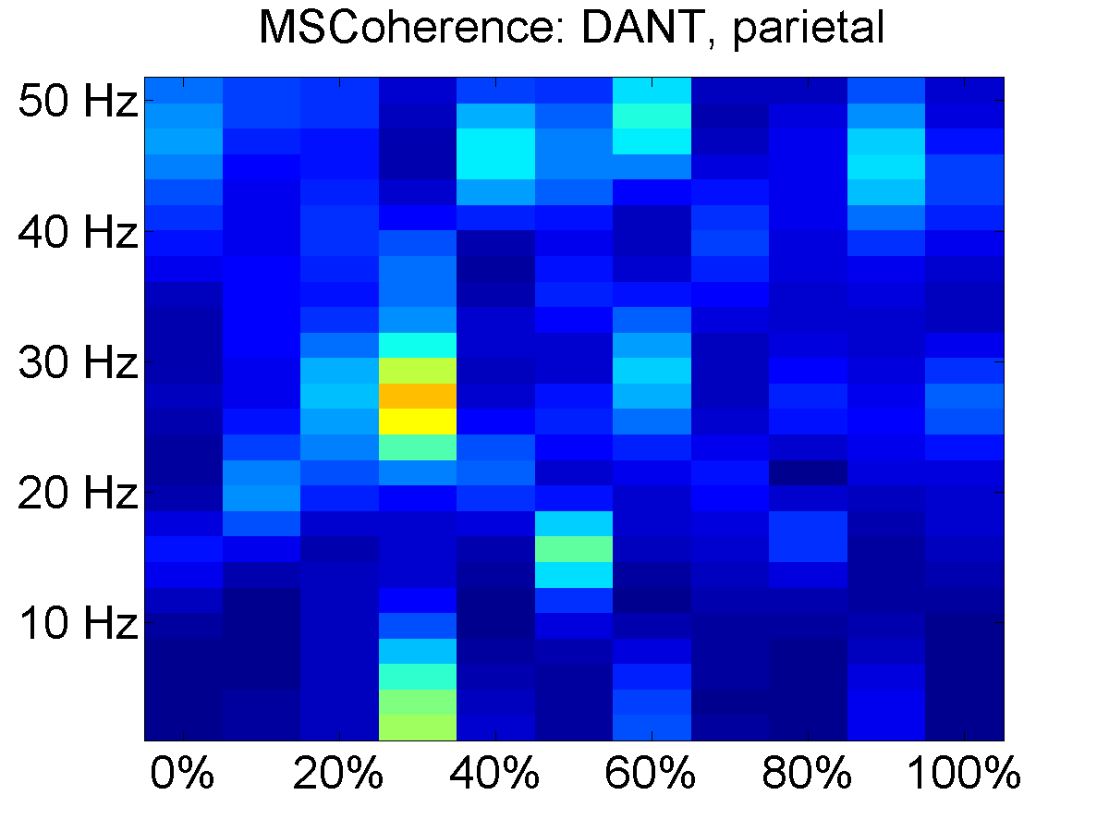
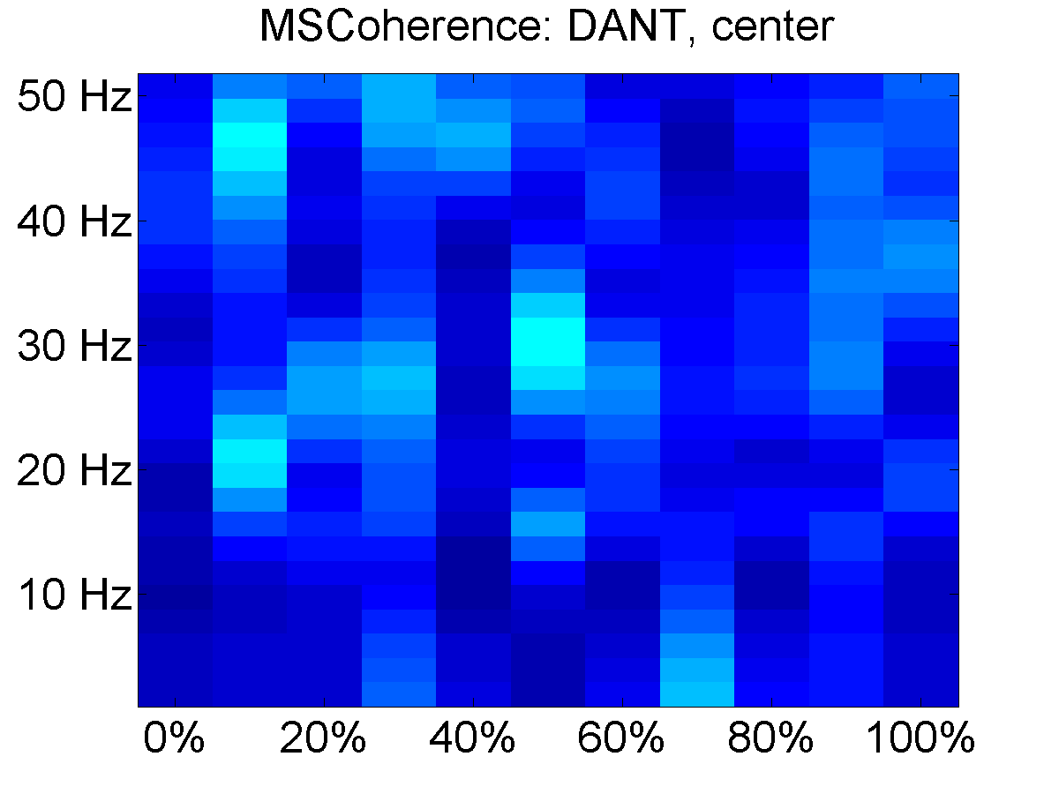
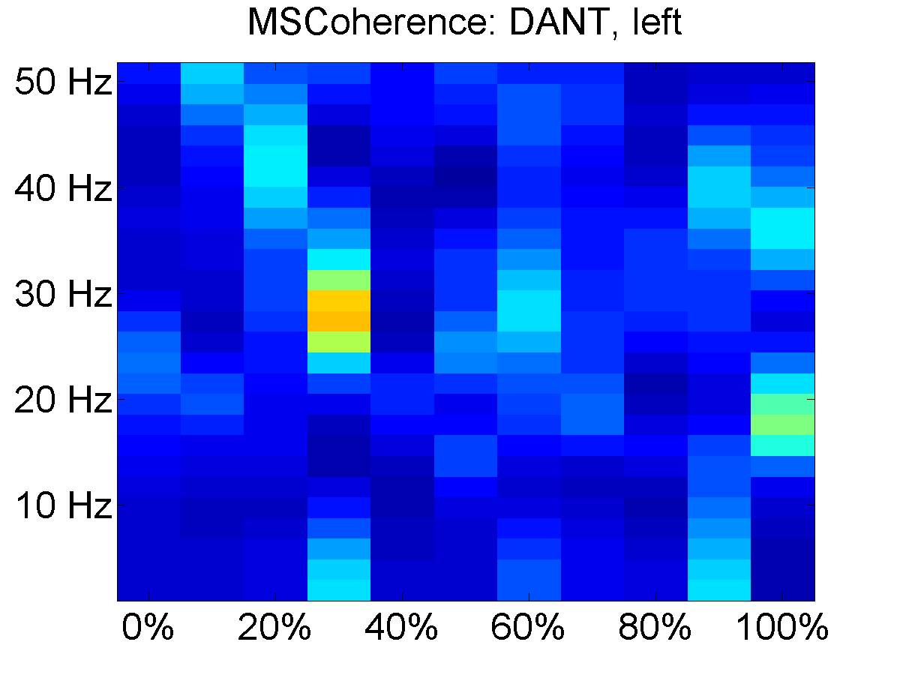
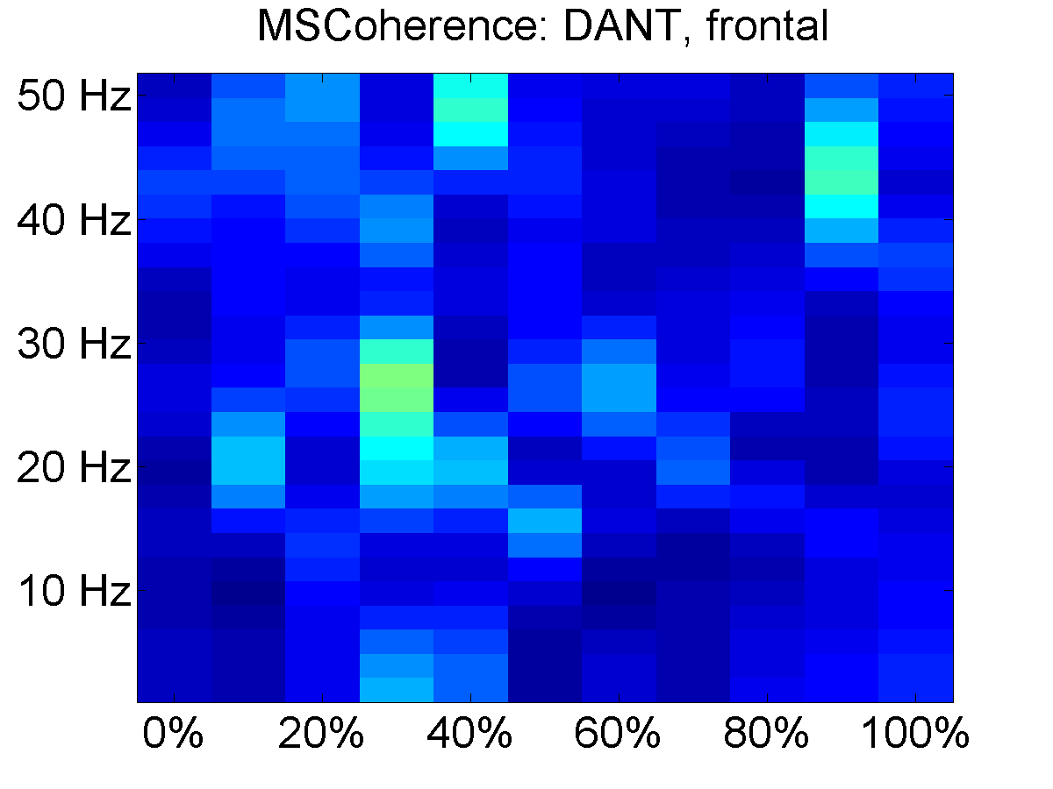
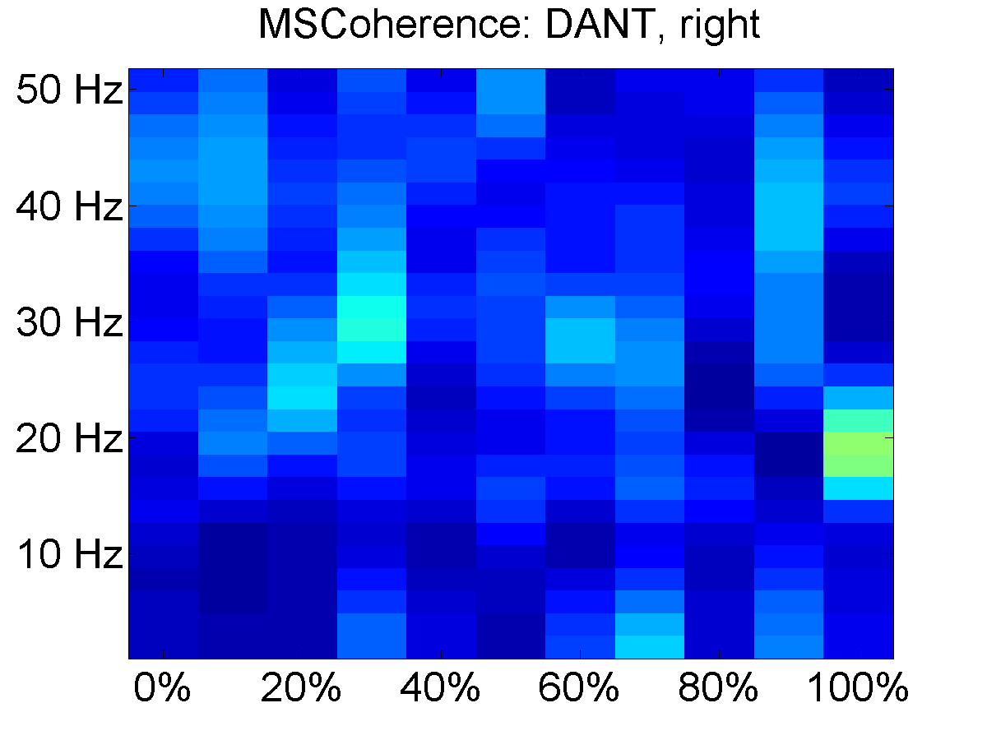

Magnitude Squared Coherence
${C_{xy} }^{2}$(f) $= \frac{\left|S_{xy}(f)\right|}{S_{xx}\left(f\right)∗ S_{yy(f)}}$
Combining across trials
The autospectra and cross-spectra $S_{xx}(f)$, $S_{yy}(f)$, and $S_{xy}(f)$ are cross trial averaged, and then ${C_{xy} }^{2}$(f) is computed.
Subject 3: Cross-trial averaged magnitude squared coherence

Slide 8

Magnitude squared coherence
${C_{xy} }^{2}$(f) $= \frac{\left|S_{xy}(f)\right|}{S_{xx}\left(f\right)∗ S_{yy(f)}}$
Significance testing
A significance value for coherence at each pixel (time point, frequency bin) is calculated using phase randomization.
Magnitude squared coherence is calculated after phase randomizing the fourier transform of the eeg (x)
For some time point, we take the windowed sampling x
$X= F\{x\} = A(f)e^{iφ(f)}$, where $A\left(f\right)$ and $φ(f)$ represent the amplitude and phase of the Fourier transform respectively.
$φ_{rand} (f)$ is a random permutation of $φ$ $(f)$
$x_{rand}=F^{−1}${$A(f)e^{iφ_{rand}(f)}$}
For a p value of .05, we perform 19 iterations of the coherence computation with phase randomization and average the results to obtain a signficance value for each frequency bin at this time point.

Slide 9
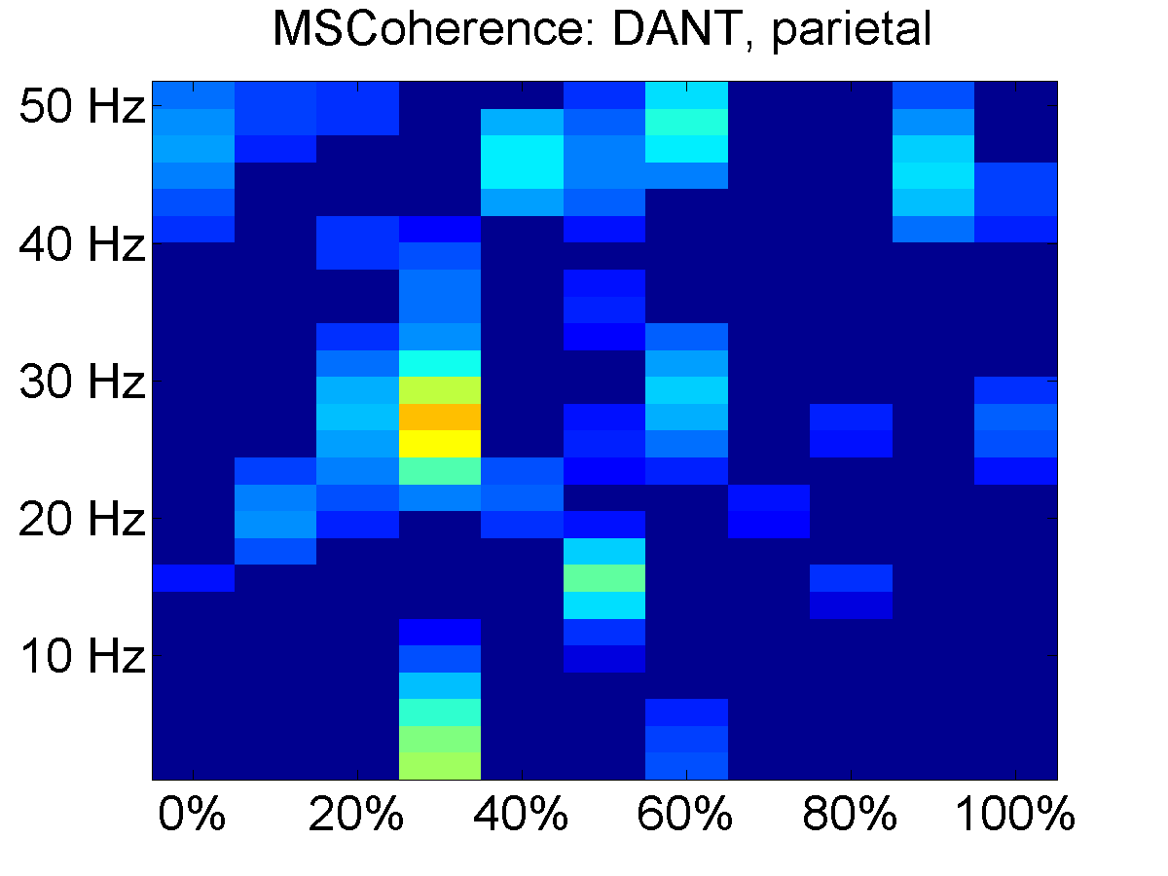
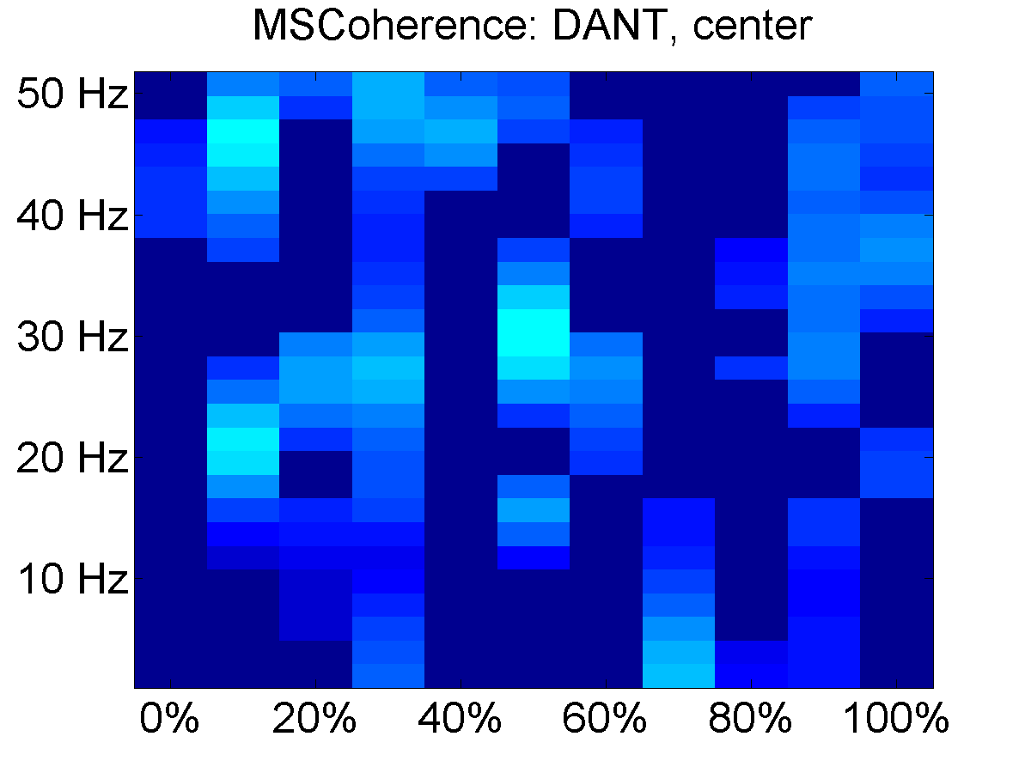

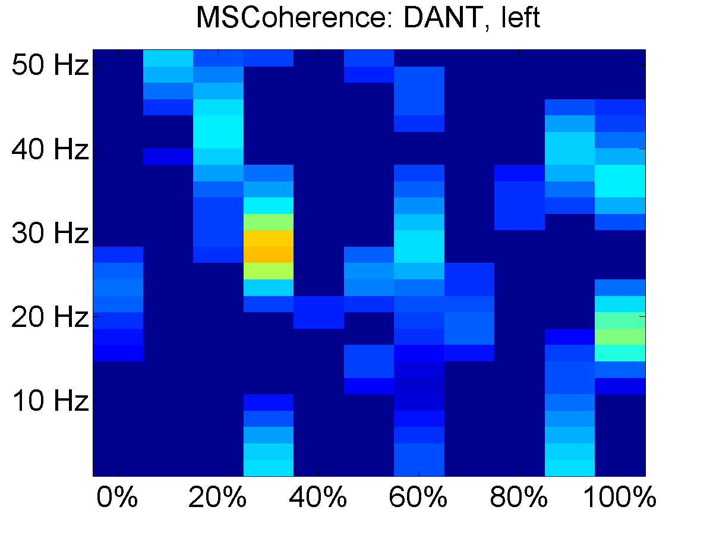
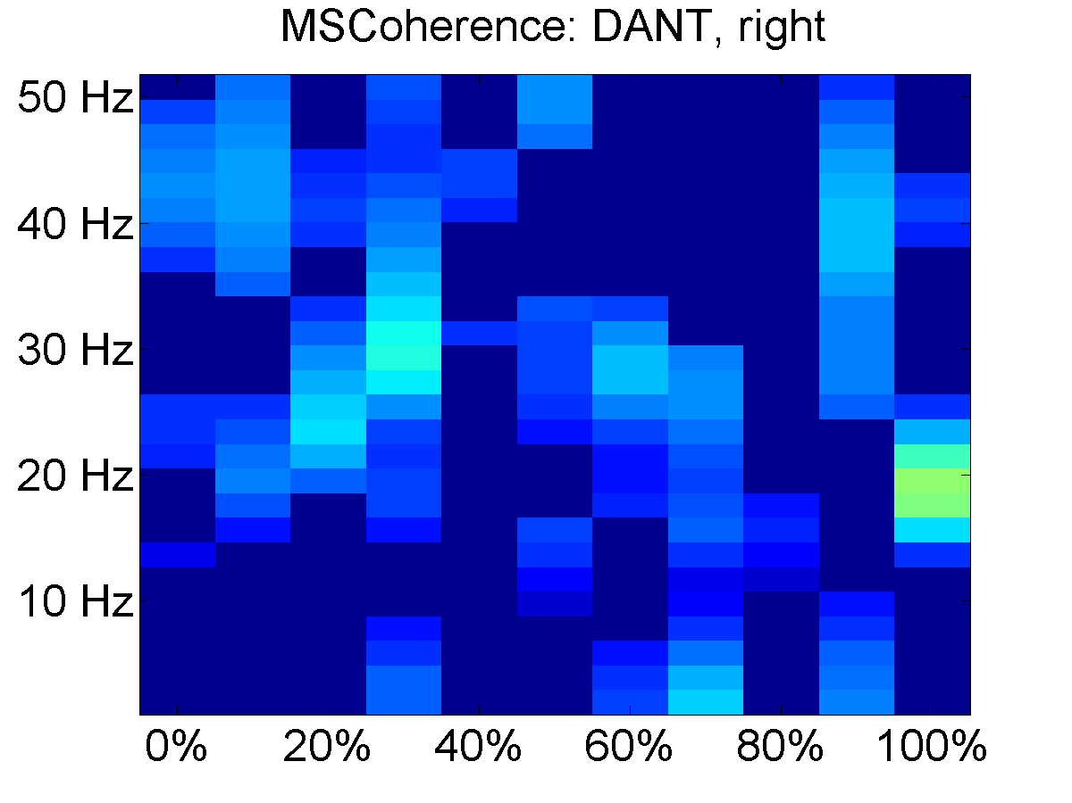
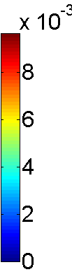
Magnitude squared coherence
${C_{xy} }^{2}$(f) $= \frac{\left|S_{xy}(f)\right|}{S_{xx}\left(f\right)∗ S_{yy(f)}}$
Significance testing
In the following plots, the coherence is only shown for time-frequency points that are deemed significant
Subject 3: Cross-trial averaged magnitude squared coherence with insignificant coherence removed

Slide 10

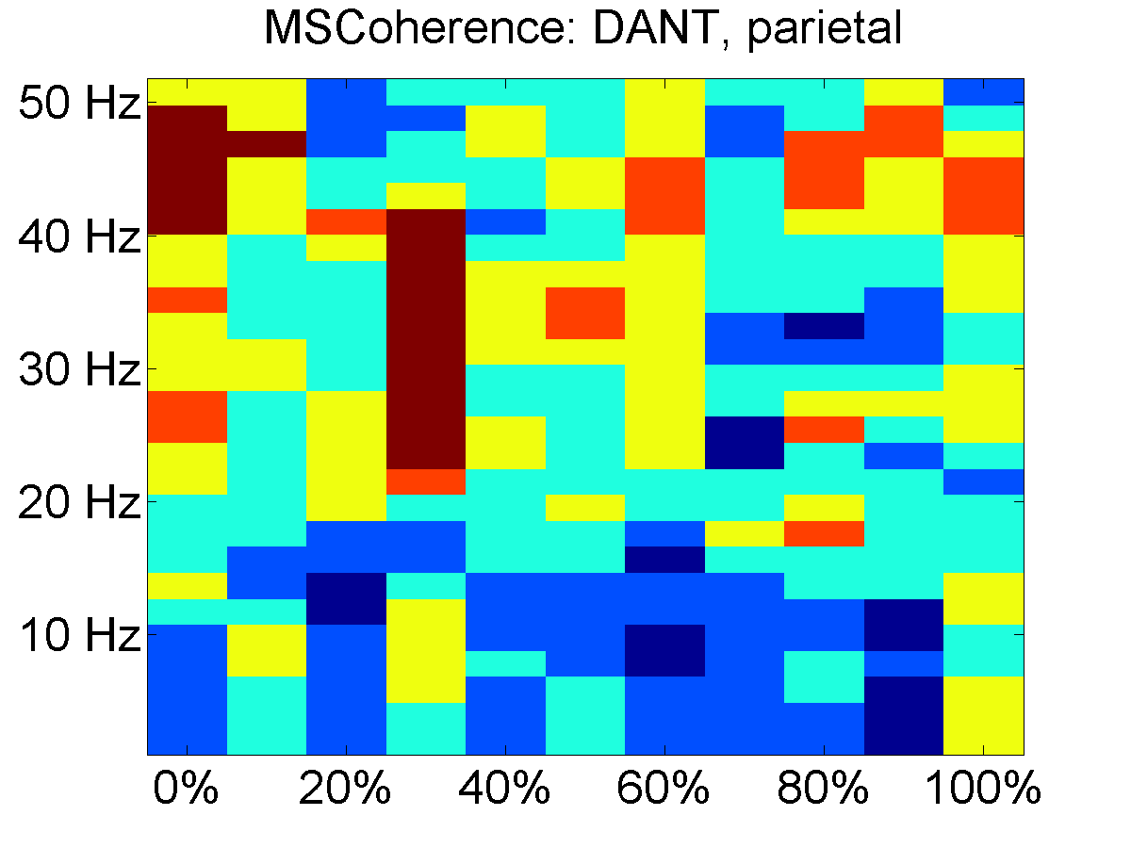
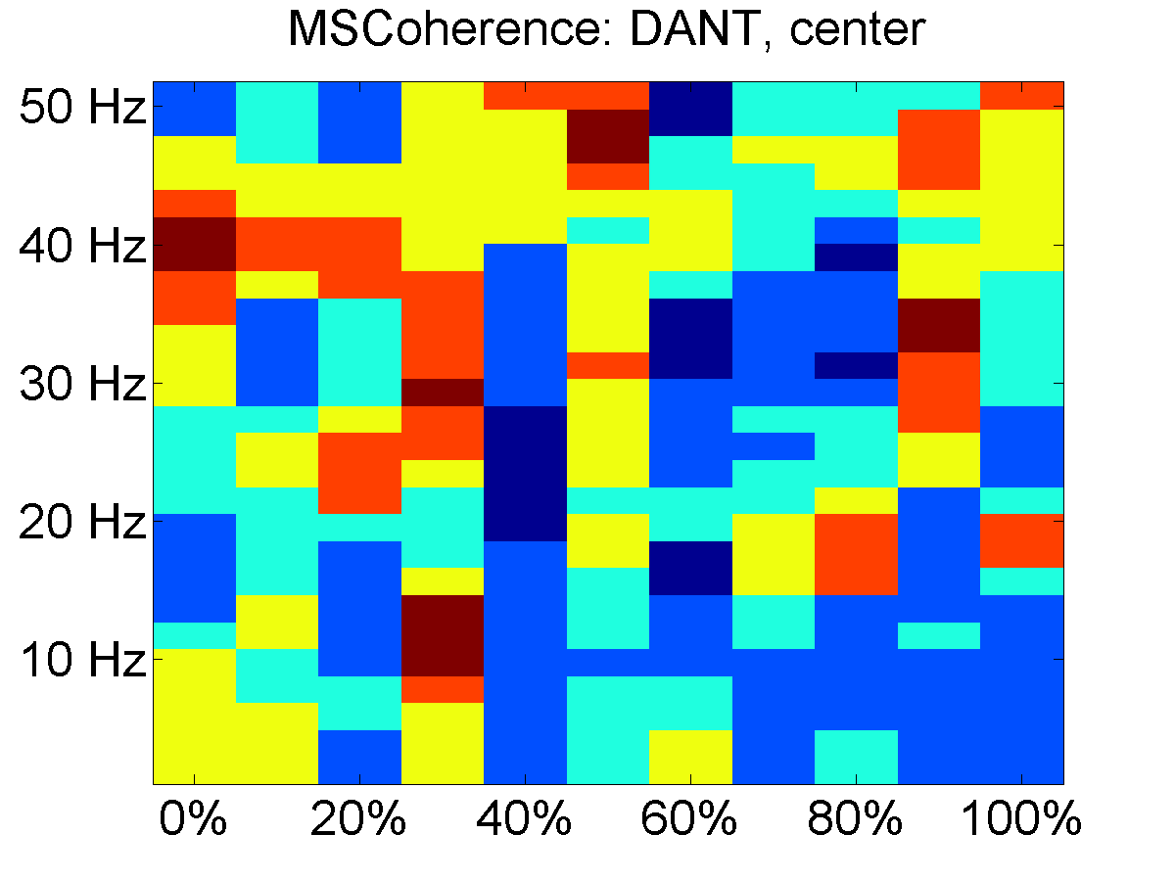
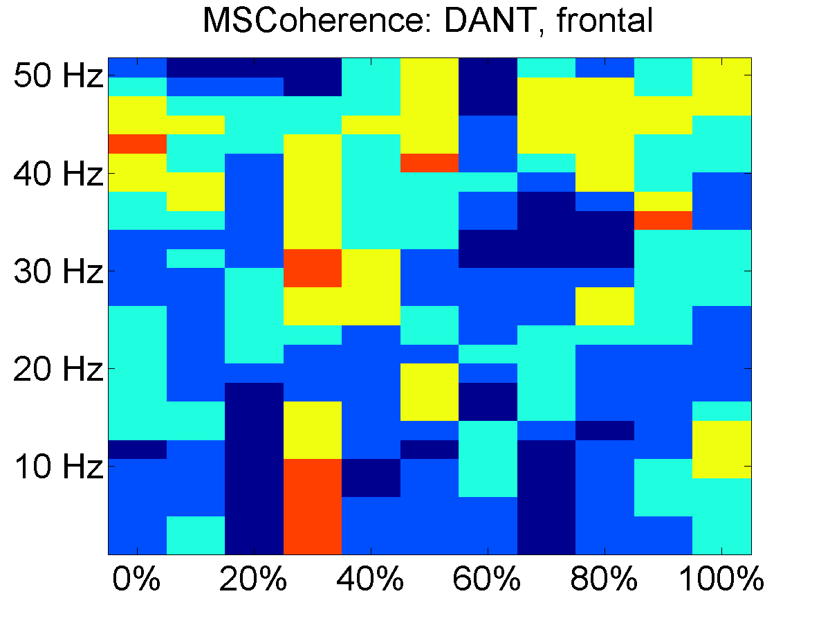
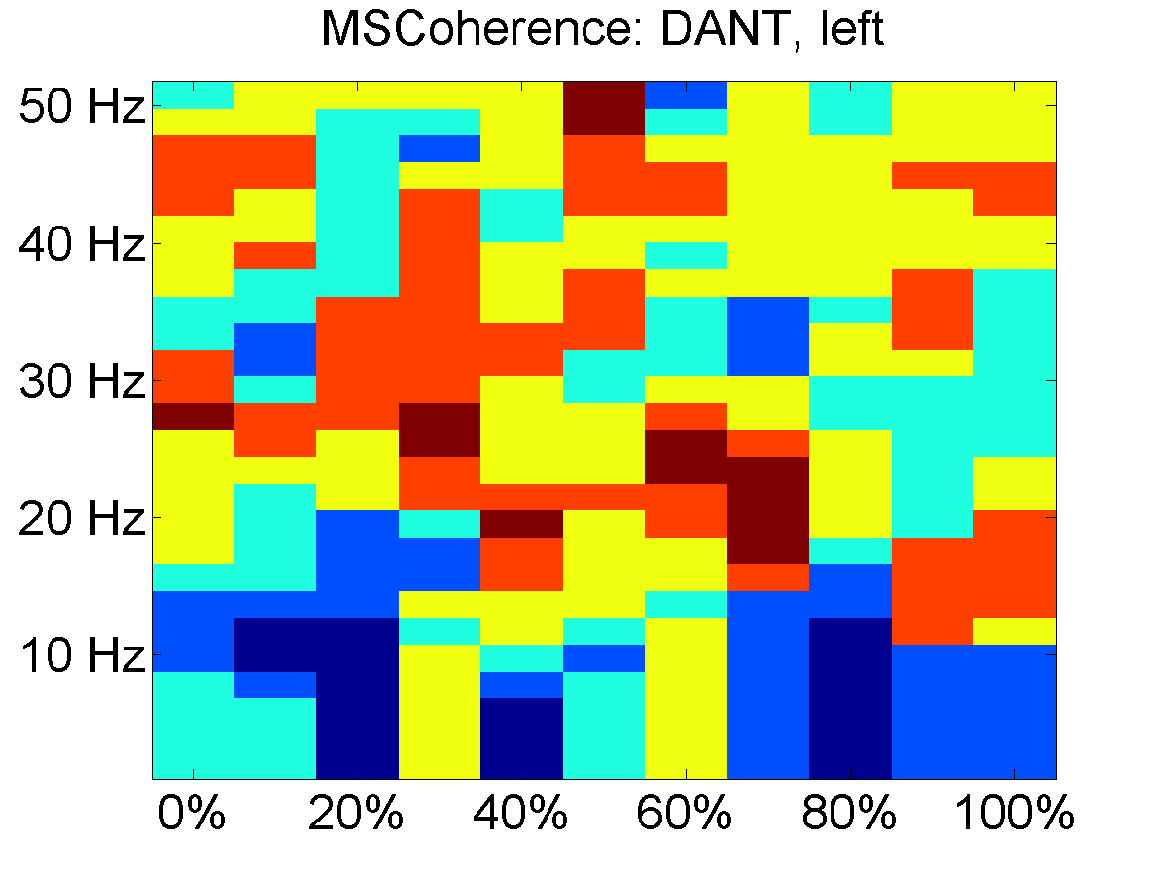
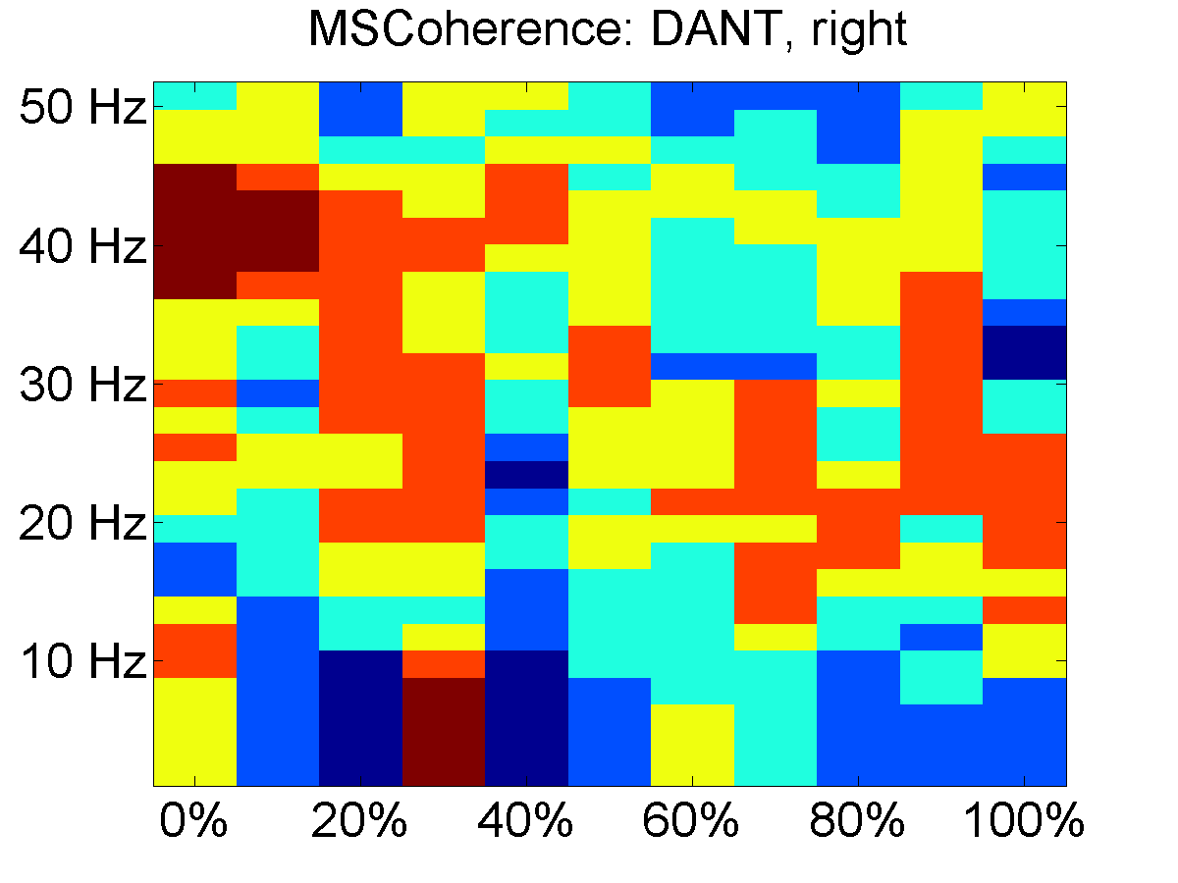
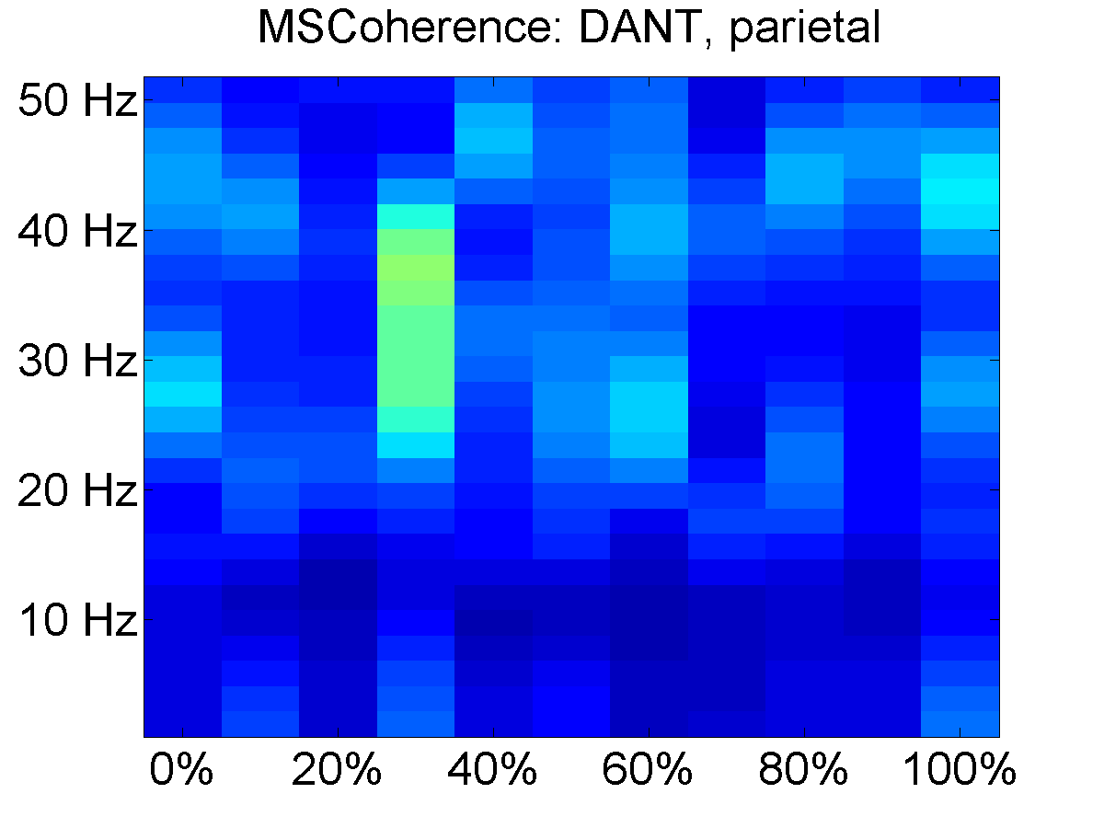
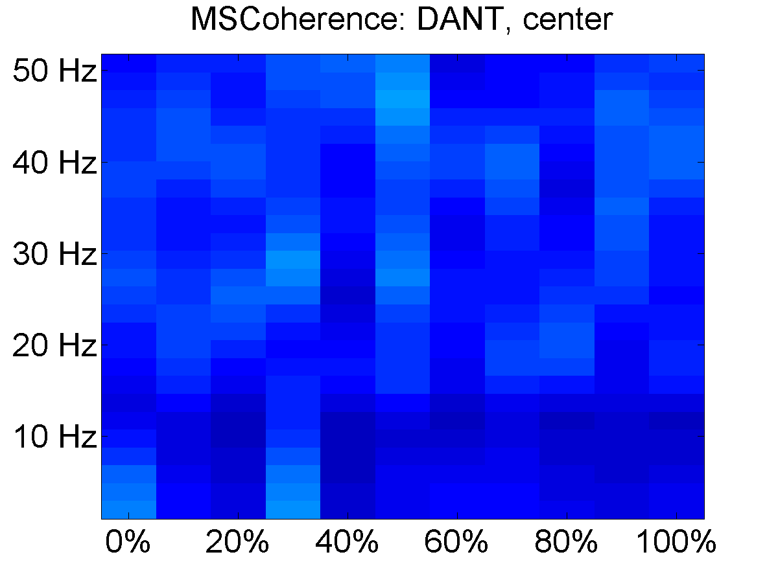
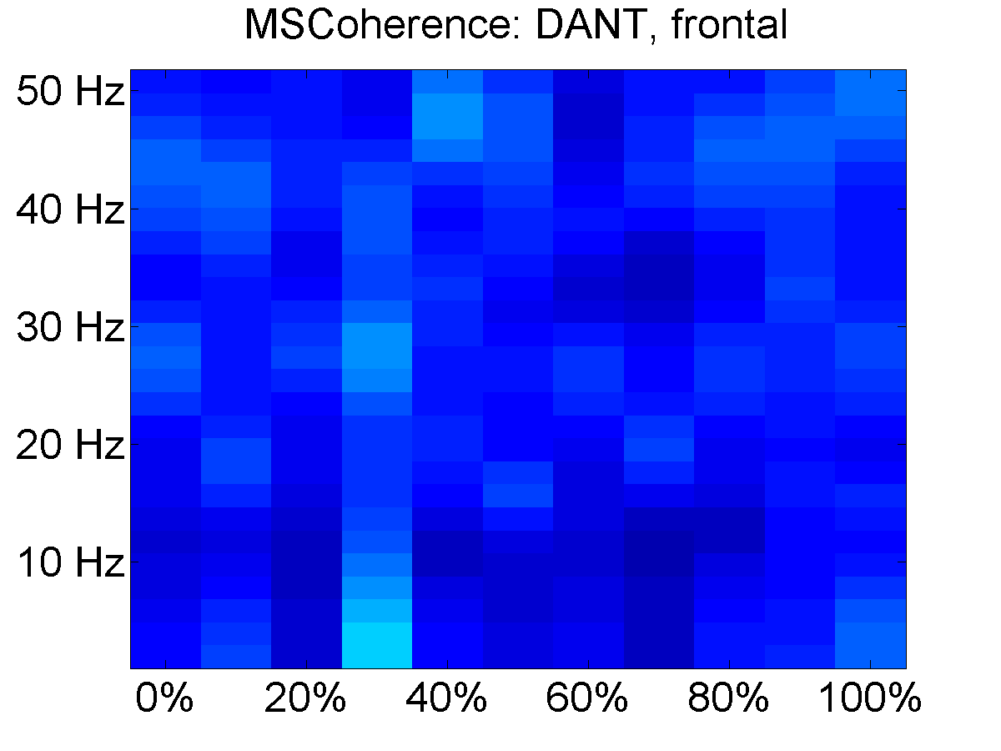
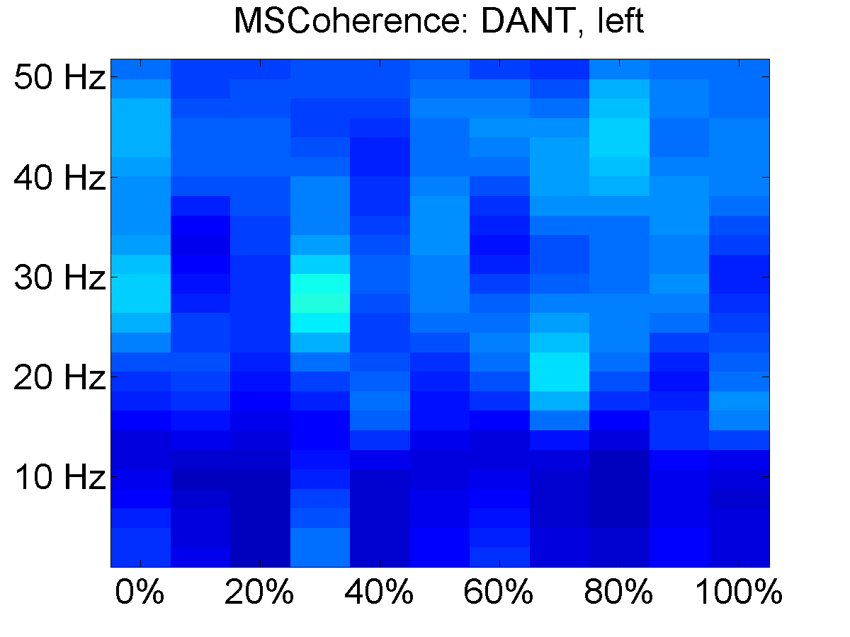
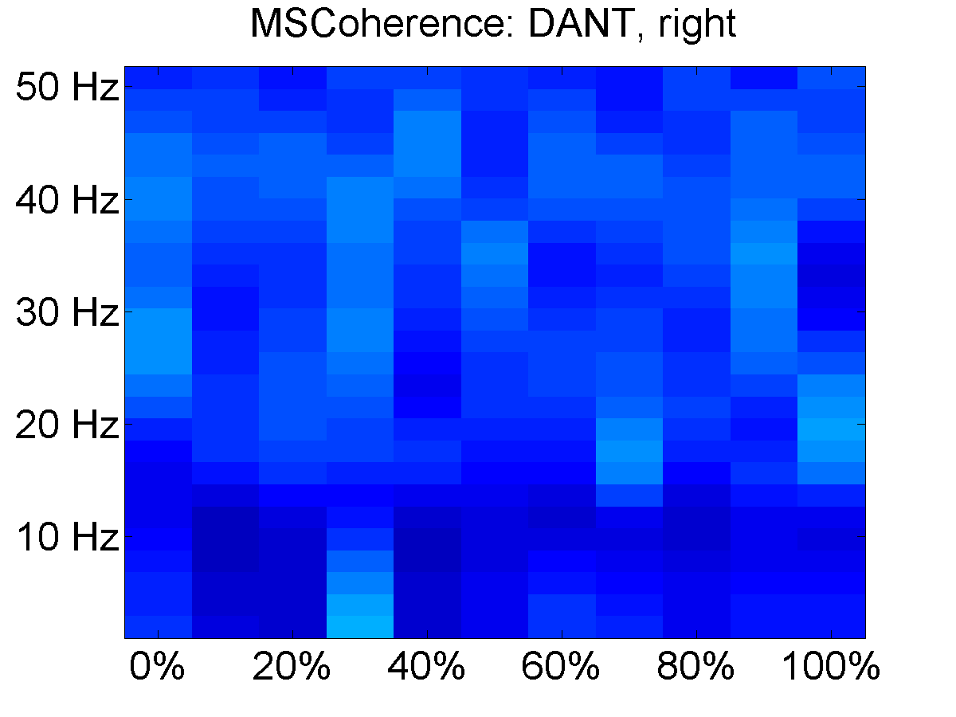
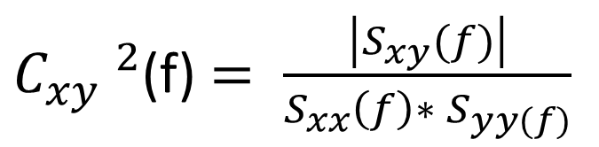
Magnitude squared coherence
${C_{xy} }^{2}$(f) $= \frac{\left|S_{xy}(f)\right|}{S_{xx}\left(f\right)∗ S_{yy(f)}}$
Combining across subjects
Time-frequency pixels were set to one if significant, and averaged across subjects
Averaged significant coherence for subjects 3,4,5,7 and 8
Averaged raw coherence for subjects 3,4,5,7, and 8

Slide 11

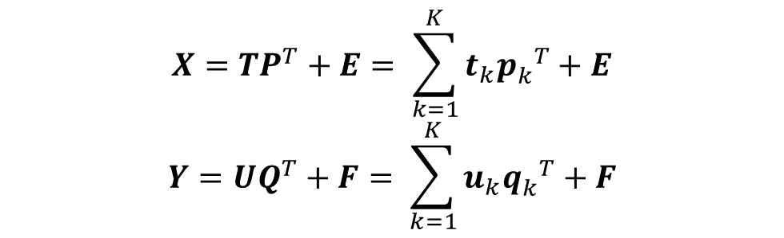
Partial least squares (PLS)
Partial least squares relates patterns of predictor variables X with patterns of response variables Y that share similar temporal signatures.
The learned components of X and Y are constrained to have the same temporal signature after scaling by an inner relation:
$$X=TP^{T}+E= \sum_{k=1}^{K}{t_{k}{p_{k}^{}}^{T}}+E$$
$$Y=UQ^{T}+F= \sum_{k=1}^{K}{u_{k}{q_{k}^{}}^{T}}+F$$
$${\text{u}}_{k}= {β_{k}t}_{k}$$

Slide 12
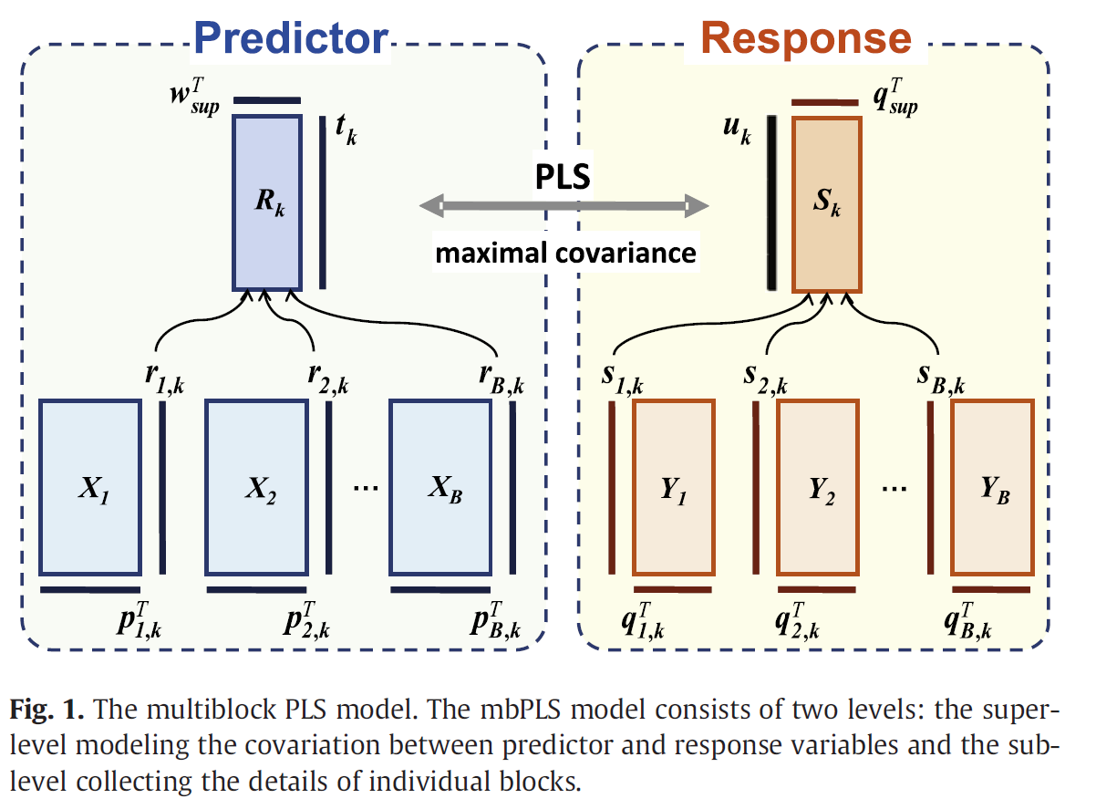


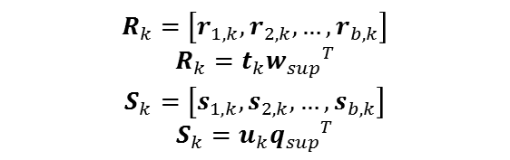
Multi-block partial least squares (mbPLS)
mbPLS allows data to be divided into separate data blocks corresponding to individual trials or subjects.
This requires two levels of regression, one at the individual data block level and one at the super-block level.
Sub-level decomposition
Super-level decomposition
$$X_{b}= \sum_{k=1}^{K}{r_{b,k}{p_{b,k}^{}}^{T}}+E_{b}$$
$$Y_{b}= \sum_{k=1}^{K}{s_{b,k}{q_{b,k}^{}}^{T}}+F_{b}$$
$$R_{k}=\left[r_{1,k}, r_{2,k}, …, r_{b,k}\right]$$
$$R_{k}=t_{k}{w_{sup}}_{}^{T}$$
$$S_{k}=\left[s_{1,k}, s_{2,k}, …, s_{b,k}\right]$$
$$S_{k}=u_{k}{q_{sup}}^{T}$$
$${\text{u}}_{k}= {β_{k}t}_{k}$$
J. Chiang et al. / NeuroImage 63 (2012) 1498–1509

Slide 13
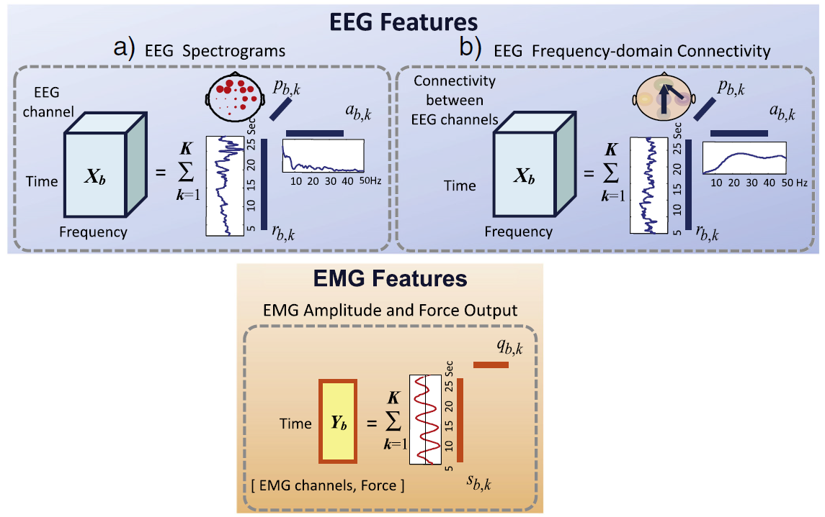

Three-way Multi-block partial least squares
Neurological data can be useful when represented as muliway arrays.
EEG spectrograms
Time-point, frequency bin, eeg electrode
EEG frequency domain connectivity
Time-point, frequency bin, electrode connectivity
Sub-level decomposition
Super-level decomposition
$$X_{b}= \sum_{k=1}^{K}{r_{b,k}⊗a_{b,k}^{}}⊗p_{b,k}+E_{b}$$
$$Y_{b}= \sum_{k=1}^{K}{s_{b,k}{q_{b,k}^{}}^{T}}+F_{b}$$
$$R_{k}=\left[r_{1,k}, r_{2,k}, …, r_{b,k}\right]$$
$$R_{k}=t_{k}{w_{sup}}_{}^{T}$$
$$S_{k}=\left[s_{1,k}, s_{2,k}, …, s_{b,k}\right]$$
$$S_{k}=u_{k}{q_{sup}}^{T}$$
$${\text{u}}_{k}= {β_{k}t}_{k}$$
J. Chiang et al. / NeuroImage 63 (2012) 1498–1509

Slide 14
Three-way Multi-block partial least squares
Neurological data can be useful when represented as muliway arrays.
EEG spectrograms
Time-point, frequency bin, eeg electrode
EEG frequency domain connectivity
Time-point, frequency bin, electrode connectivity
Sub-level decomposition
Super-level decomposition
$$X_{b}= \sum_{k=1}^{K}{r_{b,k}⊗a_{b,k}^{}}⊗p_{b,k}+E_{b}$$
$$Y_{b}= \sum_{k=1}^{K}{s_{b,k}{q_{b,k}^{}}^{T}}+F_{b}$$
$$R_{k}=\left[r_{1,k}, r_{2,k}, …, r_{b,k}\right]$$
$$R_{k}=t_{k}{w_{sup}}_{}^{T}$$
$$S_{k}=\left[s_{1,k}, s_{2,k}, …, s_{b,k}\right]$$
$$S_{k}=u_{k}{q_{sup}}^{T}$$
$${\text{u}}_{k}= {β_{k}t}_{k}$$
J. Chiang et al. / NeuroImage 63 (2012) 1498–1509

Slide 15
Three-way mbPLS with spectrogram
******** Show some results from our data ************
SB: If I can’t get the results in time or they don’t make sense, we can use Chiang’s.

Slide 16
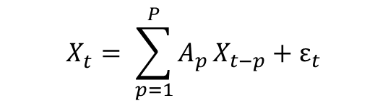
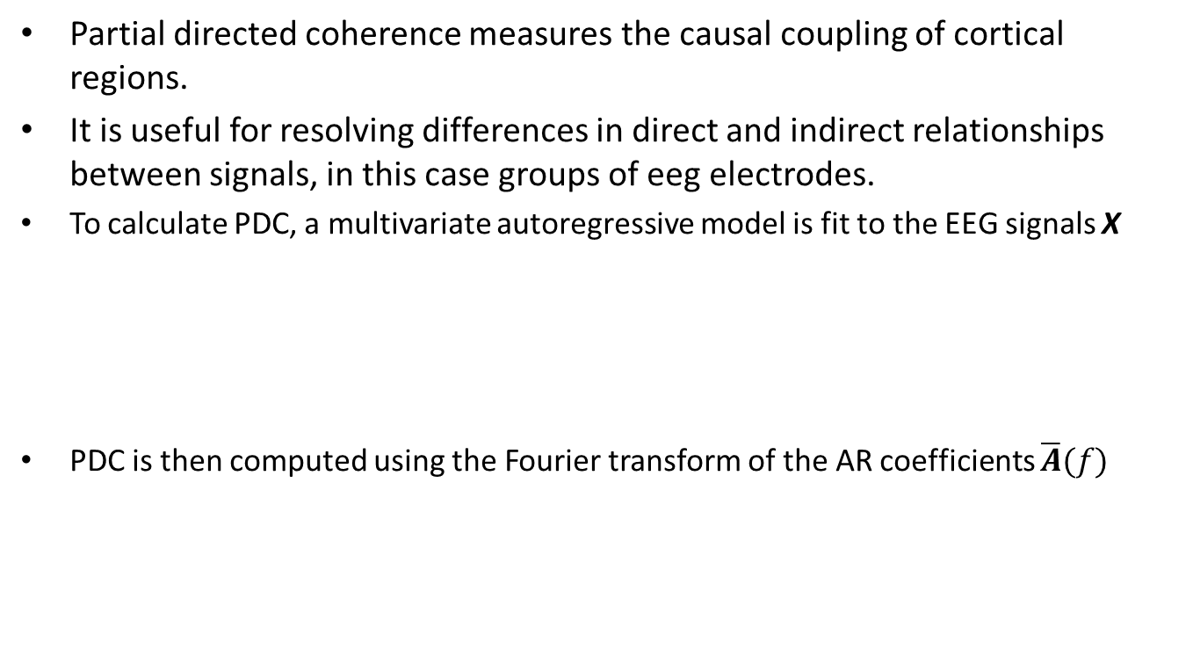

Partial directed coherence (PDC)
Partial directed coherence measures the causal coupling of cortical regions.
It is useful for resolving differences in direct and indirect relationships between signals, in this case groups of eeg electrodes.
To calculate PDC, a multivariate autoregressive model is fit to the EEG signals X
PDC is then computed using the Fourier transform of the AR coefficients $\overline{A}(f)$
$$X_{t}^{}= \sum_{p=1}^{P}{A_{p}}X_{t−p}+ε_{t}$$
$$π_{i⃪j}\left(f\right)= \frac{\overline{\left|A_{i,j}(f)\right|}}{\sqrt{\sum_{m=1}^{N_{ch}}{{\left|\overline{A_{m,j}(f)}\right|}^{2}}}}$$

Slide 17
Three-way mbPLS with PDC
******** Show some results from our data ************
SB: If I can’t get the results in time or they don’t make sense, we can use Chiang’s.

