Slide 1
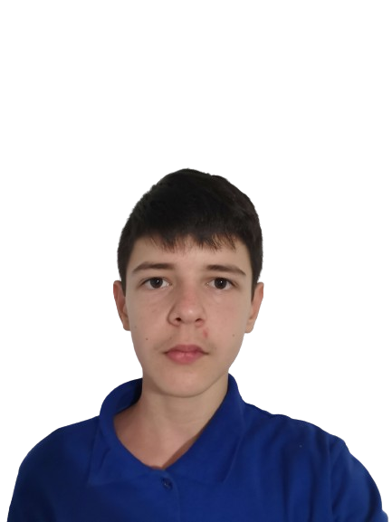
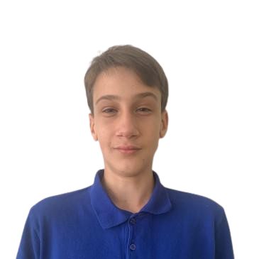
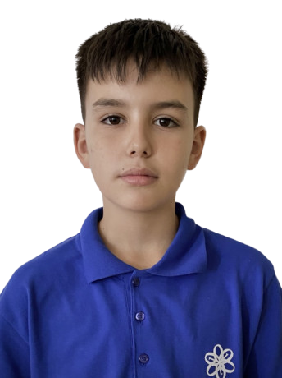
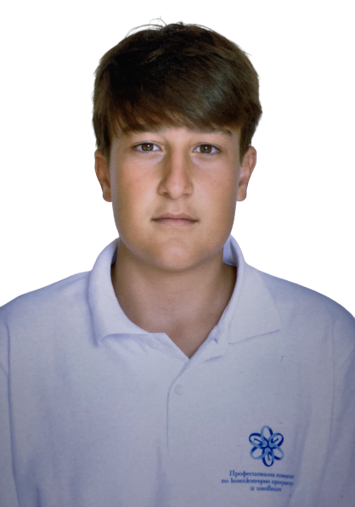


GreenTech
Our Team
Less Pollution,
More Solutions
Scrum Trainer
Stefan Ivanov
Front-end Developer
Zlatin Lazarov
Front-end Developer
Alexander Ivanov
Designer
Maxim Mateev

Slide 2
Our Team
Our Idea
GreenTech
our goal is to make sustainable future and eco-friendly living.
Scrum Trainer
Stefan Ivanov
Front-end Developer
Zlatin Lazarov
Front-end Developer
Alexander Ivanov
Designer
Maxim Mateev
Less Pollution,
More Solutions

Slide 3










Our Idea
Tech Used
Our Team
our goal is to make sustainable future and eco-friendly living.
Scrum Trainer
Stefan Ivanov
Front-end Developer
Zlatin Lazarov
Front-end Developer
Alexander Ivanov
Designer
Maxim Mateev

Slide 4
Tech Used
Our Idea
Let’s continue to the site
our goal is to make sustainable future and eco-friendly living.

Slide 5
Tech Used
Let’s continue to the site

