Slide 1
Fake News Detection Project
Sabuj Ghosh

Slide 2
Introduction
Nowadays political and economic agendas are being pushed like anything on news media. Back when Noam Chomsky theorized ‘Manufacturing consent’ to this volatile socio-political setup where we can see social media flooded with fake news and allegations, it is very important to distinguish the fake news from the real news.
Understanding regarding Natural language processing and how fake news is perpetuated is very important for this problem.
The motivation is to build a model that can detect fake news without human intervention.

Slide 3
Preprocessing
Null value handling, outlier detection and removal.
Presence of null value almost certainly denotes a fake news, so that information was stored in a separate column.
Ratio of length of headline to length of news is very high when it is a fake news; that ratio was saved in a different column.
Unnecessary columns like ID was removed after close inspection.

Slide 4
Algorithmic flow
Null value handled.
Outliers removed.
Stopwords removed.
News, headlines and ‘Written by’ tokenized.
Corpus of news, headlines and ‘Written by’ built separately.
News, headlines and ‘Written by’ vectorized.
Those vectors stacked horizontally.
Train data set and test data set created from the vectors and labels.
Various models trained with train data and tested using test data using various evaluation metrics.
The highest performing model got hypertuned.
The highest performing model got cross validated.
After successful cross validation a model is selected.

Slide 5
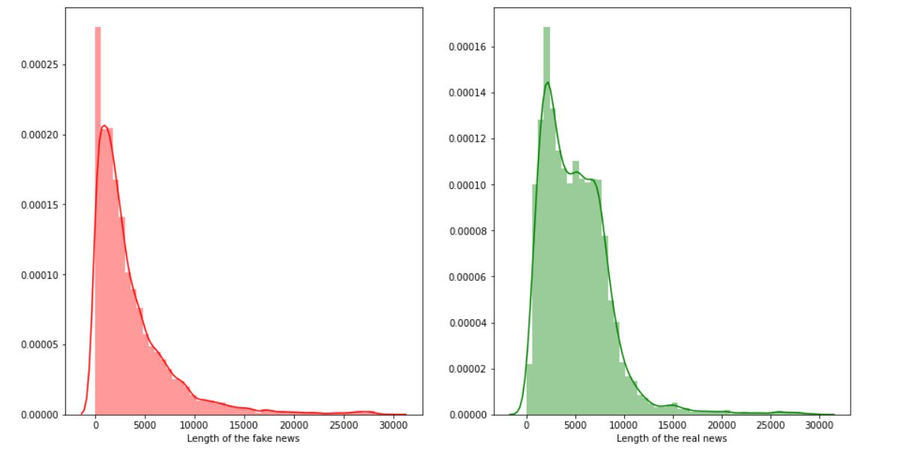
Visualization

Slide 6
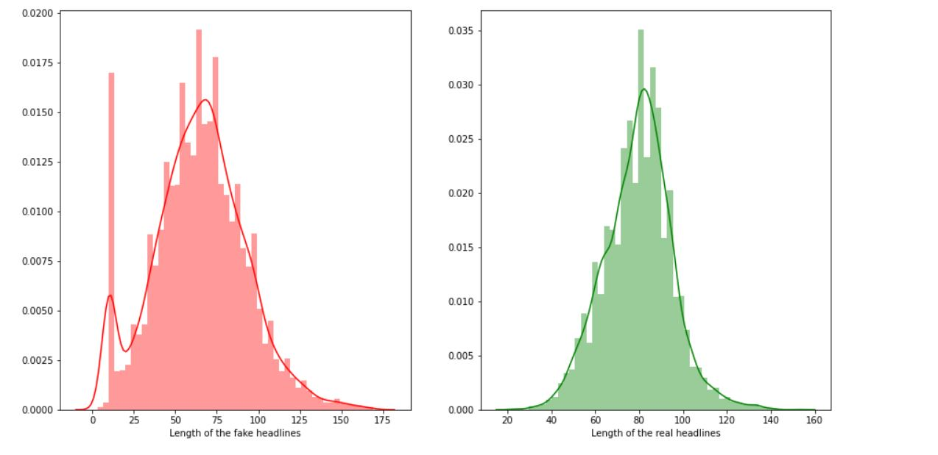
Visualization

Slide 7
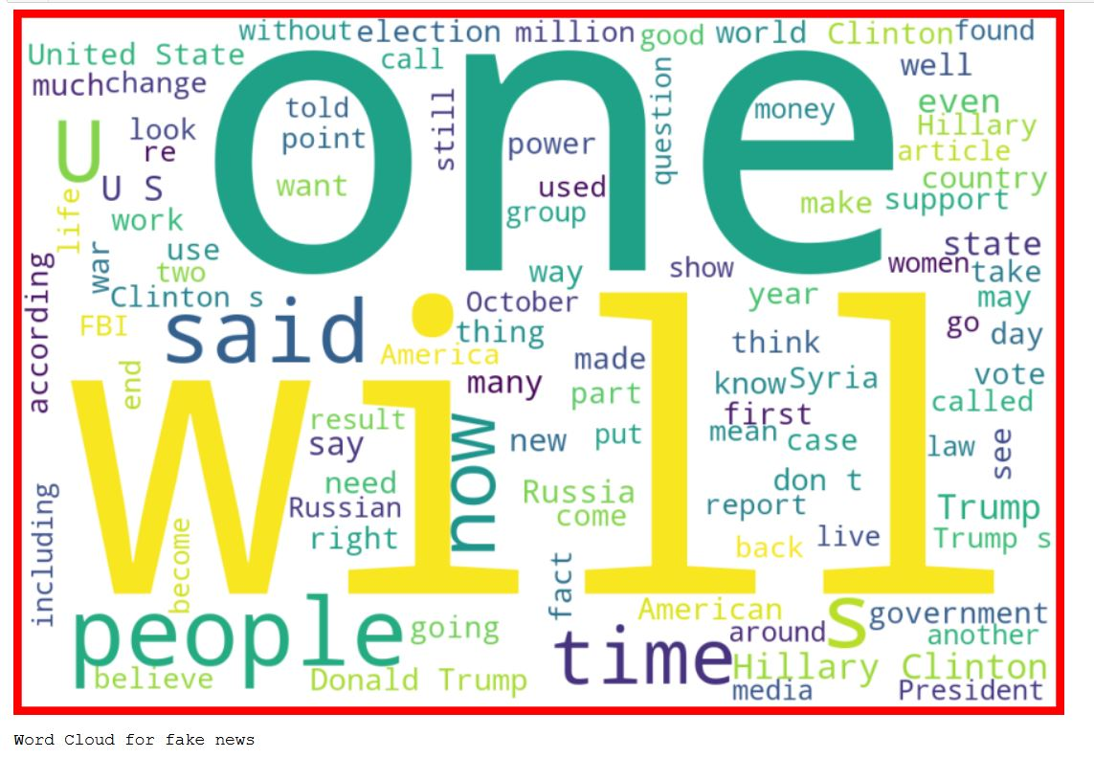
Visualization

Slide 8

Visualization

Slide 9

Visualization

Slide 10

Visualization

Slide 11
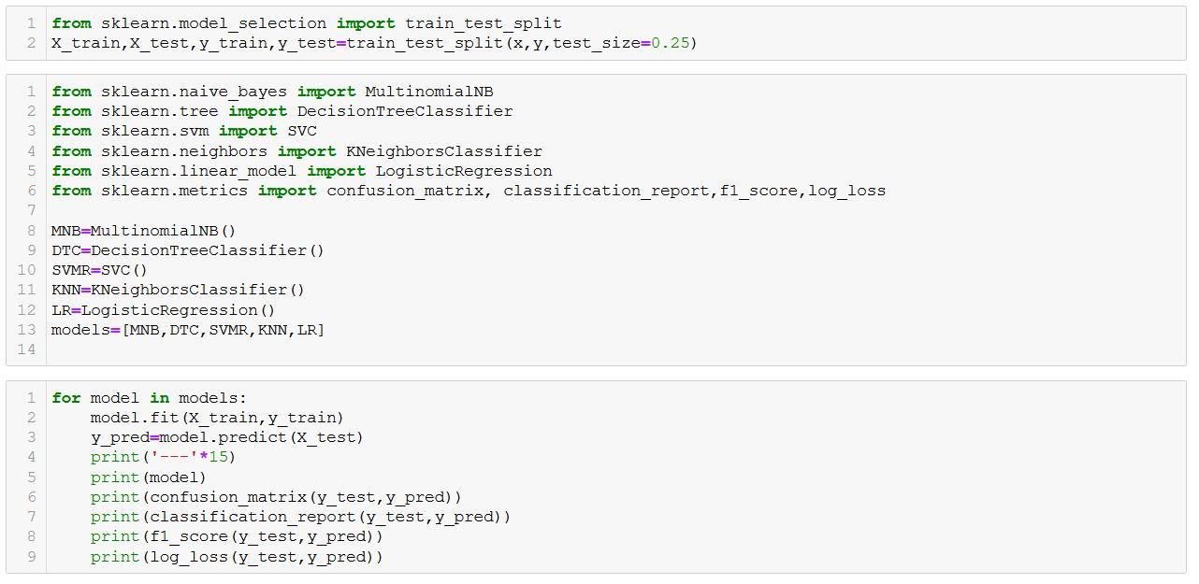
Models and Results

Slide 12
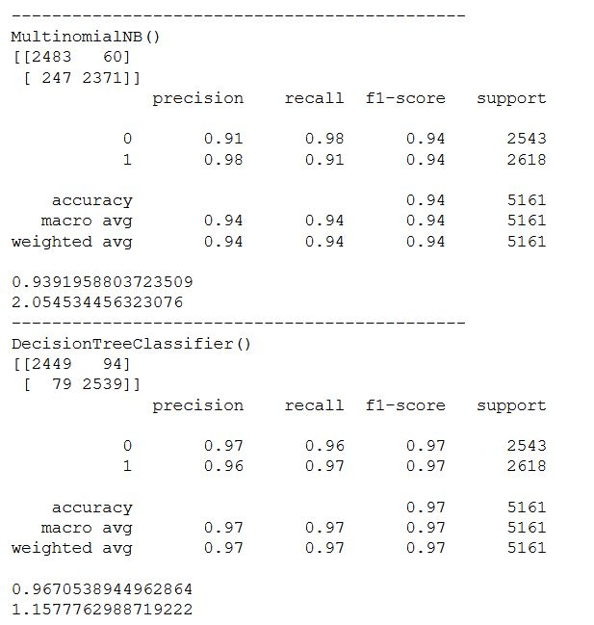
Models and Results

Slide 13
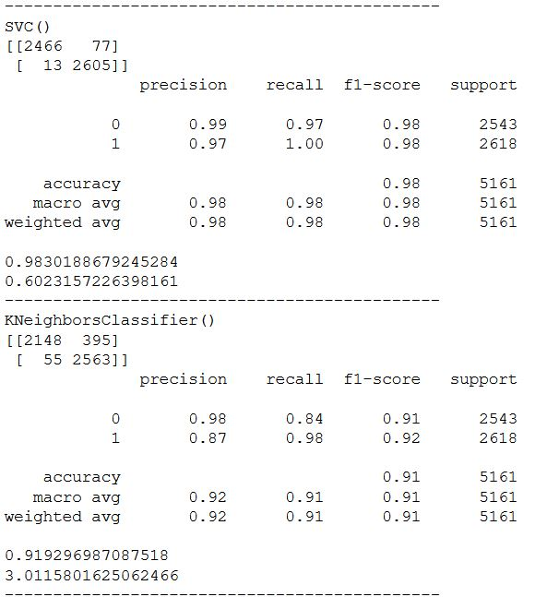
Models and Results

Slide 14
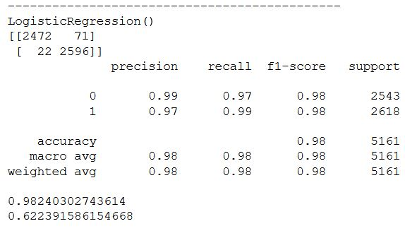
Models and Results

Slide 15
Final takeaways
Fake news have longer headlines and shorter news and hence a feature column was created which contained length of headline/length of news.
Instances which contained news with length more than 30000 and headlines with length more than 170 was removed. Presence of null value in any column denoted a high probability of the news being fake so that information was saved in a separate column.
Support Vector classifier performs best for the dataset, close contending models include logistic regression and decision tree.

Slide 16
Thank You

