Slide 1
Surprise Housing
By
Sabuj Ghosh

Slide 2
Problem statement and understanding
Prediction of residential real estate properties is needed to assist business decisions regarding investments.
Clearly this is a linear regression problem; but the data had categorical variables as well. To begin with the data had 81 features so regularization is the need of the hour.
The categorical variables were not ordinal in nature so label encoding was avoided and dummy variables were created. Missing values in continuous variables were replaced by median and the same in categorical variables were replaced by most frequent elements. Features with more than 85% missing values were removed. The data was scaled using standard scaler. Target variable had high skewness that was removed using logarithm.

Slide 3
EDA and Visualization
All categorical variables were visualized for effect on mean of sales price as well as count of the categorical variable in different categories. If any category contained more than 90-95% of the whole data the feature was dropped and not used in final model building.
All continuous variable were visualised by histogram and scatter plots. Their correlations were also bar plotted.
A few examples are shown as there are 81 of them.

Slide 4
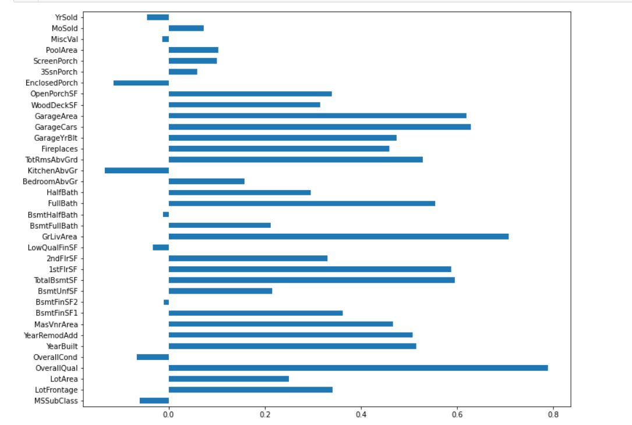
EDA and Visualization
Correlations

Slide 5
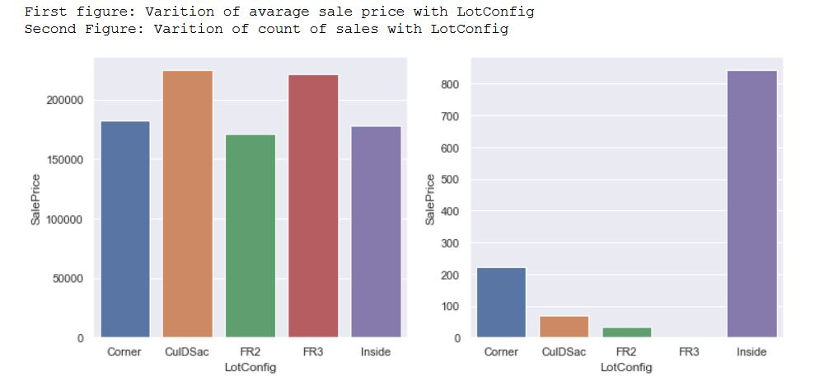
EDA and Visualization
Categorical variables

Slide 6
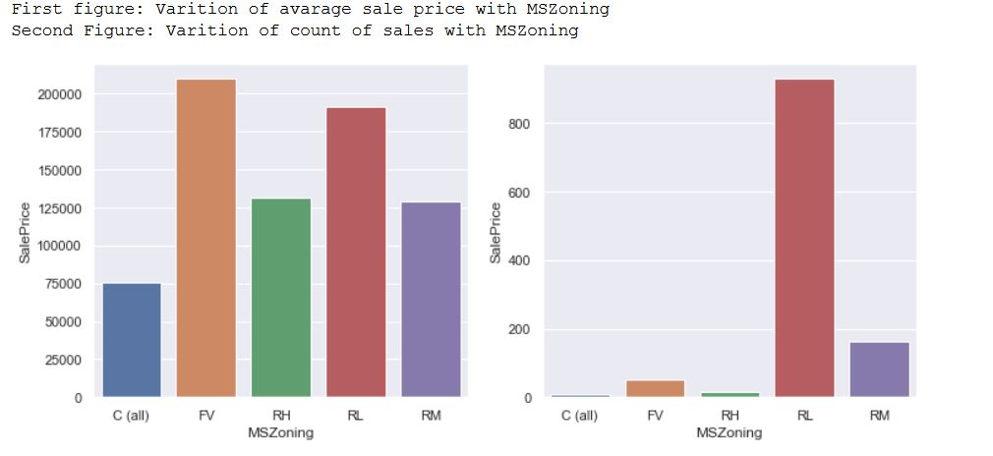
EDA and Visualization
Categorical variables

Slide 7
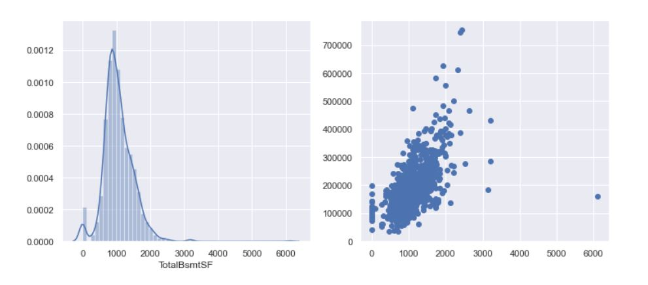
EDA and Visualization
Continuous variables

Slide 8
Steps and assumptions used to complete the project
Linear regression, ridge regression and lasso regression was used as models.
Lasso had most r2 score among the 3.
Mean cross validation score confirmed this.
Finally the lasso regration was trained on the entire data before making predictions on the test data.
We took exp(prediction) as the logarithm of target variable was fed into the model to avoid high skewness.

Slide 9
Conclusion.
Overall quality of the property, a good garage, high living space, quality basements are the ones a property dealer should look for in an investment.
Tried various algorithms, often the simplest one is the best one.
pumping up the accuracy will come with the problem of overfitting.

