Slide 1
Malignant Comment Classifier
Sabuj Ghosh

Slide 2
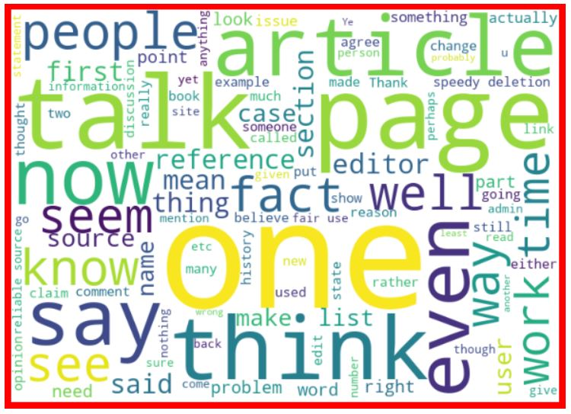
Word cloud for normal comments

Slide 3
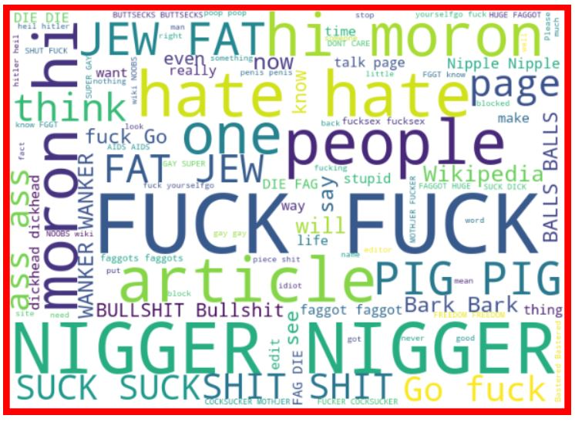
Word cloud for malignant comments

Slide 4
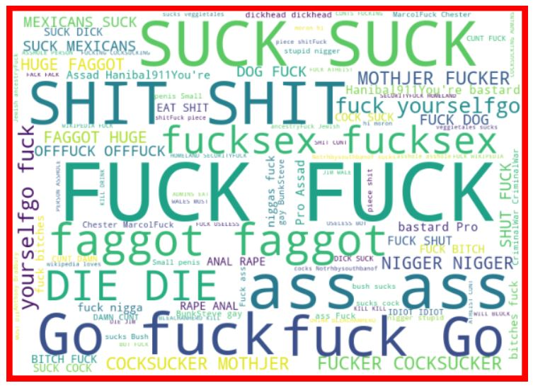
Word cloud for highly malignant comment

Slide 5
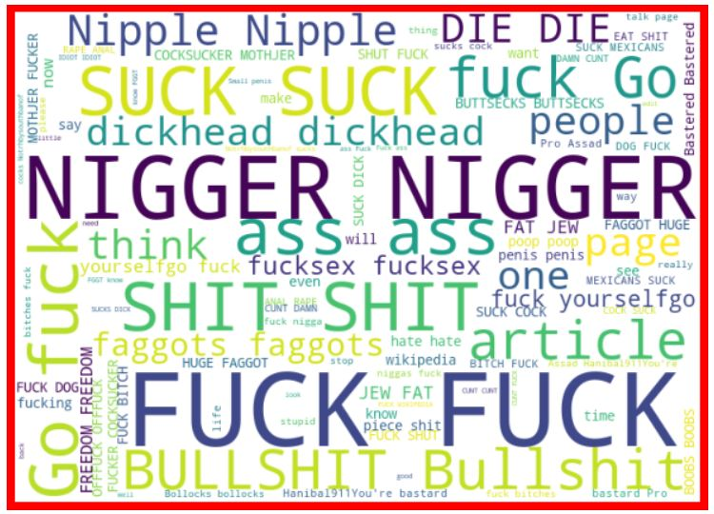
Word cloud for rude comments

Slide 6
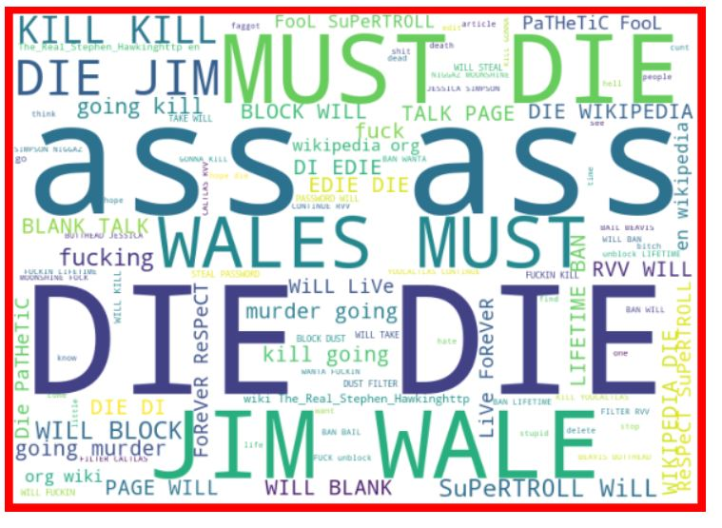
Word cloud for threat comments

Slide 7
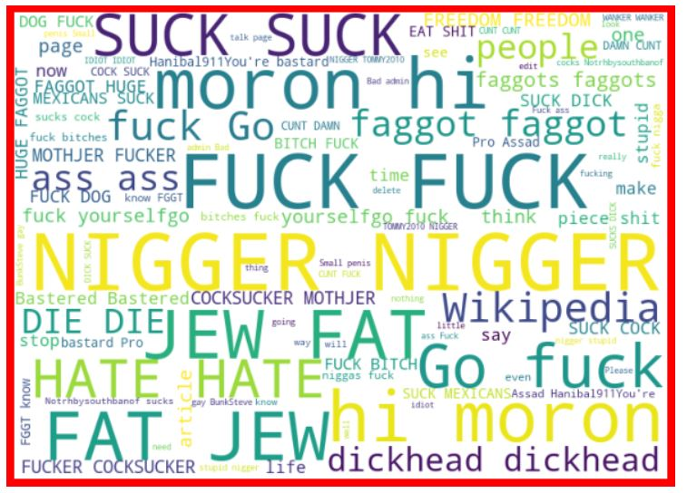
Word cloud for abusive comments

Slide 8
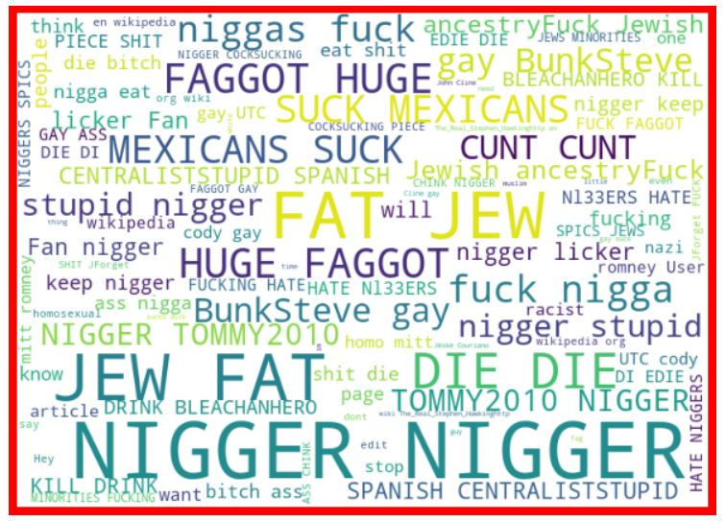
Word cloud for loathing comments

Slide 9
Inferences from word clouds
Verbal malignancy primarily begins and ends with primordial absurdity towards human sexuality and moral degradation imagined around its sociopolitical boundaries.
The other aspect of malignancy is from body shaming in brute and patriarchal manner.
Words indicative of racism pops up very often.
Rude comments have relatively higher references to female body parts indicative of misogynistic behavioral pattern.
Threat comments tend to be indicative of life threatening words like ‘die’ and ‘murder’ along with body shaming.
Loathing comments tend more towards racial slurs.

Slide 10
Data Cleaning and pre-processing
Punctuation marks were removed.
Words were stemmed.
Stop words were removed.
A corpus of comments were made.
Every comment was vectorized using the TFIDF vectorizer based on the corpus.
The same process was done for test data also only the test comments were transformed with the previous vectorizer.

Slide 11
Model building.
To begin with we considered multinomial Gaussian NB but it had a tendency of declaring every comment as normal as the only ~9% of the data was malignant.
Imblearn’s under sampling module was used to over come this problem; we could have used the over sampling module also but the resource needed for that simply was way too much.
On this under sampled data logistic regression, descision tree, random forest along with multi nomial Gaussian NB were tested.
Logistic regression performed the best.

Slide 12
Evaluation metrics
The models were evaluated using accuracy, confusion matrix, classification report and f1 scores.
The best f1 score was from logistic regression with an agreeable precision and recall.
Five logistics regression models were built for five output varibles.

Slide 13
Predictions
Every target variable was predicted with the corresponding model.
The resultant data frame was saved as csv file.

