Slide 1
AnnualEmployeeBonus
File created on: 2019-12-27 2:27:30 PM

Slide 2
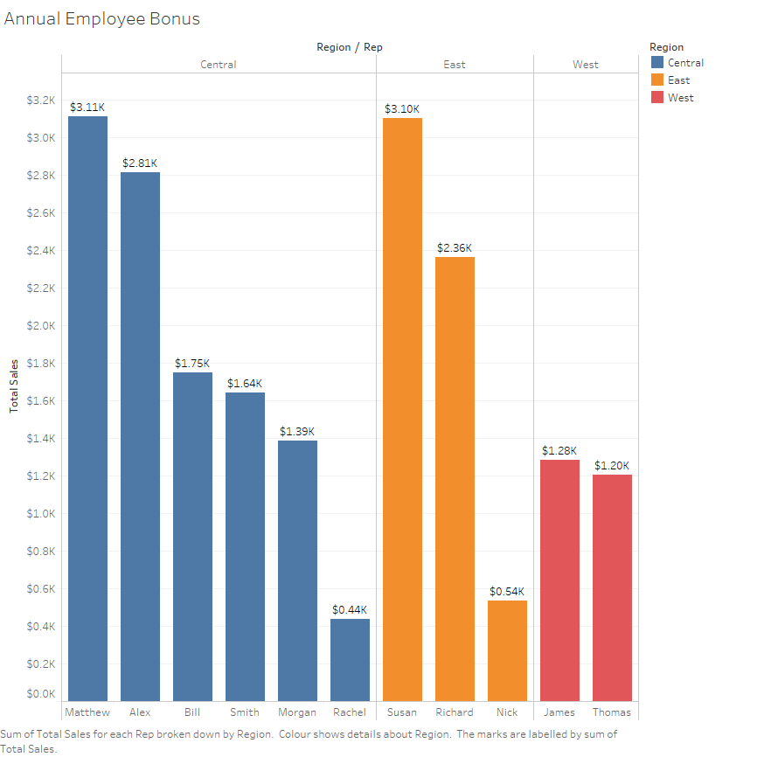

Slide 3
Conclusion
Central: Award bonus to Matthew
East: Award bonus to Susan
West: Award bonus to James

