Slide 1


CO23115
Software Testing‐ Unit 3
Black-Box Software Testing (12M)

Slide 2
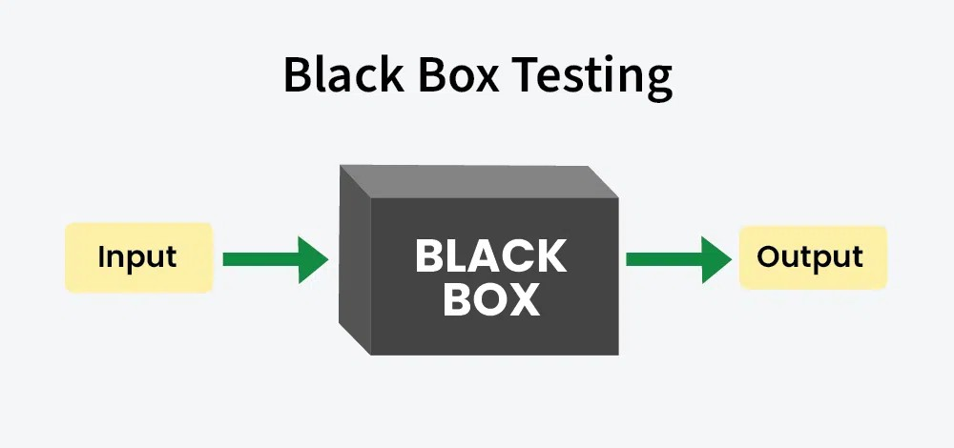
Black Box Testing
Black-box testing is a Type of Software Testing in which the tester is not concerned with the software’s internal knowledge or implementation details but rather focuses on validating the functionality based on the provided specifications or requirements.

Slide 3
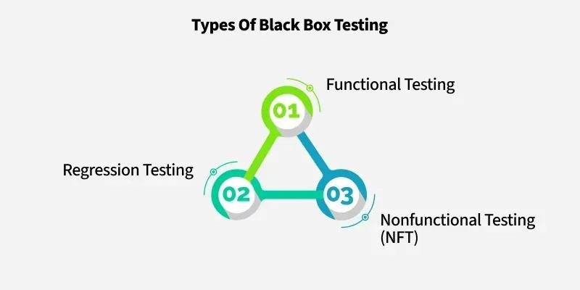
Classification of BBT

Slide 4
1. Functional Testing
Functional Testing is a type of Software Testing in which the system is tested against the functional requirements and specifications.
Functional testing ensures that the requirements or specifications are properly satisfied by the application.
This testing is not concerned with the source code of the application.
Each functionality of the software application is tested by providing appropriate test input, expecting the output, and comparing the actual output with the expected output.
This testing focuses on checking the user interface, APIs, database, security, client or server application, and functionality of the Application Under Test. Functional testing can be manual or automated.
It determines the system’s software functional requirements.

Slide 5
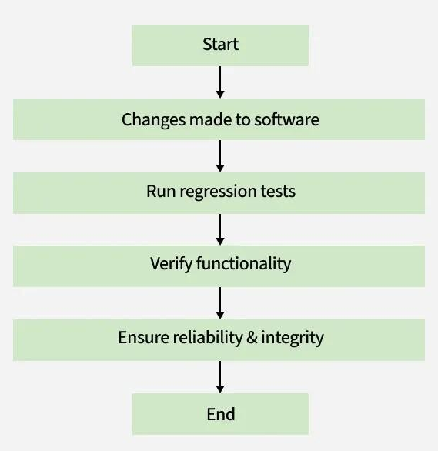
2.Regression Testing
Regression Testing involves re-executing a previously created test suite to verify that recent code changes haven't caused new issues. This verifies that updates, bug fixes, or enhancements do not break the functionality of the application.

Slide 6
When to do Regression Testing?
Regression testing is necessary in several scenarios to maintain software quality:
When new functionality is added to the system and the code has been modified to absorb and integrate that functionality with the existing code.
When some defect has been identified in the software and the code is debugged to fix it.
When the code is modified to optimize its working.

Slide 7
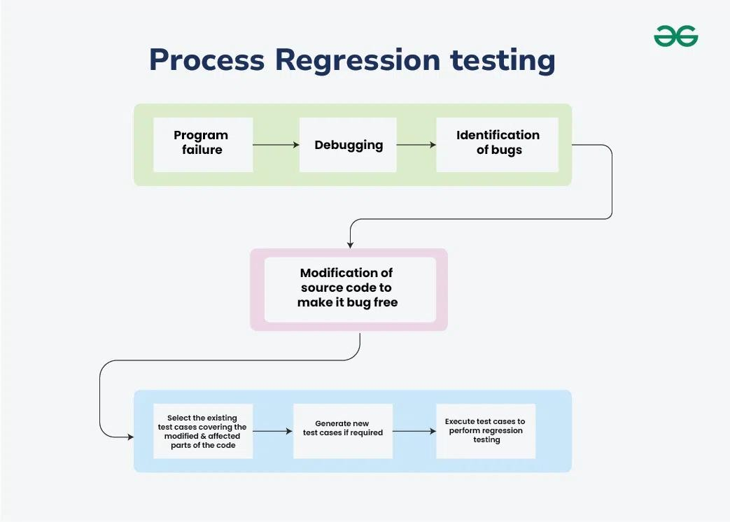
Process of Regression Testing
Here is the step-by-step process of the regression testing:

Slide 8
Non-Functional Testing
Non-functional Testing is a type of software testing that is performed to verify the non-functional requirements of the application. It verifies whether the behavior of the system is as per the requirement or not.
Non-Functional Testing Types and Techniques
Here is the Non-Functional Testing Techniques
and Types
mentioned bellow:
Performance Testing: Performance testing is a type of software testing that focuses on evaluating the performance and scalability of a system or application.
Load Testing: Load testing determines the behavior of the application when multiple users use it at the same time. It is the response of the system measured under varying load conditions.
Security Testing: Security testing is important to check and sure that applications and systems are protected from various threats. There are several types of security testing, each targeting specific vulnerabilities and aspects of security.

Slide 9
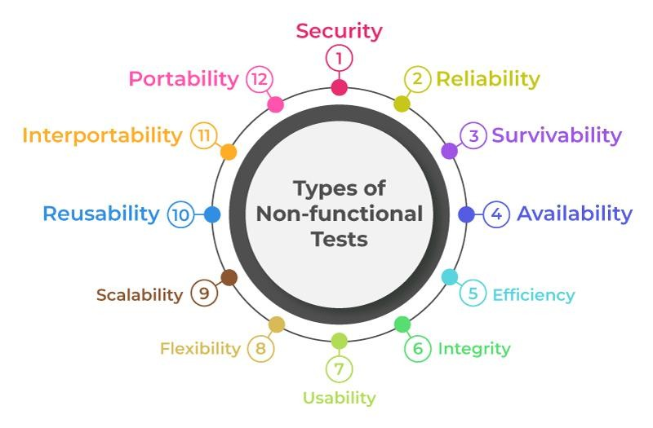
Non-functional Testing Parameters

Slide 10
Black Box Testing Techniques
Equivalence Partitioning
Boundary Value Analysis
Requirement-based testing
Positive and Negative Testing

Slide 11
Equivalence Partitioning
Testers can divide possible inputs into groups or “partitions”, and test only one example input from each group.
For example, if a system requires a user’s birth date and provides the same response for all users under the age of 18, and a different response for users over 18, it is sufficient for testers to check one birth date in the “under 18” group and one date in the “over 18” group.

Slide 12
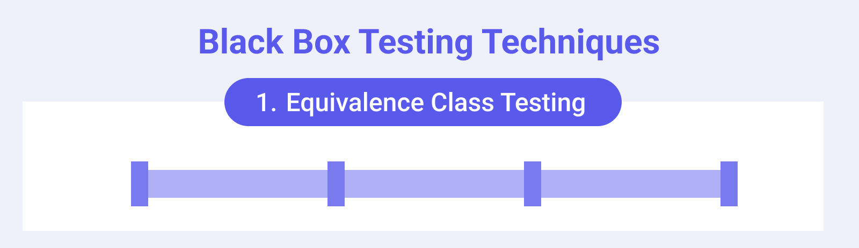
Equivalence Partitioning
Instead of testing every possible input, a representative value from each partition is selected for testing, significantly reducing the number of test cases while maintaining high test coverage.

Slide 13
Equivalence Partitioning
Example: Age Input Field
Consider a web application with an age input field that requires users to be between 18 and 60 years old (inclusive).
Identify Equivalence Classes:
Valid Equivalence Class: Ages between 18 and 60 (e.g., 25, 40, 55). Any age within this range should be accepted by the system.
Invalid Equivalence Class 1 (Below Range): Ages less than 18 (e.g., 17, 10, 0). These should be rejected.
Invalid Equivalence Class 2 (Above Range): Ages greater than 60 (e.g., 61, 70, 100). These should be rejected.
Invalid Equivalence Class 3 (Non-numeric): Inputs that are not numbers (e.g., "abc", "!@#", "twenty"). These should be rejected.

Slide 14
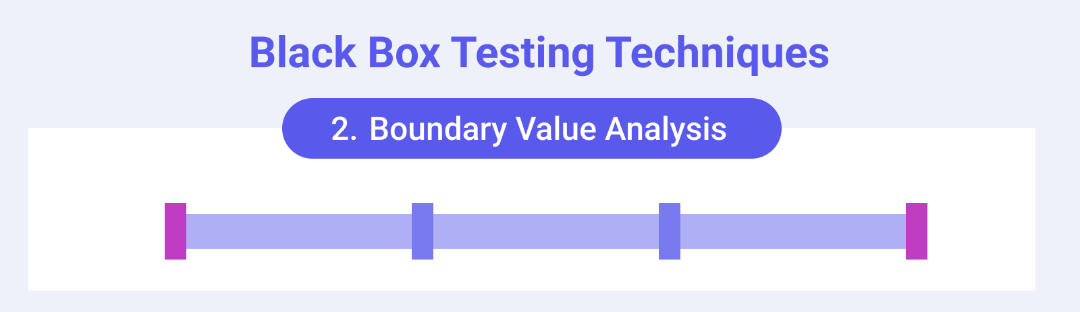
Boundary Value Analysis (BVA)
Boundary Value Analysis (BVA) is a crucial software testing technique that focuses on testing the boundaries or edges of input ranges.
It is based on the observation that errors often occur at the edges of input ranges rather than in the middle. By testing the extremes, BVA helps identify potential vulnerabilities and ensures that the system behaves correctly at its limits.

Slide 15
Boundary Value Analysis (BVA)
Boundary Value Analysis is method that aims to
a black-box testing
test the boundaries
between equivalence classes.
While Equivalence Class Partitioning only divides inputs into valid and invalid groups, BVA takes this a step further by testing only extreme values just below, just above, and at the defined boundaries.
•
This helps ensure the system properly handles edge
cases, which are often where software failures occur.

Slide 16
Boundary Value Analysis (BVA)
Let's go back to the previous example. You're testing a function that validates a user's age, with a valid age range of 18 to 60 years. We have the following equivalence classes already defined: Valid Equivalence Class: [18–60]
Invalid Equivalence Classes:
Ages less than 18: [-∞ to 17] Ages greater than 60: [61 to ∞]
Non-numeric inputs: ["abc", "#$%", etc.]
Boundary value analysis focuses on testing the boundaries of these ranges.
Just outside the lower boundary: 17
At the lower boundary: 18
Just above the lower boundary: 19 Just below the upper boundary: 59 At the upper boundary: 60
Just outside the upper boundary: 61

Slide 17
Requirement-based testing
The requirements based testing points to an important phase which includes verifying a software with respect to a particular norm.
It ensures that the software is developed as per the given requirements, and its working is aligned as per the expected results. The test cases are designed as per the specified requirements.
This type of testing systematically evaluates all the modules to check whether they are working fine.
It is recommended to develop the test strategy as per the requirements so that the software is developed with the preconceived guidelines, and solves end user expectations.

Slide 18
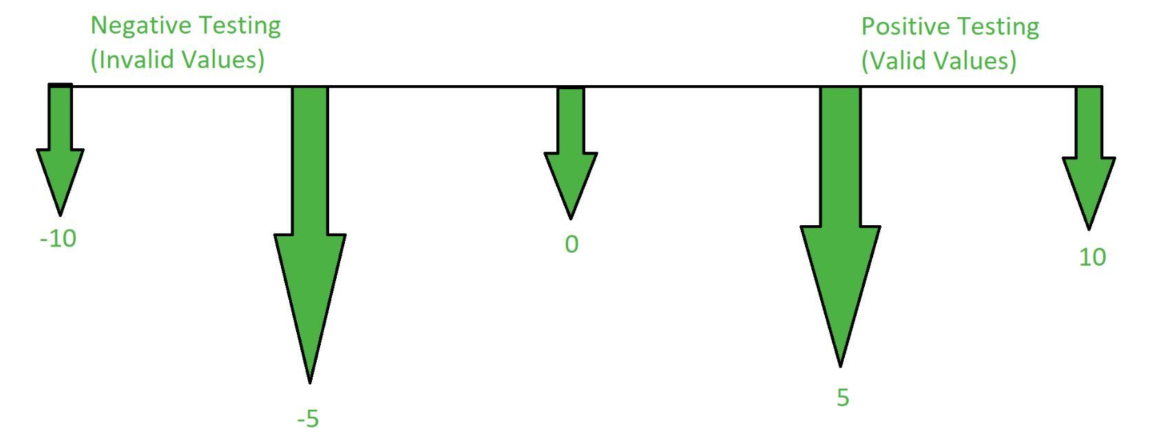
Positive and Negative Testing
Positive testing: is a type of software testing that is performed by assuming everything will be as expected.
It is performed with the assumption that only valid and relevant things will occur.
Data set and all other functionalities will be as expected.
Negative Testing: Negative testing is a type of software testing that is performed to check the system for unexpected conditions.
Negative testing plays a much important role in high-performance software development.
It checks whether on such unexpected conditions what will be the behavior of the software.

Slide 19
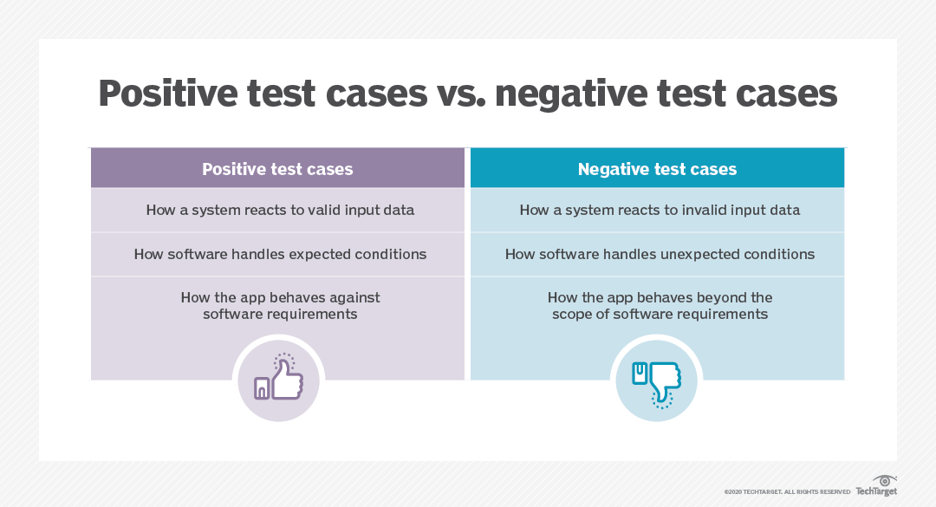

Slide 20
Gray Box Testing
Gray Box Testing is a software testing technique that combines elements of the Black Box Testing technique and the White Box Testing technique.
Objectives of Gray Box Testing:
To provide the combined advantages of both black box testing and white box testing.
To combine the input of developers as well as testers.
To improve overall product quality.
To reduce the overhead of the long process of functional and non-functional testing.
To provide enough free time to developers to fix defects.
To test from the user's point of view rather than a designer's point of view.

Slide 21
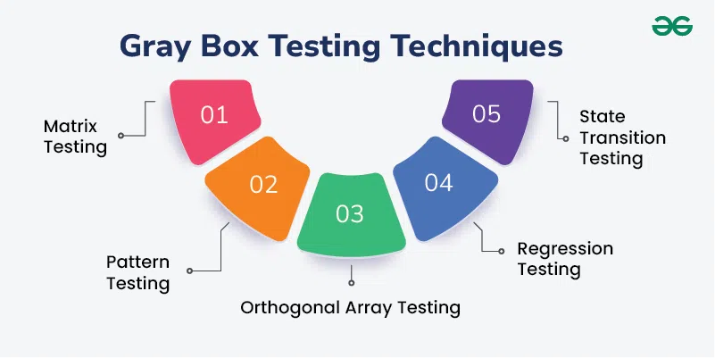
Gray Box Testing Techniques

Slide 22
1. Matrix Testing
Developers define all the variables that exist in the program.
Each variable is then assessed according to the risks it presents.
You can use this technique to identify unused or un-optimized variables.
Developers define the variables and their inherent risks, and each variable is then assessed based on these risks and its usage frequency.
This allows for targeted testing efforts on high-risk or frequently used variables.

Slide 23
2. Pattern Testing
This helps test cases designed as they are proactive in finding other failures before hitting production.
Pattern testing is a technique that evaluates past defects to identify patterns that lead to defects.
Ideally, these evaluations can highlight which details contributed to defects, how the defects were found, and how effective fixes were.
You can then apply this information to identifying and preventing similar defects in new versions of an application or new applications with similar structures.

Slide 24
3. Regression Testing
Regression testing is a technique that enables you to verify whether application changes or bug fixes have caused errors to appear in existing components.
You can use it to ensure that modifications to your application are only improving the product, not relocating faults.
When performing regression testing, you need to recreate your tests since inputs, outputs, and dependencies may have changed.

Slide 25
Pros of gray box testing
Clear testing goals are established, making it easier for testers and developers.
Testing accounts for a user perspective, improving the overall quality of products.
Testers do not need to have a programming expertise.
Testing methods create more time for developers to fix defects.
It can provide the benefits of both black and white box testing.
It can eliminate conflicts between developers and testers.
It is cheaper than integration testing.

Slide 26
Cons of gray box testing
It can be difficult to associate defects with root causes in distributed systems
Code path traversals are limited due to restricted access to internal application structure
It does not allow for full white box testing benefits since not all internals are accessible
It cannot be used for algorithm testing
Test cases can be difficult to design

