Slide 1

IM & Analytics HUB Teams – Reston & India HUB
Steven Black
Mark Geurtsen
Ashutosh Chandel
Shiva Uppushetty
2/26/2018

Slide 2
Agenda
1
Overview
Notional Architecture
Demo
Q & A
2
3
4

Slide 3
Story
Features
TODO
TODO

Slide 4



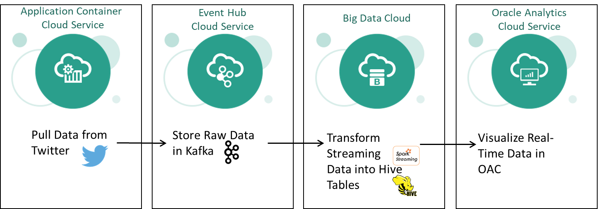
Notional Architecture

Slide 5
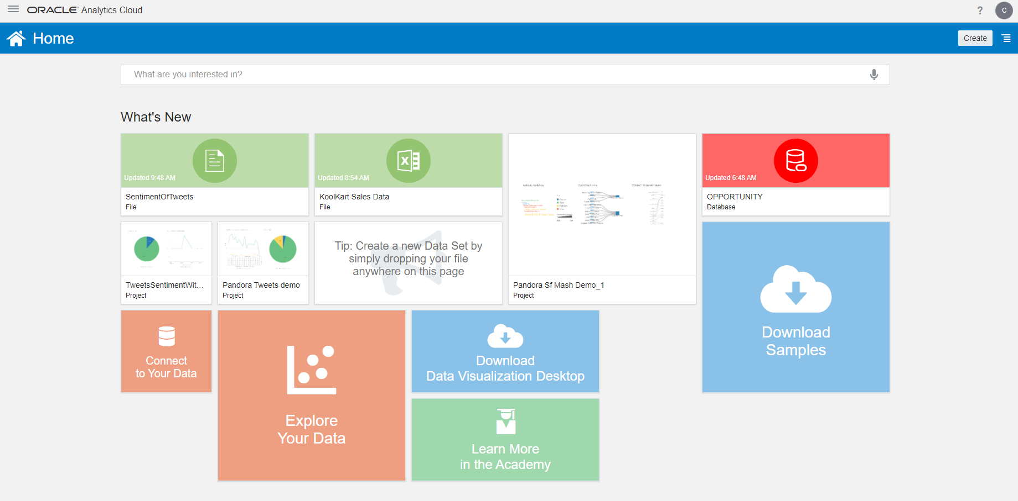
https://pandoraoac-gse00014288.uscom-east-1.oraclecloud.com/dv/ui?pageid=home
OAC – Data Visualization

Slide 6
https://hercules-gse00014288.uscom-east-1.oraclecloud.com/#/notebook/2D9N68PP2
BDC - Hadoop

Slide 8








Application Container
Cloud Service
Event Hub
Cloud Service
Big Data Cloud
Oracle Analytics
Cloud Service
Pull Data from
Twitter
Store Raw Data in Kafka
Transform Streaming Data into Hive Tables
Visualize Real-Time Data in OAC

