Slide 1

ARES – An Overview
Amateur Radio Emergency Service
Renfrew County
By
Bob Howard VE3YX (Acting EC for Renfrew County West)
www.technifest.com/~rcares

Slide 2
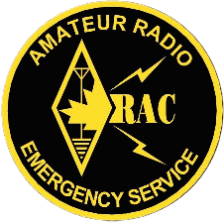
WHAT IS A.R.E.S. ?
Amateur
Radio
Emergency
Service

Slide 3
ARES Goals
To establish and provide emergency communications training for a core group of radio operators able to provide emergency site communications and supervision of the amateur communications network.
Provide peacetime emergency / disaster communications support to Municipalities, Police Services, Red Cross, and other agencies as requested.
Train radio operators to high level of effectiveness and efficiency through radio communications exercises and public service activities.
Foster teamwork and public service among area radio operators.

Slide 4
Introduction to ARES
OVERVIEW:
Amateur Radio Emergency Service (ARES) created by ARRL (Amateur Radio Relay League) in 1935
More than 70,000 ARES members throughout North America
Approximately 750 members in Ontario Section
(20 in Renfrew County)
Canadian Amateurs / Red Cross formal agreement of support in 1980
RAC (Radio Amateurs of Canada) formed in 1993 from merger of CRRL (Canadian Radio Relay League) and CARF (Canadian Amateur Radio Federation)
ARES and NTS (National Traffic Service) part of RAC Field Services Organization

Slide 5
Introduction to ARES
ORGANIZATIONAL STRUCTURE:
Field Services Manager – FSM (National)
Section Manager – SM (Provincial)
Section Emergency Coordinator - SEC
District Emergency Coordinator - DEC
Emergency Coordinator – EC (Local)
Assistant Emergency Coordinator – AEC
ARES Registered Stations

Slide 6
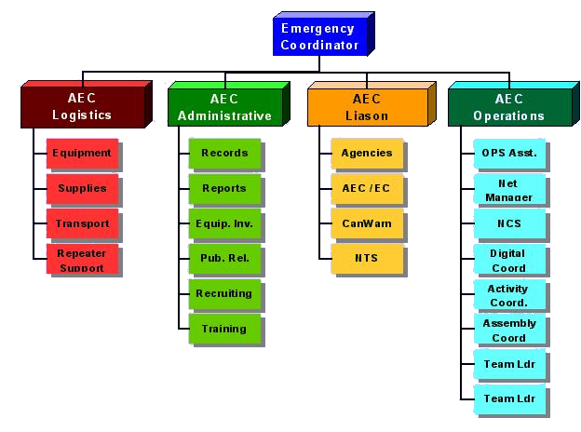
Local Organization

Slide 7
Introduction to ARES
RECAP:
ARES – a national structure
Planning is done at the local level
Maintains a “first response” procedure

Slide 8
What do we do?
Through the use of amateur radio frequencies, operators, equipment, and skills, on the request of a recognized authority, we provide to our communities and certain organizations, backup or primary communication resources.

Slide 9
What do we do?
ARES provides communications support only for those agencies requesting assistance
Rarely would we provide any other service, and only if it did not conflict with assigned communications task
Agencies and interaction are spelled out in formal, predetermined understandings
As a support group, ARES does not normally initiate any action
When requested to support, ARES puts their own emergency plan into effect, responding to the situation at hand

Slide 10
What do we do?
SEQUENCE OF EVENTS:
A disaster occurs within the community or service area
Police are notified and respond to the scene
Authorities or police assess the initial situation and call for specific aid
  More police
  Fire trucks
  Public utilities
  Ambulances and medical personnel
  Hazardous material containment team
  Etc.

Slide 11
What do we do?
SEQUENCE OF EVENTS – cont’d:
Specific agencies would be notified and put on standby under the Peacetime Emergency Plan
  Social Services become involved when people require food, clothing, or shelter
    Red Cross is called if shelters are to be established
    ARES will be notified if communications are required
The DEC, EC, or AEC will be called with a request and initial assessment of the situation
  DEC, EC, and/or AEC quickly confer to assess requirements and actions required

Slide 12
What do we do?
SEQUENCE OF EVENTS – cont’d:
Initiate call up tree to alert members – assign a temporary net controller to also make announcements on local emergency frequency
  Inform members of course of action
    Standby
    Report to a shelter or office
    Report to a central rally point for instructions
    Establish a permanent NCS

Slide 13
What do we do?
SEQUENCE OF EVENTS – cont’d:
DEC, EC and/or AEC actions
  Meet at EOC or where requested for further instructions and liaison to other agencies
    Provide additional communications if requested
      Police department
      Fire department
      Municipal officials
      Hospitals
      Civic shelters or Red Cross Centres

Slide 14
What do we do?
SEQUENCE OF EVENTS – cont’d:
DEC, EC and/or AEC actions
  Continue until requested to stand down
  Conduct a debriefing after the event to learn valuable lessons

Slide 15
What do we do?
RECAP:
ARES is called by Municipal officials
Alert members via call up methods
Set up at EOC (Emergency Operations Centre)
Establish scheduling and logistics support
Provide communications as requested
Learn from the event

Slide 16

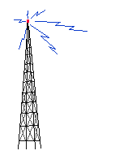
Sample of Communication System
VE3XAV
Shelter Two
VHF
VE3ZRV
Hospital
VHF
VE3TLH
EOC
Net Control
HF/VHF
VA3CRL
Red Cross
VHF
VE3RYA
Emergency
Site
VHF
Voice / Digital

Slide 17

Sample of Communication System
Voice / Digital
VE3NRR
PEMBROKE
V/UHF
VA3RBW
Pt. ALEXANDER
V/UHF
VA3KU
PEOC
HF
VA3ED
Hospital
VHF
VA3SUR
Shelter Two
V/UHF
VE3UCR
FOYMOUNT
VHF
VA3AJT
Lapasse
VHF/HF
VA3GPD
Red Cross
V/UHF
VE3YX
EOC
Net Control
VHF
VE3HAR
Emergency Site
VHF

Slide 18
Establishing a Station
The ARES Emergency Coordinator will authorize the establishment of stations.
The station location should be pre-determined in the emergency plan, with alternate locations.
The station will consist of a station supervisor, operator, and logger.
Messages should be handled according to standard procedure.

Slide 19

Standard RAC Message Form
RADIOGRAM
VIA AMATEUR RADIO
NUMBER
PRECEDENCE
HX
STATION OF ORIGIN
CHECK
PLACE OF ORIGIN
TIME FILLED
DATE
TO:
TELEPHONE NUMBER ( ) -
SIGNED
FROM DATE TIME
REC’D
FROM DATE TIME
SENT

Slide 20
Message Handling
A formal message contains four parts”
  PREAMBLE: the record keeping part
  ADDRESS: information about the party to whom the message is sent
  TEXT: what the sender wants to tell the addressee.
  SIGNATURE: identifies the person sending the message
Message forms must be legible and completed in full!

Slide 21
An ARES Volunteer
What is expected of them:
While in the event of an actual emergency, ARES volunteers may be asked to participate in telecommunication operations, it is recognized that first and foremost, volunteers must address their own personal safety needs and those of their loved ones.
Once the volunteer’s immediate needs are addressed, they are better able to serve the public as part of an ARES team.

Slide 22
Technology
Voice
Packet
ATV, SSTV
Repeaters
GPS tracking/ APRS
CanWarn
Satellite

Slide 23
Team/Resources
Our Resources
  Equipment
    Municipal Funding (JEPP Grant) to establish permanent EOC’s
    Personal base, mobile and portable equipment owned by individual radio amateurs
      Includes computers, laptops, antenna systems and structures, backup generators, cameras, test equipment, etc.

Slide 24
Team/Resources
Our Resources
  Locations
    Radio amateurs are resident in many areas
    Geographical area is very large with seasonal fluctuations in Amateur population density
    Repeater coverage includes almost all of Renfrew County

Slide 25
Team/Resources
Our Resources
  Support & outside services
    Entire ARES organization – district, province, national and international
    National Traffic Service
    All radio amateurs, members and non-members of ARES

Slide 26
Procedures
Clearly defined organization structure, protocols, procedures, methods, and operations
Official recognition in municipal plans
Regular training and testing of resources
Upgrading, installation, and maintenance of radio equipment.

Slide 27
ARES Overview
THANK YOU FOR YOUR INTEREST
Amateur Radio Emergency Service
Renfrew County

