Slide 1
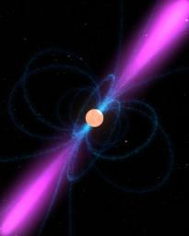
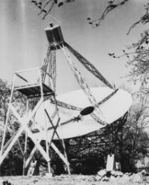
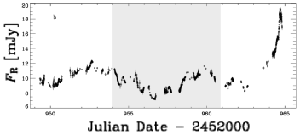
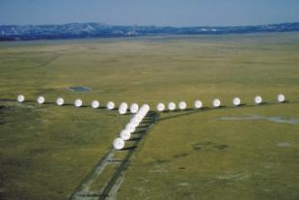
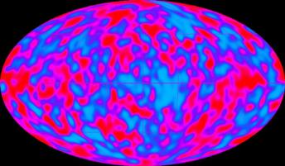
Radio Astronomy
Listening to the Sky
Jeremy P. Carlo
N2ZLQ
Renfrew County Amateur Radio Club
January 17, 2011

Slide 2
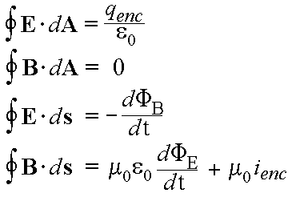
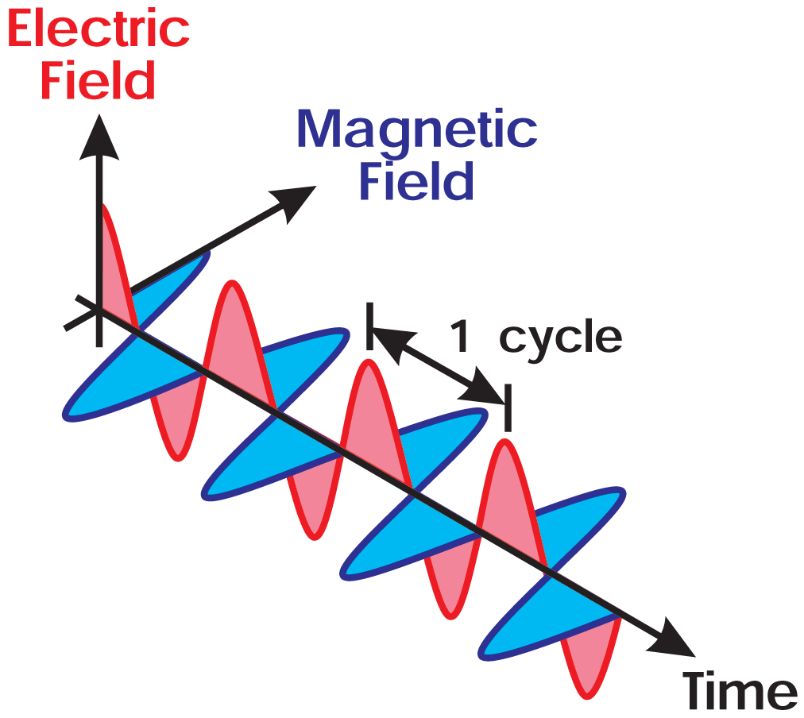
The electromagnetic spectrum
Theory: Maxwell (1860s):
  Light as special case of EM

Slide 3
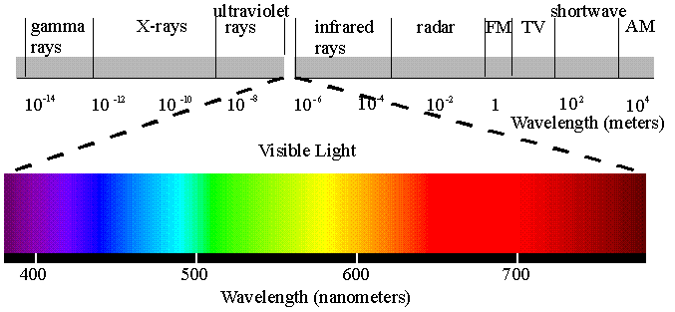
The electromagnetic spectrum
EM radiation
characterized by
wavelength λ
frequency f
energy E
& constant speed c
Ranges:
Radio
Microwave
Infrared
Visible
Ultraviolet
X-rays
Gamma rays

Slide 4

The electromagnetic spectrum
Infrared: late 1700’s/early 1800’s
X-rays: Roentgen – cathode rays
Gamma: Curies et al. – radioactivity
Radio: experiments start with Hertz (1880s)
  Transmission/reception of radio waves
  Then Marconi, Tesla, etc.
What about using radio waves for astronomy?

Slide 5
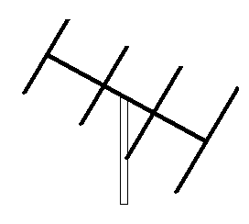
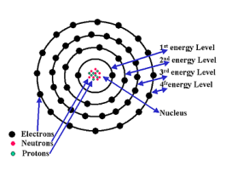
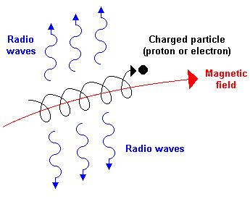
Production of Radio Waves
  (terrestrial) currents in wires
    Crossed E, B, fields…
  Atomic resonances
    Low-energy electronic transitions
    Rotational/vibrational modes
    Magnetic (e.g. hyperfine) interactions
  Synchrotron radiation
    Acceleration of charged particles
      Strong B fields, high energies!
  Or, other types of EM radiation
  that have been Doppler shifted…

Slide 6
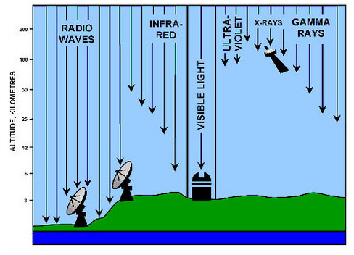
EM Radiation in Astronomy
Only some EM radiation gets
through the earth’s atmosphere.
“Window” for visible light
(some IR also)
Another window in radio!
Pretty much everything else requires satellites
(a little can be done with high-altitude balloons)

Slide 7

EM Radiation in Astronomy
Up until ~1900 only visible light
astronomy was done!
But there’s so much more to “see!”

Slide 8
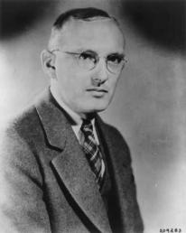
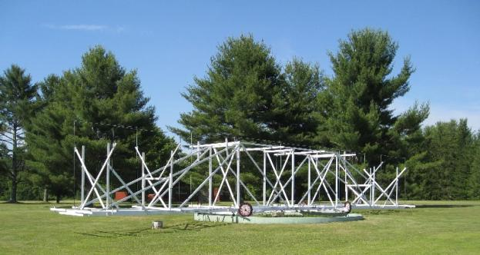
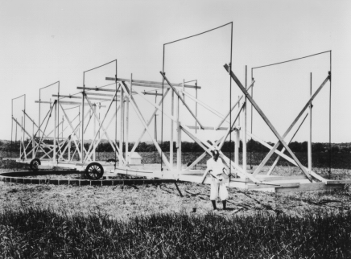
The Birth of Radio Astronomy
First astronomical radio observation
  Karl Jansky, 1932-1933 (Bell Labs)
  Investigate sources of radio noise
  Steerable phased array at 20.5 MHz
  Lots due to thunderstorms
  Found signal that repeats
  every day
  (not exactly… 23h 56m)
  Now identified with
  galactic center
  (supermassive black hole!)
Karl Jansky, 1905-1950

Slide 9

The Birth of Radio Astronomy
Bell Labs was satisfied with Jansky’s identification of QRN sources… no more studies needed!
And…

Slide 10
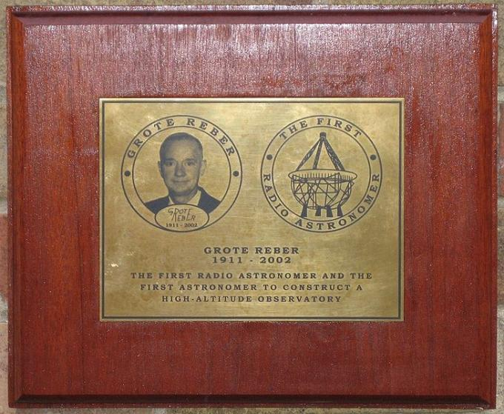
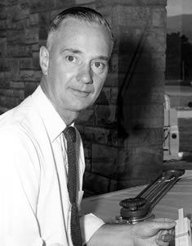

The (Re)birth of radio astronomy
Grote Reber, W9GFZ
Built a 9m parabolic dish
in his backyard in 1937
Conducted first
all-sky radio
survey, 1941
After his work
came a post-
war boom!
Grote Reber (1911-2002)

Slide 11
Later advances
Increased wavelength range
  & integration with studies at other wavelengths: visible, IR, x-ray, gamma
Larger dishes = more sensitivity
Interferometry = better angular resolution
Dual nature of radio waves: they probe both sedate, slow processes, and some of the most energetic phenomena in the universe!

Slide 12
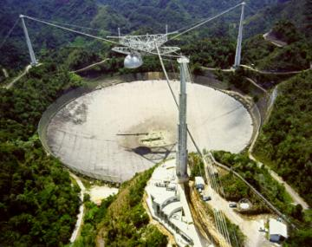
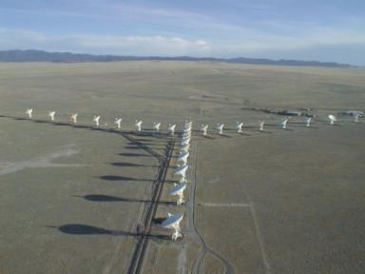
Radio Astronomy Today
Many observatories spanning the globe
Large-area dishes for high sensitivity
Extremely high resolution via interferometry
Coordination between observatories for continuous observations
Coordination of observatories at different wavelengths!
Tracing of solar activity crucial to “space weather” forecasting for the health of satellites & electronic equipment!
Arecibo,
Puerto
Rico
Very Large Array (VLA), New Mexico

Slide 13
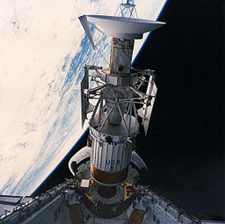
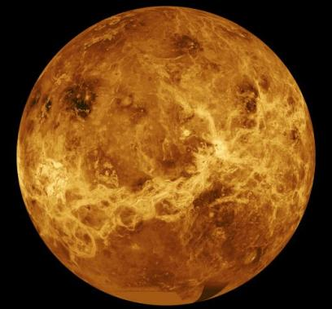
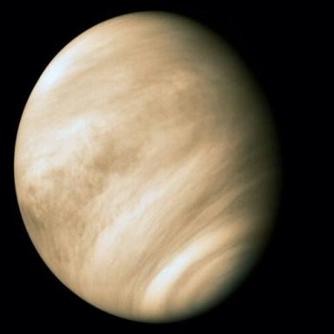
Mapping Planets with RADAR
Venus: surface obscured by permanent clouds
Radar map by Magellan satellite
Visible light image

Slide 14
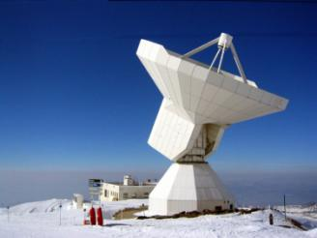
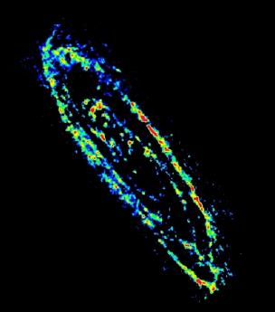
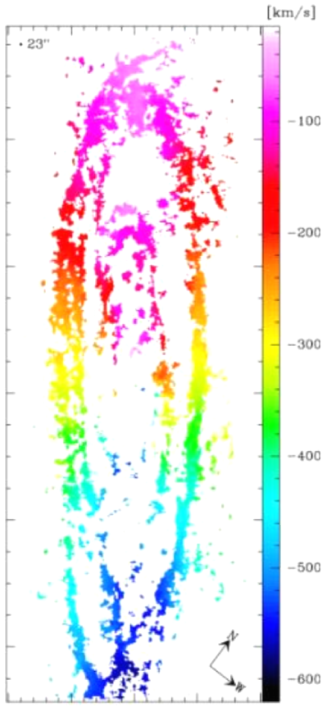
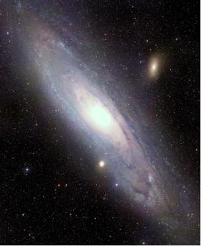
Mapping Cold Gas in Galaxies
M31 visible light image M31 in radio at CO resonance
115 GHz
Trace out star formation in galaxy
Trace out dynamics of gas clouds
Doppler map

Slide 15
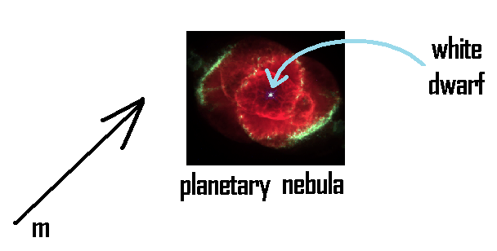

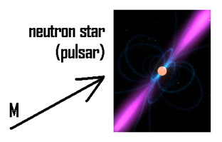
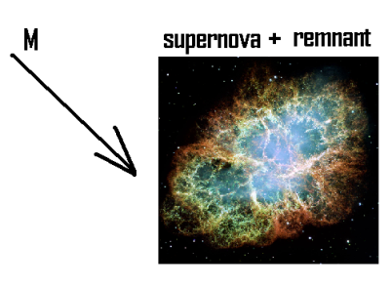
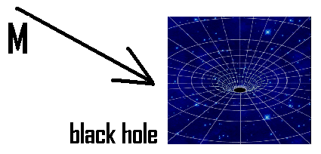
Mapping the Stellar Lifecycle

Slide 16
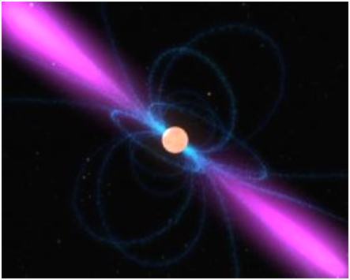
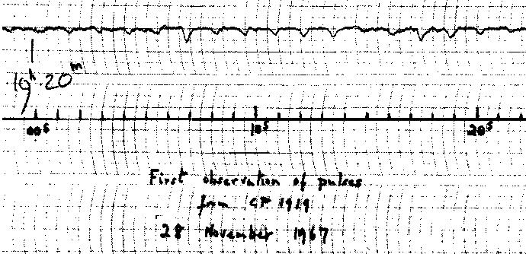
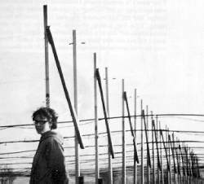
Pulsars: Timekeepers of the Universe
Neutron star:
theoretical idea from
Zwicky (1930’s)
Observation:
Jocelyn Bell Burnell & Antony Hewish, 1967
Nobel Prize (Hewish), 1974

Slide 17
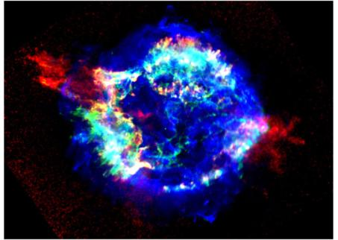
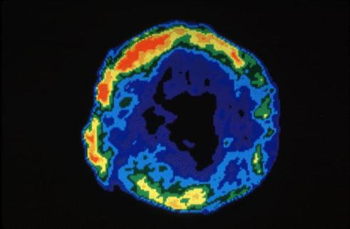
Supernova Remnants
Casseiopeia A Supernova Remnant Tycho’s Supernova Remnant
Radio emission from shock front: expanding material striking interstellar medium
Radio is the best tool for detecting new SNRs!

Slide 18
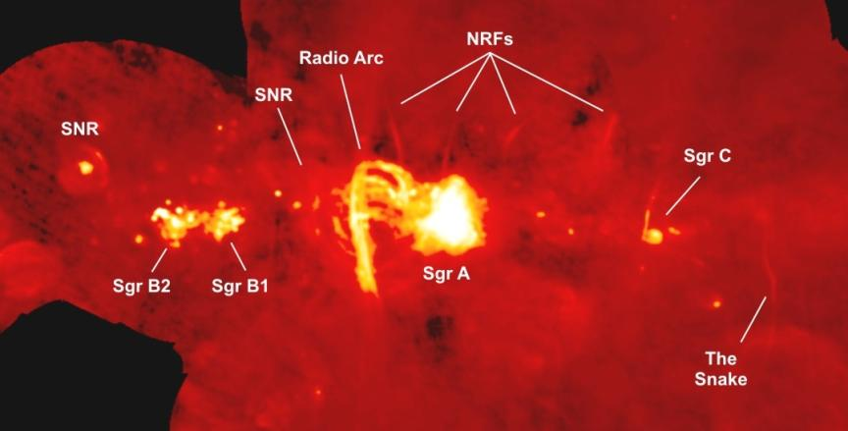
The Galactic Center
At visible wavelengths this region is obscured by dust!
Sgr A = galactic center (supermassive black hole)

Slide 19
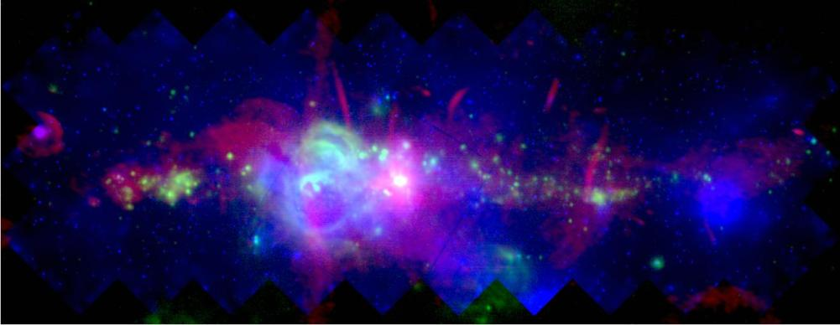
The Galactic Center
Multiwavelength overlay
red = radio, green = infrared, blue = x-rays

Slide 20
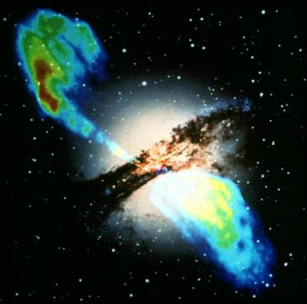
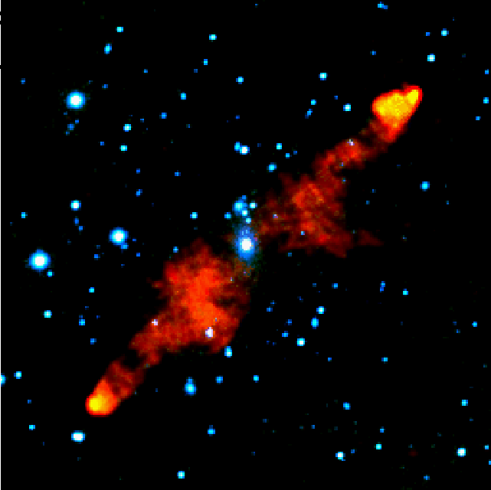
Radio Galaxies: Supermassive Black Holes
Centaurus A (NGC 5128), overlay of
radio and visible images
PKS 2536-61. Radio (red), optical (blue).

Slide 21
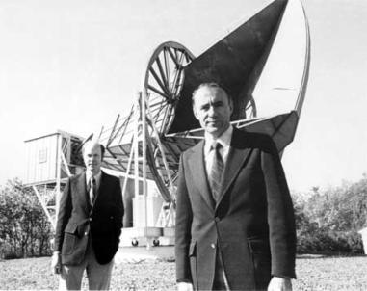
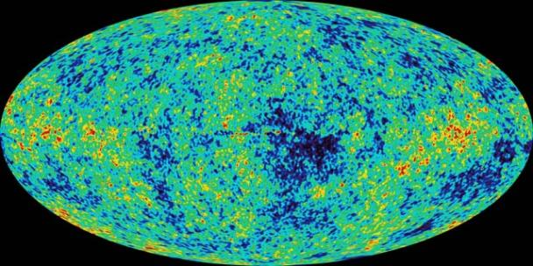
The CMB: Echo of the Big Bang
Key prediction of Big Bang Theory
Peak ~ 200 GHz
Penzias & Wilson, 1964
1976 Nobel Prize
COBE (1989)
2006 Nobel Prize, Smoot & Mather
WMAP (2001), Planck (2009)
The size scale and intensity
of these fluctuations place
stringent limits on cosmological models.
T_{universe} = 13.7 Gy

Slide 22
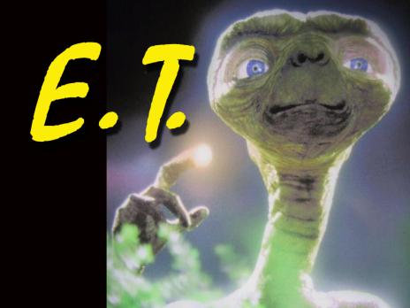
SETI: The Search for Intelligent Life
Proposed ~ 1960: use radio/microwave frequencies to listen for signals from extraterrestrial civilizations, or send signals for them to receive!
Jury’s still out…
?

Slide 23
Summary
Radio provides a valuable and unique source of information about the universe:
  Radar mapping of moon & planets
  Following solar activity
  Tracing cold gas clouds & star forming regions
  Seeing “through” dust & gas to distant objects
  High angular resolution through interferometry
  Detecting expired stars & stellar remnants
  Precision cosmology via the CMBR
  SETI

