Slide 1
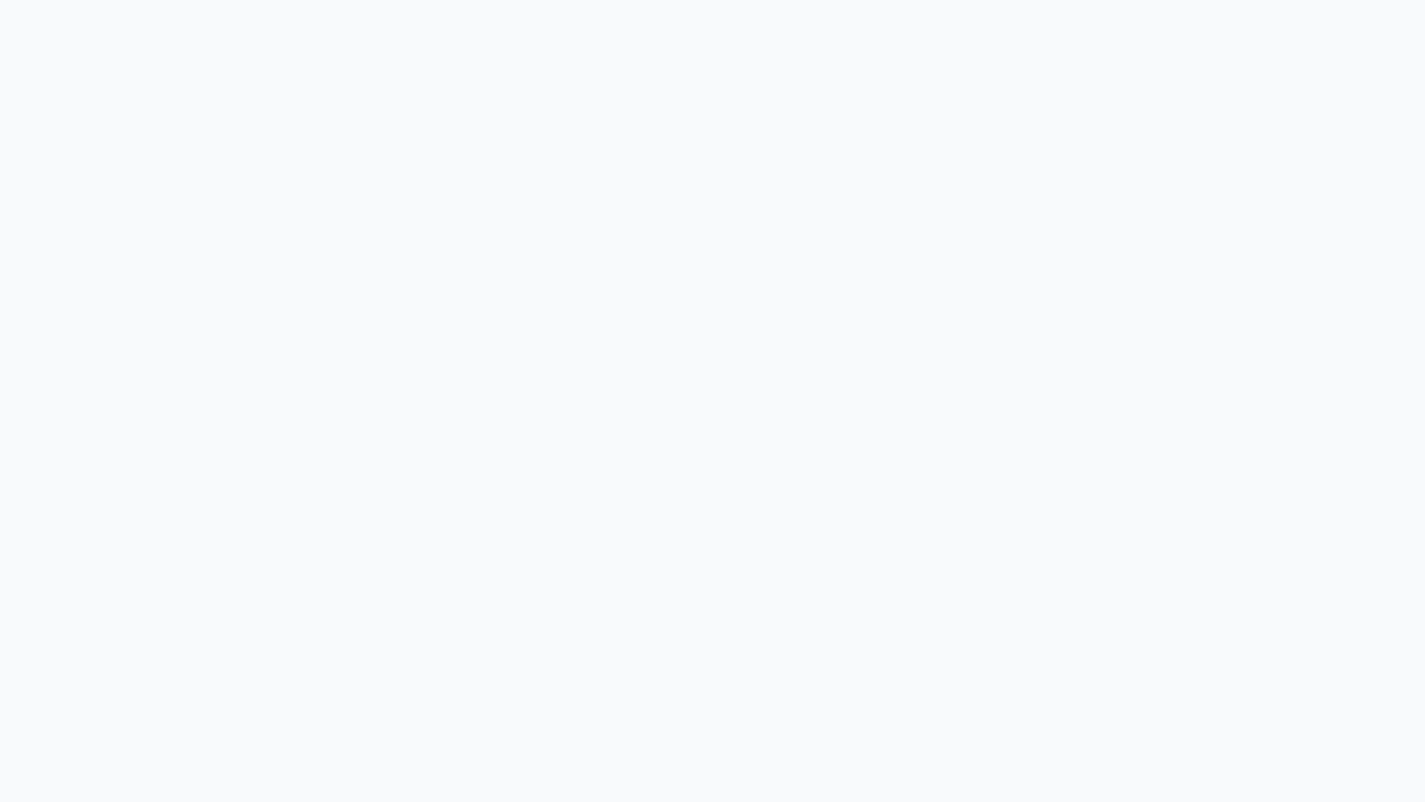

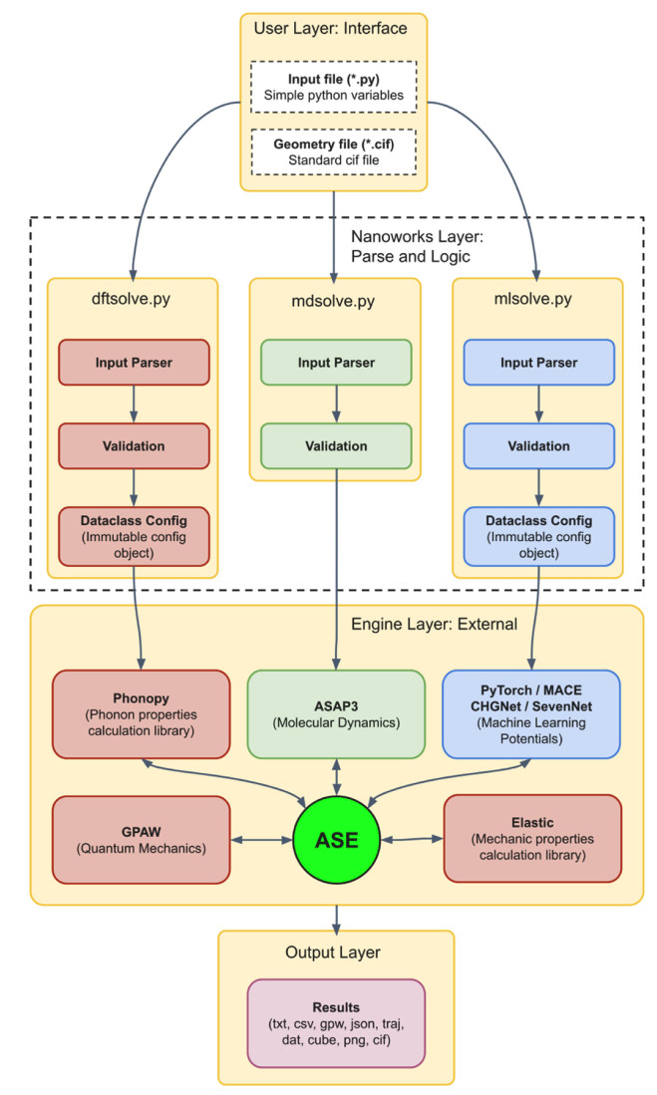
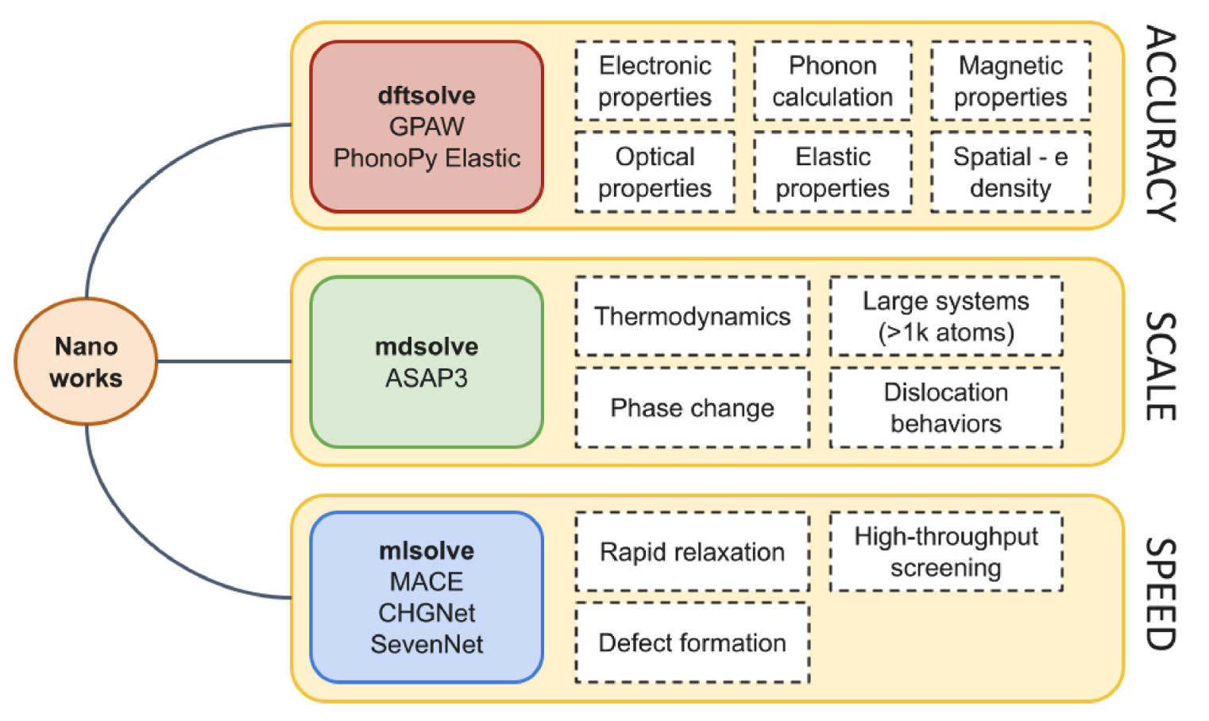
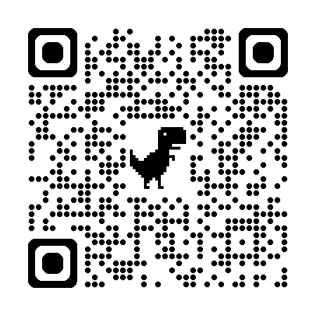
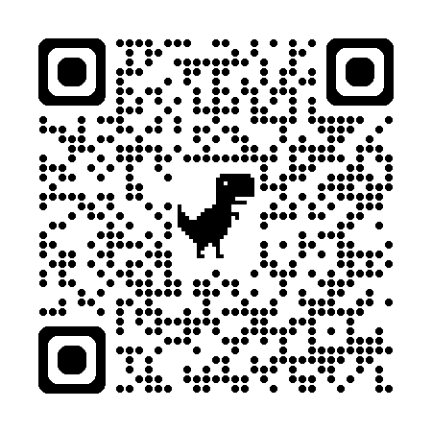
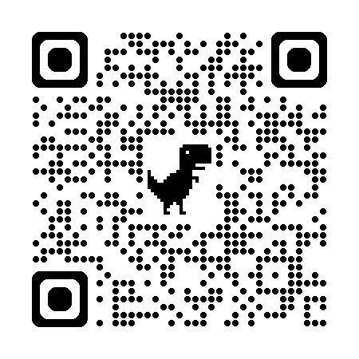
Nanoworks
Open source multi-scale python-based orchestrator for materials science simulations
Nanoworks
Nanoworks aims to be not just a DFT interface, but an integrated
simulation orchestrator that combines quantum-mechanical (DFT), classical molecular dynamics (MD), and machine-learned interatomic potential (MLIP)-based calculations under one roof. The software architecture of the Nanoworks package, transformed into a secure, modular structure, performs calculations of electronic
structure, optical properties, elastic properties, phonon dispersion, dynamics of large-scale multi-atomic systems, and MLIP through the dftsolve, mdsolve, and mlsolve main modules, using standardized, simplified input files.
Fig. 1. The modular command structure of Nanoworks software and the purposes for which these commands can be used (from article).
Key Features of dftsolve command in Nanoworks
Advanced Electronic Structure Analysis: Band structure, DOS, PDOS, Raw PDOS, and 'Fat Band' plotting capabilities with full support for spin-polarized (Sz) states and orbital projections with GPAW and ASE integration.
Fig. 2. Nanoworks architecture (from article).
+
Read the Article
doi.org/10.1016/j.cocom.2026.e01362
B. Sarikavak-Lisesivdin, S. B. Lisesivdin “Nanoworks: A multi-scale python-based orchestrator for materials science simulations” Comput. Condens. Matt. 48, e01362 (2026).
+
Optical Properties Calculation: Using RPA and BSE, automatic calculation of dielectric functions (real and imaginary), refractive index, and absorption coefficients with PNG/CSV outputs.
+
Elastic, Thermodynamics & Phonons: Elastic calculations with Elastic package integration. Phonon dispersion, free energy, heat capacity (Cv), and entropy analysis with Phonopy package integration.
Documentation
nanoworks.readthedocs.io/en/latest/
Installation, usage, examples, input file keywords, release notes and more…
+
Precise Corrections: Precise optimizations with Spin-Orbit Coupling (SOC), with van der Waals (vdW) corrections and hybrid functionals.
Install with
pip install nanoworks
More detailed installation of system-wide libraries can be found at Installation page of the documentation website.
GitHub Repository
github.com/sblisesivdin/nanoworks
Submit your bug reports, pull requests, feature requests. Discuss anything about the project! We are looking for active users and developers!
Spread the word! If you like Nanoworks and want to share it with your colleagues or students, you can get our promotional poster from Nanoworks website, print it out and pin it to your department or laboratory boards!

