Slide 1
Chlorophyll distributions in relation to physical processes off Long Bay, South Carolina, USA, in the winter of 2012 Stephen Lockhart¹, Harvey Seim¹, Jim Nelson², Catherine Edwards² ¹Department of Marine Sciences, University of North Carolina at Chapel Hill, 3202 Venable Hall, Chapel Hill, NC 27599 ²University of Georgia, Skidaway Institute of Oceanography Savannah, Georgia, USA
Notes:
My talk is on “Chlorophyll distributions in relation to physical processes off Long Bay, South Carolina, USA, in the winter of 2012”. This project is a collaboration between UNC-CH and SkIO.

Slide 2
Outline
Intro to Project
Background on Long Bay
Observations
Where and when did we see blooms on the shelf/slope
Time Series of Chl (at 3 depths from a chain on the shelf)
Some Transects of Chl (from 2 gliders)
Discussion
Sources of nutrients on the shelf
Notes:
After giving a brief intro to the project, I’ll give some background on the region. Then, I would like to share with you some of our observations—basically where and when we saw chlorophyll on the shelf/slope off LB in the winter of 2012. Based upon these observations, we then make some educated guesses about the sources of nutrients on the shelf.

Slide 3
Related Talks at Ocean Sciences
Jim Nelson
Earlier today
PO21B-05: Export of a Winter Shelf Phytoplankton Bloom at the Shelf Margin of Long Bay (South Atlantic Bight, USA)
Harvey Seim
Friday 9am
PO51B-05: Upper slope jets inshore of the Charleston Bump – barriers to shelf-slope exchange?
Notes:
…But, first, I’d like to point out some related talks—same LB project--here at Ocean Sciences. Hopefully, you saw Jim Nelson’s talk this morning. Also, my advisor, Harvey Seim, has a talk on the LB project Friday morning.

Slide 4
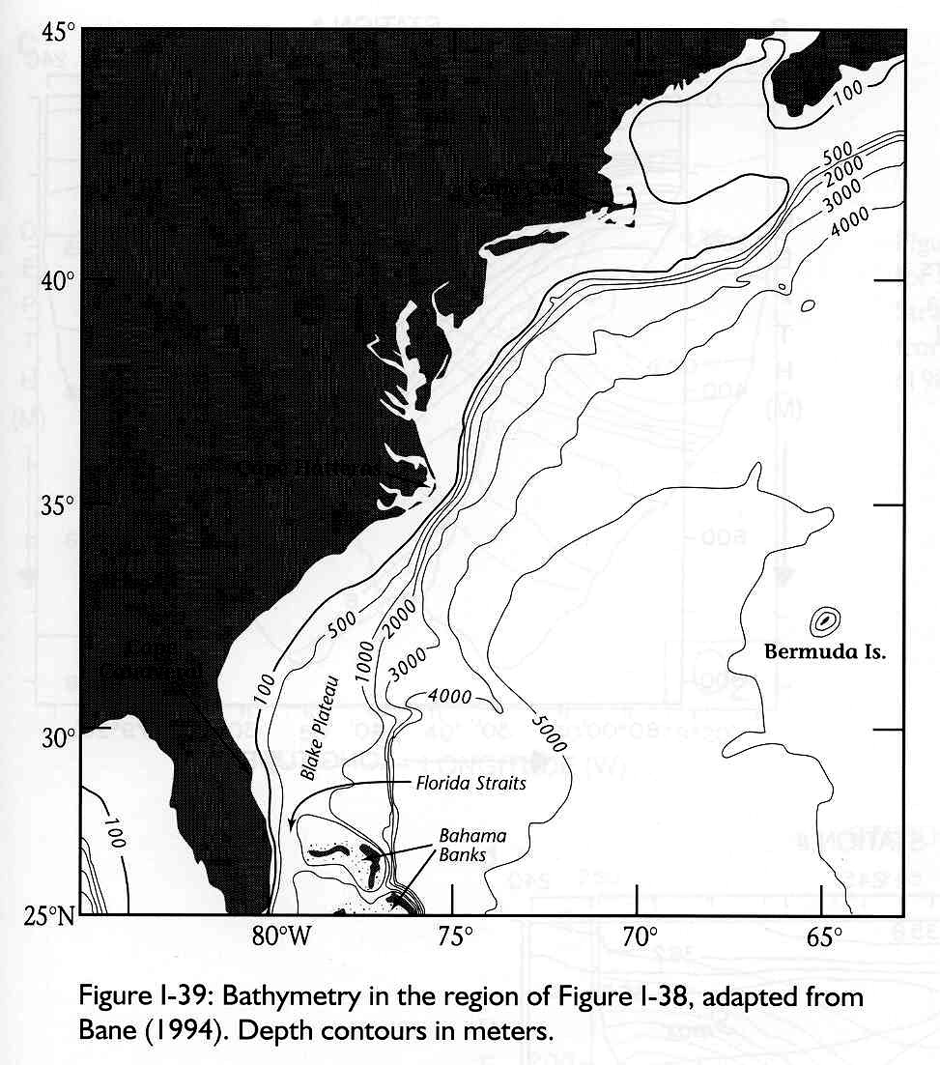
Introduction Overview of Long Bay Field Program
Notes:
So, this slide just orients us. The blue patch is where we had our instruments from late January to early April of 2012.

Slide 5
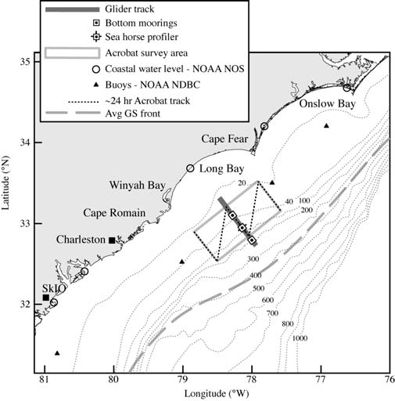
Introduction Overview of Long Bay Field Program
Towed body (Acrobat)
2 gliders (Pelagia, Ramses)
3 moorings on mid-transect
Notes:
Zooming in, here’s Long Bay, off of South Carolina. The R/V Savannah and its towed body Acrobat sampled along 3 transect lines (north, middle, and south), and 2 gliders sampled along the mid-transect. We also had 3 moorings on the middle transect—moorings LB1, LB2, and LB3.

Slide 6
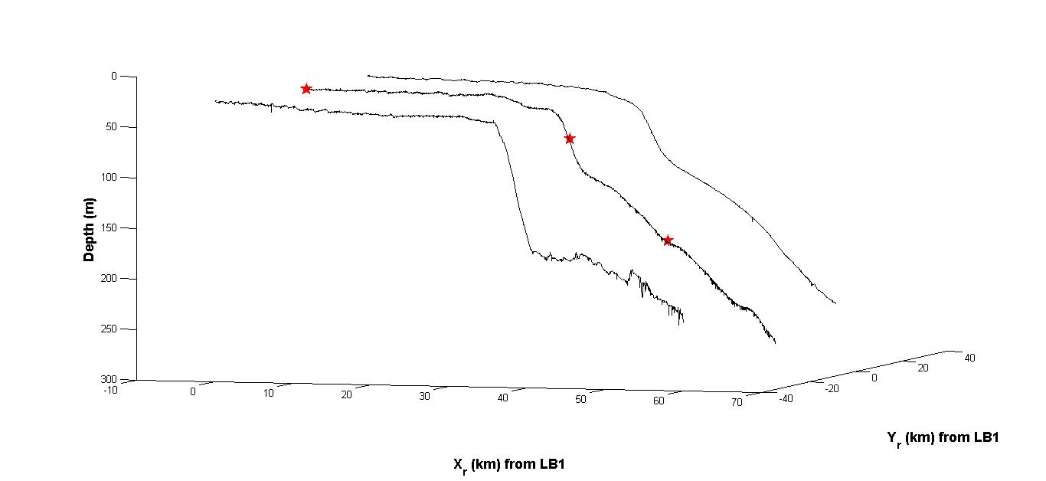
Introduction Overview of Long Bay Field Program
LB1
LB2
LB3
Notes:
Here we see the topography for each transect line, where the moorings are indicated with red stars. LB1 is at 30m depth on the shelf, LB2 is at 75m around the shelf break, and LB3 is around 175m, on the slope.

Slide 7
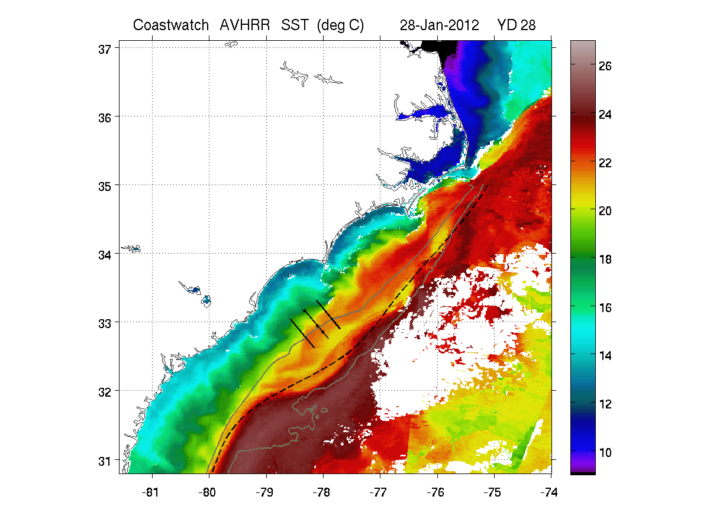
Background SST Image
Notes:
Some background on this region. This is a region where the Gulf Stream influences the shelf and slope with its meanders and filaments. For example, here’s a GS filament coming through our mooring array in late January 2012. The dashed line shows the average position of the Gulf Stream front (Miller, 1994). Also shown are the 100m and 600m isobaths. Downstream of the “Charleston bump”, the stream exhibits a bimodal behavior—where it can quickly switch from a weakly-deflected to a strongly-deflected mode. (In this figure, it appears to be weakly-deflected.)

Slide 8
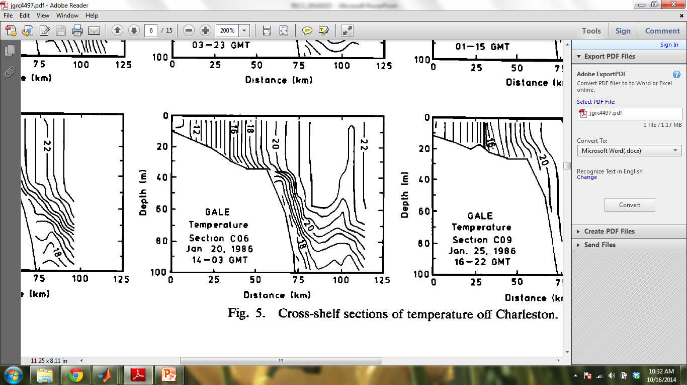
Background Horizontal Gradients on the Shelf in the SAB
(Fig 5 from Atkinson et al., 1989)
Notes:
It’s also a region where a horizontal density gradient develops especially in the winter, with the shelf water cooling more, becoming more dense than the slope water. Like a reverse estuary. This is from the GALE Study, almost 30 years ago! As in the GALE study, we too saw stratification events on the shelf during the winter months—about 1/3 of the time.

Slide 9
Observations
Observations
Where and when did we see blooms on the shelf/slope
Time Series of Chl
3 depths at LB1
Some Transects of Chl (2 gliders)
Notes:
Onto the observations. First, I’ll show you some time series of measured Chl—from 3 different depths over the shallowest mooring, LB1.

Slide 10
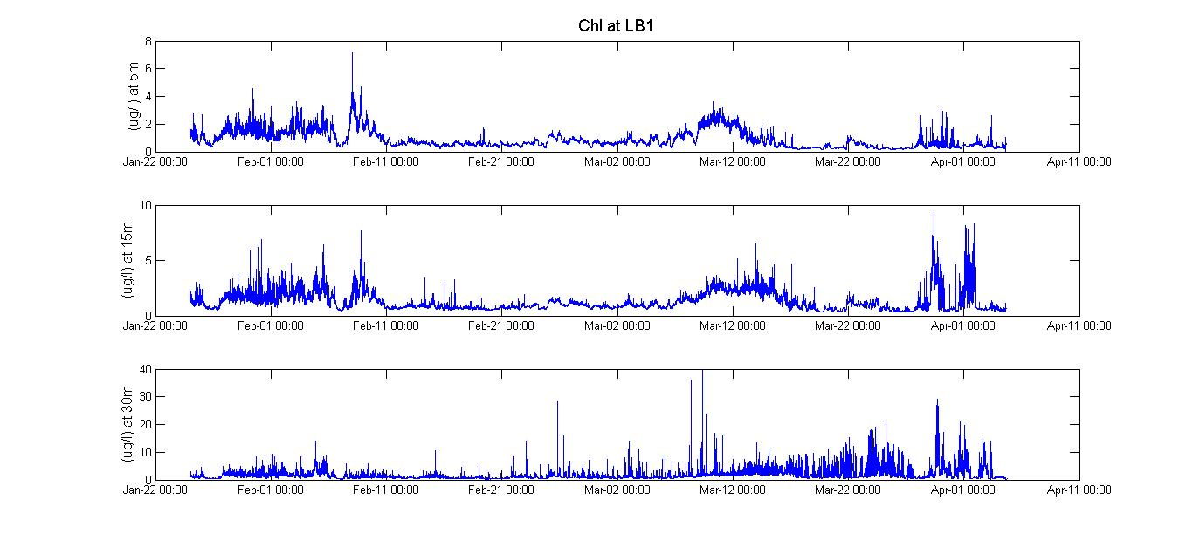
Observations Time Series of Chl: 3 Depths at LB1
Notes:
Here are time series of Chl from 3 different depths at the LB1 mooring—the top panel at 5m, the middle panel at 15m, and the bottom panel at the bottom, around 30m. Note that the scales on the y-axes are not the same. (I’ll fix that in a minute.) But, you see three periods of time where we see relatively high Chl near the surface and mid-depth on the shelf. At the bottom, it gets very spikey.

Slide 11
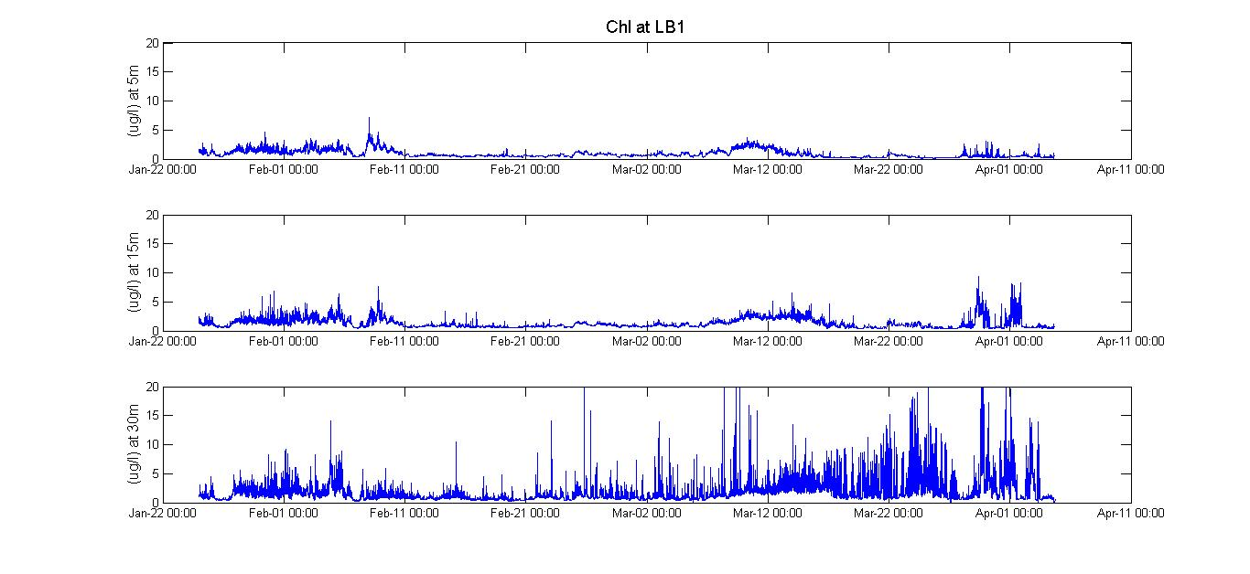
Observations Time Series of Chl: 3 Depths at LB1
Notes:
Same slide with all the y-axes (Chl) using the same scale (0-20 ug/l—even though there’s some clipping of the large spikes at 30m with this scale). This morning, Jim Nelson talked about this first event in late January/early February with cascading and export of Chl off the shelf. In my talk, I’ll focus on the 2nd half of March.

Slide 12
Observations
Observations
Where and when did we see blooms on the shelf/slope
Time Series of Chl
3 depths at LB1
Some Transects of Chl (2 gliders)
Notes:
Next, I’m going to show you Chl from a series of glider transects.

Slide 13
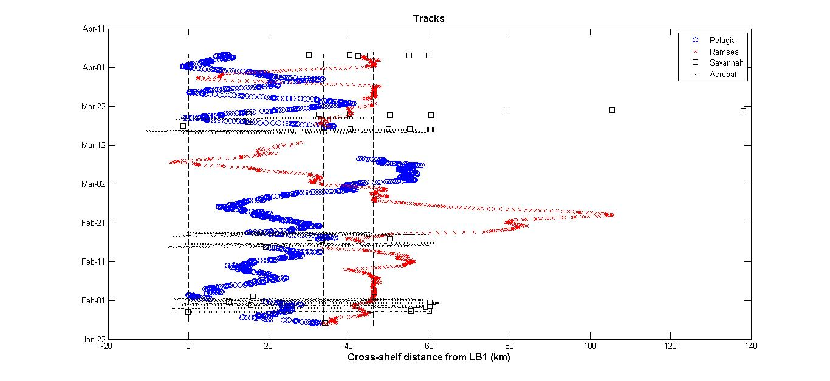
Observations Glider Transects of Chl
Notes:
Here, we see how the gliders zig-zagged across the shelf. Cross-shelf distance is on the x-axis, and time is on the y-axis. The dashed vertical lines show where the three moorings are located. In March, we had 5 transects by Pelagia (in blue) and 2 transects by Ramses (in red). That’s what I’ll be showing

Slide 14
Observations
Observations
Where and when did we see blooms on the shelf/slope
Time Series of Chl
3 depths at LB1
Some Transects of Chl (2 gliders)
5 x Pelagia March 14 – April 1
2 x Ramses March 26 –April 1
Notes:
I’ll focus on the 5 transects from Pelagia and show the two from Rames if time permits.

Slide 15
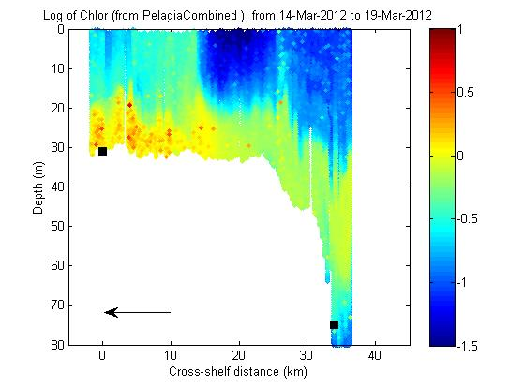
Observations Glider Transects of Chl: Pelagia
Notes:
March 14 – 19. Black squares indicate mooring locations (LB1 and LB2). The arrow indicates the direction the glider is going across the shelf.

Slide 16
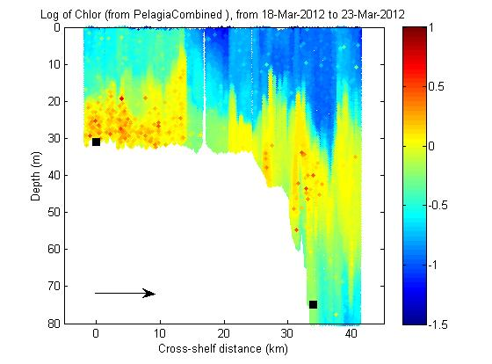
Observations Glider Transects of Chl: Pelagia
Notes:
March 18 - 23

Slide 17
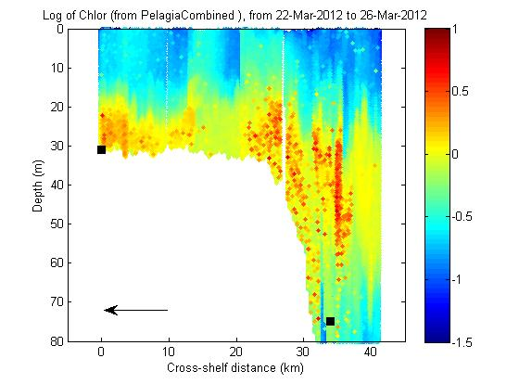
Observations Glider Transects of Chl: Pelagia
Notes:
March 22 - 26

Slide 18
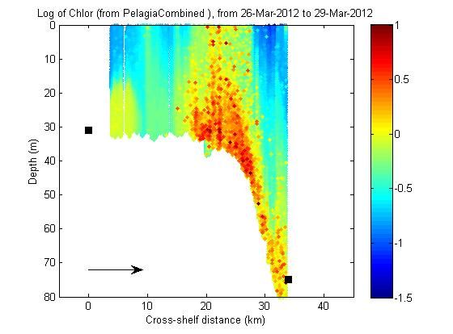
Observations Glider Transects of Chl: Pelagia
Notes:
March 26 - 29

Slide 19
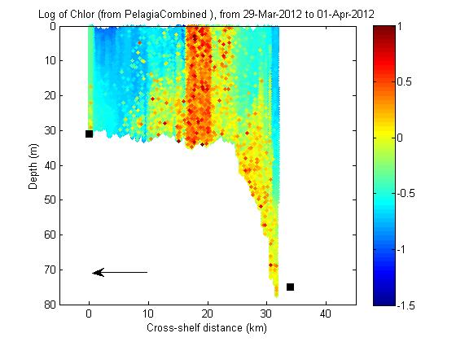
Observations Glider Transects of Chl: Pelagia
Notes:
March 29 – April 1

Slide 20
Observations Glider Transects of Chl: Pelagia
REPEAT
Notes:
REPEAT...Let’s look at those 1st 3 again. These first 3 from Pelagia show the growth of the spikes in Chl at depth…

Slide 21
Observations Glider Transects of Chl: Pelagia

Slide 22
Observations Glider Transects of Chl: Pelagia

Slide 23
Observations Time Series of Chl: 3 Depths at LB1
Notes:
Going back to the time series at 3 depths over LB1, I’ve shaded this time period, when the shelf is stratified, and the spikes grow at the bottom….

Slide 24
Observations Glider Transects of Chl: Pelagia
Glider Pelagia March 26-29, March 29-April 1
Notes:
Then, the last two in March from Pelagia are interesting in a different way.

Slide 25
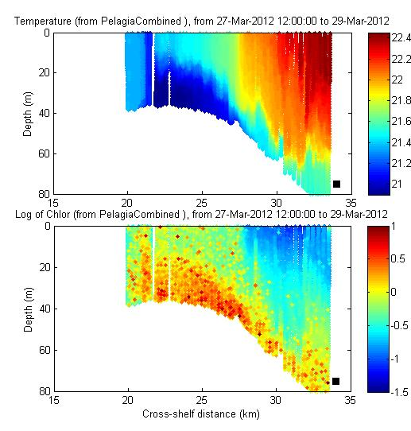
Observations Glider Transects of Chl: Pelagia
Notes:
Here I zoom in on the shelf break and upper slope, plotting also temperature from this glider. The satellite imagery is very cloudy during this time period, but the ADCP velocity data indicates this is a GS meander on the upper slope.

Slide 26
Observations
Observations
Where and when did we see blooms on the shelf/slope
Time Series of Chl
3 depths at LB1
Some Transects of Chl (2 gliders)
5 x Pelagia March 14 – April 1
Towed body transects 1 week earlier (March 18) on South transect
+Nitrate, ship-board ADCP
2 x Ramses March 26 –April 1
Notes:
So, I looked for other occurrences of this phenomenon in our data. There are several examples, but the most striking example is from the towed body, about a week earlier (March 18) on the south transect.

Slide 27
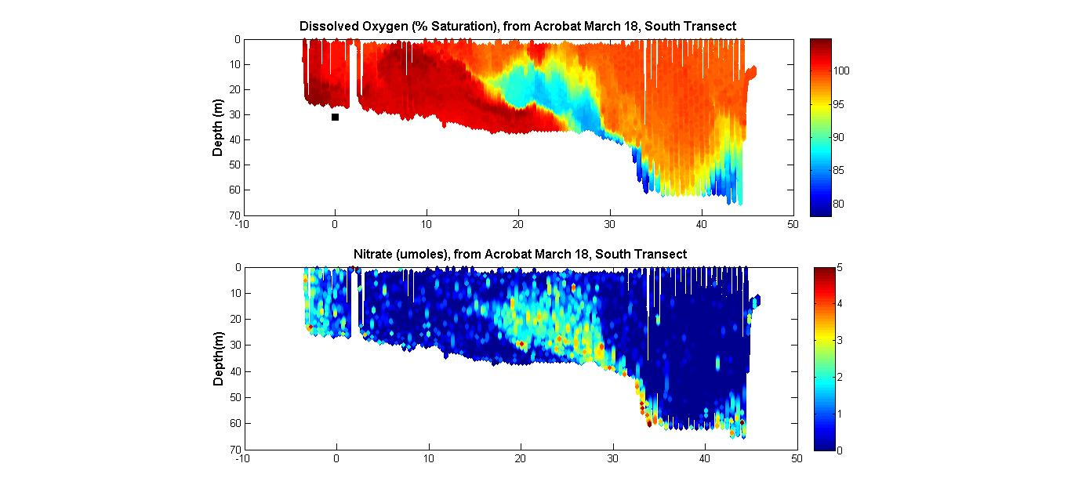
Observations Towed Body March 18 (South transect)
Towed Body Acrobat ~1 week earlier (March 18)
Notes:
Here we see DO on the top panel, and nitrate on the bottom panel.

Slide 28
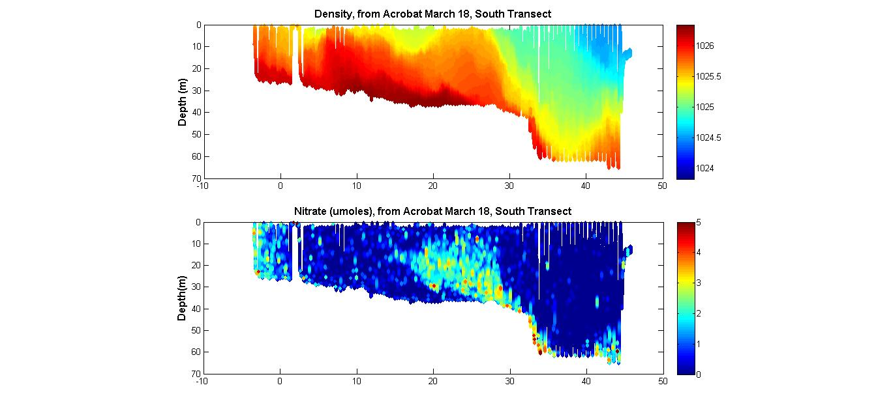
Observations Towed Body March 18 (South transect)
Towed Body Acrobat ~1 week earlier (March 18)
Notes:
Density and nitrate. (I’m keeping nitrate on the bottom and varying what’s on top…)

Slide 29
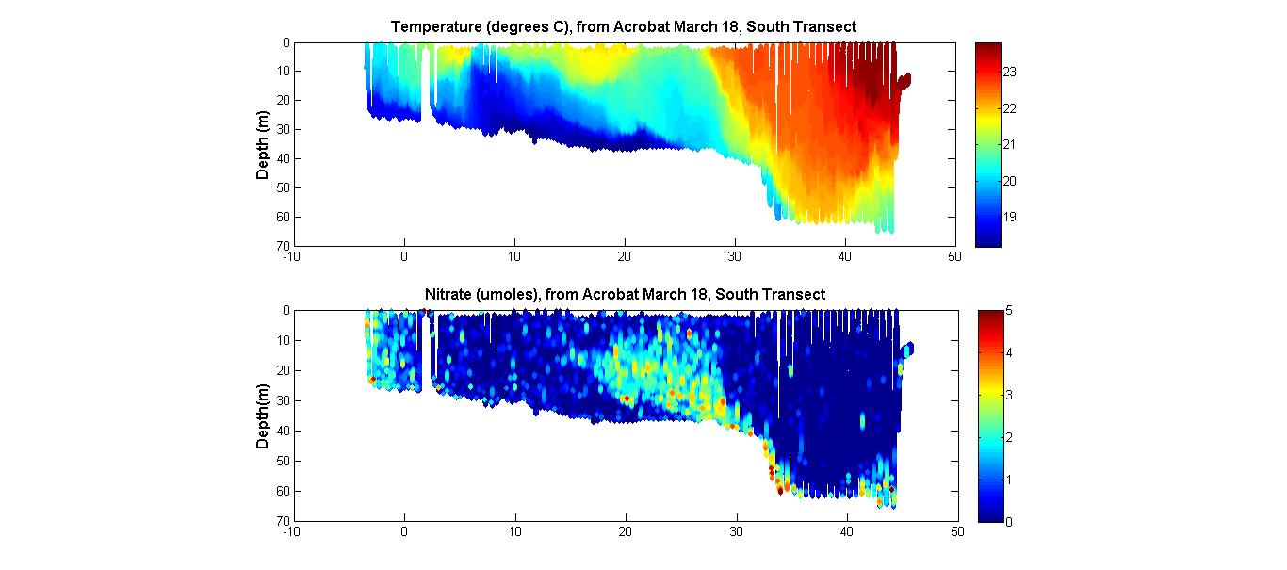
Observations Towed Body March 18 (South transect)
Towed Body Acrobat ~1 week earlier (March 18)
Notes:
Temperature and nitrate. What we’re looking at here is a GS meander crest, heading poleward, into the page…

Slide 30
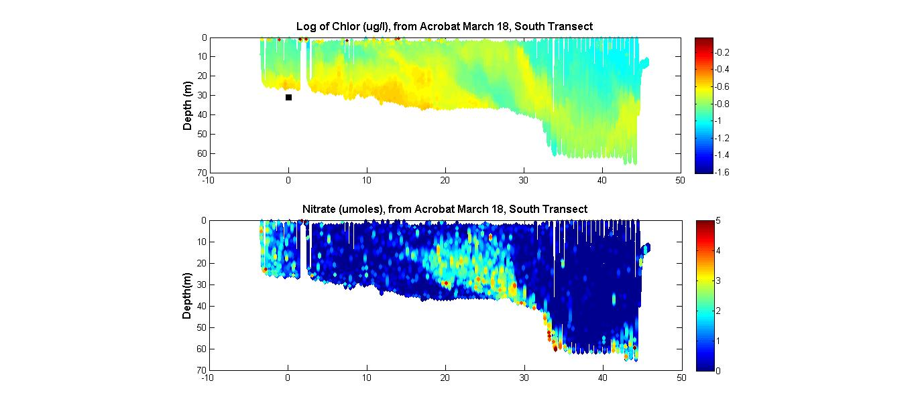
Observations Towed Body March 18 (South transect)
Towed Body Acrobat ~1 week earlier (March 18)
Notes:
Log of Chl and nitrate

Slide 31
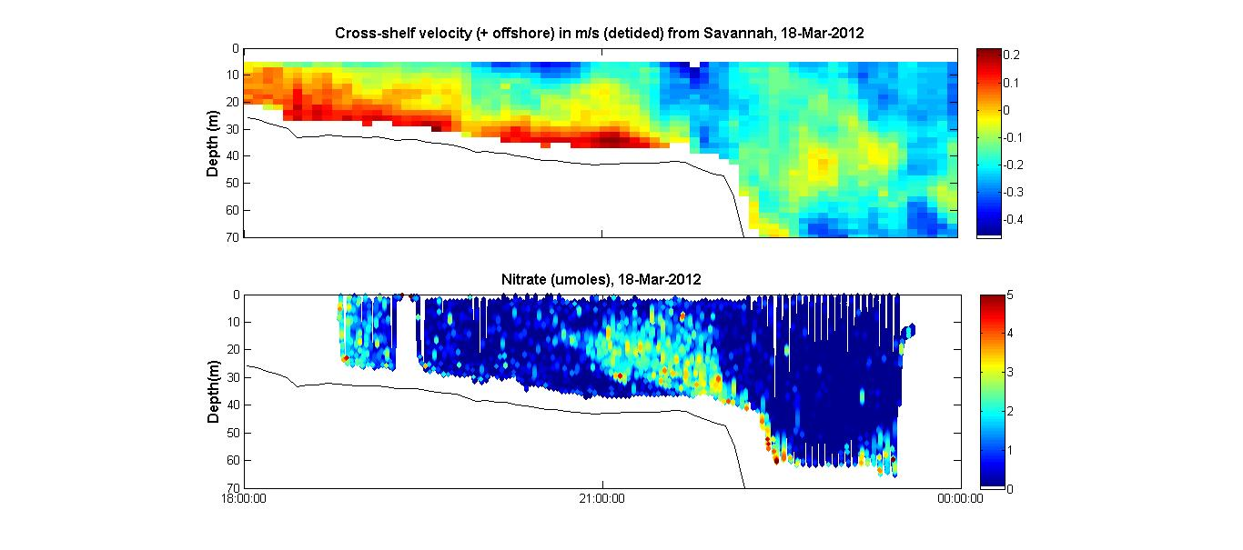
Observations Towed Body March 18 (South transect)
Towed Body Acrobat ~1 week earlier (March 18)
Notes:
Cross-shelf velocity and nitrate, where the velocity is measured by the ship-board ADCP. Clearly, the shelf water very near the bottom is heading out to sea at up to 20 cm/sec (red), but--right above that--water on the slope is heading toward the shore at up to 40 cm/sec at some places (blue).

Slide 32
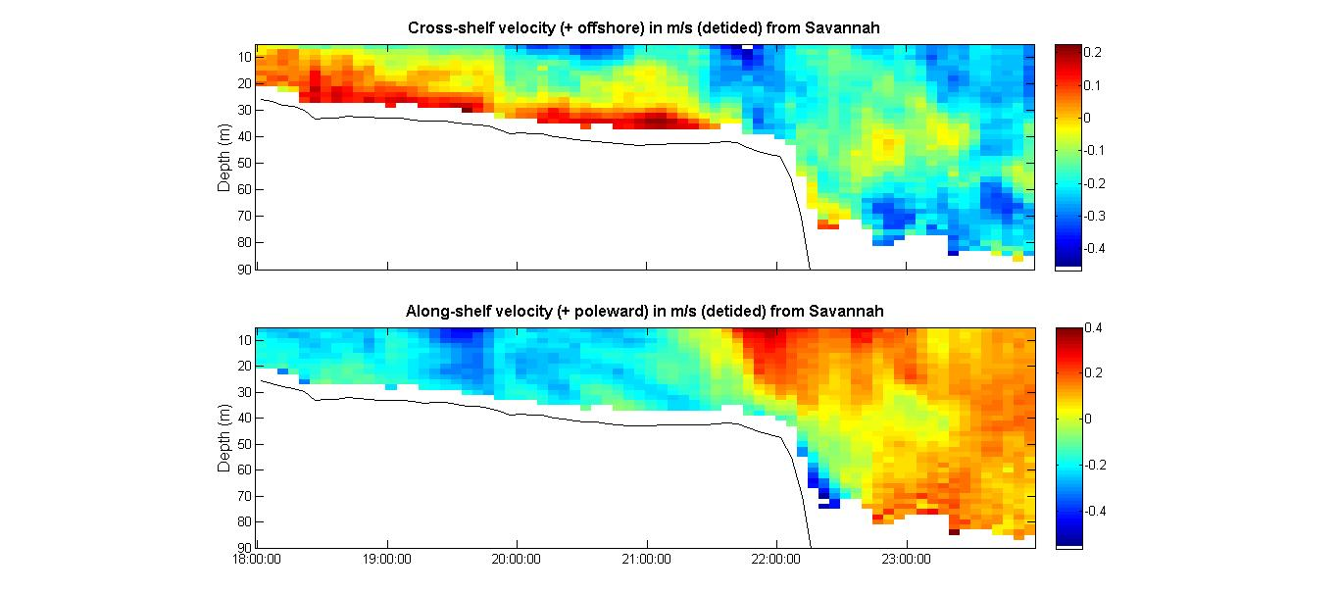
Observations Towed Body March 18 (South transect)
Towed Body Acrobat ~1 week earlier (March 18)
Notes:
Here we see why. This is shipboard ADCP—both u and v, showing the Gulf Stream meander crest interacting with the shelf/slope.

Slide 33
Discussion
Re-suspension of organic matter from sediment on the shelf?
Stratified shelf
Strong flow (20 cm/sec) near the bottom (seen by towed body)
Large spikes ( > 30 ug/l) close to the bottom (seen by gliders and mooring)
Up-slope transport of nutrients onto the shelf?
March 26-29 (middle transect) from glider Pelagia
March 18 (South transect) from towed body Acrobat
Associated with meander crests
E.g. upwelling of the “nutrient-bearing” strata at the crest
Period between meanders of the weakly-deflected Gulf Stream is ~1 week (Bane and Dewar, 1988)
Notes:
More work needs to be done here, but these observations suggest a couple possible sources of nutrients for blooms on the shelf.

Slide 34
Acknowledgments
The Long Bay project was supported by NSF grants OCE-1032285 (SkIO) and OCE-1032276 (UNC-CH).
Thanks to the crew of the R/V Savannah at Skidaway Institute of Oceanography for their support of the field work.
Thanks also to Trent Moore, Julie Amft, Charles Robertson (at Skidaway Institute of Oceanography), Sara Haines , Chris Calloway, and William Stark (at University of North Carolina’s Department of Marine Sciences ) for field work, data processing, and analysis.

Slide 35
References
Atkinson, L. P., E. Oka, S. Y. Wu, T. J. Berger, J. O. Blanton, and T. N. Lee (1989), Hydrographic variability of southeastern United States shelf and slope waters during the Genesis of Atlantic Lows Experiment: Winter 1986, J. Geophys. Res., 94(C8), 10699–10713, doi:10.1029/JC094iC08p10699.
Bane Jr., J. M., and W. K. Dewar, 1988. Gulf Stream bimodality and variability downstream of the Charleston bump. J. Geophys. Res., 93(C6), 6695–6710, doi:10.1029/JC093iC06p06695.
Hitchcock, G.L., A.J. Mariano, T. Rossby (1993), Mesoscale Pigment Fields in the Gulf Stream Observations in a Meander Crest and Trough, J. Geophys. Res., 98(C5), 8425-8445. doi:10.1029/92JC02911.
Miller, J. L., 1994. Fluctuations of Gulf Stream frontal position between Cape Hatteras and the Straits of Florida, J. Geophys. Res., 99: 5057-5064.
Ryan, J.P. and J.A. Yoder, 1996. Long-term mean and event-related pigment distributions during the unstratified period in South Atlantic Bight outer margin and middle shelf waters. Cont. Shelf Res. 16:1165-1183.
Simpson, J. H. and J. Sharples. (2012). Introduction to the Physical and Biological Oceanography of Shelf Seas, Cambridge University Press.

