Slide 1

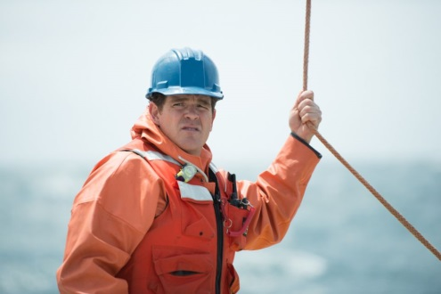
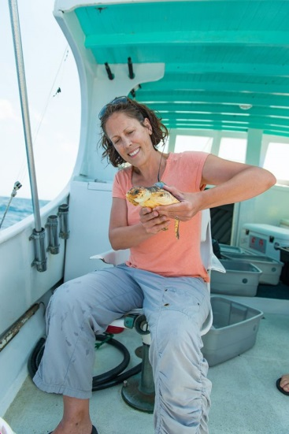
4aAB3
Detection of dolphin burst-pulses off Cape Hatteras, North Carolina, correlated to oceanographic features
University of North Carolina Coastal Studies Institute
Steve Lockhart
Mike Muglia
Lindsay Dubbs
sblockhart.zzero@gmail.com
Notes:
Good morning! I’m Steve Lockhart. Today, I’d like to share with you some work I’ve done with the University of North Carolina Coastal Studies Institute. First, here are my colleagues. Dr. Lindsay Dubbs is leading this project, funded by the North Carolina Renewable Ocean Energy Program. They want to know how feasible it is to extract energy from the Gulf Stream using turbines. Lindsay wants to know how that might impact marine life. So, she asked me to analyze the hydrophone data. Michael Muglia is the hands-on oceanographer who deploys and retrieves the instruments.

Slide 2
Outline
Introduction
Signals of Interest (Whistles and “Quacks”)
Detection
Correlating Detections with Gulf Stream Position
Summary
Next Steps
Notes:
After some background on this area, I’ll briefly discuss how I’m detecting whistles and quacks. Then, I’d like to show you the relationship I found between these vocalizations and the physical oceanography.

Slide 3
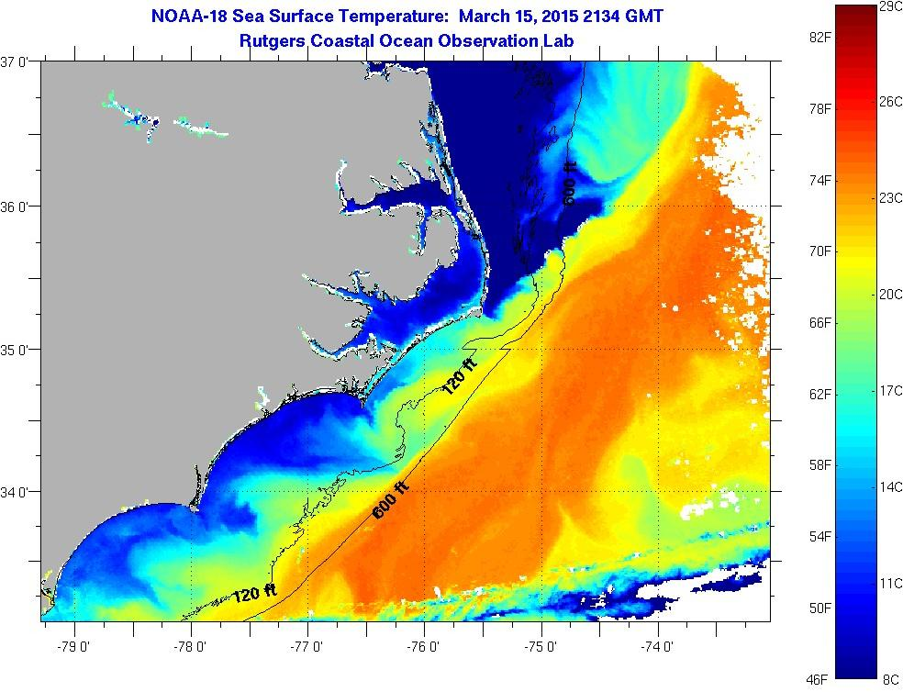
Introduction
Satellite image of sea surface temperature (SST) near Cape Hatteras on March 15, 2015, from Rutgers Coastal Ocean Observation Lab (COOL), using AVHRR. I’ve added a star to show the location of our mooring, at a depth of ~230m.
Notes:
Here’s where Mike deploys the instruments—on a mooring at a depth of 230m off Cape Hatteras, off the coast of North Carolina, USA. You see in the SST image, the Gulf Stream meanders here—offshore (that’s the trough), onshore (that’s the crest). Sometimes, there’s a filament of warm water that peels off the crest and wraps back around. That seems to be happening a little bit in this image.

Slide 4
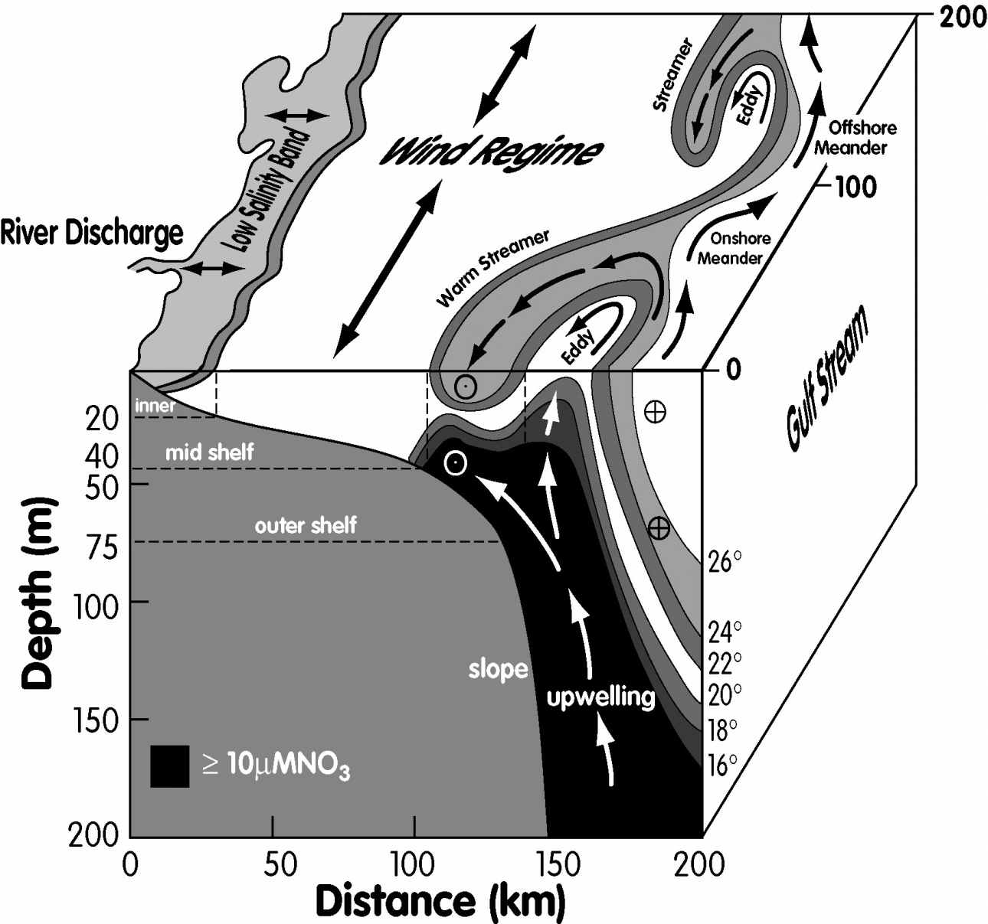
Introduction
Figure from Jahnke and Blanton, 2010
Notes:
In this more complex 3-D visual, there’s a lot of information here about the meandering GS. I want to highlight a few things. On the surface, I already mentioned that the GS meanders back and forth in this location. In the cross-section, note the temperature structure of the Gulf Stream. As the Gulf Stream meanders back and forth over our mooring, we will measure these different temperatures at the bottom, along the western wall of the GS front. I also want to point out that there could be upwelling of cooler, nutrient-rich water into the meander trough. The physical oceanography here is complicated, so we can expect the acoustic propagation to be complicated.

Slide 5
Introduction
Instruments on the mooring:
AURAL-M2 hydrophone
Sampling under water sound at max rate of 32768 samples/second
Sampling for 5 minutes out of every half-hour
CTD
Temperature (at the bottom)
Salinity (at the bottom)
Pressure (at the bottom)
Acoustic Doppler Current Profiler (ADCP)
Velocity field (above the mooring)
Acoustic backscatter field (above the mooring)
Notes:
We have 3 instruments on the mooring—the Aural M2 hydrophone sampled at 32k samples/sec. It’s on for 5-minutes out of every half-hour. We also have a CTD (which gives us T and S at the bottom), and an ADCP, which gives us a vertical profile of the water velocity above the mooring. So far, we’ve had two deployments of the mooring, giving us a total of 15 months of data.

Slide 6
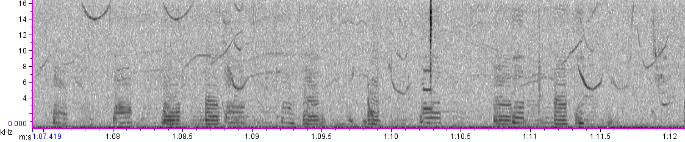

Signals of Interest
Example of “quacks” (spectrogram + sound)
Notes:
Here are the signals I’m looking for. In this spectrogram (f in kHz up to 16k on the vertical axis and t on the horizontal axis—about 9 seconds of data in this spectrogram) The quacks appear to have harmonic content. If your ears are better than mine, you can hear the whistles as well as the lower frequency quack sounds. <PLAY if time at the end>

Slide 7
Detection: Whistles
For each of the 20,000+ wav files (5-minute recording interval):
Skip recording interval if it’s too noisy.
Remove instrument noise
High-pass filter with cut-off frequency of 1 kHz.
Call Silbido to detect whistles
beta2 version at http://roch.sdsu.edu/index.php/software/
SNR threshold of 10 dB
Process the returned detection event.
Automated post-processing to remove some anthropogenic sounds.
Add up the duration of whistling (in seconds) per 5-minute recording interval. This is the vocalization metric for whistles.
Notes:
Here are the steps I follow in my matlab code to detect whistles. Basically, my matlab program loops through all of my wav files and calls Silbido, a whistle detector developed by Marie Roch’s lab at SDSU. The only post-processing I did was to automatically remove some anthropogenic signals, like 12kHz echo sounder. I then add up the total duration of whistling per 5-minute recording interval.

Slide 8
Detection: “Quacks” or “Barks”
For each of the 20,000+ wav files (5-minute recording interval):
Skip recording interval if it’s too noisy.
Remove instrument noise
Bandpass filter (100 to 6000 Hz)
Apply swipep pitch detector to overlapping time windows, specifying a detection threshold and a range of possible pitch values (300 – 1000 Hz)
implementation in matlab at https://www.cise.ufl.edu/~acamacho/publications/swipep.m
Identify which recording intervals had one or more detections
Manually remove false alarms
Notes:
To detect the “quacks”, I used a pitch detector. I selected a free matlab program called swipep. I used it before in some speech signal processing work. Unfortunately, the false alarm rate was a little too high ~10-15%. So, I put in a lot of time, manually removing the false alarms—a step that I did not perform for the whistles.

Slide 9
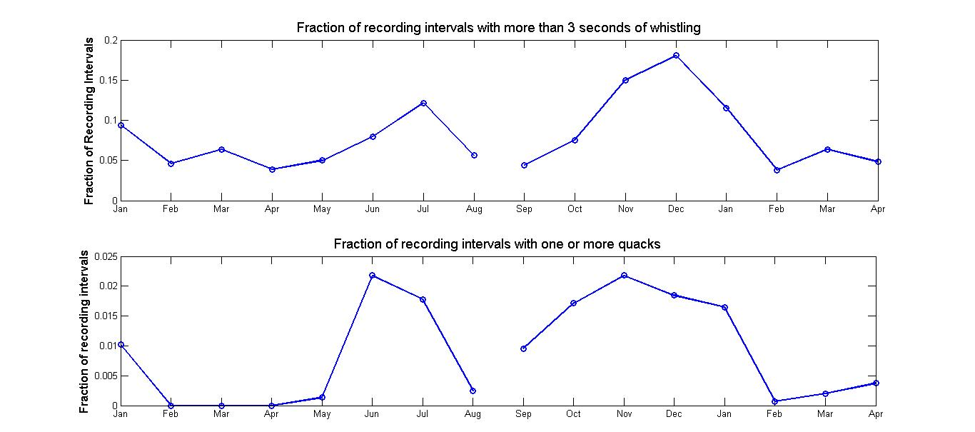
Detection: Temporal Patterns
Notes:
SKIP
Here I’m showing the temporal pattern of these two signal types over the 15 months. The top panel shows whistles. On the horizontal axis, months. On the vertical axes I have the fraction of recording intervals that have more than 3 seconds of whistling—with peaks in July and December. The second panel. The vertical axis (different scale) is the fraction of recording intervals that had one or more quack sound. So, you see the temporal pattern is similar with peaks in June and November. In fact, the recording intervals with quacks are a subset of the recording intervals with whistles.

Slide 10
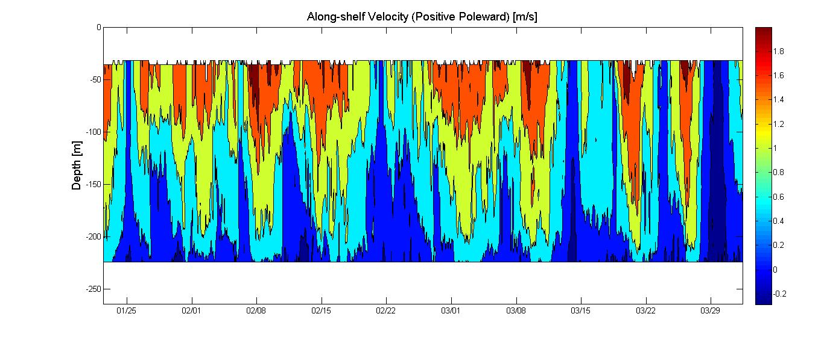
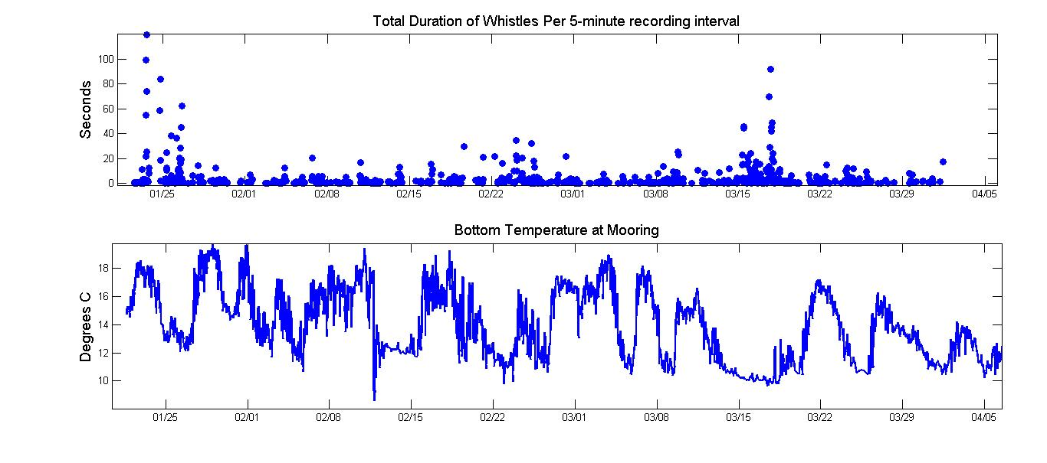
Notes:
Now let’s start comparing the detections to oceanographic variables. In these 3 plots, time is on the horizontal axes. I’m zooming in on about 2 months of data here. On top, from the ADCP, contours of the velocity above the mooring. So, vertical axis is depth, time on the horizontal, and the strength of the along-shore velocity is color-coded, with red being fast water, blue being slow water. So, here, for example, where it’s red on top, the western wall of the GS is over the mooring. Here, where it’s all blue, the GS has meandered offshore, and the mooring is in a meander trough. The second panel is the number of seconds of whistling in the 5-minute recording interval. Finally, at the bottom, is the temperature at the bottom. So, comparing these, one notices times like <HERE> when the GS is offshore, the T at the bottom is much cooler, and there are a lot of vocalizations.

Slide 11
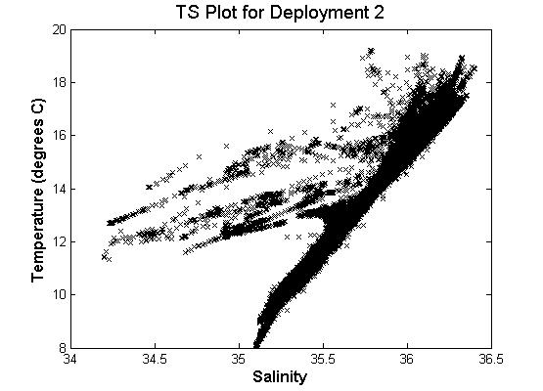
Correlating Detections with Gulf Stream Position
Notes:
But, visual inspection of 2 months of a time series is not too convincing. Here’s another way to look at it. Here is a scatter plot of the CTD data for the entire 2nd deployment. Bottom temperature on the vertical axis, bottom salinity on the horizontal axis.

Slide 12
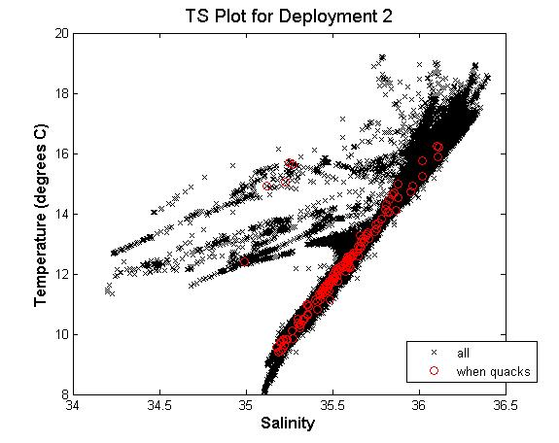
Correlating Detections with Gulf Stream Position
Notes:
Now, in red, I have plotted a subset of the temperature and salinity values—those samples that were acquired WHEN dolphin quacks were present. So, this color-coded TS plot is a useful way to visualize what seems to be a relationship between a physical variable (T,S at the bottom) and a biological variable (the occurrence of a dolphin quack). (Notice I switched from whistles to quacks there.)

Slide 13
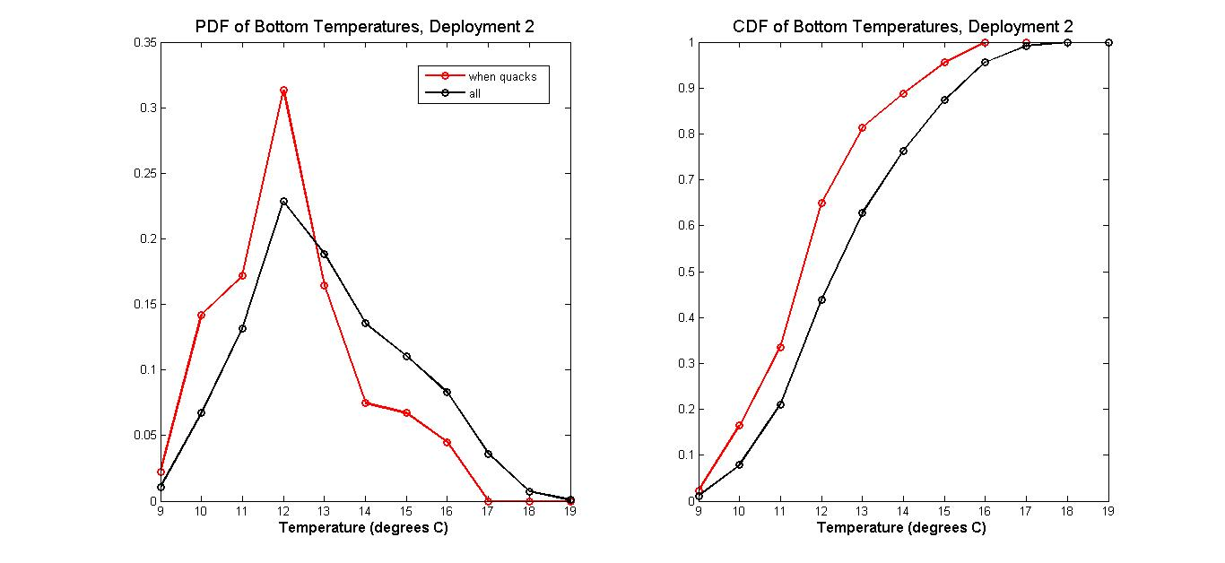
Correlating Detections with Gulf Stream Position
Notes:
To be more rigorous, let’s look at some statistics. We need to look at the distributions to see if they are statistically different. On the left, I plotted PDFs of temperature—again, creating two subsets: black for all the data, red for the data acquired when I heard the quacks. So, the black curve is the PDF of ALL the temperature values in the 2nd deployment. In red the PDF of the T values that were acquired WHEN dolphin quacks were recorded. You can see that the red curve is skewed to the colder water. Then, on the right are the corresponding CDFs. Then, there’s this Kolmogorov-Smirnoff or KS test that tells you if two different distributions are statistically different. In this case, the KS test does confirm that these distributions are statistically different with 99% confidence.

Slide 14
Correlating Detections with Gulf Stream Position
If, instead, we use a GAM…
Formula: presence ~ s(temperature) + s(salinity)
R-sq.(adj) = 0.000502
Deviance explained = 1.99%
So, this approach of using PDFs and KS test can be better in some case than GAM for revealing a relationship between the biological (presence/absence) data and the physical data (T,S).
See Woodworth P.A., Schorr G.S., Baird R.W., Webster D.L., McSweeney D.L., Hanson M.B., Andrews R.D., and J.J. Polovina. (2012). Eddies as offshore foraging grounds for melon-headed whales (Peponocephala electra). Marine Mammal Science 28: 638-647.
Notes:
Here, I’m showing that when I used a gam, I found virtually no relationship between the vocalizations and the physical variables T,S.
So, this approach of using PDFs and KS test can be better in some case than GAM for revealing a relationship between the biological data (a marine mammal detection) and the physical data (T,S).
I first saw this “probabilistic” approach it in a paper by Phoebe Woodworth of PIFSC, where she compared melon-headed whale sitings to SSH. I’d be interested to know if others are using this approach and if it fits into a larger framework for habitat modeling.
9:15

Slide 15
Outline
Introduction
Signals of Interest (Whistles and “Quacks”)
Detection
Correlating Detections with Gulf Stream Position
Is correlation “Real” (biological)…
or is it environmental:
Acoustic propagation related to Gulf Stream position?
Acoustic noise related to Gulf Stream position?
or both?
Summary
Next Steps
Notes:
OK, so we found a relationship between vocalizations and bottom temperature. Why is this? Are dolphins favoring the cooler, fresher water? Or, is there an environmental reason? Perhaps the acoustic propagation IS more favorable when the GS meanders farther offshore. Or, maybe the noise is lower in this case. Let’s look at each of these possibilities.

Slide 16
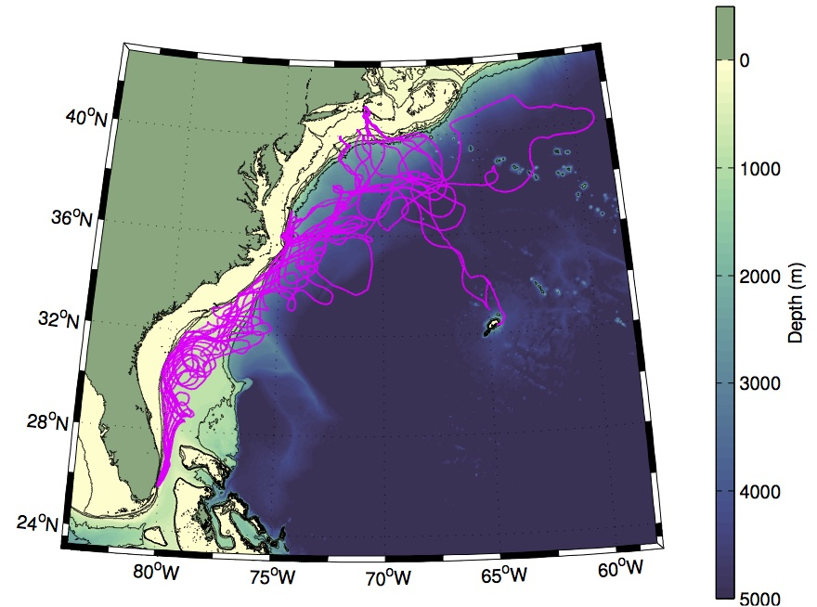
Acoustic Propagation
Would like to model the acoustic propagation under two scenarios:
Transect when Gulf Stream meander at crest
Transect when Gulf Stream meander at trough
…but, all we have is T,S at one point (230m deep, at bottom)
Get glider data.
From http://rtodd.whoi.edu/wp-content/uploads/all_GS_tracks_for_web.jpg
Notes:
Ideally, I would have the data to build propagation models for the following scenarios:
GS meander crest
GS meander trough
Then, I could see how much acoustic propagation is contributing to the relationship we’re seeing between vocalizations and bottom T. But, all I have is one mooring. So, I found some nearby glider data, collected by Dr. Robert Todd of WHOI. He puts gliders in the water in FL and retrieves them in New England. Here are some of his glider tracks.

Slide 17
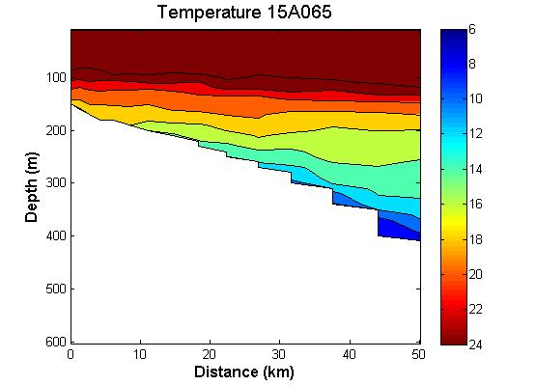
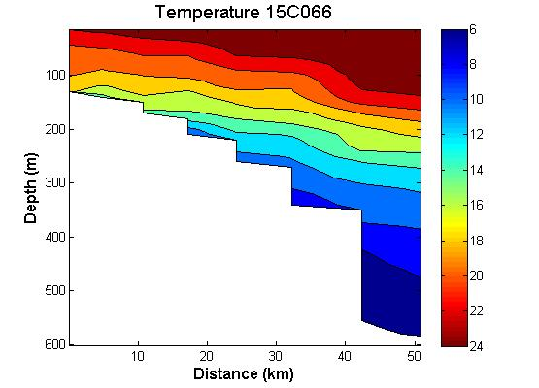
Acoustic Propagation
Isotherms flat, T>14C at bottom=230m
Isotherms tilted, T<12C at bottom=230m
Notes:
I picked two very different glider transects near my mooring to build propagation models. One has flat isotherms, the other has tilted isotherms. For each one, I placed my hydrophone at 230m.

Slide 18

Acoustic Propagation
Notes:
Then, I put the sound source at 50m depth around 20 km away.

Slide 19
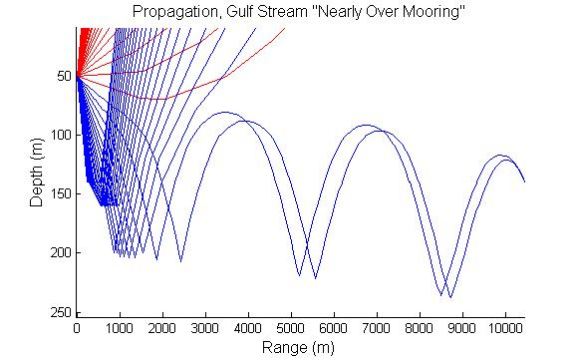
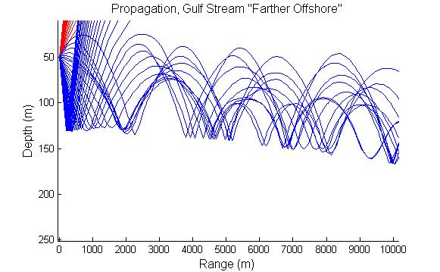
Acoustic Propagation
Isotherms flat, T>14C at bottom=230m
Isotherms tilted, T<12C at bottom=230m
Only rays within a 1.5 degree arc can propagate more than 2km down the slope for this scenario.
Rays within a 10 degree arc can propagate more than 2km down the slope for this scenario.
Notes:
Then I ran bellhop to model the acoustic propagation. On the left, the case where the isotherms were flat. On the right, the case where the isotherms were tilted. In the case where the isotherms were tilted, I found enhanced propagation. A wider arc of rays can propagate down the slope. So, there does seem to be enhanced propagation when the isotherms are tilted up. On the other hand, it is difficult to compare these transects. They are in different locations at different times of the year with different bottom topography.
I would also point out that previous studies have measured enhanced propagation through CCRs. A CCR has cyclonic circulation, which induces upwelling—like in our meander trough. The isotherms are lifted up, the sound channel along the bottom becomes taller, enhancing the propagation.

Slide 20
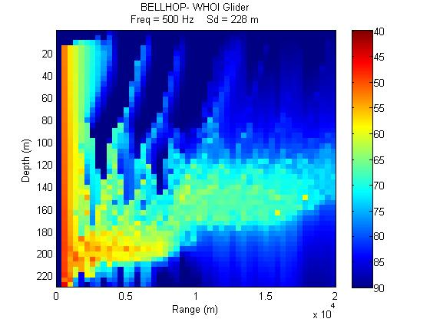
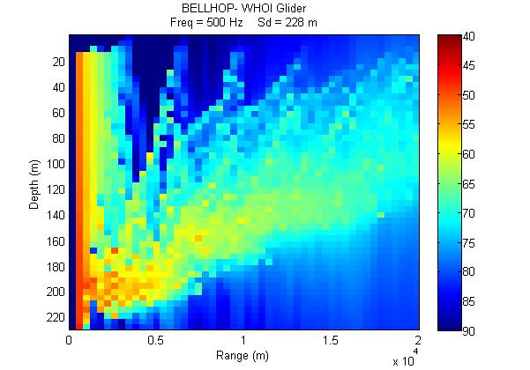
Acoustic Propagation
Isotherms flat, T>14C at bottom=230m
Isotherms tilted, T<12C at bottom=230m
Distance Shoreward
Notes:
SKIP

Slide 21
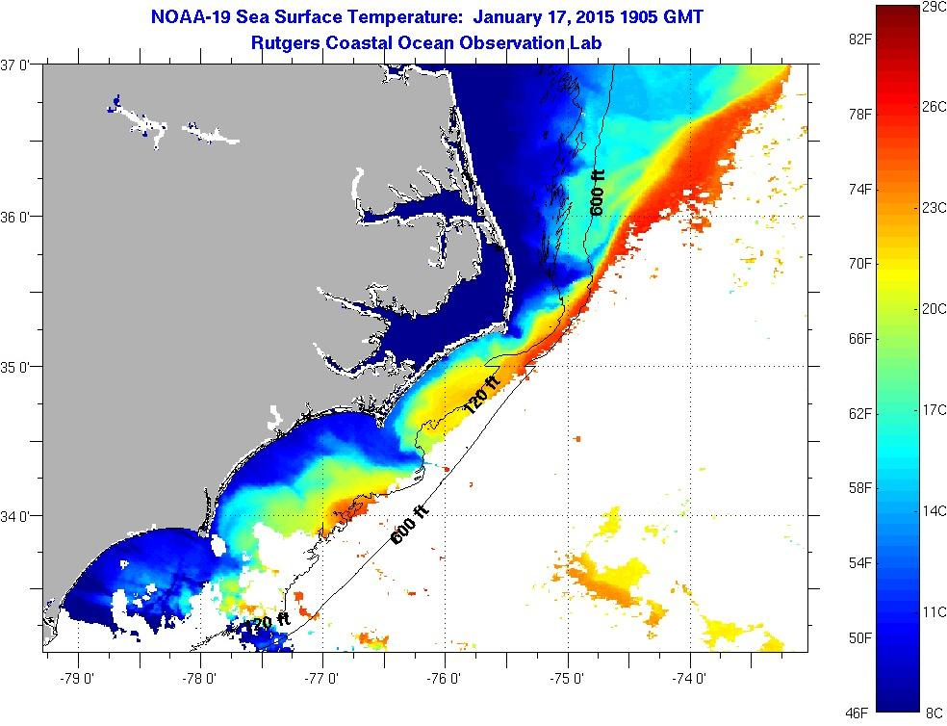
Acoustic Noise
Notes:
This SST image from January shows cloud cover all along the GS front. So, it made me think that there might be increased noise in the vicinity of the front due to precipitation and/or more vigorous air-sea interactions. If so, the noise would be lower if the GS front was farther away. But, I did not find strong evidence of this.

Slide 22
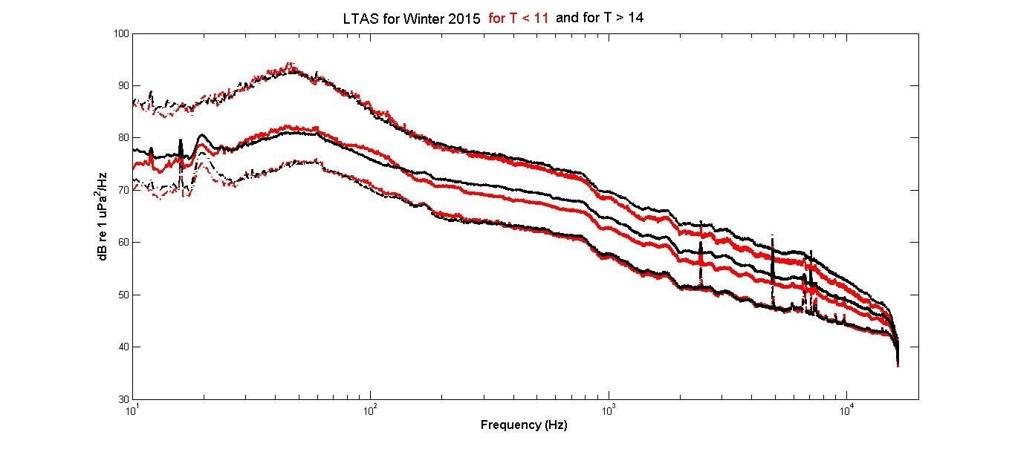
Acoustic Noise
In black: LTAS (10%, median, 90%) for the recording intervals when bottom T > 14 C
In red: LTAS (10%, median, 90%) for the recording intervals when bottom T < 11 C
Notes:
SKIP
But, I did not find strong evidence for that. I took the LTAS for two sets of recording intervals. In black, the 10%, median, and 90% spectra for recording intervals when bottom T was high (T > 14). In red, the 10%, median, and 90% spectra for recording intervals when bottom T was low (T < 11). The biggest difference was in Winter of 2015, and it was only 1 dB quieter when bottom T was cooler. This slight trend disappeared in the Winter of 2016. So, acoustic noise does not appear to be related to GS position.

Slide 23
Summary
Temporal pattern for quacks similar to that of whistles. (Recording intervals with quacks are a subset of the recording intervals with whistles.)
Dolphin quacks observed when water at the bottom was cooler, fresher
i.e. when Gulf Stream farther offshore and…
The mooring is in a meander trough
Highlights the advantage of a probabilistic approach for comparing biological and physical data

Slide 24
Summary
The upwelling of nutrient-rich water could be attracting the dolphins (and their prey)…
Or, it is possible that it’s just easier to detect these signals when the Gulf Stream is farther offshore:
…due to enhanced propagation of the signal?
…due to relative proximity of the front?
Or, all of the above?
Highlights the need to have measurements of the temperature and salinity fields to feed the acoustic propagation model.

Slide 25
Next Steps
More data
…to look for seasonal trends
Transects that show upwelling
Improve detector for “quacks”
…tweak to reduce false alarms

Slide 26
Acknowledgements
We would like to thank Sara Haines of the University of North Carolina at Chapel Hill for processing CTD and ADCP data.
We acknowledge the support of Dr. Robert Todd of WHOI for his glider transects, used as input to the propagation model.
This project was funded by the North Carolina Renewable Ocean Energy Program.
Notes:
+4:15

Slide 27
References
Baggenstoss P.M. and F. Kurth. (2014). Comparing shift-autocorrelation with cepstrum for detection of burst pulses in impulsive noise. The Journal of the Acoustical Society of America 136, 1574. doi: 10.1121/1.4894734
Beckerle J.C., Baxter L., Porter R.P., and R. C. Spindel (1980). Sound channel propagation through eddies southeast of the Gulf Stream. The Journal of the Acoustical Society of America 68, 1750. doi: 10.1121/1.385220
James R.W. and R.E. Cheney. (1977). Physical characteristics Of ocean fronts and eddies in the North Atlantic. Technical Note 3700-59-77. US Naval Oceanographic Office.
Camacho A. and J.G. Harris. (2008). A sawtooth waveform inspired pitch estimator for speech and music. The Journal of the Acoustical Society of America 124, 1638. doi: 10.1121/1.2951592
Jahnke R.A. and J.O. Blanton. (2010). The Gulf Stream. Chaper 3 in Carbon and Nutrient Fluxes in Continental Margins, Springer.
Woodworth P.A., Schorr G.S., Baird R.W., Webster D.L., McSweeney D.L., Hanson M.B., Andrews R.D., and J.J. Polovina. (2012). Eddies as offshore foraging grounds for melon-headed whales (Peponocephala electra). Marine Mammal Science 28: 638-647.
beta2 version of Silbido from https://roch.sdsu.edu/index.php/software/
swipep implementation in matlab at https://www.cise.ufl.edu/~acamacho/publications/swipep.m
Satellite images from Rutgers Coastal Ocean Observation Lab (COOL) at https://marine.rutgers.edu/cool/sat_data/?nothumbs=0&product=sst&region=capehat

Slide 28
Extra Slides

