Slide 1

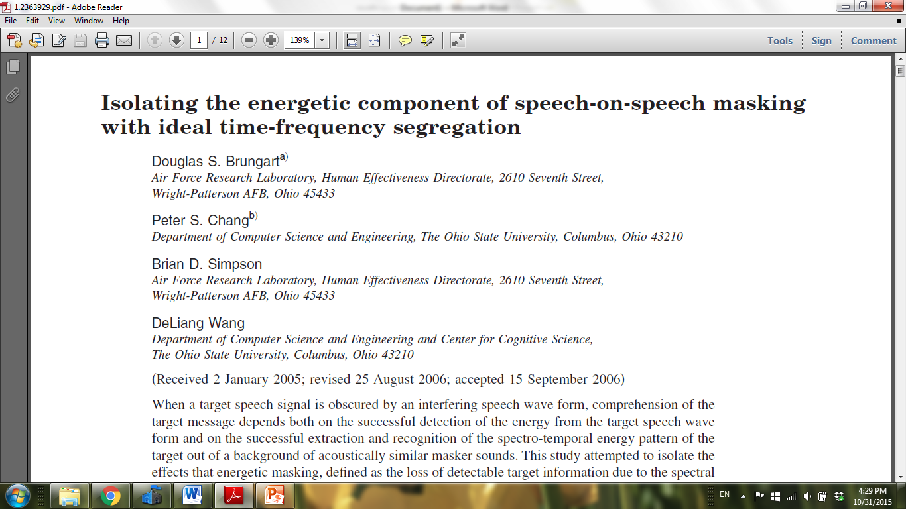
Ideal Binary Mask Implementation
Our ideal binary mask implementation was motivated by this paper by Brungart et al. In this presentation, I’ll outline the approach and highlight where the approach diverged from that used by Brungart et. al.

Slide 2
Ideal Binary Mask Implementation
Adapt on SNR
Gated stimuli (signal + masker segment)
For each trial:
“Chop” the signal into t-f bins
“Chop” the masker segment into t-f bins
For each t-f bin
Compare measured SNR to a threshold

Slide 3
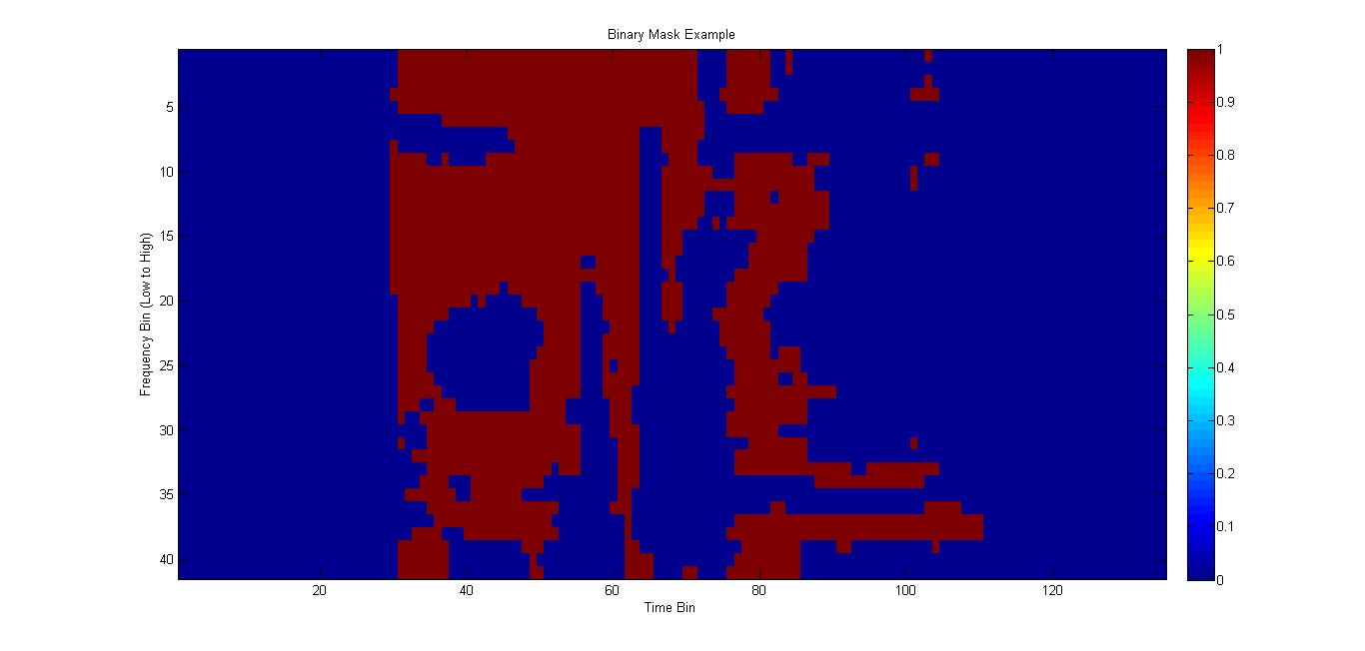
Ideal Binary Mask Implementation
For each t-f bin, the mixture (signal + masker) “passes through” if the SNR > threshold . In the figure above, the t-f bins in red are those for which the SNR > threshold.

Slide 4
Ideal Binary Mask Implementation
To “chop” in time, just use 50% overlapping windows
To “chop” in frequency, use a gammatone filterbank.
We used an implementation of the gammatone filter from Ning Ma. Details on this implementation can be found here.

Slide 5
Ideal Binary Mask Implementation
BW_{gammatone} = 1.019*ERB
ERB = 24.7 + 0.108*f_{c}

Slide 6
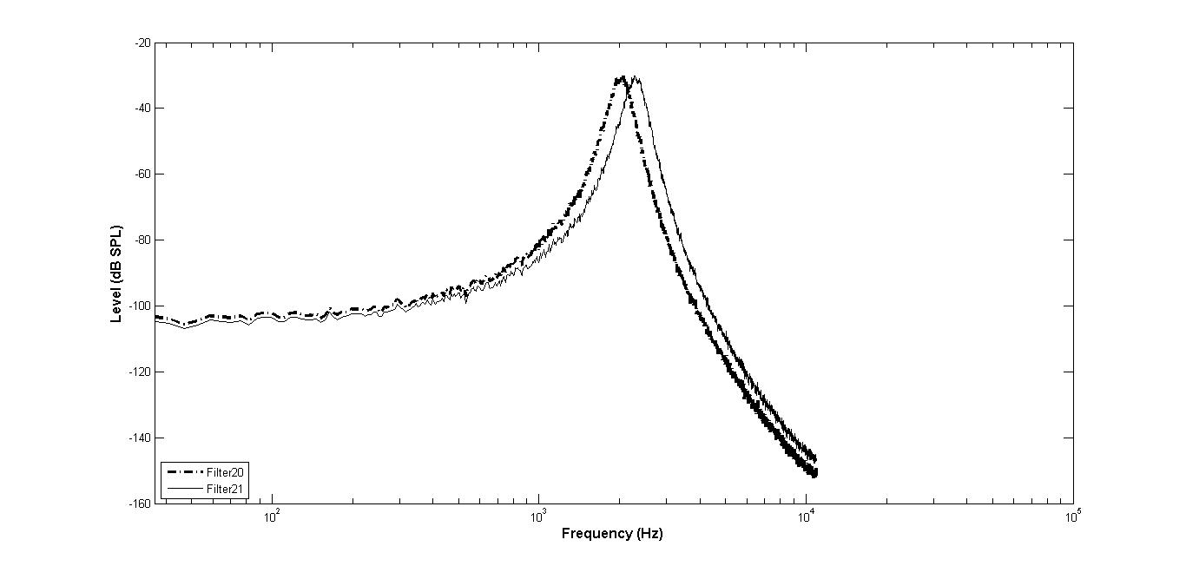
Ideal Binary Mask Implementation
The filters in our gammatone filter bank are spaced such that they overlap at their 3 dB points. For example, this figure shows the frequency response of two consecutive filters in our filter bank. (The frequency response was generated by passing Gaussian white noise through our filter bank and plotting the spectra of the output of two consecutive filters.)

Slide 7
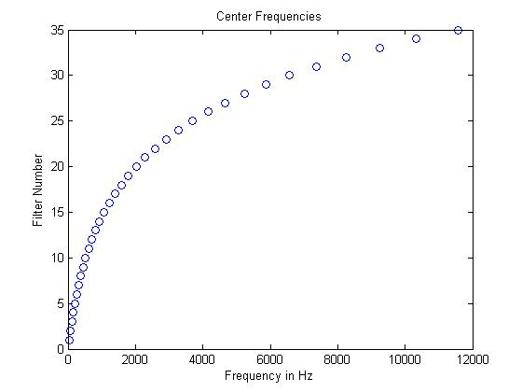
Ideal Binary Mask Implementation
If you space the gammatone filters such that they overlap at their 3 dB points, you need only 35 filters to span the range of center frequencies from 50 Hz to over 11 kHz.

Slide 8
Ideal Binary Mask Implementation
To reconstruct the stimulus, all we need to do is to sum the outputs of all the time-frequency bins of the binary mask.
The following two plots were generated to evaluate the quality of the reconstruction. In this case, there is no masker. A signal is passed through the filter bank and then reconstructed without applying a SNR threshold. This allows us to measure the phase distortion from the gammatone filter bank. The signal is the word “birthday”.

Slide 9
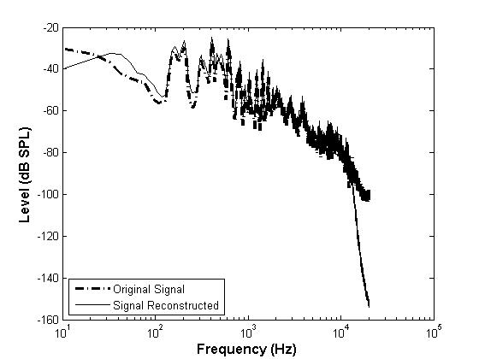
Ideal Binary Mask Implementation
A signal is passed through the filter bank and then reconstructed without applying a SNR threshold. The plot shows the magnitude of the spectrum for both the original signal and its reconstruction.

Slide 10
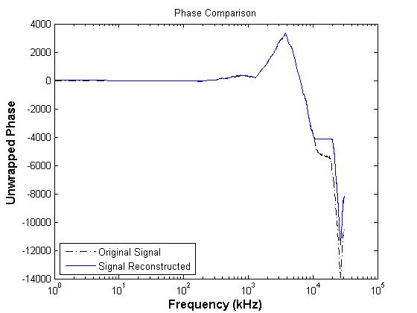
Ideal Binary Mask Implementation
A signal is passed through the filter bank and then reconstructed without applying a SNR threshold. The plot shows the phase of the spectrum for both the original signal and its reconstruction.

Slide 11
Ideal Binary Mask Implementation
The following table details the differences between our filter bank configuration and the one used by Brungart et. al.
Parameter | Brungart’s Setting | Our Setting
Lowest Center Frequency (Hz) | 80 | 50
Highest Center Frequency (Hz) | 5000 | 11569
Number of Filters | 128 | 35
Also, since there is no significant phase distortion, reverse filtering is not used during reconstruction.

Slide 12
Ideal Binary Mask Implementation
References
Brungart, D.S., Chang, P.S., Simpson, B.D., and DeLiang, W. (2006). “Isolating the energetic component of speech-on-speech masking with ideal time-frequency segregation”, J. Acoust. Soc. Am. 120, 4007-4018.

