Slide 1
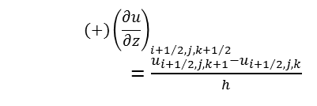
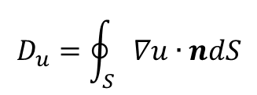
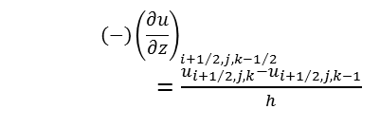
$$D_{u}=\oint_{S}{∇u∙ndS}$$
u_{i+1/2,j+1,k}
$${(−)\left(\frac{∂u}{∂z}\right)}_{i+1/2,j,k−1/2}$$
$=\frac{u_{i+1/2,j,k}−u_{i+1/2,j,k−1}}{h}$
u_{i+3/2,j,k}
u_{i+1/2,j,k+1}
u_{i+1/2,j,k-1}
u_{i+1/2,j,k}
u_{i-1/2,j,k}
$${(+)\left(\frac{∂u}{∂z}\right)}_{i+1/2,j,k+1/2}$$
$=\frac{u_{i+1/2,j,k+1}−u_{i+1/2,j,k}}{h}$
u_{i+1/2,j-1,k}

