Slide 1
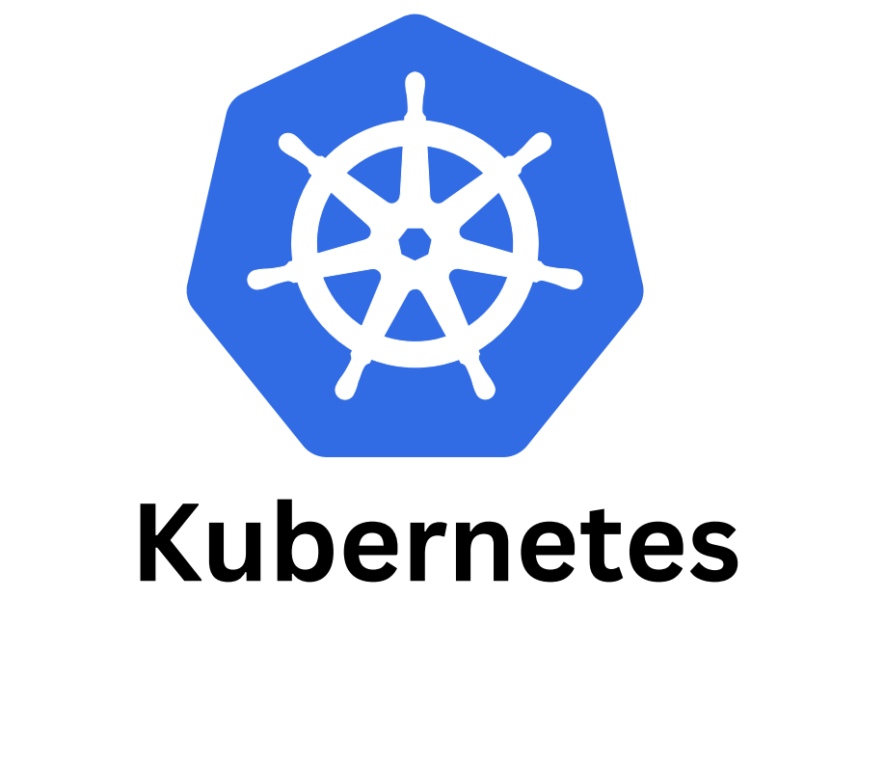
Kubernetes

Slide 2
Agenda
What is kubernetes(k8)
Key features of K8s
Docker vs K8s
Component of K8s
What is POD
What is Miniqube
Example

Slide 3
Terms
Docker
What it is: A containerization platform.
Kubernetes
What it is:
A container orchestration platform.
Minikube
What it is:
A local Kubernetes cluster.
Amazon ECS (Elastic Container Service)
What it is: AWS’s managed container orchestration service.

Slide 4
🐳 Docker
What it is: A containerization platform.
What it does:
* Builds container images
* Runs containers on a single machine
* Packages app + dependencies
Used for:
* Local development
* Simple deployments
☸️ Kubernetes
What it is: A container orchestration platform.
What it does:
* Manages containers across multiple machines
* Auto-scaling, self-healing, load balancing
* Rolling updates & rollbacks
Used for:
* Large-scale, production systems
* Microservices

Slide 5
🧪 Minikube
What it is: A local Kubernetes cluster.
What it does:
* Runs Kubernetes on your laptop
* Helps learn & test Kubernetes features
Used for:
* Learning Kubernetes
* Local testing of manifests
☁️ Amazon ECS (Elastic Container Service)
What it is: AWS’s managed container orchestration service.
What it does:
* Runs Docker containers on AWS
* No need to manage Kubernetes
* Integrates tightly with AWS services
Used for:
* AWS-first deployments
* Simpler container orchestration

Slide 6
Tool | Purpose | Environment | Complexity
Docker | Run containers | Local / Single host | Easy
Kubernetes | Orchestrate containers | Cloud / On-prem | Complex
Minikube | Local Kubernetes | Local machine | Easy
ECS | AWS container orchestration | AWS only | Medium

Slide 7
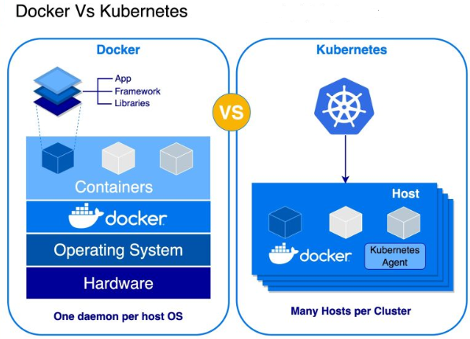

Slide 8
Docker vs Kubernetes
Characteristic | Kubernetes | Docker
What is it? | Container orchestration tool. | Stack of container technologies to create and run containers.
Use | Coordinate multiple containers across multiple servers. | Package applications with libraries and runtime into container images.
Main benefit | Define and run complex containerized applications at scale. | Standardize application operations and ship code faster.

Slide 9
Kubernetes
Kubernetes, often shortened to K8s (K, 8 letters, s), is an open-source platform that automates the deployment, scaling, and management of containerized applications.
Origin: Developed by Google, inspired by internal systems Borg and Omega.
Launch: Officially released in 2014.
Adoption: Widely used across major cloud providers today.
Name Meaning: Kubernetes comes from Greek, meaning “helmsman” or “pilot”, symbolizing its role in steering applications.

Slide 10
Features
Container orchestration: Kubernetes automates many of the manual processes involved in deploying, managing, and scaling containerized applications. This makes it easier to run containerized applications in production environments.
Service discovery and load balancing: Kubernetes provides a built-in service discovery and load balancing mechanism. This makes it easy to deploy and manage microservices-based applications.
Self-healing: Kubernetes automatically restarts failed containers and reschedules them to healthy nodes. This helps to ensure that your applications are always available.
Horizontal scaling: Kubernetes makes it easy to horizontally scale your applications by adding or removing nodes. This allows you to scale your applications up or down as needed.

Slide 11
Some features of K8s:
Automated Scheduling – Efficiently places containers on nodes for optimal resource use.
Self-Healing – Automatically restarts, replaces, and reschedules failed containers.
Rollouts & Rollbacks – Manages application updates and reverts when needed.
Scaling & Load Balancing – Supports horizontal scaling and distributes traffic.
Resource Optimization – Monitors and ensures efficient resource utilization

Slide 12
Components of Kubernetes
  1. Control Plane (Brain of the Cluster)
  2. Master Node
  3. Worker Node Components (Do the Work)
  4. Core Kubernetes Objects
  5. Networking Components
  6. Security Components
  7. Observability Components

Slide 13
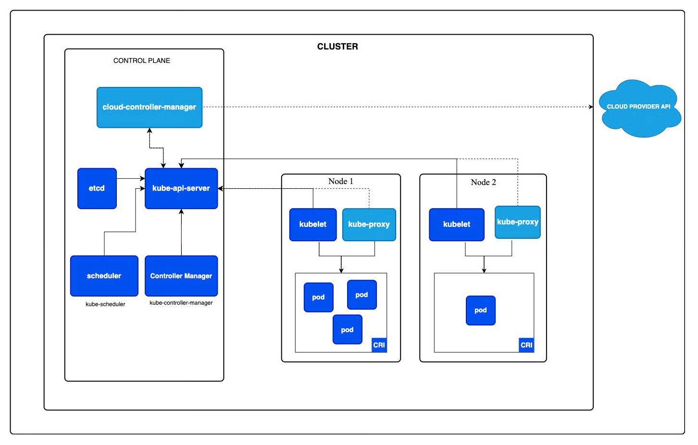

Slide 14
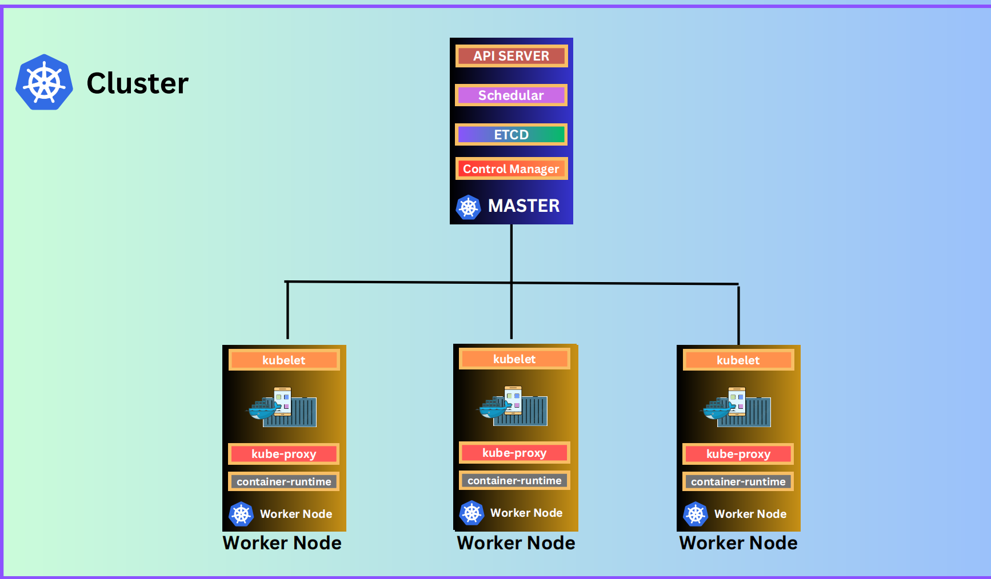
Cluster

Slide 15
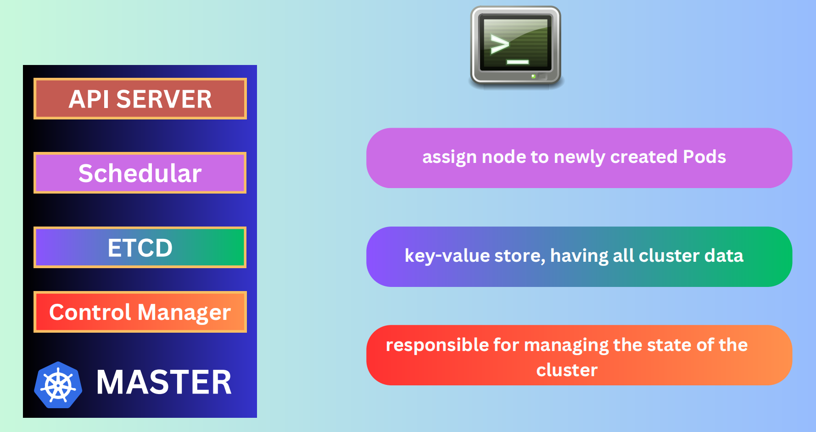
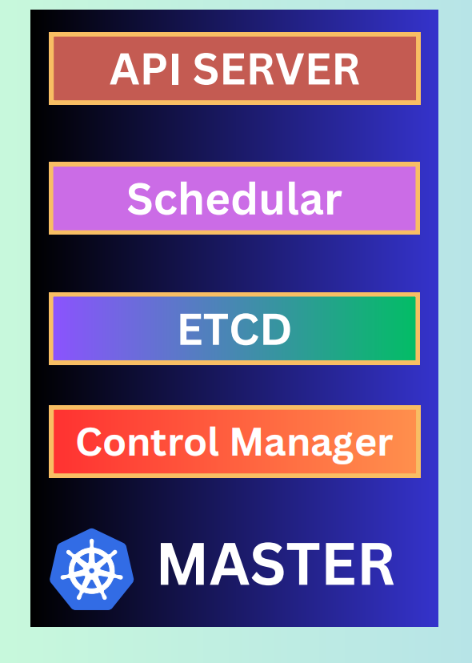

Slide 16
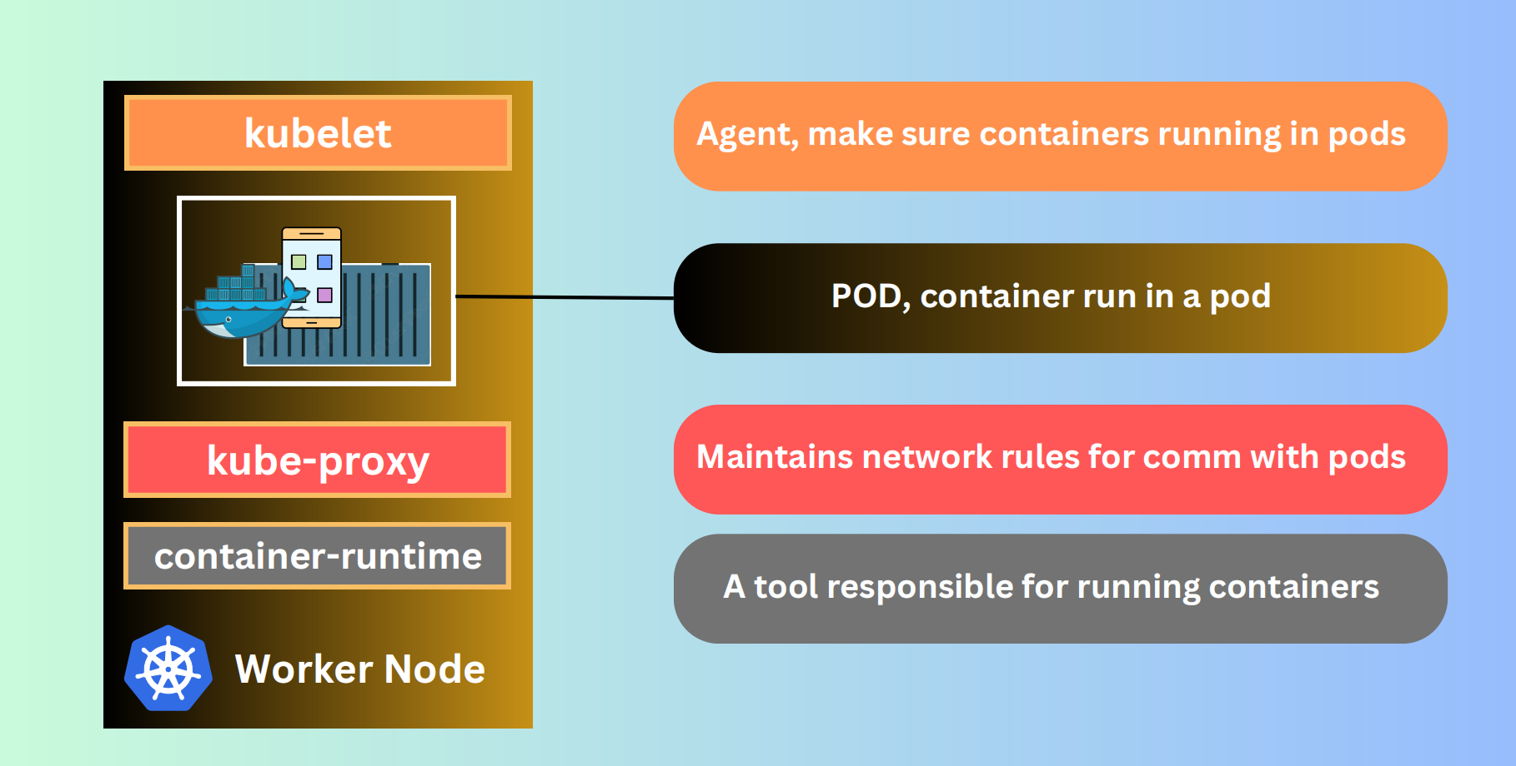

Slide 17
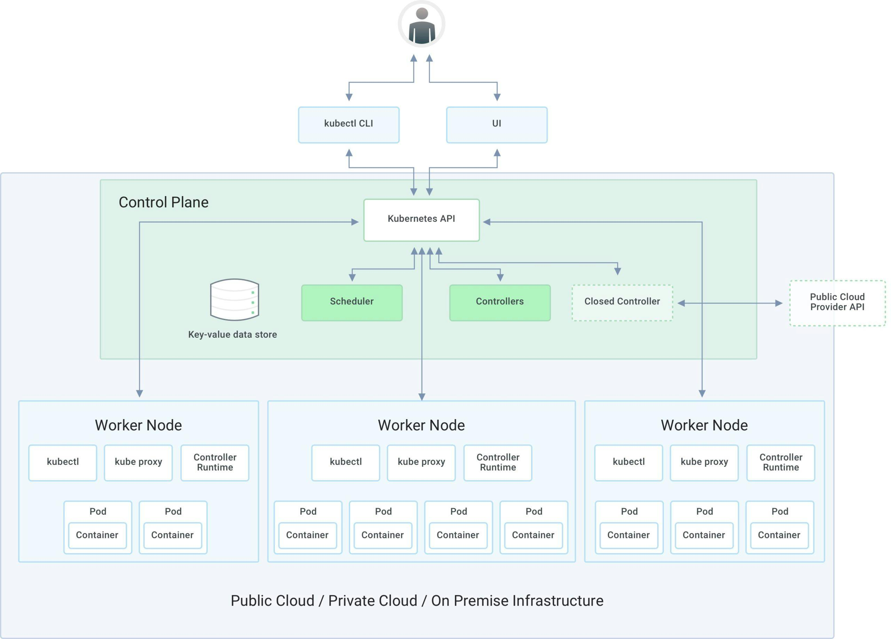

Slide 18
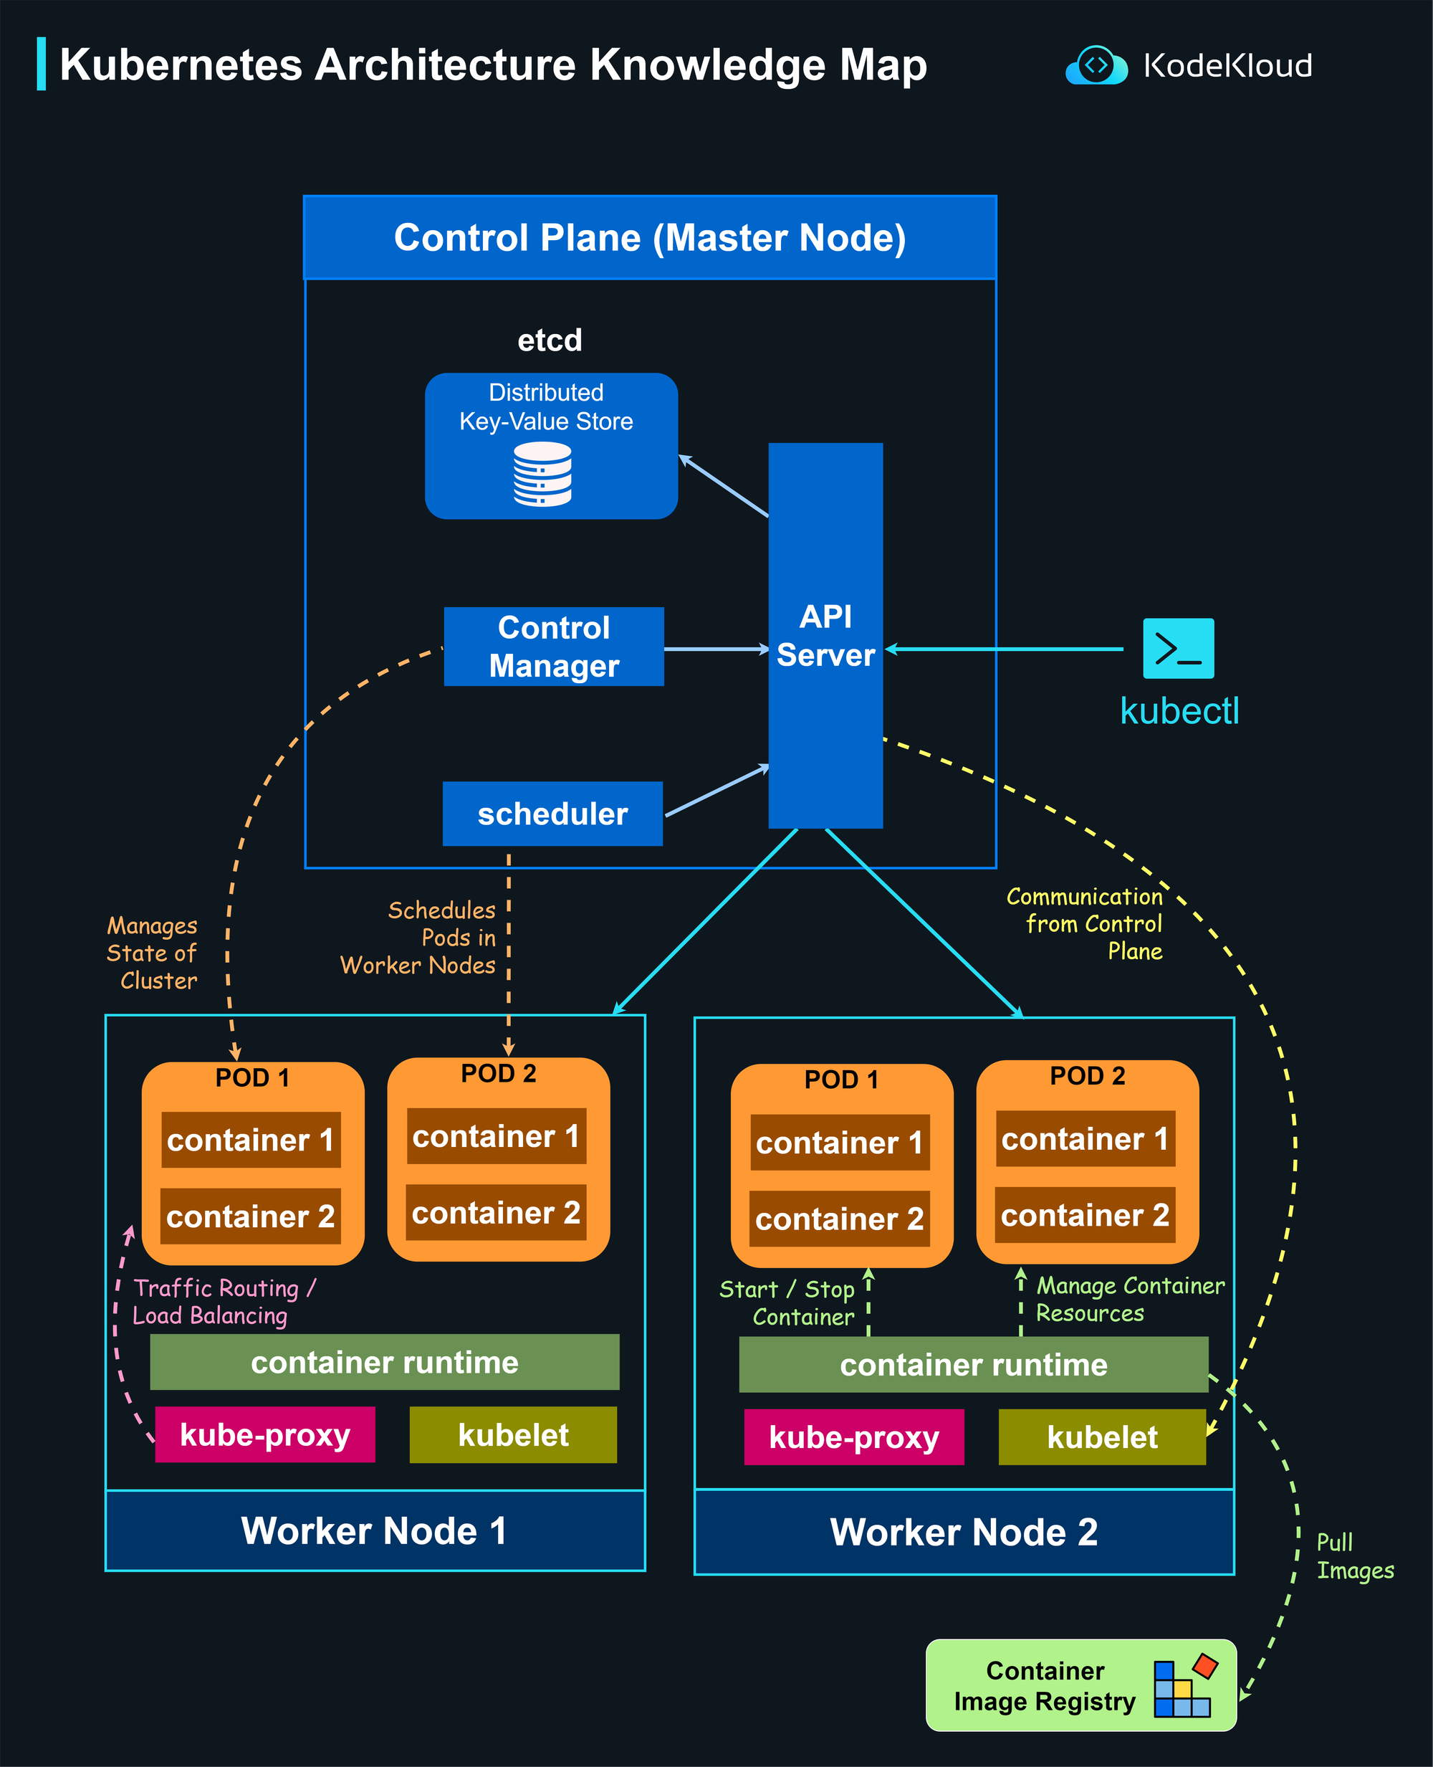

Slide 19
The master node defines what should happen.
The worker nodes execute how it happens.
Feature / Role | Master Node (Control Plane) | Worker Node
Primary Function | Manages the cluster and makes decisions | Runs workloads and executes containers
Key Components | API Server, etcd, Scheduler, Controller Manager | Kubelet, Kube-Proxy, Container Runtime
Workload Execution | No (management only) | Yes (Pods and containers)
State Management | Maintains desired and actual state of cluster | Reports local state to control plane
Failure Recovery | Restores workloads on healthy nodes | Recreates or moves Pods when needed
Scalability Role | Manages scaling strategy | Hosts scaled workloads

Slide 20
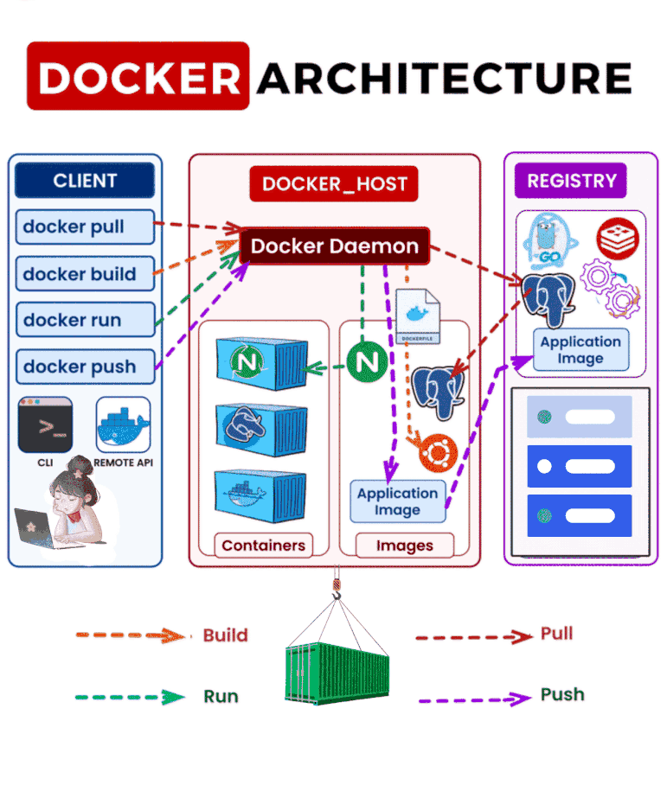

Slide 21
1. Pod
A Pod is the smallest unit you can deploy in Kubernetes. It wraps one or more containers that need to run together, sharing the same network and storage. Containers inside a Pod can easily communicate and work as a single unit.
2. Node
A Node is a machine (physical or virtual) in a Kubernetes cluster that runs your applications. Each Node contains the tools needed to run Pods, including the container runtime (like Docker), the Kubelet (agent), and the Kube proxy (networking).
3. Cluster
A Kubernetes cluster is a group of computers (called nodes) that work together to run your containerized applications. These nodes can be real machines or virtual ones.
There are two types of nodes in a Kubernetes cluster:
* Master node (Control Plane):
* Think of it as the brain of the cluster.
* It makes decisions, like where to run applications, handles scheduling, and keeps track of everything.
* Worker nodes:
* These are the machines that actually run your apps inside containers.
* Each worker node has a Kubelet (agent), a container runtime (like Docker or containerd), and tools for networking and monitoring.
4. Deployment
A Deployment is a Kubernetes object used to manage a set of Pods running your containerized applications. It provides declarative updates, meaning you tell Kubernetes what you want, and it figures out how to get there.
5. ReplicaSet
A ReplicaSet ensures that the right number of identical Pods are running.

Slide 22
6. Service
A Service in Kubernetes is a way to connect applications running inside your cluster. It gives your Pods a stable way to communicate, even if the Pods themselves keep changing.
7. Ingress
Ingress is a way to manage external access to your services in a Kubernetes cluster. It provides HTTP and HTTPS routing to your services, acting as a reverse proxy.
8. ConfigMap
A ConfigMap stores configuration settings separately from the application, so changes can be made without modifying the actual code.
Imagine you have an application that needs some settings, like a database password or an API key. Instead of hardcoding these settings into your app, you store them in a ConfigMap. Your application can then read these settings from the ConfigMap at runtime, which makes it easy to update the settings without changing the app code.
9. Secret
A Secret is a way to store sensitive information (like passwords, API keys, or tokens) securely in a Kubernetes cluster.
10. Persistent Volume (PV)
A Persistent Volume (PV) in Kubernetes is a piece of storage in the cluster that you can use to store data and it doesn’t get deleted when a Pod is removed or restarted.
11. Kubelet
A Kubelet runs on each Worker Node and ensures Pods are running as expected.
12. Kube-proxy
Kube-proxy manages networking inside the cluster, ensuring different Pods can communicate.

Slide 23
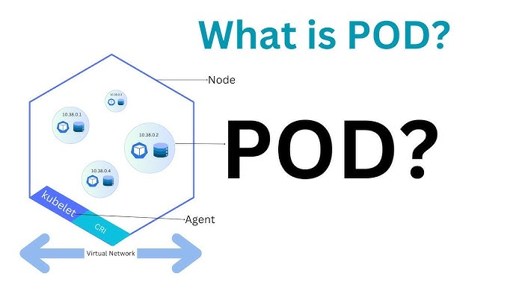
A Pod is the smallest deployable unit in Kubernetes.
It represents one or more containers that:
Run together on the same node
Share the same IP address
Share storage (volumes) and network
Are deployed and managed as a single unit

Slide 24
Minikube
Minikube is a local Kubernetes cluster that runs on your laptop or desktop.
It is mainly used for learning, testing, and development.
In simple terms: 👉 Minikube = Kubernetes on your local machine
Key points:
* Runs a single-node Kubernetes cluster
* Supports Docker, containerd, or VM drivers
* Lets you practice kubectl commands locally
* No cloud cost involved

