Slide 1

PYTHON CRN 22146 Analysis on Subway Felonies and crimes
By:
Shubham Mittal
Swayambhu Dhuri
Akshat Shanbhag

Slide 2
Abstract
Examining felony data from 2019 to 2024 across MNR, SIR, LIRR, and NYCT, alongside MTAPD and NYPD involvement, this project employs Python's pandas and matplotlib for visualization. Our analysis reveals trends and discrepancies in felony occurrences, aiding in understanding subway security dynamics. By identifying patterns and variations, we inform strategies for targeted interventions and resource allocation. This study provides actionable insights for bolstering safety measures and enhancing law enforcement efficacy within New York City's subway systems.

Slide 3

Introduction
New York City's subway systems, operated by the Metropolitan Transportation Authority (MTA), are crucial for millions of daily commutes.
Ensuring passenger safety in these vast networks poses ongoing challenges.
This project focuses on analyzing felony occurrences within MTA agencies.
Additionally, we scrutinize the response of law enforcement entities to these criminal incidents.
Through data analysis and visualization, we aim to uncover patterns in felony occurrences from 2019 to 2024.
Insights gained will inform strategies for enhancing subway security and optimizing law enforcement efforts, ultimately ensuring safer commuting experiences.

Slide 4
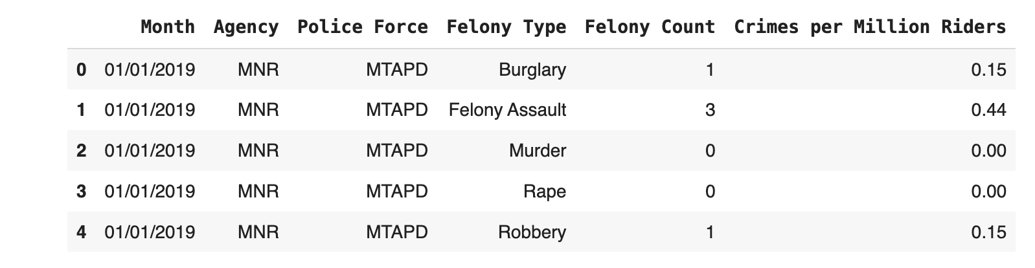
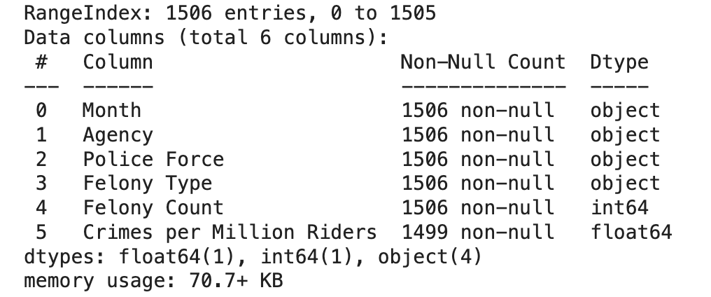
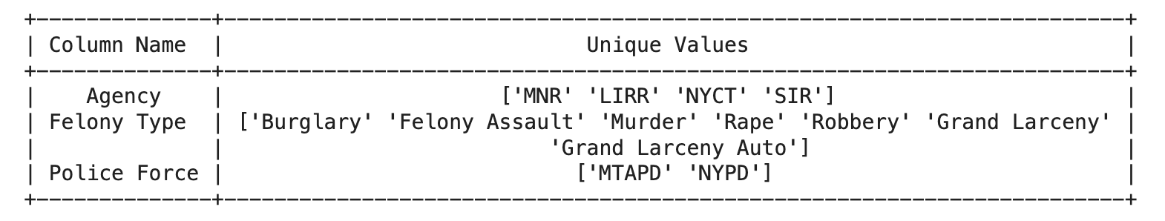

Dataset
The dataset contains:
Rows: 1506
Columns: 6
Column Details:
Month: Represents the time in MM-DD-YYYY format for the first day of each month.
Agency: Refers to the specific MTA agency (NYCT, SIR, MNR, LIRR).
Police Force: Indicates the law enforcement agency involved (MTAPD or NYPD).
Felony Type: Describes the category of major felony reported.
Felony Count: Provides the count of major felonies committed for each entry.
Crimes per Million Riders: Represents the number of each type of major felony per million riders in a month. Formula,
$$Crimes per Million Riders=\frac{Felony Count}{Total Ridership}×1000000$$
Figure 1: Head of data present in dataset
Figure 2: Columns and column details
Figure 3: Unique values present in the columns Agency, Felony Type, and Police Force

Slide 5
Preprocessing
Handling Null Values: Checked for null values within the dataset. Replaced any null values with zeros to ensure consistency in data representation.
Datetime Conversion: Converted the 'Month' column from object type to datetime data type. This conversion enables time-based operations.
Data Exploration: Explored the dataset to understand its structure, contents, and any potential patterns. Identified relevant features and variables for further analysis and visualization.

Slide 6
Literature Review
S.No. | Author | Paper and Publication | Findings
1. | Nan li, Young-An Kim | Subway Station and Neighborhood Crime: An Egohood Analysis Using Subway Ridership and Crime Data in New York City, Crime & Delinquency, 69(11), 2303-2328 (2022). | Examining the effects of the number of subway stations as well as magnitude of subway ridership on crime in 1/4-mile egohoods in New York City.
2. | Eric P. Baumer | Neighborhood disadvantage and police notification by victims of violence, Criminology, 40(3), 579–616 (2002). | Examining the influence of neighborhood socioeconomic disadvantage on the likelihood of police notification by victims of violence.

Slide 7
Architecture/Methodology
Data Loading
Data Exploration
Data Preprocessing
Time-series Analysis
Visualization
Interpretation

Slide 8
Results

Slide 9
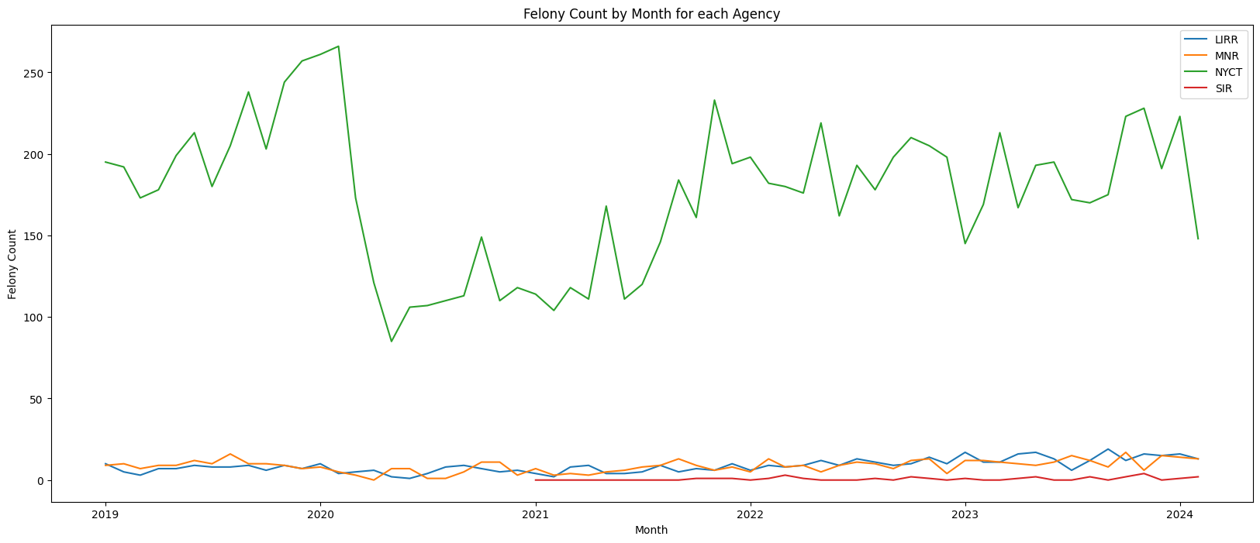
Figure 4: Graph representation of Felony count by Month for each Agency

Slide 10
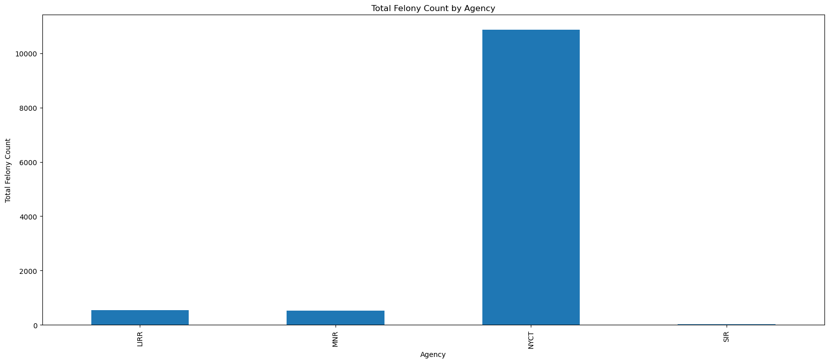
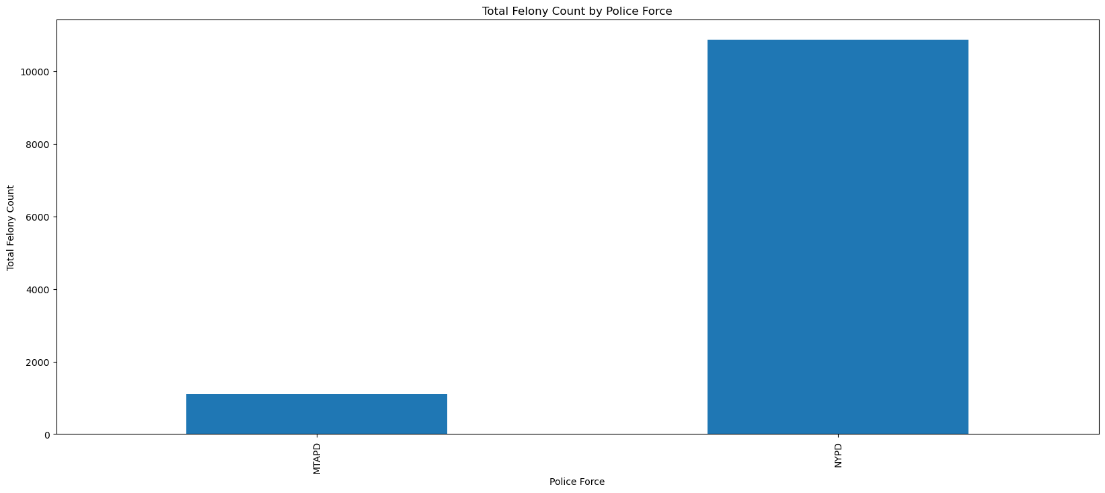
Figure 5: Bar Graph representation of Total Felony count by Agency
Figure 6: Bar Graph representation of Total Felony count by Police Force

Slide 11
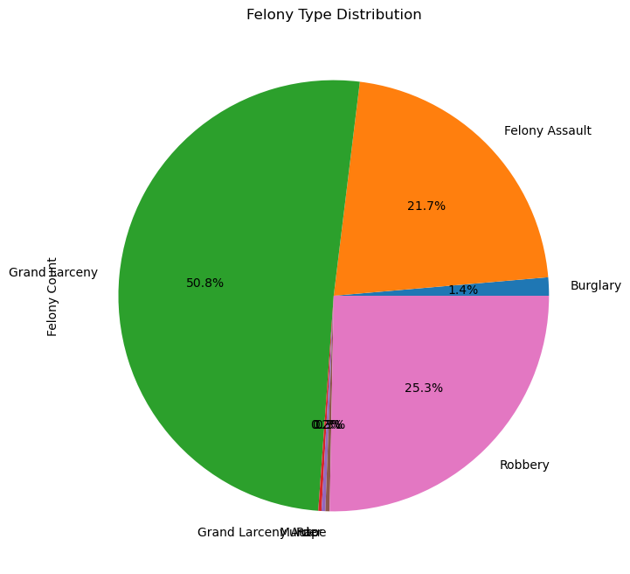
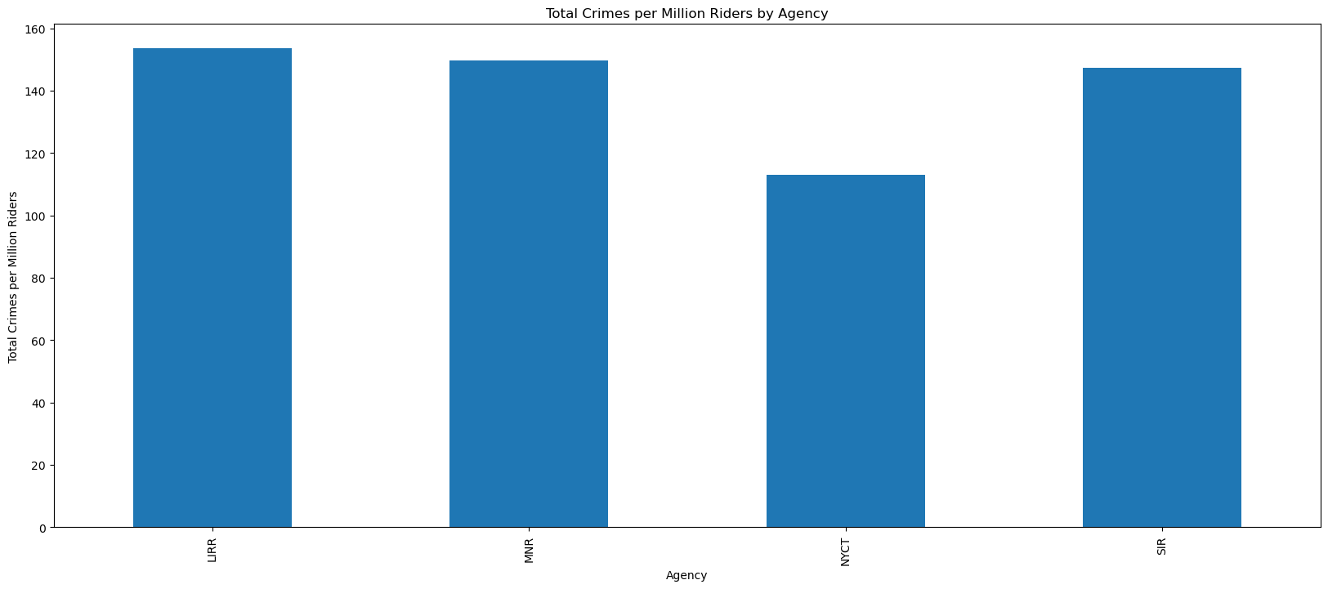
Figure 7: Pie Chart representation of Felony Type Distribution
Figure 8: Bar Graph representation of Total Crimes per Million Riders by Agency

Slide 12
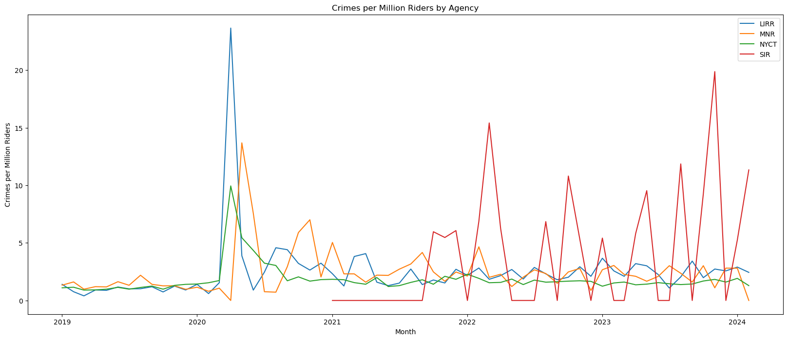
Figure 9: Graph representation of Crimes per Million Riders by Agency

Slide 13
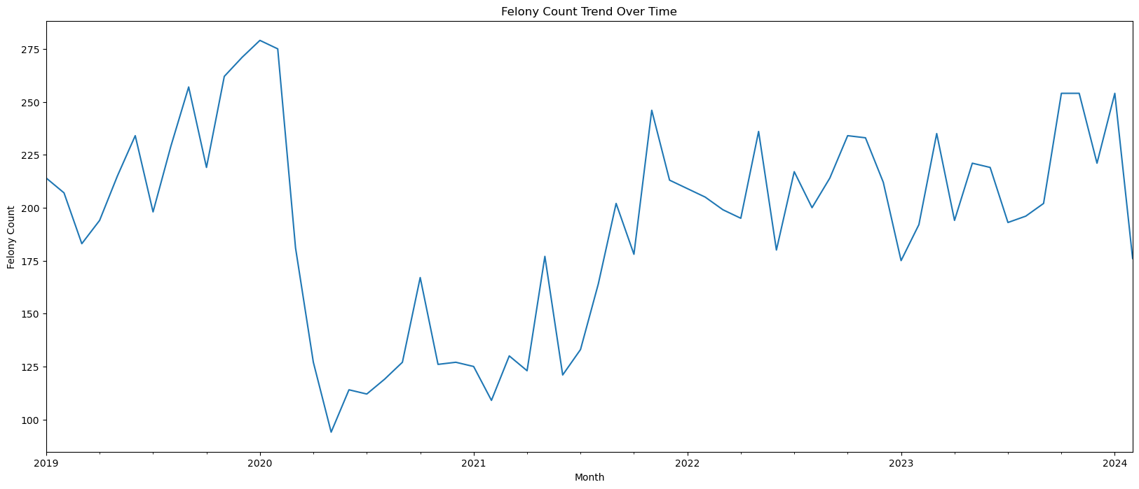
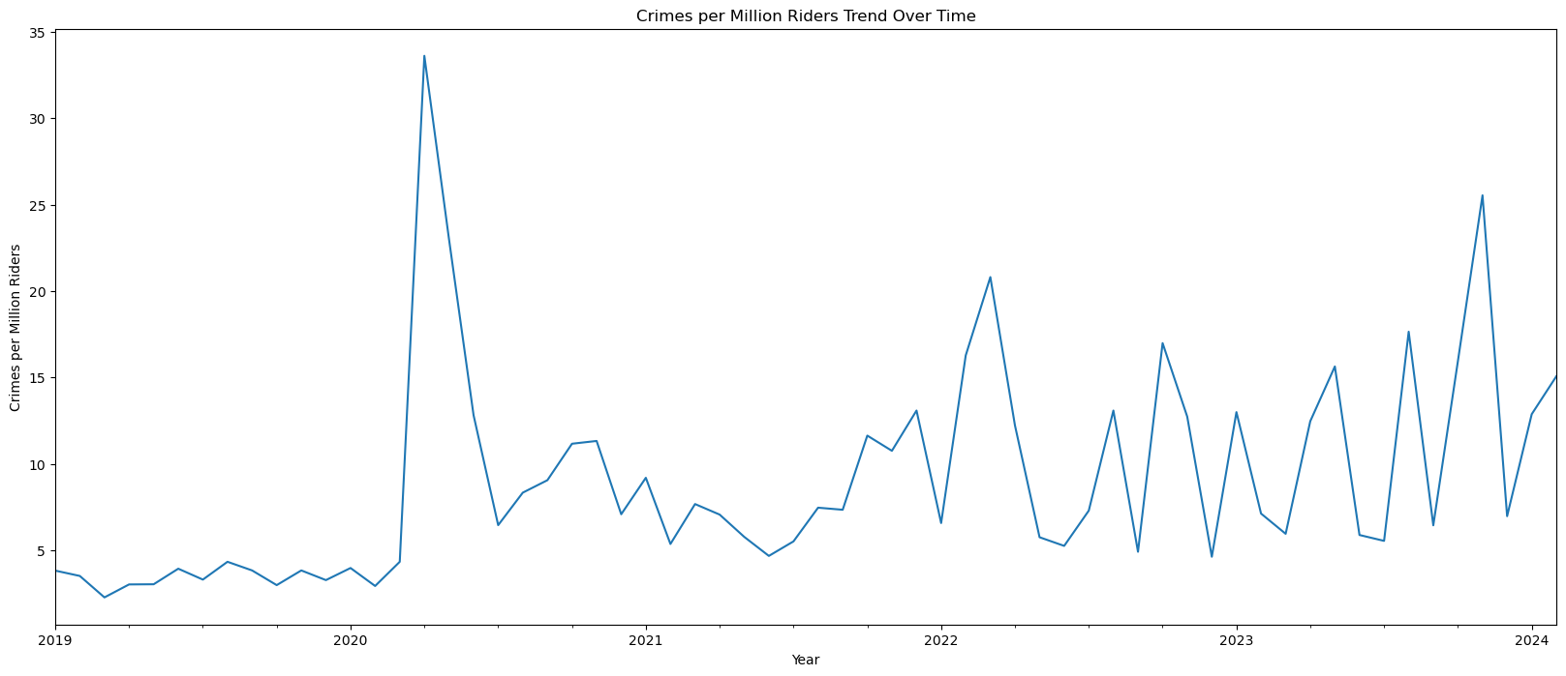
Figure 10: Line Graph representation of Felony Count Trend Over Time
Figure 11: Line Graph representation of Crimes per Million Riders Trend Over Time

Slide 14
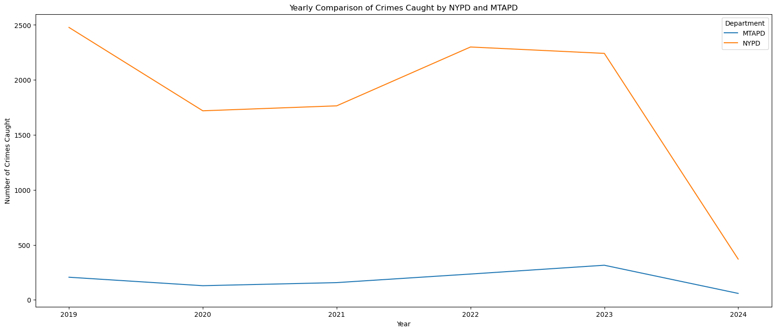
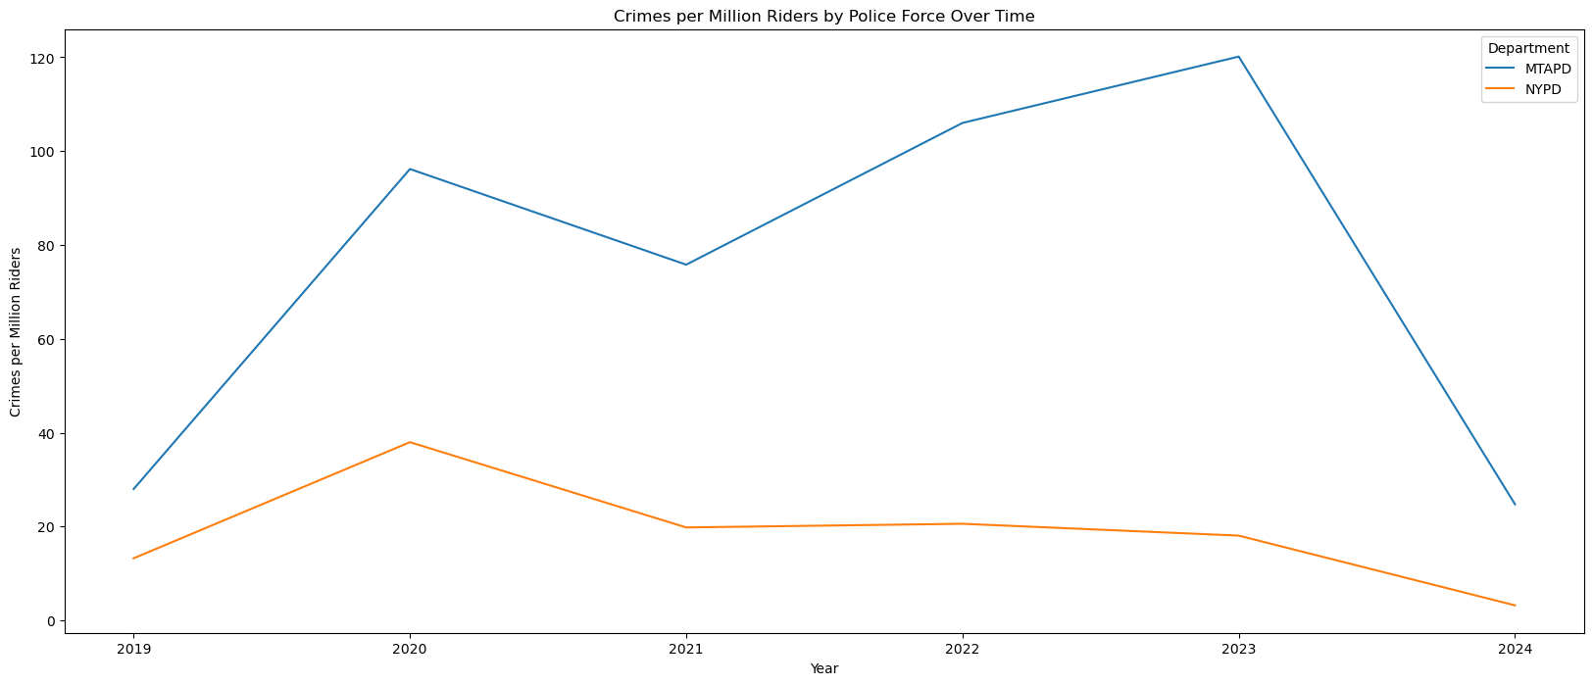
Figure 12: Graph representation of Yearly Comparisons of Crimes caught by NYPD and MTAPD
Figure 13: Graph representation of Crimes per Million Riders by Police Force Over Time

Slide 15
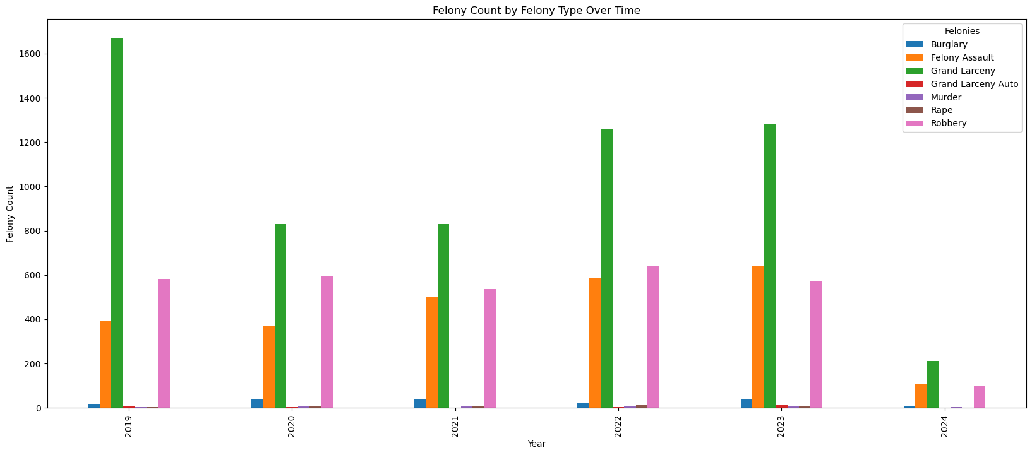
Figure 14: Bar Graph representation of Felony count by Felony Type over time

Slide 16
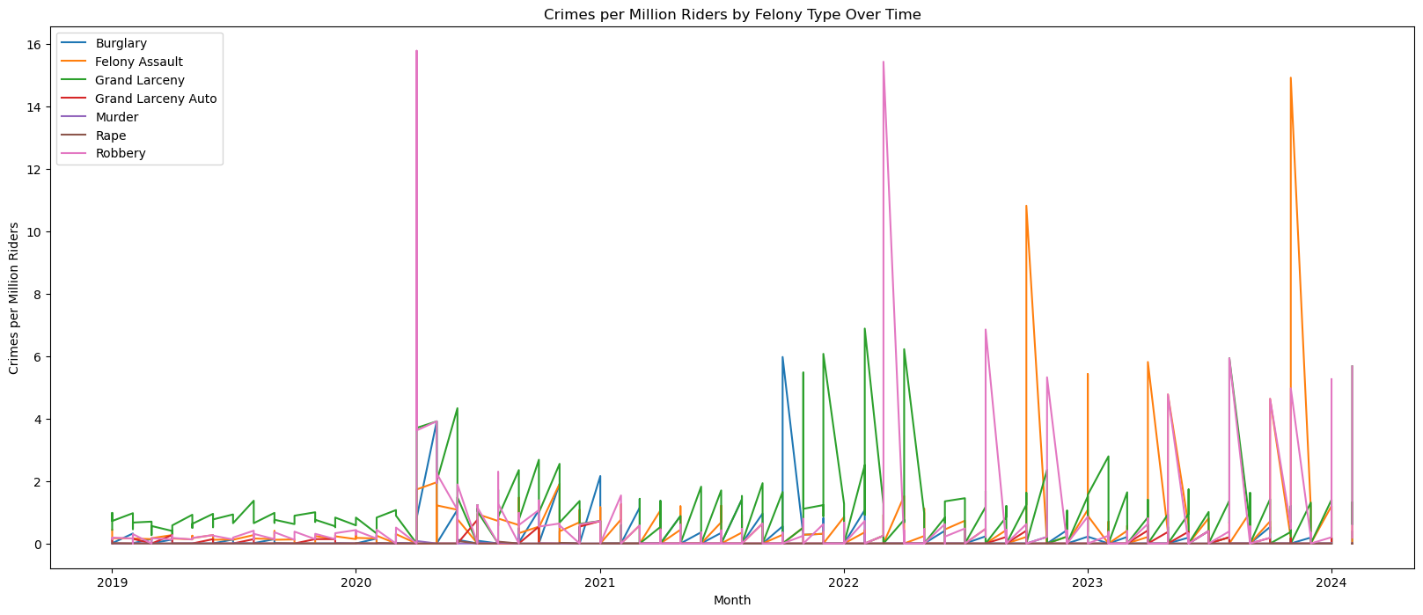
Figure 15: Graph representation of Crimes per million Riders by Felony Type Over Time

Slide 17
Conclusion
The data analysis shows that there is considerable drop in 2020 to 2021 showing the trends that during COVID-19 lockdown period ridership data. Hence, number of felonies occurring is comparatively high per total ridership count. (Figure 10 & Figure 11).
The trend in the graphical representation also, explains that that the NYCT contains the maximum amount of ridership. Being the highest felonies occurring in NYCT as per Figure 5, still the felonies per million riders is least compared to other three agencies.
Also, this can be concluded that NYPD reports the greatest number of felonies happening in subways.
Hence, the above analysis shows that the number of felonies are decreasing per year in New York City with respect to the total amount of ridership. By leveraging data analysis, the NYPD and MTAPD can develop data-driven strategies to enhance public safety and ensure a secure and reliable experience for MTA riders.

Slide 18
References
https://data.ny.gov/Transportation/MTA-Major-Felonies/yeek-jhmu/about_data
https://pandas.pydata.org/docs/
https://matplotlib.org/stable/index.html

Slide 19
Github Repository Code
Github Repository Link: https://github.com/sbmittal389/PythonMidterm
Github Code Link: https://github.com/sbmittal389/PythonMidterm/blob/main/Group1_PythonNotebook.ipynb
Dataset Link: https://github.com/sbmittal389/PythonMidterm/blob/main/MTA_Major_Felonies.csv

