Slide 1

The SBML Java™ library

Slide 2
History
Project started in September 2009
http://jsbml.sourceforge.net/
Current main developers :
  Nicolas Rodriguez¹
  Andreas Dräger²
¹ European Bioinformatics Institute (EBI)
² Center for Bioinformatics Tuebingen (ZBIT)

Slide 3
Status
Abstract Programming Interface as close as possible to the libSBML Java bindings API
  Integration of the libSBML java tests files.
All core functions implemented, need some more work/test on Notes and Annotation.
module to use libSBML to read/write the XML files.
Several project are already using it.
Problem to open invalid models?
To download and build:
svn co https://jsbml.svn.sourceforge.net/svnroot/jsbml/trunk jsbml
ant jar

Slide 4
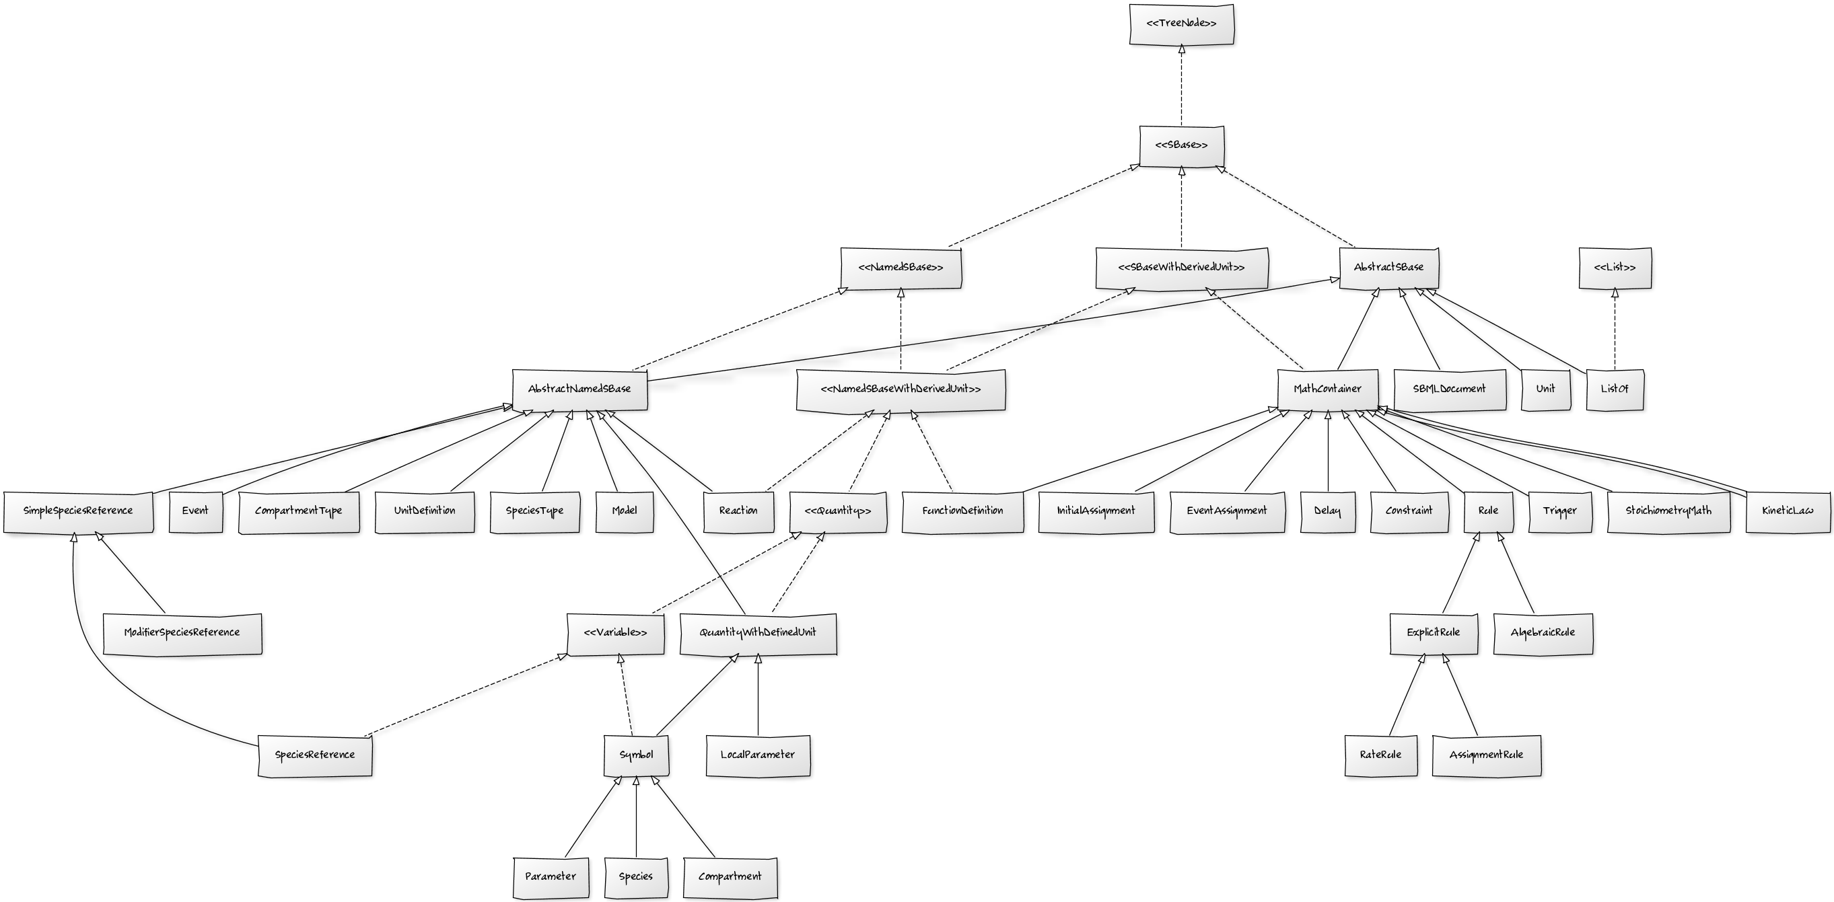
Type hierarchy

Slide 5
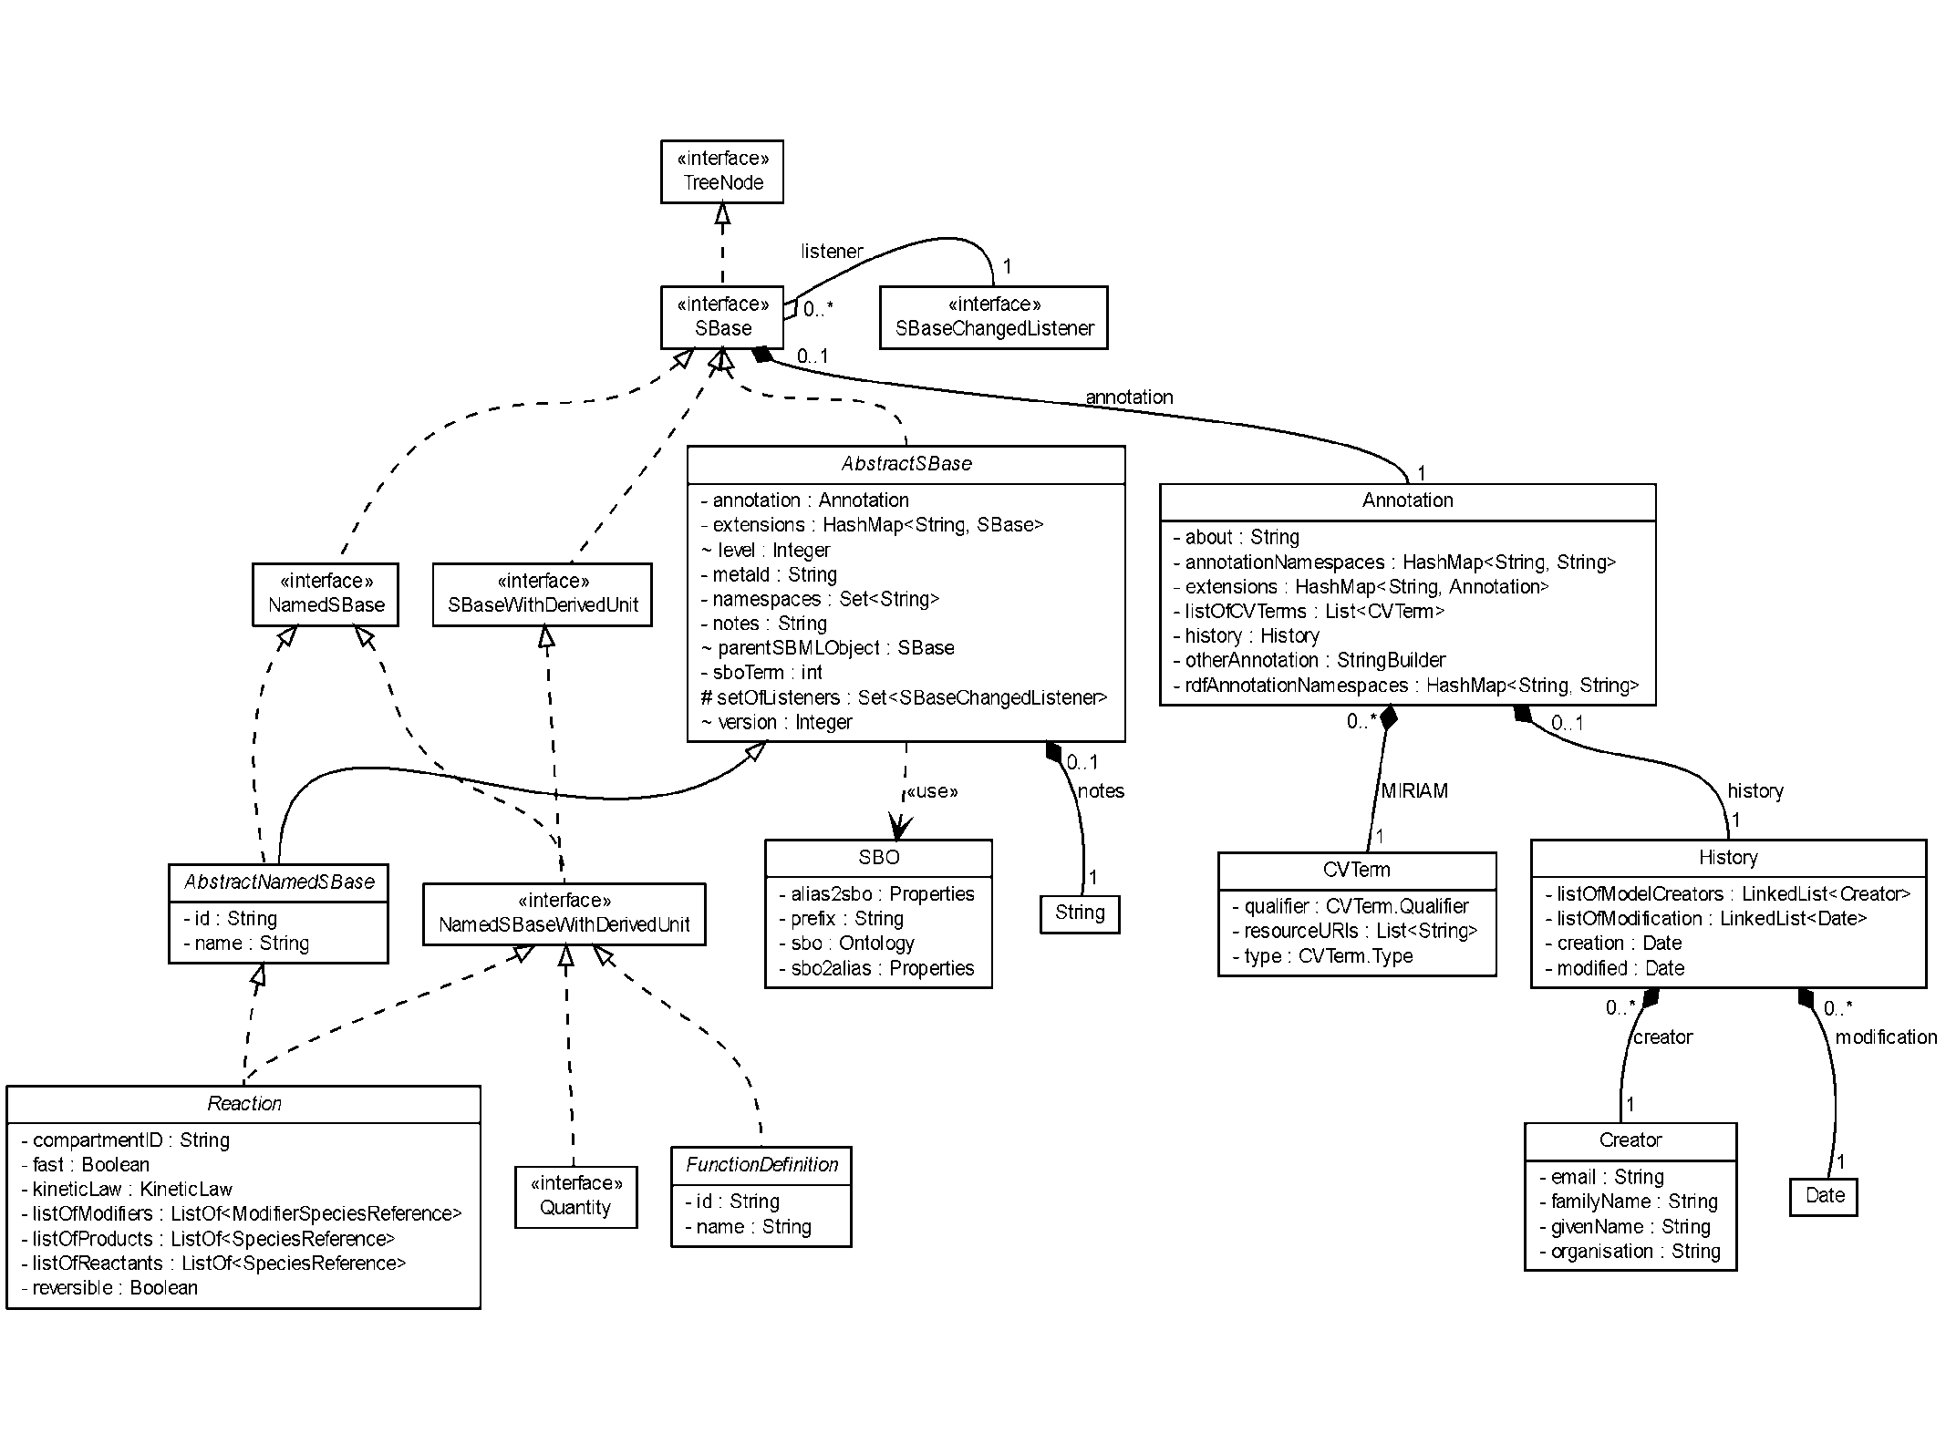
Taking a closer look…
Add detailled type hierarchy

Slide 6
Roadmap
We will have a release before the end of the year
(probably end of October or during November)
Version : jsbml-0.8.x
  complete support for SBML level 2
  parse notes, annotation into XMLNode and math elements into ASTNode
  implement the functions converting ASTNode to infix formula
  Add more tests files, both tests from the libSBML java API and some new tests.
  Improve the documentation
Version : jsbml-1.0.x
  complete support for SBML level 3 (and level 1)
  implementation of the getTypeCode() methods
  implementation of the toSBML() methods
  implement constructor and methods with namespaces
  implement a libsbml compatibility module
  have a correct indentation when writing the SBML

Slide 7
Thanks http://jsbml.sourceforge.net/
Nicolas Rodriguez¹
Marine Dumousseau¹
Andreas Dräger²
Clemens Wrzodek²
Alexander Dörr²
Sarah M Keating¹
Akiya Jouraku^{3,4}
Nicolas Le Novère¹
Andreas Zell²
Michael Hucka⁵
¹European Bioinformatics Institute (EBI), Hinxton, United Kingdom
²Center for Bioinformatics at the University of Tuebingen (ZBIT), Germany
³Keio University, Yokohama and 5National Institute of Agrobiological Sciences, Japan
⁴California Institute of Technology, Pasadena, California, United States

