Slide 1
Care and Feeding of
Computer-Controlled Potentiostats
Penn State Corrosion Short Course
June 2010
Notes:
I’m Max Yaffe
V.P. & one of the 3 founders of Gamry Instruments.
I’m an electrochemist, engineer, computer hacker, whatever it takes to create these instruments.
So lets start with the part of this business you’re most interested in--

Slide 2
What’s a Potentiostat?
Potentiostat
  An electronic instrument that measures and controls the voltage difference between a Working Electrode and a Reference Electrode.
  It measures the current flow between the Working and Counter Electrodes.
Notes:
So in words, what is a potentiostat?
Job1: Control the potential of the Working Electrode
Job2: Measure the current
Job 3: Measure the potential (self-check on job 1)
A potentiostat, by classical definition, doesn’t have to measure anything! It just holds (stats) a potential. In reality, you are generally interested in knowing the current and it is a good idea to measure the potential although it isn’t required.
In our previous software and all of our competitors software, it is assumed that the applied potential is the same as the measured so why bother measuring. In V3.0, we always measure the potential independently.

Slide 3
What is Potential?
Potential or Voltage (E, sometimes V):
  Unit: Volt
  The Potential is the driving force for the redox reaction.
  The potential is related to the thermodynamics of the system:
  ΔG = -n F ΔE (negative ΔG is spontaneous)
  Potential is always measured versus a Reference Electrode.
  A positive voltage is oxidative and a negative voltage is reductive.
  0 Volts is not nothing! Redox reactions happen at 0 volts that do not happen at +1 volt.
There is no correlation between the thermodynamics of the chemical system and the kinetics (rate) of the reaction.

Slide 4
What is Current?
Current (i):
  Unit: Ampere
  Electron flow is the result of a redox reaction.
  Current measures the rate of the reaction (electrons per second).
  Zero current is nothing, i.e., if the current is zero, no redox reactions are occurring (that’s not quite true in corrosion!).
  Anodic (oxidation) and cathodic (reduction) currents have different polarity (signs).
  Current may be expressed as current or current density.

Slide 5
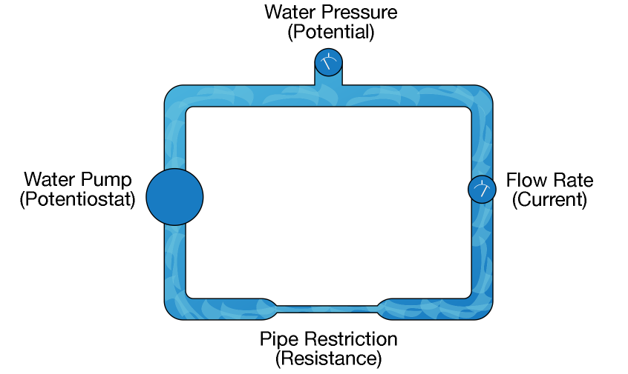
An Analogy of Potential and Current as a Flowing Water Circuit

Slide 6
Electrodes
  A Potentiostat works with three electrodes immersed in a conductive electrolyte.
  Working Electrode
  A sample of the corroding metal being tested.
  Reference Electrode
  An electrode with a constant electrochemical potential.
  Counter Electrode
  A current-carrying electrode that completes the cell circuit.
Notes:
A potentiostat generally requires three electrodes. That’s true for both field probes and lab cells. There are some places where 2 electrode potentiostats are useful.
The working electrode represents the system being studied. It can be bare metal or coated.
The reference electrode potential has a constant electrochemical potential as long as no current flows through it. The most common lab references are the SCE and the Ag/AgCl electrodes. In field probes, a pseudo-reference (a piece of the working electrode material) is often used.
The counter electrode in lab cells is generally an inert conductor like platinum or graphite. In field probes it's generally another piece of the working electrode material. The current that flows into the solution via the working electrode leaves the solution via the counter electrode.

Slide 7
Why does a Potentiostat have three electrodes?
We would like to study the electrochemical events taking place at one specific electrode…the Working Electrode. The use of a three-electrode potentiostat with a separate Reference and Counter Electrode allows the potential at the WE and the current at the WE to be measured with little or no “interference” or “contribution” from the other electrodes.

Slide 8
Pay Special Attention
to the Reference Electrode!
  A Potentiostat needs a low impedance Reference Electrode!
    Use large junction reference electrodes
    Replace isolation frits regularly
    Avoid narrow Luggin Capillaries
  Potentiostats are less forgiving of high-impedance Reference Electrodes than pH Meters!
  If there’s an problem with the cell, it’s almost always the Reference Electrode!
Notes:
One of the most sensitive components is the reference electrode. Our website has several technical articles about reference electrodes that you can check out after you’re more comfortable with the equipment.
Noise is a problem. A high impedance reference electrode acts like an antenna. You’d like as low an impedance as possible.
If the reference impedance can also cause potentiostats to oscillate causing all sorts of bizarre behavior. I’ll talk about this in a bit.
Reference electrode contents can pollute the chemistry. One common reference is Ag/AgCl in KCl. Chloride from the reference can activate corrosion of normally passive materials.
You can check out our website for tech tips about reference electrodes and the nasty things they do to potentiostats

Slide 9
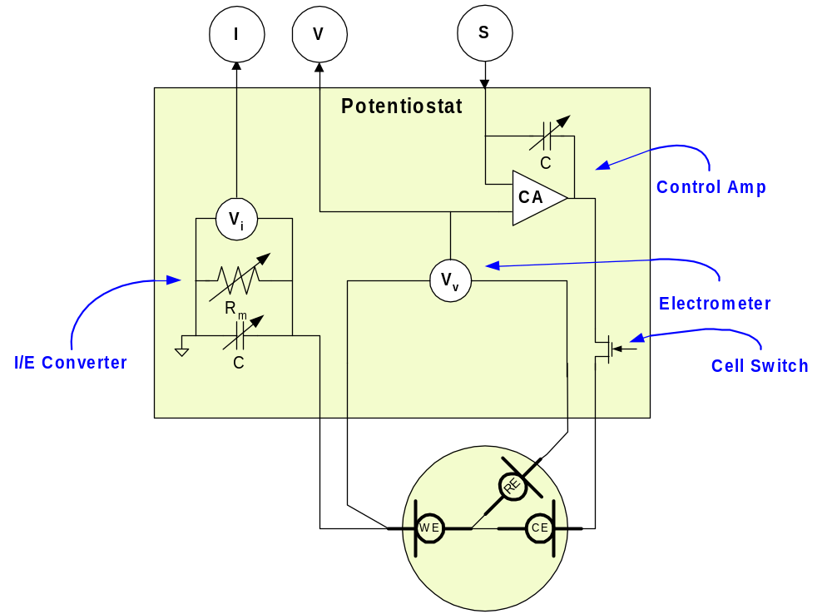
The Analog Potentiostat
Notes:
A few more pieces go into the control section of the potentiostat.
Here’s the actual ammeter which we call an I/E converter. It’s made up of a Range Resistor and a Voltmeter. The range resistor is selectable. In a PC4-300 there are 9 decade ranges from 300 mA full scale down to 3 nA. Most techniques automatically set the appropriate range for the current you’re trying to measure.
The cap controls the speed of the I/E converter. There is a noise/speed tradeoff. Too much noise? Slow it down.
There is another cap across the control amp which is also tweaked depending on the experiment.
Finally there is a cell switch. Actually there are two -- a Solid State one, and a relay. This is used for current interrupt and to keep from frying your electrode when the pstat is in some indeterminate state.

Slide 10
Three Primary Components of a Potentiostat
Control Amplifier: Supplies the power to maintain the controlled potential between the Working and Reference Electrodes.
Electrometer: Measures the potential difference between the Reference and Working Electrodes.
Current-to-Voltage Converter: Measures the current between the Working and Counter Electrodes.

Slide 11

A Potentiostat is a feedback/servo device…measure the voltage (electrometer), apply power from the Control Amp…repeat until the experiment is finished.
What happens if the feedback is too slow in our Potentiostat…uhh, shower?
Skin = Electrometer
Hand = Control Amp
Water is too hot
  Turn the knob to COLD
  2 seconds later, you’re freezing !
  Turn the water to HOT
  2 seconds later, you’re scalded !
  Turn the knob to COLD
  Repeat
Then an electrochemical reaction occurs by flushing the toilet!

Slide 12
Do you need to know how a Potentiostat works?
No.
Do you need to be able to recognize when something is wrong?
Yes!
Why would something go wrong?
Because the performance of the Potentiostat is affected by the electrical characteristics of the sample…or something in the cell is causing a problem…or the Potentiostat is busted!

Slide 13
To Evaluate Your Electrochemical Data…
Look At It!
Electrochemical data is always a collection of individual data points…one followed smoothly by another.
Noisy data is bad.
Flat-lined data is bad.
Overloads are bad.
It is very rare to collect bad data that looks good.

Slide 14
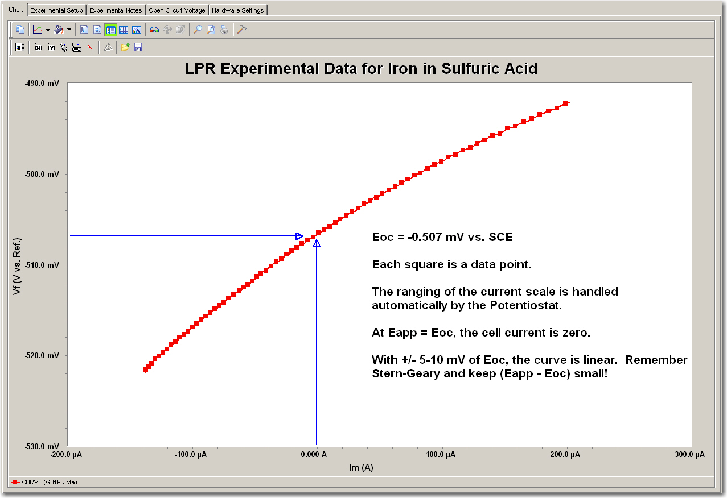
Notes:
If electrochemical data looks good, it almost certainly IS good.

Slide 15
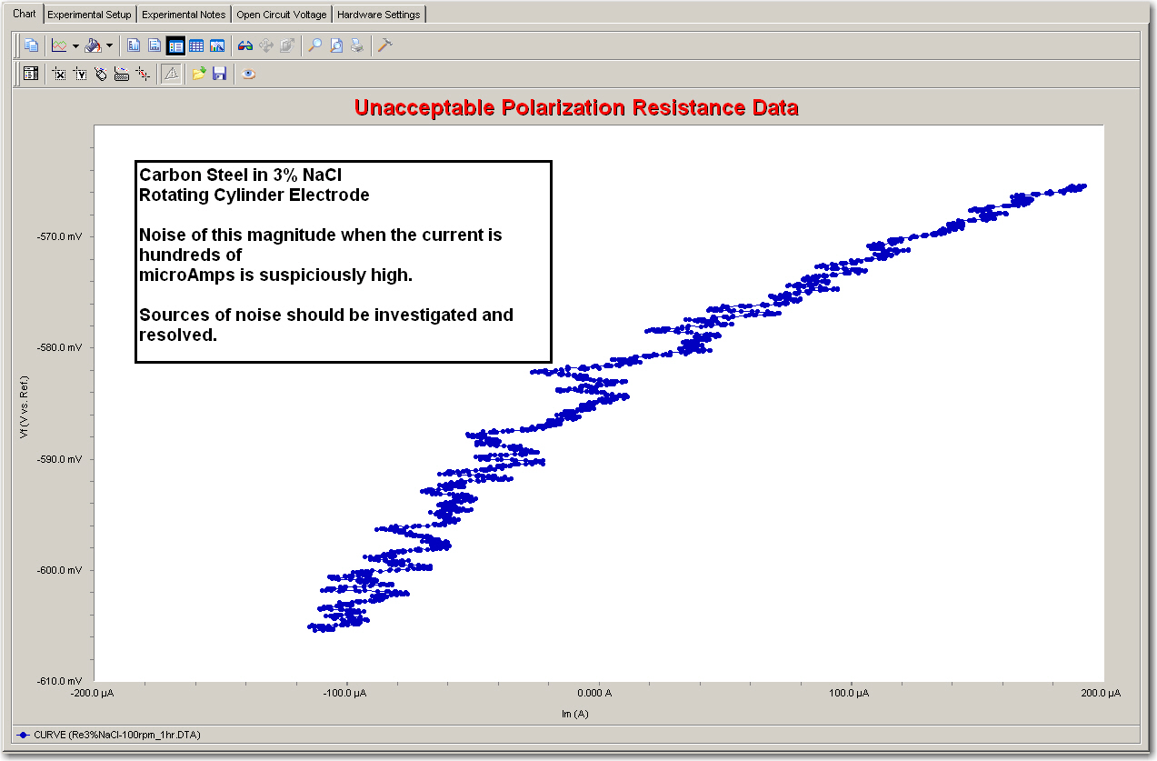

Slide 16
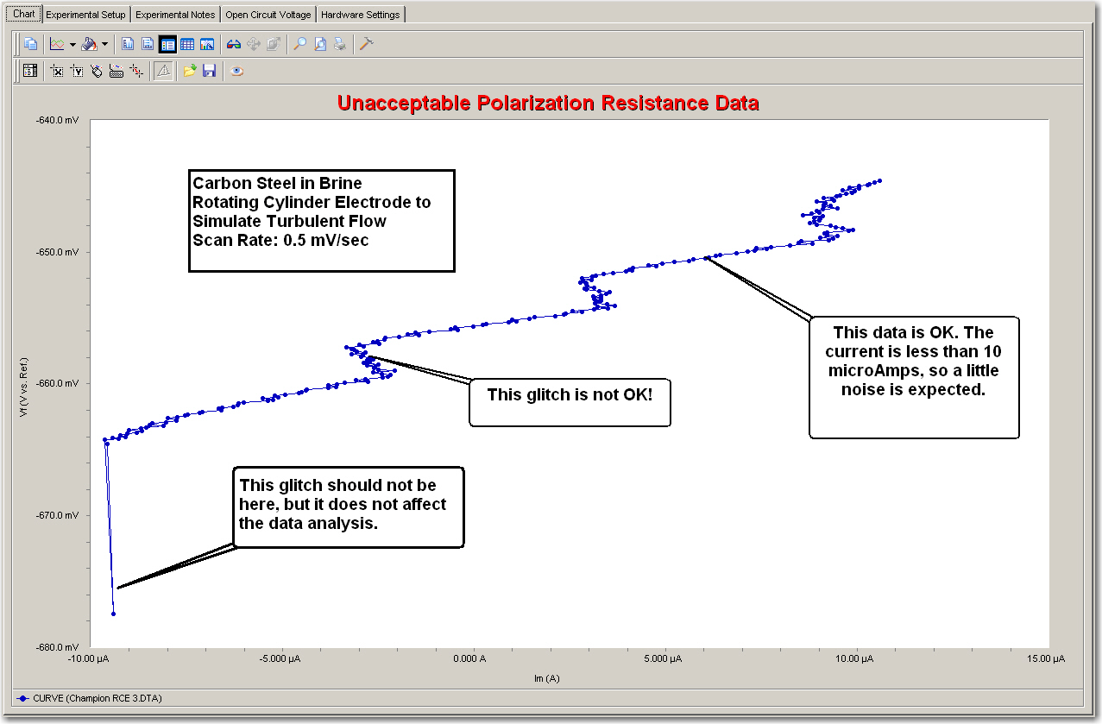

Slide 17
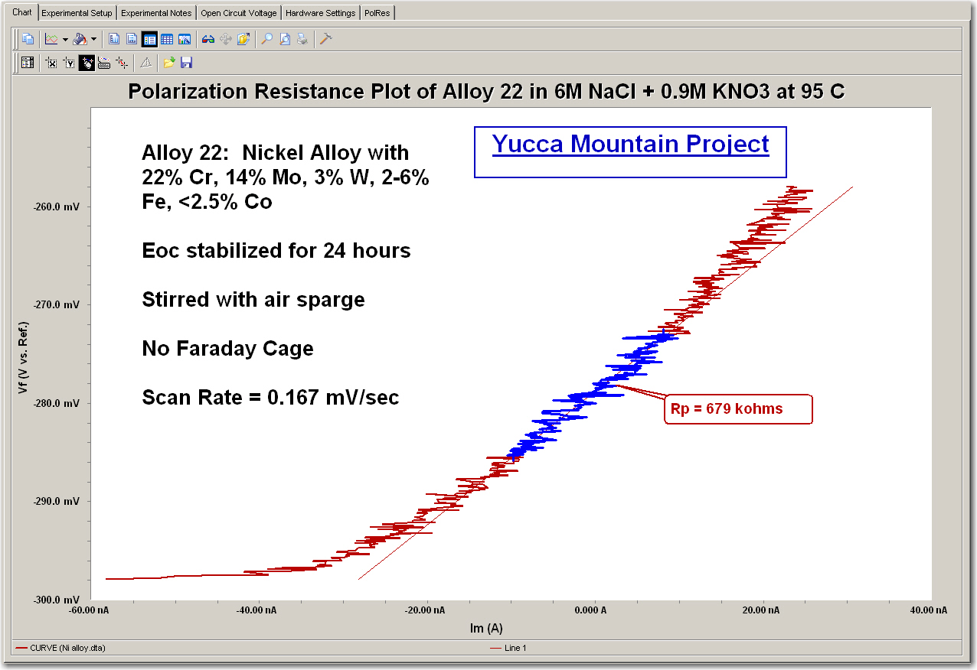

Slide 18
My Data Is Bad. Now What Do I Do?
Calibrate the Potentiostat.
If calibration is successful, check the Potentiostat by running a dummy cell (a network of resistors/capacitors that give a known result).
If the instrument is OK, then check the cell. Check the Reference Electrode first!
If the cell is OK, then it’s something in your sample chemistry. Do you need a Faraday Cage?
At some point, you should contact your Potentiostat supplier for technical support.

Slide 19
The One Equation You Need to Know
Ohm’s Law
E = iR
If I apply 100 mV to a 1000 ohm resistor, I should measure a current of…
100 µA

Slide 20
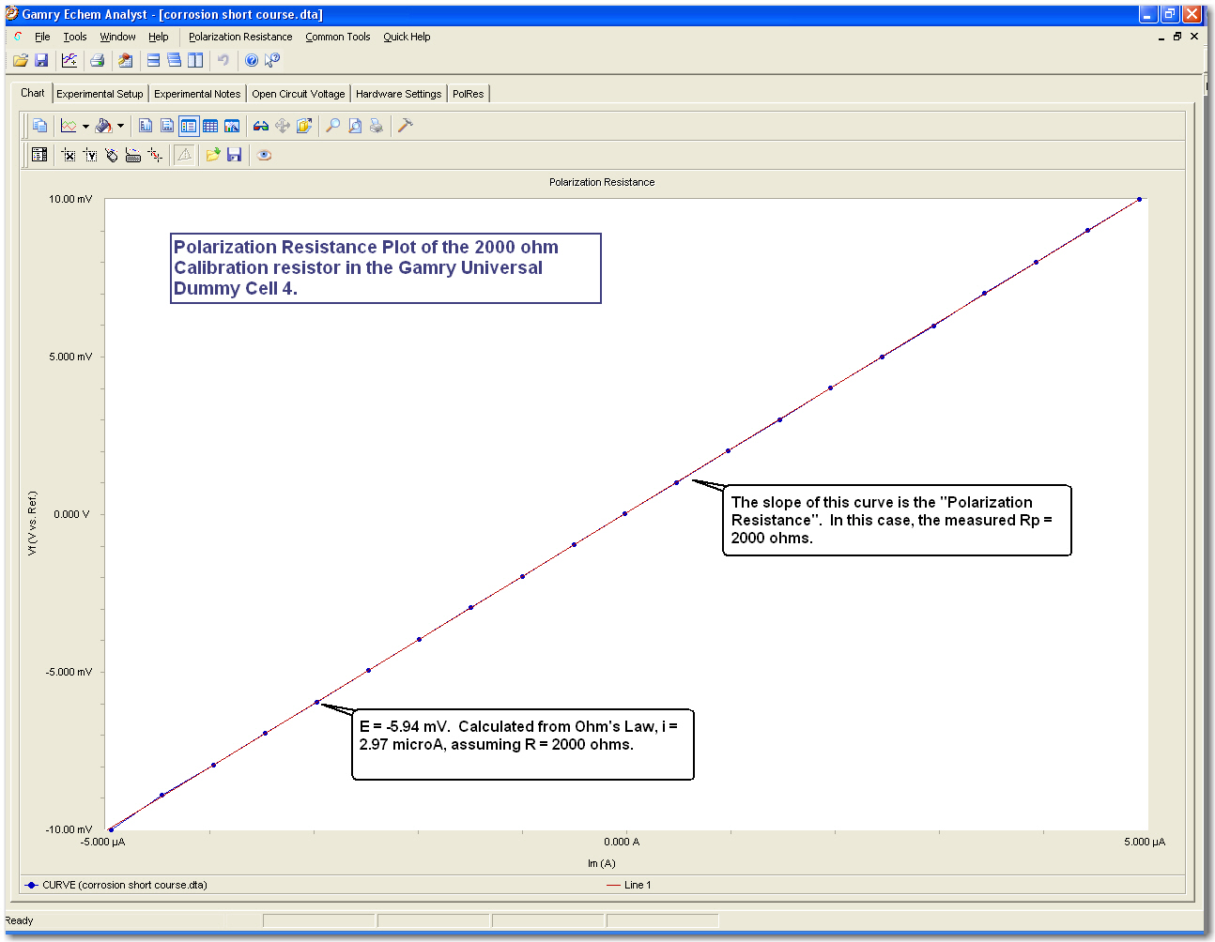
Pstat Check-Out: PolRes on a 2000 Ohm Resistor

Slide 21
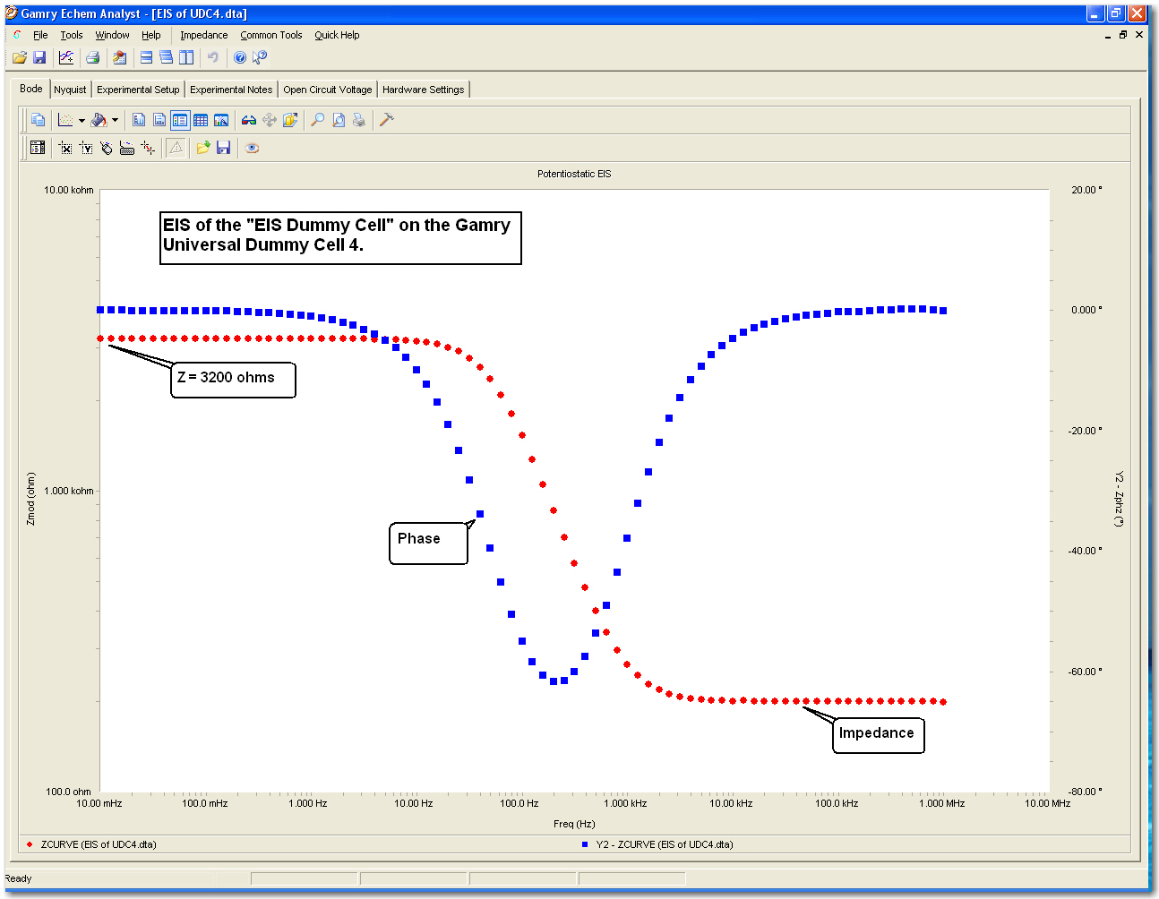
Pstat Check-Out: EIS on a Dummy Cell

