Slide 1




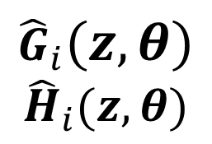






Optimal Experiment Design: practical implementation
$${\hat{G}}_{i}\left(z,θ\right)$$
$${\hat{H}}_{i}(z,θ)$$
$$u_{i}(t)$$
$$y_{i}\left(t\right)$$
System
Identification
Experiment
$$u_{i+1}(t)$$
Experiment
Design
$$A_{i}$$
$$α_{i}$$
$$f( .)$$
$$g( .)$$
$$f\left( .\right):$$
function that extracts multi-sine coefficients from signal
$$g\left( .\right):$$
function that evaluates covariance of damping coefficients
$$u\left(t\right)=\sum_{i=1}^{M}{A_{i}\cos\left(ωit\right)}$$

Slide 2

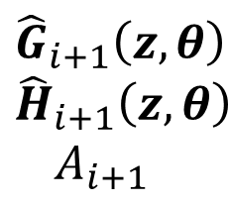
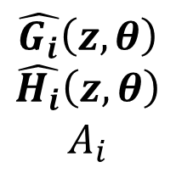



Optimal Experiment Design: practical implementation
$$\hat{G_{i}}\left(z,θ\right)$$
$$\hat{H_{i}}\left(z,θ\right)$$
$$A_{i}$$
$${\hat{P}}_{i+1}$$
$${\hat{G}}_{i+1}\left(z,θ\right)$$
$${\hat{H}}_{i+1}\left(z,θ\right)$$
$$A_{i+1}$$
$$A_{i+1}$$
$$P_{i}$$
$$P_{i+1}$$

Slide 3
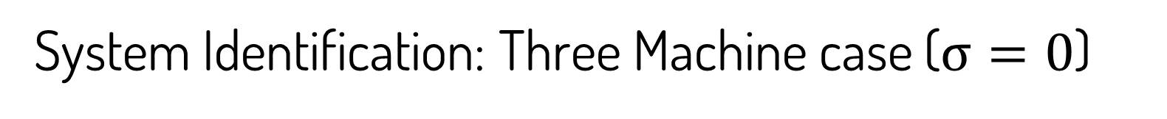
System Identification: Three Machine case ($σ=0$)

Slide 4
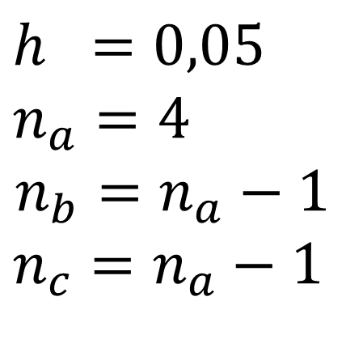
System Identification: Three Machine case ($σ=0$)
$$h =0,05$$
$$n_{a}=4$$
$$n_{b}=n_{a}−1$$
$$n_{c}=n_{a}−1$$

Slide 5
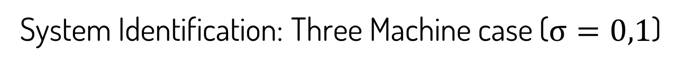
System Identification: Three Machine case ($σ=0,1$)

Slide 6
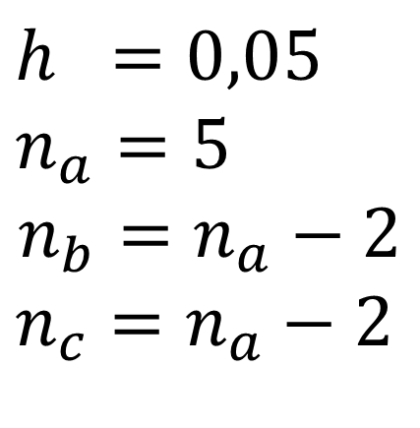
System Identification: Three Machine case ($σ=0,1$)
$$h =0,05$$
$$n_{a}=5$$
$$n_{b}=n_{a}−2$$
$$n_{c}=n_{a}−2$$

Slide 7

System Identification: Five Machine case ($σ=0$)

Slide 8
System Identification: Five Machine case ($σ=0$)

Slide 9
System Identification: Five Machine case ($σ=0$)

Slide 10
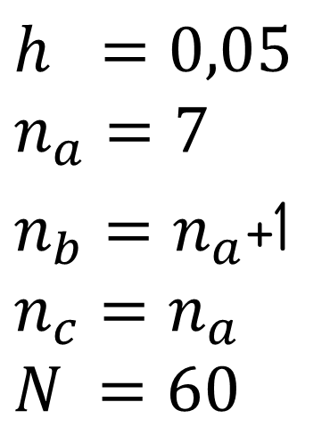
System Identification: Five Machine case ($σ=0$)
$$h =0,05$$
$$n_{a}=7$$
$n_{b}=n_{a}$+1
$$n_{c}=n_{a}$$
$$N =60$$

Slide 11

System Identification: Five Machine case ($σ=0,01$)

Slide 12
System Identification: Five Machine case ($σ=0,01$)

Slide 13
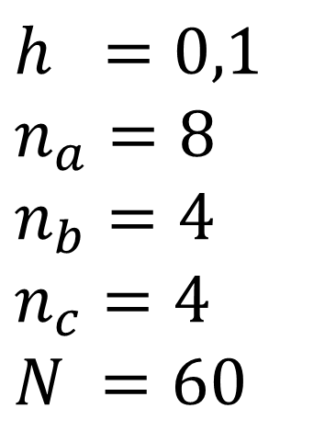
System Identification: Five Machine case ($σ=0,01$)
$$h =0,1$$
$$n_{a}=8$$
$$n_{b}=4$$
$$n_{c}=4$$
$$N =60$$

Slide 14
System Identification: Five Machine case ($σ=0,01$)

Slide 15
System Identification: Five Machine case ($σ=0,01$)

Slide 16
System Identification: Five Machine case

Slide 17
System Identification: Five Machine case

Slide 18
System Identification: Five Machine case

Slide 19
System Identification: Five Machine case

