Slide 1
Enhancement 1 Initial Technical Recommendations Session
BoGoodSki
November 5, 2019

Slide 2
Agenda
Introduction
Enhancement 1 Technical Goals – Description
System Architecture Assumptions
System Architecture Alternative:
Description
Example (Use case)
Benefits
Technical Discovery Goals – Description
Next Steps

Slide 3
Introduction
The initial phase of Enhancement 1 is Discovery.
As of Nov., 2019: Discovery is currently in progress.
This presentation discusses technical assumptions identified prior to Discovery and during its early phase:
Based on:
System architectural documents.
Initial Discovery discussions.
Previous experience working with stakeholders.
Most shortfalls and recommendations for the technical enhancement will be uncovered during continued Discovery.

Slide 4
Perceived Shortfalls
Applications lagging policy and technology advancements.
User interfaces not prepared for the modern workforce, with little responsiveness to mobile, tablet, and IOT devices, nor adherence to modern design principles.
Fails to implement Angular component library.
Applications without functionality required by the user groups.
Possible cost-savings missed due to lack of implementation of modern efficient technologies.
General data standardization issues:
Unclear if one authoritative set of data exists to support enterprise-level decision-making.
No strategy for use of Extract/Transform/Load (ETL) and/or Data Virtualization processes.
Integrity of data among disparate applications.
Notes:
The missing required functionality bullet invites a desired conversation about intended automation that wasn’t implemented (EDPA, for example, automating the certification application process) but is still needed. The functionality is still required to support organizational goals such as risk-based and data-supported decision-making, and standardization of processes.

Slide 5
Perceived Shortfalls
Deprecation of system technology:
Microsoft is discontinuing updates to the .NET Framework, moving to .NET Core.
System architecture that fails to allow for modern, rapid, cost-efficient updates:
.NET Core is platform-agnostic, and thus ready for cloud-migration in a way in which the .NET Framework fundamentally is not.
Reliance on Simple Object Access Protocol (SOAP) messaging versus modern RESTful APIs.
Architecture subject to system-wide downtime due to failures or updates:
Example: 2019 outage during Enterprise Services update.
Missing foundational functionality

Slide 6
Thinking Bigger…
The technical recommendations that Enhancement 1 provides should go beyond simply resolving shortfalls.
To best achieve Enhancement 1’s goals, technical recommendations should:
Prepare system to leverage modern technologies in a cost-efficient manner.
Define a path-forward for an implementation that provides data analyses and insights that directly support workforce decision-making.
Describe system architecture suitable that allows for rapid implementation of functionality and changes due to business sponsor needs and policy changes.
Identify a software development process that centralizes business stakeholder input.
Plan for services that scale, with some optimized for heavy workload, others for less – based on historical usage metrics, and real-time usage data going forward.
Design an architecture in which all applications interact intuitively, share internal data, and pull effectively from vetted external data resources.
Outline a data governance plan that standardizes enterprise-level data usage/storage.

Slide 7
Current System Architecture
Currently implements Service Oriented Architecture (SOA):
Data saved to SQL Server 2012 databases;
Business logic written in C# via the .NET Framework;
Work coordinated among disparate client-side applications and the data access layer via Window Communication Foundation (WCF), potentially using service bus(ses) and SOAP-type messaging.
Client-side applications written in .NET MVC, utilizing HTML, CSS, and JavaScript (jQuery).
Data isn’t saved to structures that maximize cost-savings or promote efficiency for the functionalities they serve.
Over-reliance on SQL versus modern non-relational blob, document, and other No-SQL technologies.
Data guidance lacking in both:
Structure
Separating production tables from reporting – Virtualization strategies, ETL, implementing 3rd Party Services, etc.
Policy
Defined roles and definitions: Data-Marts, Warehouses, Data Custodians, Data Stewards, etc.

Slide 8
Current System Architecture
Monolithic-like codebase (and use of agency hosted service bus), other design practices, may contribute to systemic single point failures.
Adding/Updating services requires revisions to entire applications.
As opposed to a strategy that encourages easy stand-up of .NET Core Web APIs, exposing data from small databases dedicated to individual services.
Dev Kit provides Software Development Kits (SDKs) for the following back-end technologies:
Java (Spring)
Node.js
.NET Core
Out-of-date frontend technologies result in complex development cycles that require extensive workload in time and resources.
Recommends use of Angular as the JavaScript front-end framework and has a SDK for support.

Slide 9
System Architecture - Alternative
Without removing the current SOA, all future enhancements could be implemented via the microservice pattern including client-side Single Page (JavaScript) Applications (“SPAs”):
Small, cost-efficient data caches that support individual services;
Business logic exposed via Web API, eliminating the need for service bus(es) and leveraging RESTful APIs;
Supports efficient full-stack development teams that produce small services and service prototypes rapidly for immediate business owner input;
Failures boundary limited to individual services, minimizing vulnerability for system-wide failure;

Slide 10
System Architecture - Alternative
Modern data strategy that implements Virtualization or Extract/Transform/Load, following defined system-level guidance, to consolidate disparate data while separating production data sets from reporting queries;
Portal for on-boarding external users that implements latest LexisNexis technology for identity-proofing and Okta for user/role management;
Implementation of user design principles that meet requirements of modern devices and reflect human factor analyses for expected application behavior;
Architectural and coding principles that incorporate common industry standards, reducing costs in talent procurement by widening the pool of potential developers;
Aligns with Agile software development methodology, supporting business reps’ constant development status awareness, and centralizing coding around their input.

Slide 11
Microservices – Case Example
Business Request: Enhanced searching
Instead of updating the entire codebase, the microservice pattern allows the development team to add this functionality to the existing infrastructure:
Implement cost-efficient ElasticSearch database that is structured specifically to support search functionality.
Write business logic into the .NET Core data access layer, implementing event handling via one of any industry-standard event orchestration tools.
Expose search data via .NET Core Web API endpoint for consumption by the client-side application.
Separate production data from queries via Data Virtualization or ETL.
Client-side application implements modern asynchronous data-fetching requests to call the API endpoint, the presentation layer further filters the data as necessary for display to user.
Development of enhanced search service could be overseen by a single project manager and a small team of front- and back-end developers.
Initial search functionality completed during a two-week sprint, presented in the development environment for stakeholder review.
Design described above is just one option of many – that is, focusing on individual services allows team to try any tool and technology best suited for the specific use case.
Implementing enhanced search service doesn’t require modification to the rest of application.
When completed, enhanced search available as a service to all of application.

Slide 12
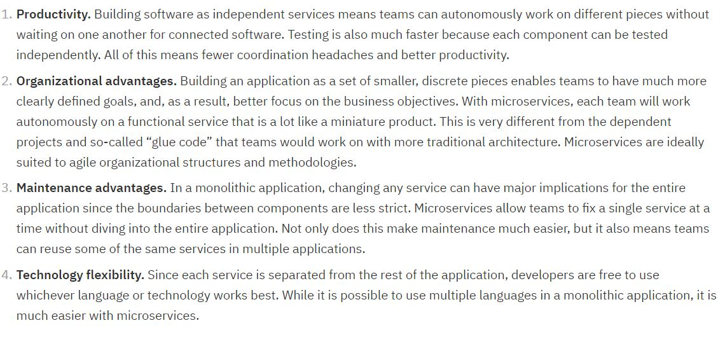
Microservices Promote Integration and Enhancement
Microservices enable integration:
Data are exposed via API:
Allows implementation of Data Virtualization and/or ETL.
API endpoints can provide their data to any tool including:
Future custom-developed applications.
Existing tools.
COTS products:
Palantir Foundry.
Power BI.
Tableau.
IBM (on microservices):
Notes:
Text is small – so bring attention to the relevant key points.

Slide 13
Technical Discovery - Validation
By learning more about the system architecture during the Enhancement 1 Discovery phase, we will:
Understand more thoroughly how the system is designed and functions, and the policy it supports:
Identifying both additional shortfalls as well as successes that can serve as “best practices”.
Confirm the perceived system architecture shortfalls.
Validate the benefits of implementing future functionality via the strategies described here, including microservices and data governance approaches.
Compare current system architecture to the proposed recommendations, identifying potential increased efficiencies in:
Costs.
Resources in both human capital (developers, project managers, etc.) and hardware.
Application performance.
Adaptation of advancing technologies.
Implementation of future functionality due to business sponsor needs and policy changes.
Identify the risks of not mitigating observed system shortfalls.
Notes:
In other words, we are suggesting potential enhancements based on industry best practices, but Discovery still dictates ultimately what technical recommendations will be provided during Enhancement 1.

Slide 14
Questions?
???

Slide 15
Back-Up Slides
Slide Intentionally Blank

Slide 16
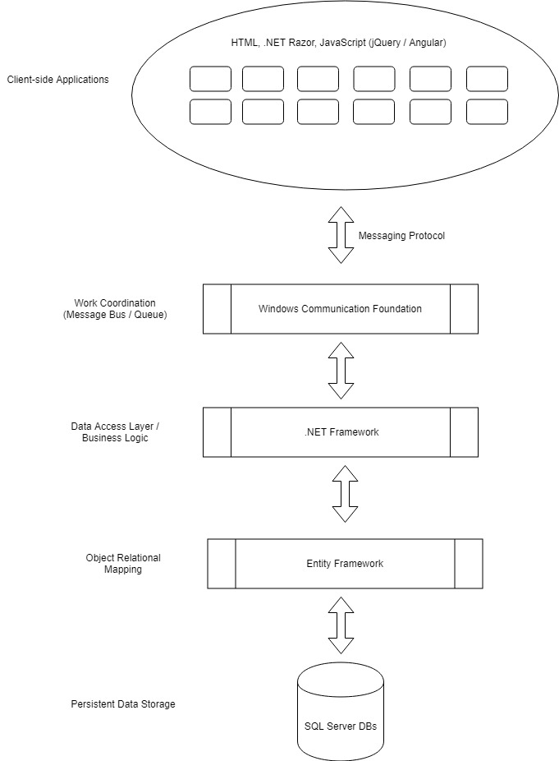
ASKME Architecture Overview - General
Note: This is a super simplified depiction of the general system architecture

Slide 17
ASKME Architecture: Potential System Failures

Slide 18
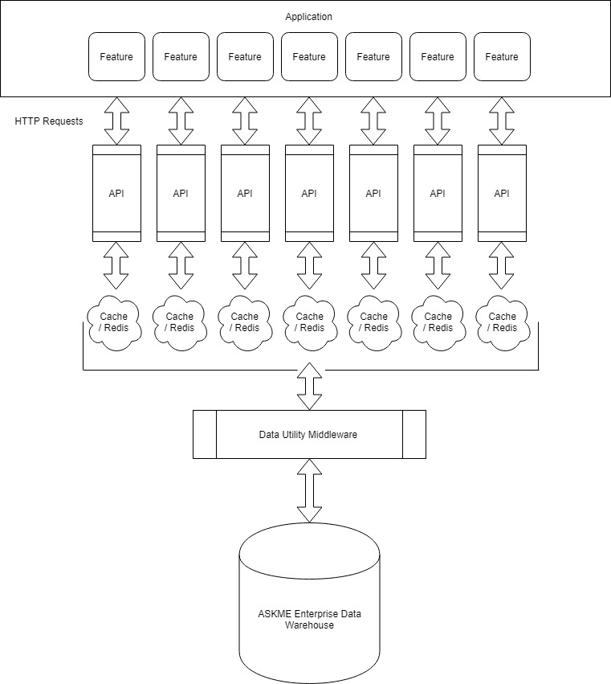
ASKME Future State: Overview
Note: This is a simplified generalization, subject to update based on future Discovery.

Slide 19
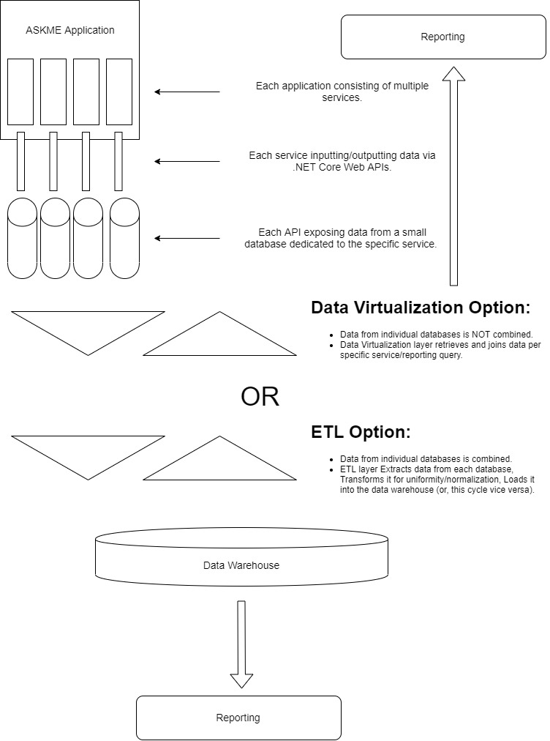
Proposed Data Strategy

Slide 20
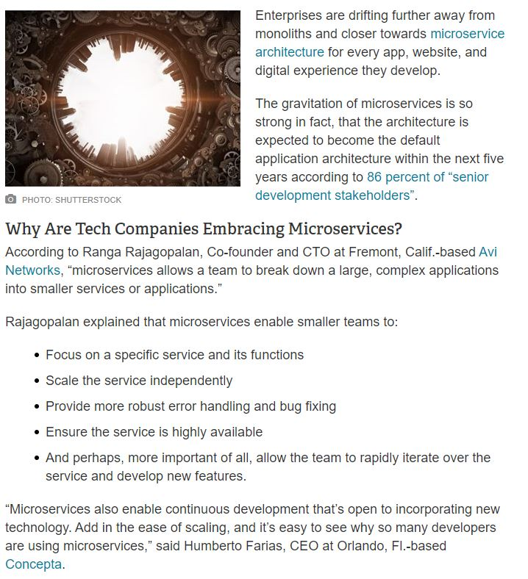
Recommendations: Testimonials
https://www.cmswire.com/information-management/7-tech-giants-embracing-microservices/

Slide 21
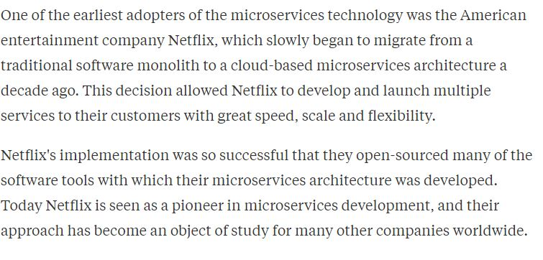
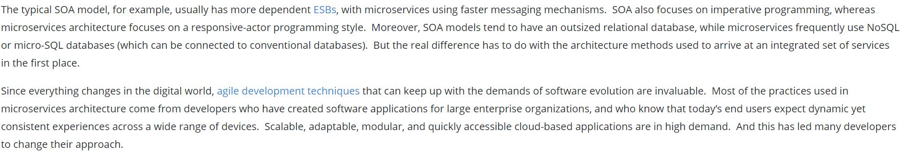
Recommendations: Testimonials
https://www.quora.com/How-can-I-find-out-how-many-companies-are-using-microservices-architecture
https://smartbear.com/solutions/microservices/

Slide 22
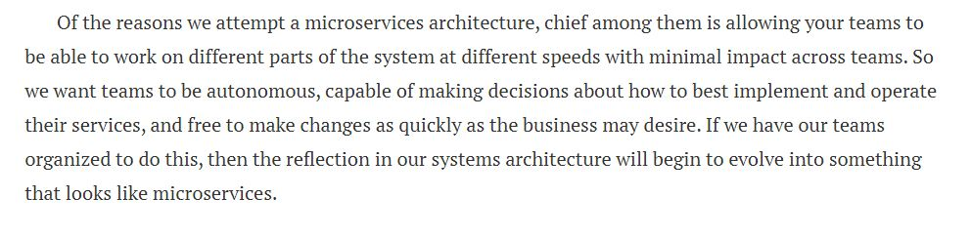
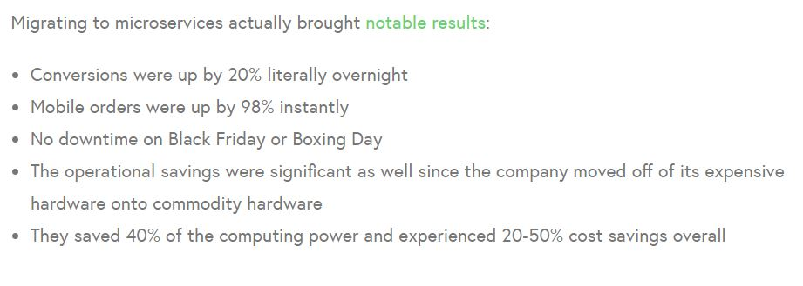
Recommendations: Testimonials
https://blog.christianposta.com/microservices/the-hardest-part-about-microservices-data/
Walmart Canada
https://apiumhub.com/tech-blog-barcelona/microservices-architecture-implementation/

Slide 23
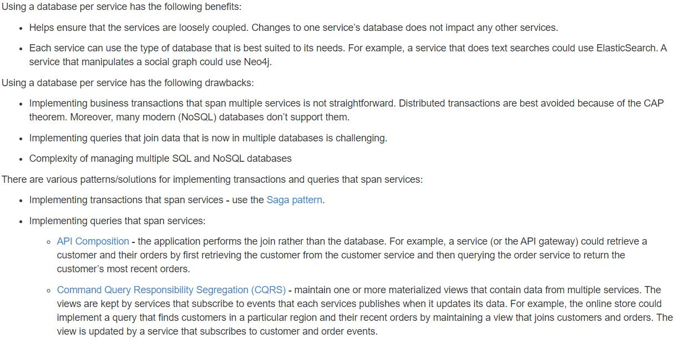
Recommendations: Testimonials
https://microservices.io/patterns/data/database-per-service.html

