Slide 1
If you haven’t done it yet, download and install Anaconda:
https://www.anaconda.com/products/distribution
Download the material for this tutorial at:
https://github.com/sbonaretti/2022_JCWMSK_tutorials
Code (green button) -> Download zip

Slide 2
Tutorial – Day 1 Intro to the Jupyter ecosystem and Python
Serena Bonaretti

Slide 3
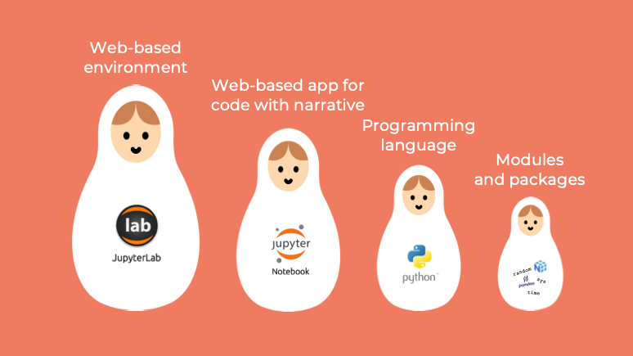
The Jupyter ecosystem

Slide 4
The Jupyter ecosystem

Slide 5
The Jupyter ecosystem

Slide 6
The Jupyter ecosystem

