Slide 1

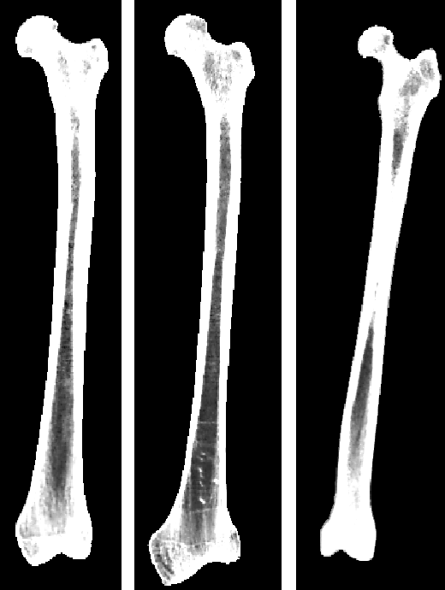
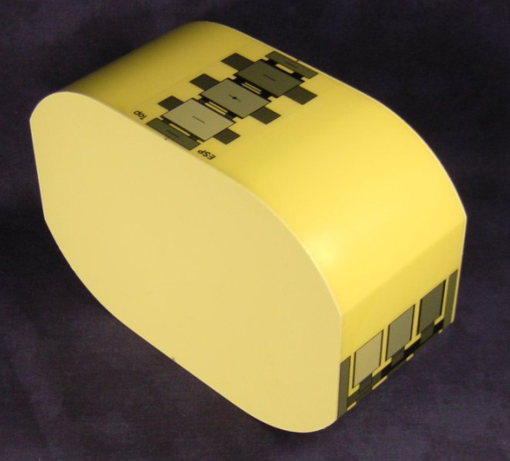
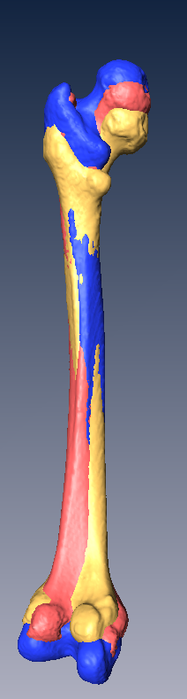
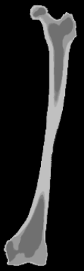
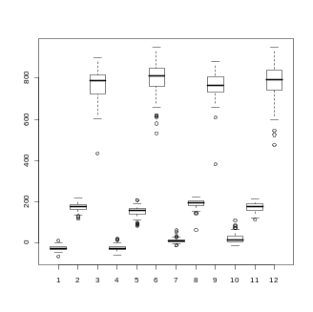
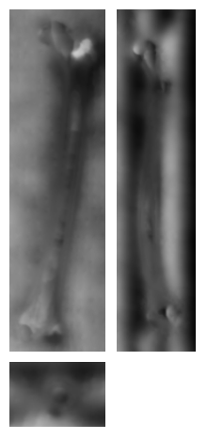
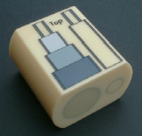
Automatic bone density evaluation from CT images
S. Bonaretti¹, P. Büchler^{1,} N. Reimers², W. Schmidt², C. Seiler¹, S. Weber¹, M. Reyes¹
¹ ARTORG Center for Biomedical Engineering Research– ISTB, University of Bern, Bern, Switzerland
² Stryker Osteosynthesis, Kiel, Germany
Introduction
The evaluation of the bone density from medical images is an important task both in clinical and research fields.
Clinically it is one of the parameters used for osteoporosis prediction and therefore bone fracture risk assessment. It is commonly measured using the Dual Energy Xray Absorptiometry (DEXA).
In biomedical research it can be used to compute the mechanical properties of the bone for subject-specific finite elements models.
We propose a method to evaluate automatically the bone density from CT images. Differences between males and females and the variations between the left and the right sides of the body for the lower extremities are evaluated.
Material
CT images of Caucasian patients.
TIBIA | left male | right male | left female | right female
# patients | 65 | 61 | 80 | 78
Age [yy] | 65.9±15.4 | 66.4±14.7 | 64.1±16.6 | 64.7±16.4
FEMUR | left male | right male | left female | right female
# patients | 69 | 66 | 86 | 81
Age [yy] | 65.9±14.3 | 65.8±14.4 | 64.7±16.4 | 63.8±16.5
Method
CT images segmentation
CT image calibration
Rigid and non-rigid registration
Reference bone labeling
Correspondence calculation
Statistical analysis
Marrow
Cortical bone
HU
Trabecular bone
Preliminary Results
tibia
femur
Lower values correspond to marrow, intermediate ones to trabecular bone, while the higher to cortical bone.
Intensities are higher for males than for females (p<0.05) for cortical bone and marrow.
Female densities are more spread than for males.
No significant differences comparing left and right sides, for both males and females, were found.
HU
HU
left male
left female
right male
right female
left male
left female
right male
right female
Discussion and Conclusion
Hounsfield unit values are lower than expected for the cortical bone, while they are in the expected range for the trabecular bone and marrow. This could be linked to errors in the correspondence detection, due to the small thickness of the cortical bone.
The comparison between males and females underlines both higher densities for men and larger differences among women. Both results can be linked to the variation of bone density that affects women after 40 years old.
9th Annual Meeting of CAOS-International. Boston, MA, USA, June 17-20, 2009
ARTORG Center for Biomedical Engineering Research – ISTB
University of Bern
Stauffacherstrasse 78
CH-3014 Bern, Switzerland
+41 31 631 59 48
serena.bonaretti@artorg.unibe.ch

