Slide 1
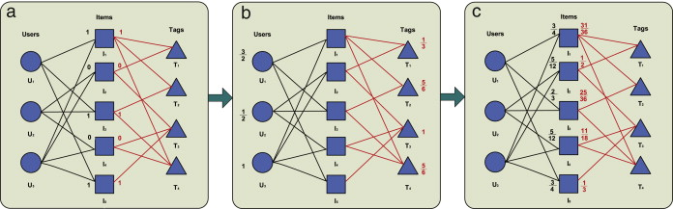
Tripartite graph structure learning

Slide 2
Contents
Overview
Sentence Generation Overview
Method 1
  Case 1
  Case 2
Method 2
Results

Slide 3
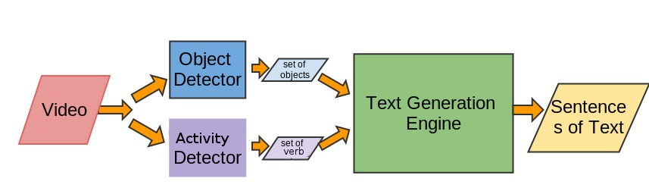
Video to Text Overview

Slide 4
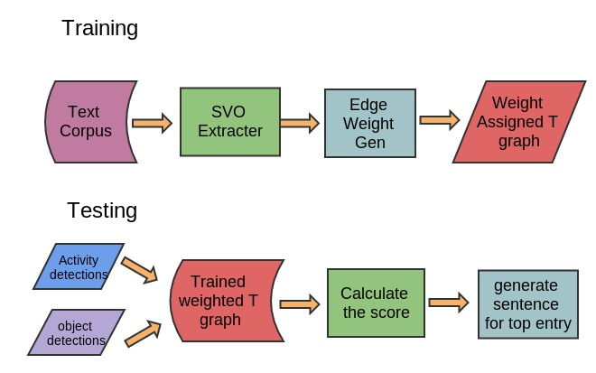
Text Sentence Generation

Slide 5
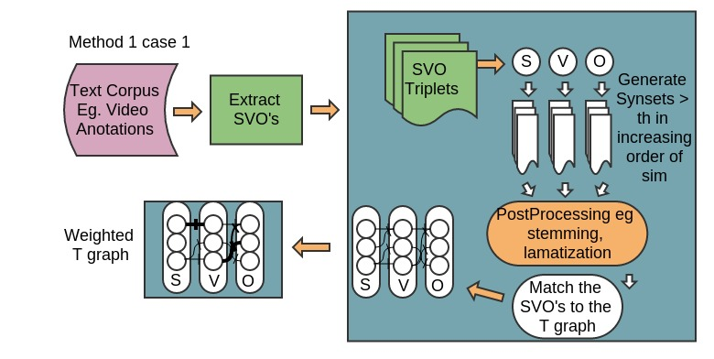
Proposed Methods

Slide 6
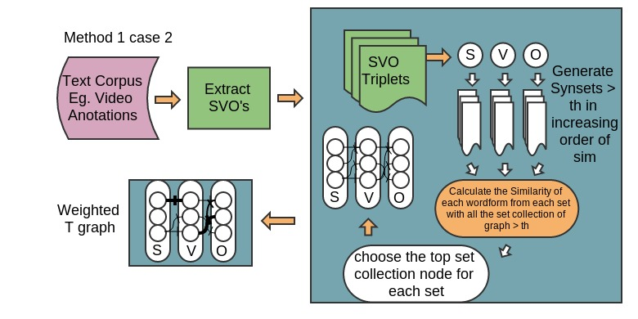
Proposed Methods

Slide 7
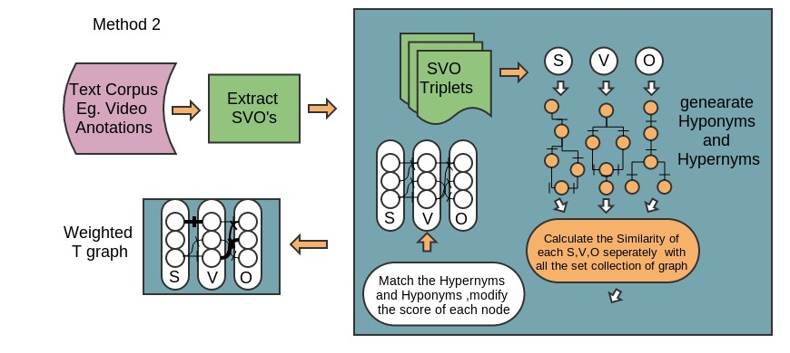
Proposed Methods
Node Score =

Slide 8
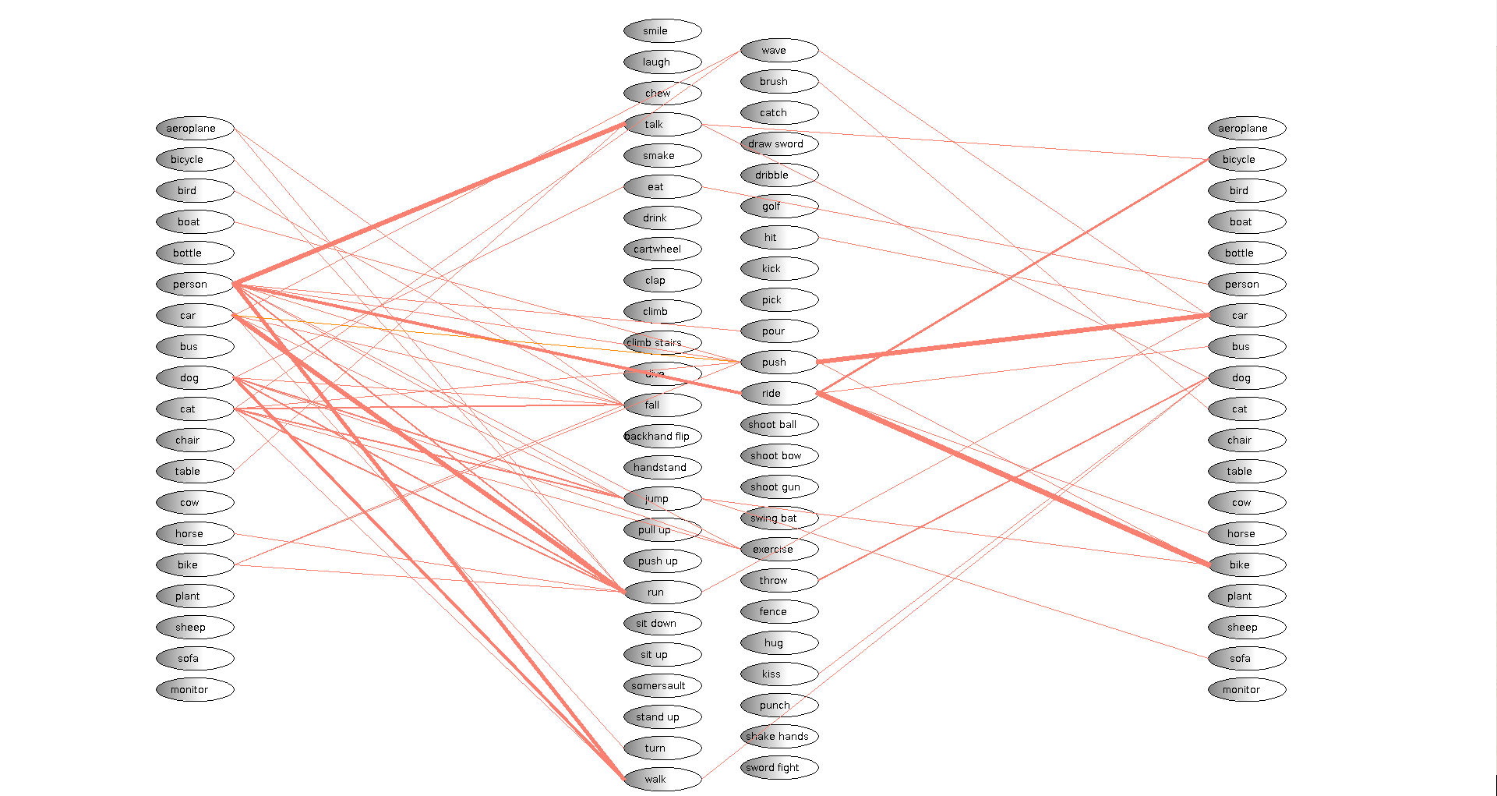
Results: Method1 case1 weighted
Subject Verb objects

Slide 9
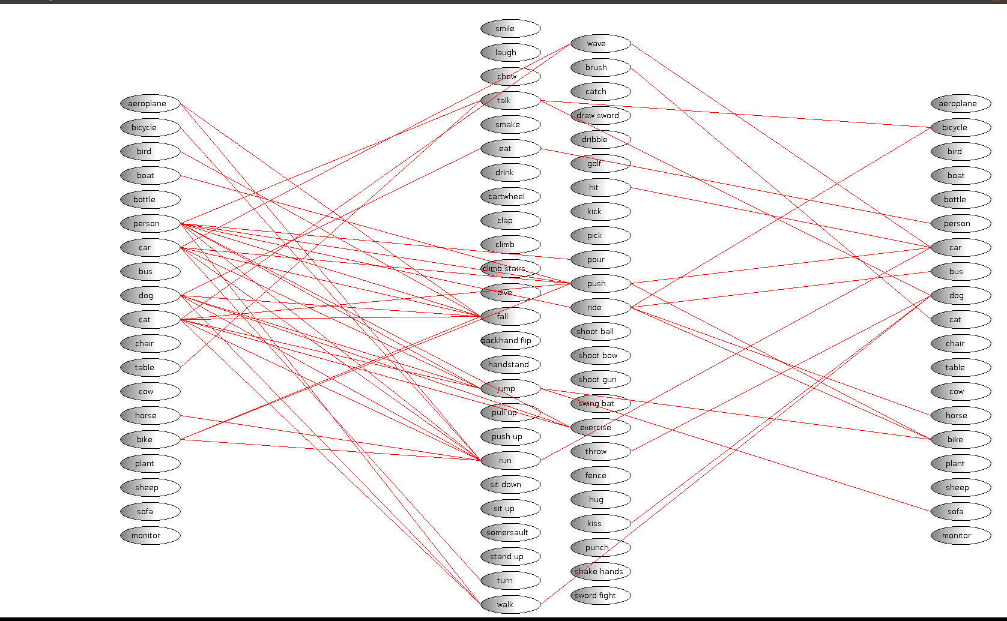
Results: Method1 case1 Non-weighted
Subject Verb objects

Slide 10
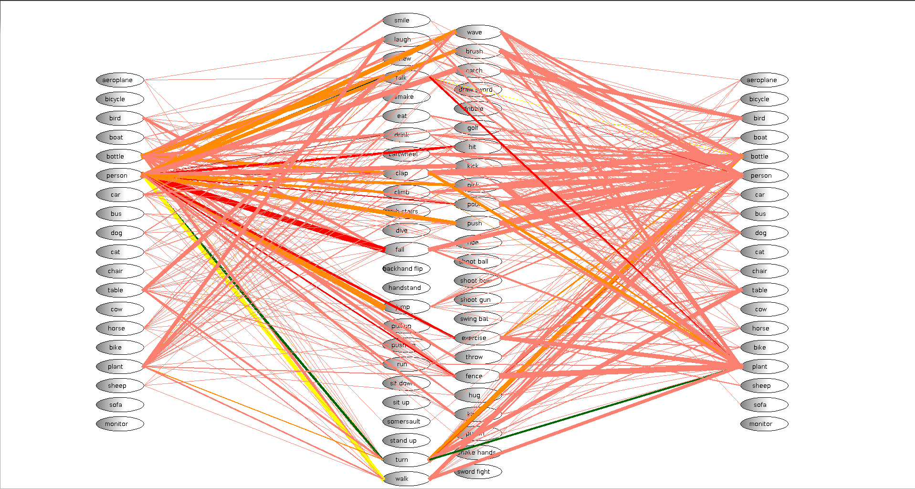
Results: Method1 case2 weighted
Subject Verb objects

Slide 11
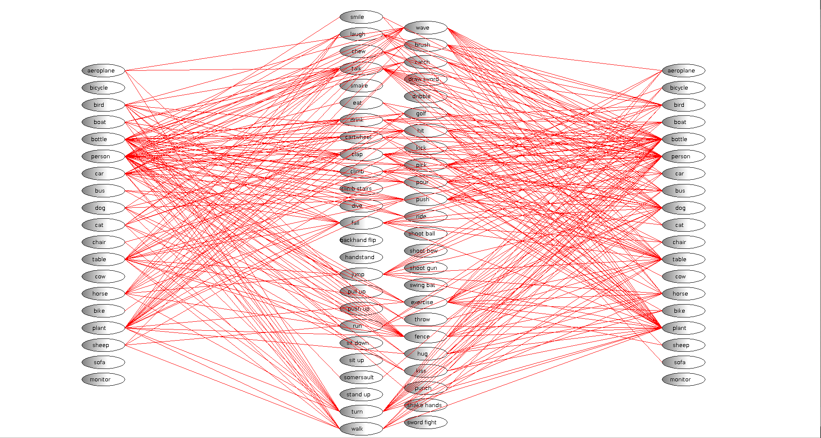
Results: Method1 case2 Non-weighted
Subject Verb objects

Slide 12
Results:
Each method outputs two files along with the graph
The files are
1. edgeweight.txt – outputs the connection and its weight,which could be used for calculation of triplet scores
2.SVOoutput.txt – outputs the list of SV,VO and SVO results along with their counts
Methods | Time Taken to complete execution using
Method 1 case 1 | 31 min
Method 1 case 2 | 1h 2 min
Method 2 | 33 min
Table 1: list of methods and time taken to calculate the results for the 3500 annotations text

