Slide 1
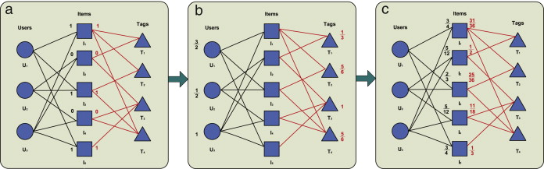
Tripartite graph structure learning

