Slide 1
Cookie Sales per Median Income

Slide 2
Linear Regression Model
X = median income
y = boxes sold per digital transaction
sklearn train-test-split (80%, 20%)
Raw data
Scaled data
sklearn LinearRegression()
Calculations
R-squared
Model coefficient/intercept
Mean squared error

Slide 3
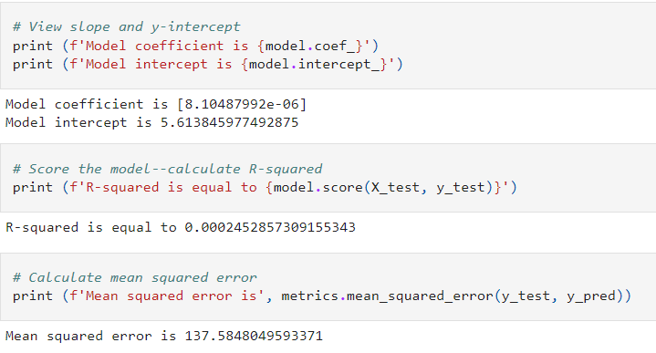
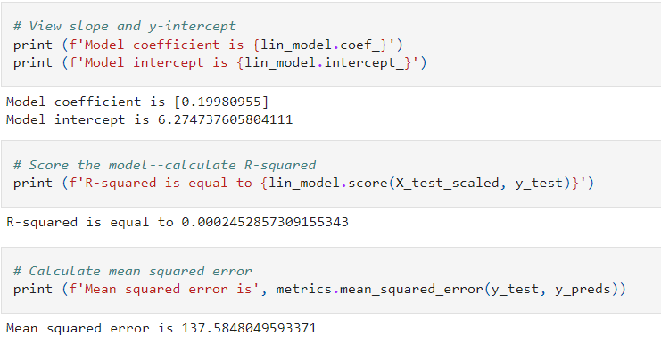
Linear Regression Results
Raw Data:
Scaled Data:

Slide 4
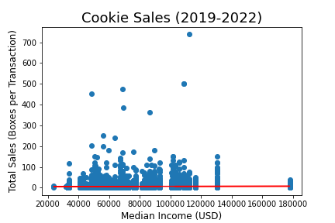
Linear Regression Conclusions
The model is not a good predictor of boxes sold per digital transaction based on median income.
Individuals are just as likely to buy the same number of boxes in any income area.
The high MSE can be attributed to high variation and outliers in sales data.

