Slide 1
Research Questions
Does median income predict individual digital cookie sales?
Linear Regression Model
Do sales of cookie types based on single digital transactions predict low or high income areas?
Logistic Regression Model

Slide 2
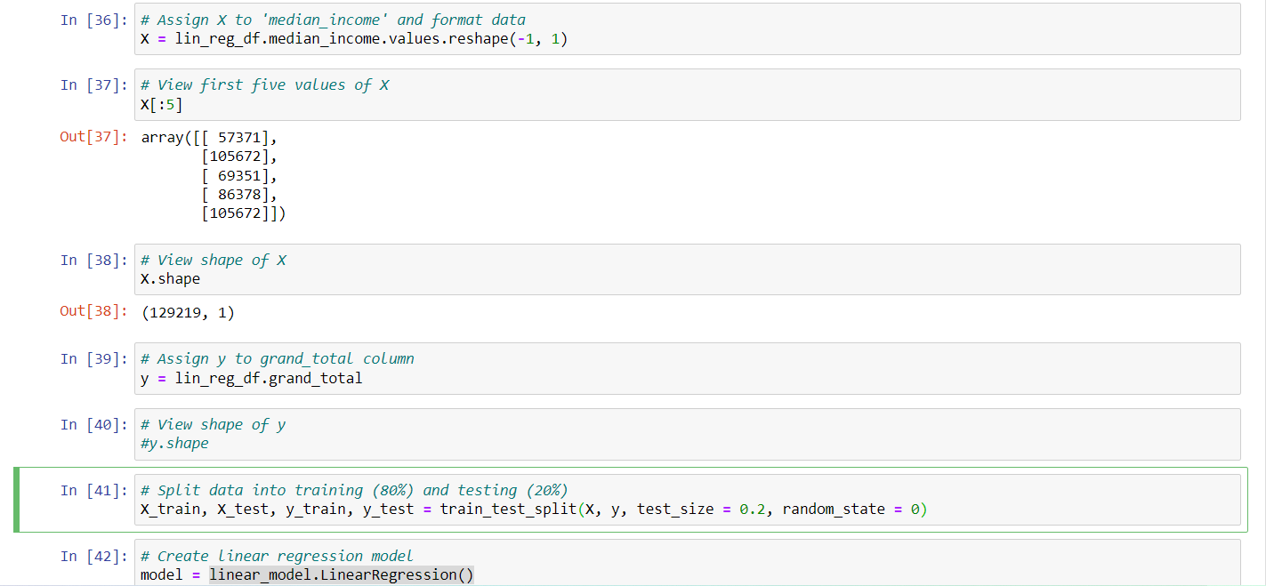
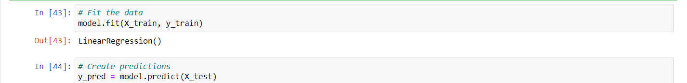
Linear Regression Model
X = median_income
y = grand_total
sklearn train-test-split (80%, 20%)
Raw data
Scaled data
sklearn LinearRegression()
Calculations
R-squared
Model coefficient/intercept
Mean squared error

Slide 3
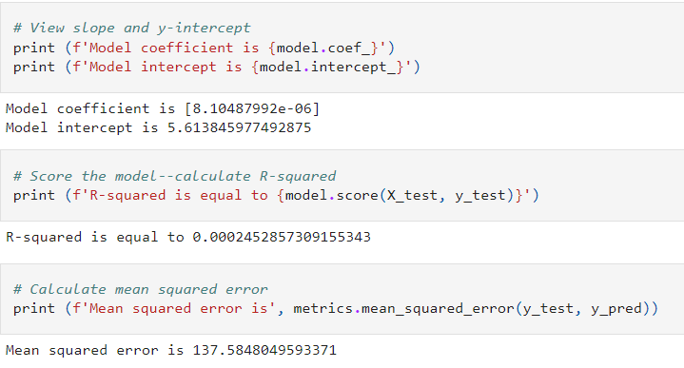
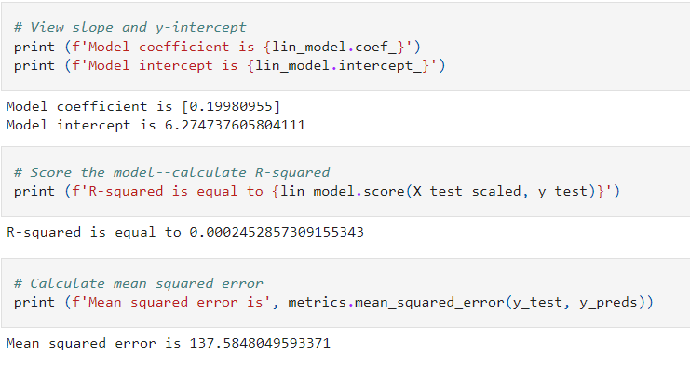
Linear Regression Results
Raw Data:
Scaled Data:

Slide 4
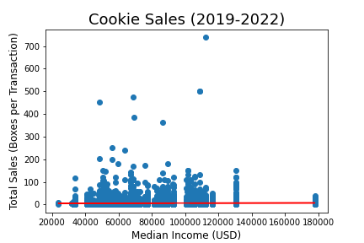
Linear Regression Conclusions
The model is not a good predictor of boxes sold per digital transaction based on median income.
Individuals are just as likely to buy the same number of boxes in any income area.
The high MSE can be attributed to high variation and outliers in sales data.
y = 8.1e-06x + 5.61

Slide 5
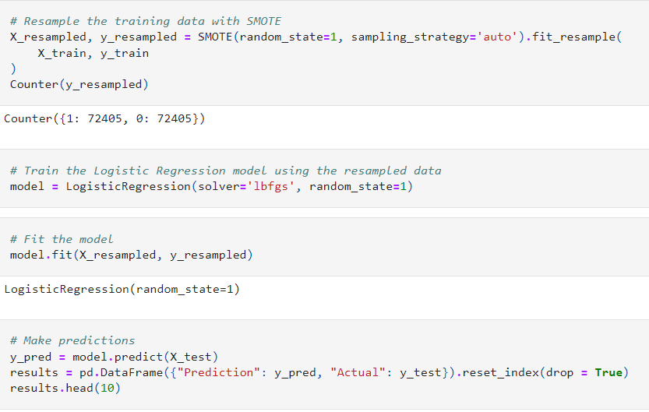
Logistic Regression Model
X = all cookie columns in df
y = high_low_income
sklearn train-test-split (80%, 20%)
Raw data
Scaled data
SMOTEENN
SMOTE
sklearn LogisticRegression()
Calculations
Accuracy/Balanced accuracy score
Confusion matrix
Classification report/Imbalanced classification report

Slide 6
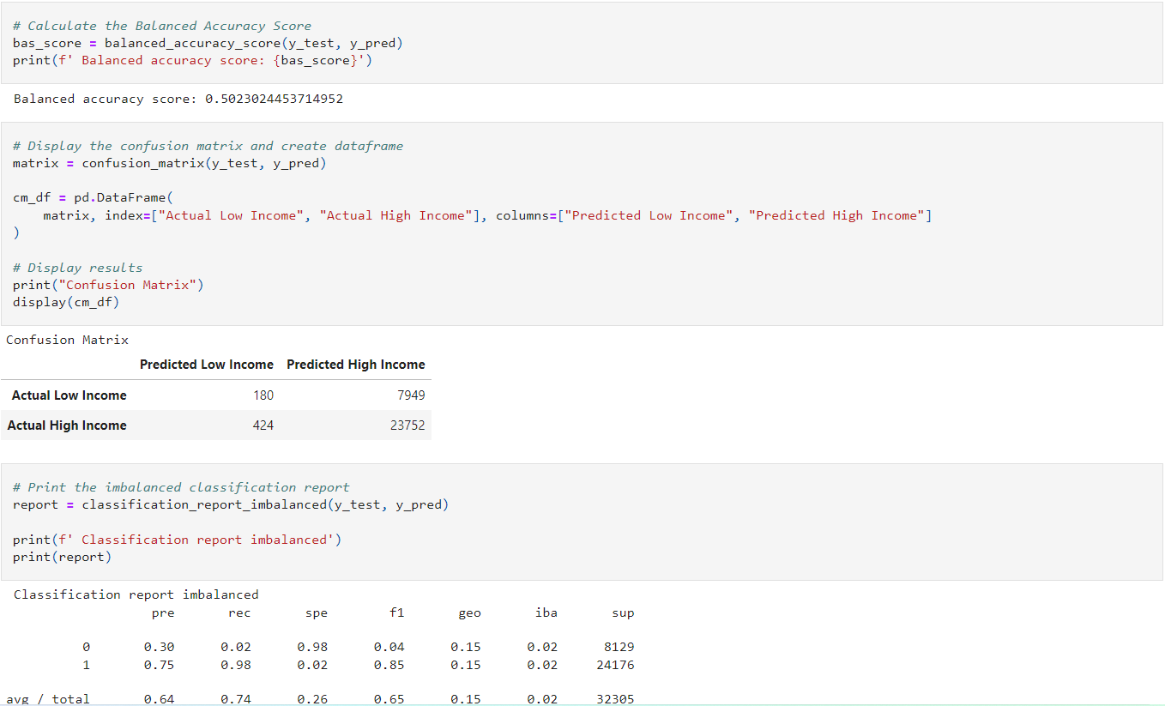
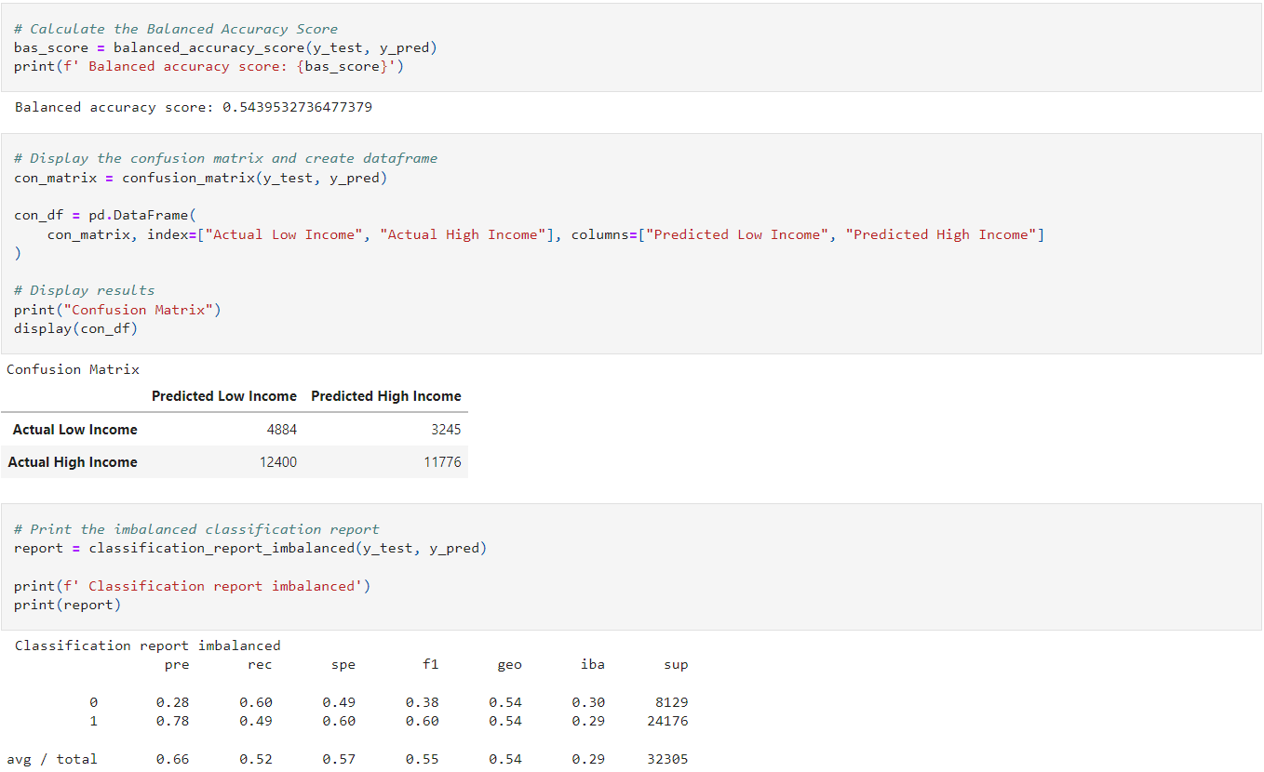
Logistic Regression Results
SMOTEENN:
SMOTE:

Slide 7
Logistic Regression Conclusions
The model is not a good predictor of high or low income areas when using digital sale transactions.
Recall improved for predicting low income areas but decreased for high income areas with SMOTE.

