Slide 1
Installing NS 2.29 on Ubuntu 10.10
Thejdeep G | 12CO99
Shiva Sagar B | 12CO83

Slide 2
Download Instructions
For downloading Ubuntu 10.10 Maverick Meerkat
http://old-releases.ubuntu.com/releases/maverick/
Select and download appropriate .iso or .torrent – either 32bit or 64bit
For downloading NS 2.29
http://sourceforge.net/projects/nsnam/files/allinone/ns-allinone-2.29/
Select ns-allinone-2.29.3.tar.gz

Slide 3
First Run
Extract the downloaded ns-allinone by -
tar -zxvf ns-allinone-2.29.3.tar.gz
z ->unzip , x-> extract , v-> print verbosely, f->filename
'cd' into extracted folder
./install

Slide 4
Some Fatal Errors
Ns-allinone-2.29/tk8.4.11/unix/../generic/tk.h:96 : fatal error: X11/Xlib.h: No such file or directory compilation terminated. Make failed.
Conclusion : Xlib.h is not present
So, which package contains the file Xlib.h ?

Slide 5
Tool for Installation Issues : apt-file
Apt-file is a command in the Advanced Packaging Tool that allows you to find which package includes a specific file
Installation – sudo apt-get install apt-file
Once installed, run apt-file update for its database to get populated. This command attempts to fetch contents<arch>.gz from the remote sources specified in /etc/apt/sources.list

Slide 6
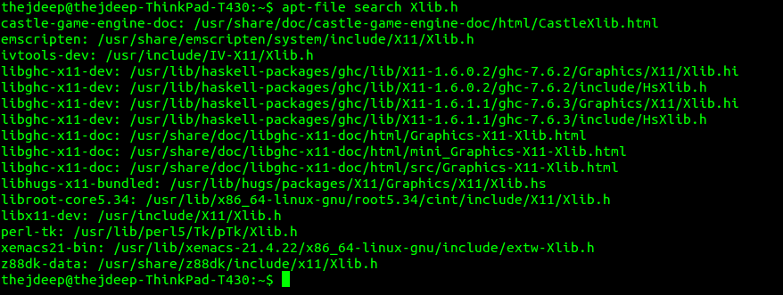
The search for Xlib.h
Running apt-file search Xlib.h gives me

Slide 7
Installation of libx11-dev
Running 'sudo apt-get install libx11-dev' gives a 'Package Not found' error
How about a 'sudo apt-get update' ?
Running 'sudo apt-get update' in the terminal throws many 404's (Not found).

Slide 8
Fixing Package Fetching
After support for old ubuntu releases is dropped, repositories are removed from main servers
To get back the repository train, edit your /etc/apt/sources.list and replace all instances of archive.ubuntu.com and security.ubuntu.com with old-releases.ubuntu.com

Slide 9
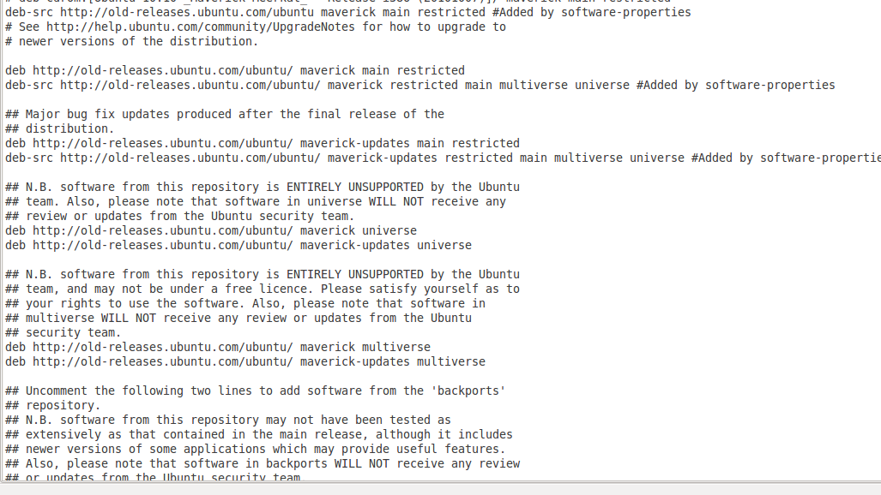
Fixing Package Fetching
The new /etc/apt/sources.list file

Slide 10
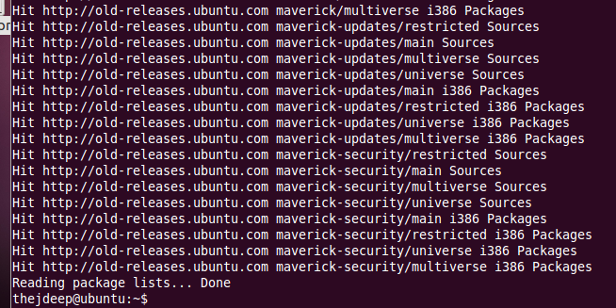
Next Steps
Now, executing 'sudo apt-get update' updates all the packages
Next, 'sudo apt-get install libx11-dev' to install the Xlib.h dependency issue

Slide 11
Second Run
Running ./install for the second time
Error : can't find X includes otcl-1.11 configuration failed! Exiting …
X libraries are not able to find utility functions
Run 'sudo apt-get install libxmu-dev'

Slide 12
Third Run
Running ./install for the third time
Error: otcl.o: In function `OTclDispatch':/home/thejdeep/Desktop/ns-allinone-2.29/otcl-1.11/otcl.c:495: undefined reference to `__stack_chk_fail_local'
This error is because the linker being used is "ld -shared" instead of "gcc -shared". If you edit one line in otcl-1.13/configure, and rerun install.

Slide 13
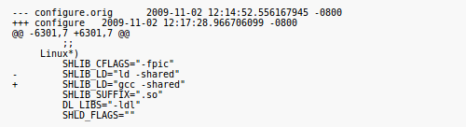
Third Run

Slide 14
Fourth Run
Running ./install for the fourth time
Error : Tcl.cc: In member function ‘void Tcl::eval(char*)’:
Tcl.cc:182: warning: deprecated conversion from string constant to ‘char*’. Tcl make failed
Solution : Go to file tcl.cc and at line no. 564, replace with the following
- char *p =strchr(localName, '(');
+ char *p =const_cast<char*>( strchr(localName, '('));

Slide 15
Fifth Run
Run ./install in the terminal
Error : ./common/packet.h:254:warning:deprecated conversion from string constant to 'char*'
Solution: Add this flag '-Wno-write-strings' to the CCOPT line in the Makefile of ns-2.29 folder

Slide 16
Sixth Run
Run ./install in the terminal
Error : queue/red.cc: In member function ‘virtual void REDQueue::trace(TracedVar*)’:
queue/red.cc:874: error: invalid conversion from ‘const char*’ to ‘char*’
Solution : In queue/red.cc at 874 line, do the following changes
Replace (p = strstr(v->name(), "ave")) with ((p = const_cast<char*>(strstr(v->name(), "ave")))

Slide 17
Seventh Run
Run ./install again
Similar error as previous with queue/rio.cc
Solution: Do the following changes at queue/rio.cc and line no. 565
-if (((p = strstr(v->name(), "ave")) == NULL) &&
+if (((p = const_cast<char*>(strstr(v->name(), "ave"))) == NULL)

Slide 18
Eighth Run
Run ./install again
Similar errors encountered for the following files :
queue/pi.cc
queue/vq.cc
queue/rem.cc
queue/gk.cc
Solutions for these are available at
http://ramakrishnamundugar.blogspot.in/p/network-simulator-v2.html

Slide 19
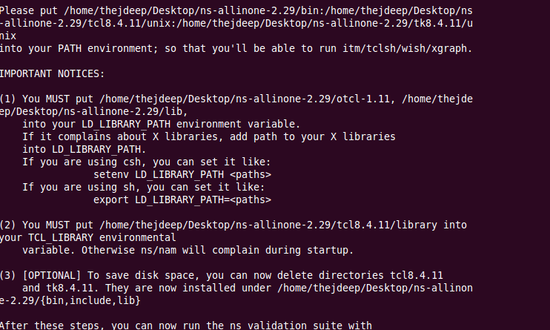
Finally

Slide 20
Setting Path Variables

Slide 21
Oops.
Executing 'ns' in the terminal now works, gives the % symbol. But Nam doesn't.
Error : [code omitted because of length]
: no event type or button # or keysym
while executing
“bind Listbox {
%W yview scroll [expr {- (%D / 120) * 4}] units
}”

Slide 22
Patching Tk
Download tk-8.4-lastevent.patch from
http://www.linuxquestions.org/questions/attachment.php?attachmentid=4166&d=1279693038
Place the patch file inside the tk folder
Run this in terminal - patch -p0 < tk-8.4-lastevent.patch
'cd' back to root dir of ns-allinone
./install again for the last time
Ns and Nam works !

Slide 23
Thank You

Slide 24
Patching Tk
Download tk-8.4-lastevent.patch from
http://www.linuxquestions.org/questions/attachment.php?attachmentid=4166&d=1279693038
Place the patch file inside the tk folder
Run this in terminal - patch -p0 < tk-8.4-lastevent.patch
'cd' back to root dir of ns-allinone
./install again for the last time
Ns and Nam works !

