Slide 1
MVision Internship

Slide 2
Objective
Test if self-supervised approaches can help improve the results obtained from supervised segmentation models
Some self supervised approaches -
Siamese Twins
BYOL
Barlow Twins
This research focuses on testing barlow twins

Slide 3
Initial Plan
Test transformer based segmentation models to produce a baseline
Medical transformers
Use the same model configuration to pretrain on unlabelled data using the barlow twins approach
Test if the pretrained model used as a backbone helps to improve the performance

Slide 4
Update in plan
Transformer model used in medical transformer was too big to be run in barlow twins using the computation resources we had, so started to experiment with small models like resnet50 and resnet18
It is not easy to attribute the success of a segmentation model on the pretrained encoder, as the decoder layer could have helped to learn the features.
Hence, we decided to create a multi label image classification problem to identify if the ROI is present in the image or not.

Slide 5
How to make the data suitable for classification
If the slice had the ROI, then its class is 1
If the slice does not have the ROI, but other slices of that 3D image have the ROI, then its class is -1
If the ROI is none for that image then its class is -1
Else its class is 0

Slide 6
Challenge 1: Not able to support the batchsize barlow twins was trained with
The model does not converge until the batchsize is 256, so I used a small model like resnet18, with a very low learning rate to be able to fit the model in memory
The final model uses a learning rate weights of 0.002 and the learning rate biases of 0.000048 after trial and error.

Slide 7
Challenge 2: Setup the loss function when training multi label classification, when each label has 3 (not 2 labels).
Classes are 0,1, -1
We don't care about the samples where the class is 0 as we don’t know if the ROI is present or not.
Get weights which is 0 if the class is 0
Convert the class for -1 to 0.
Multiply the final loss with weights so that records wit ROI class 0 does not impact the loss.

Slide 8
Challenge 3: Biased models
The above methodology led to completely biased model that were not able to classify labels 0 and 1 -
Then we used the true positives, false positives, true negatives and false negatives to identify which labels were not getting identified correctly and realised that the label 1 classes was too over sampled.
This further made me realize that there was data loading error due to which the data wasn’t being loaded properly.
I fixed the data loading problem which led to better results

Slide 9
Challenge 4: The barlows twins model was not doing better than a random model
This could be due to some transforms making the performance of the overall model worse
To test this hypothesis, we tried to disentangle the transforms and run them individually over a common base model.
As hypothesized some transforms were not performing as well as the others.

Slide 10
Experiments
Freeze the resnet backbone and get results of classification for -
Random weights
Imagenet pretrained weights
Barlow twins pretrained weights (trained from scratch)
Barlow twins pretrained weights (using imagenet pretrained)
Barlow twins pretrained weights (using imagenet pretrained) with individual transforms for 50 epochs
Blur
Color jitter
Sharpen
Cutout
Elastic transformation
Crop
Finetune the resnet backbone
Random initialization
Imagenet pretrained weights
Barlow twins pretrained weights (trained from scratch)

Slide 11
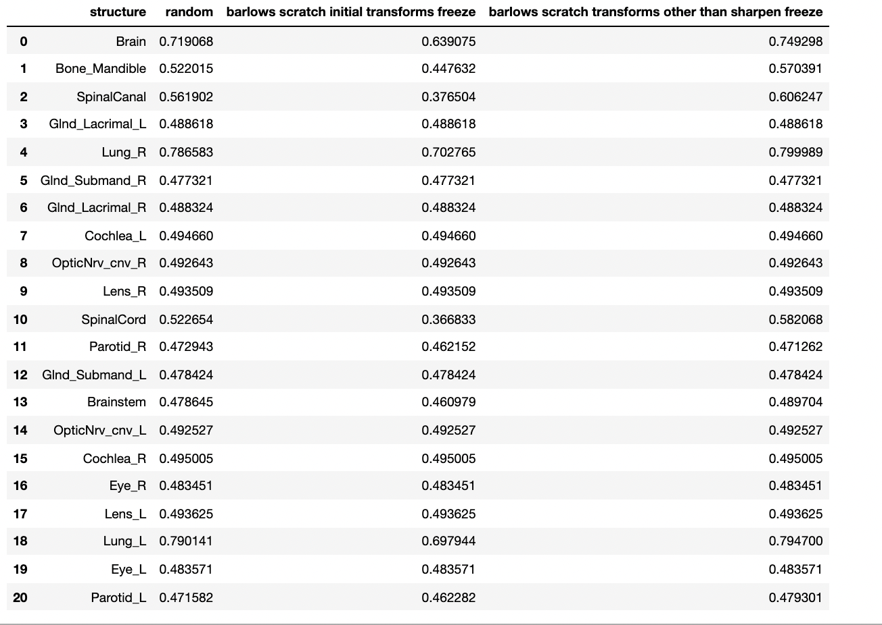
Results of the experiments
First experiment was to understand if a barlow twins trained model can improve the performance of a model which is randomly initialized, where we freeze the resnet layers
With the initial transforms the barlow twins doe not improve the performance over randomly initialised weights.
Initial transforms were - Cropping, blurring, sharpening, random brightness contrast

Slide 12
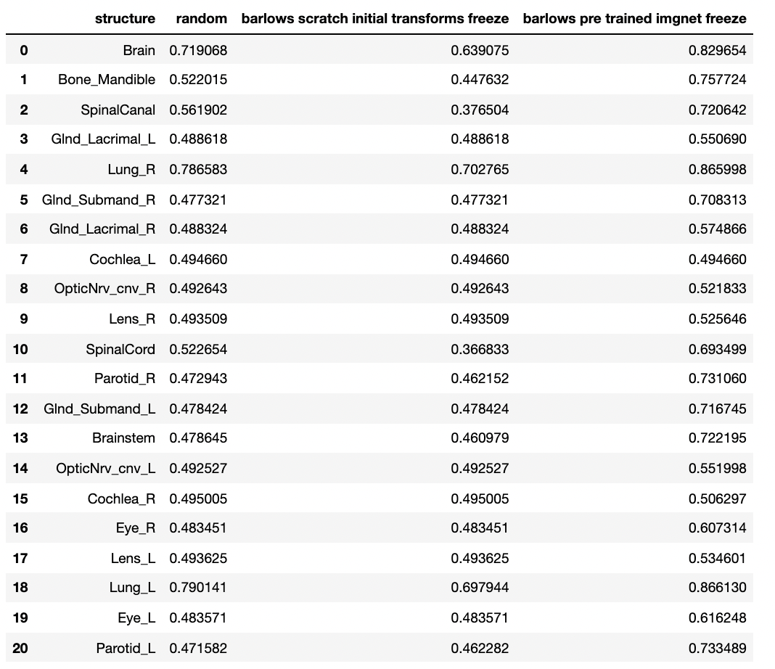
Results of the experiments
Second experiment we ran was to see if barlow twins model trained with pre-trained imagenet weights could perform better. We can clearly see that this significantly improved the performance for all the ROIs

Slide 13
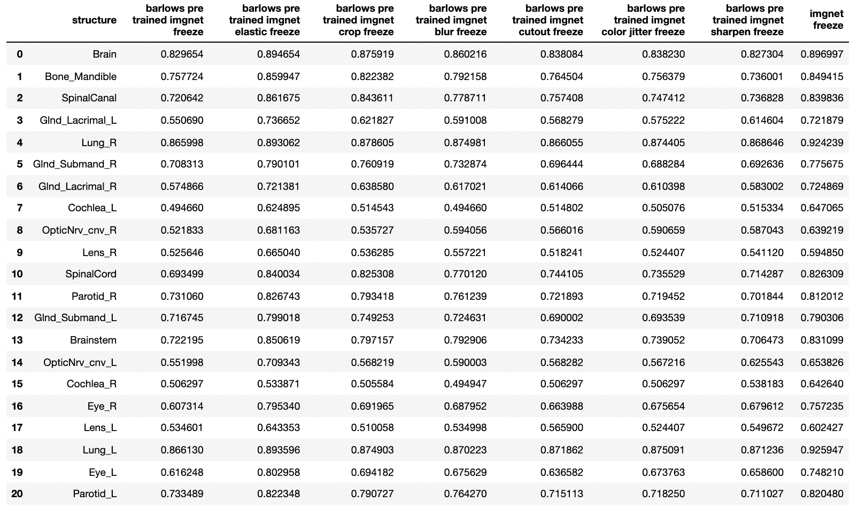
Results of the experiments
Third experiment we ran was to try individual transforms on top of the barlows pre trained imagenet model to see which transformations improve the performance the most.

Slide 14
Results of the experiments
We can observe in the third experiment that the transformations improve performance over the base model in this order - elastic transformation, crop, blur, cutout, color jitter and sharpen.
Elastic transformation was able to reach imagenet and surpass it performance in several tasks as well.
Sharpen leads to a decrease in performance for some ROIs over the base model and hence was discarded in the final model

Slide 15
Results of the experiments
Final model was trained with the following transformations - elastic transformation, crop, blur, cutout, color jitter. This is shown to improve performance over random initialization for some ROIs like Brain, Bone mandible, Spinal cord, Spinal canal, Lung L, Lung R, Brainstem

Slide 16
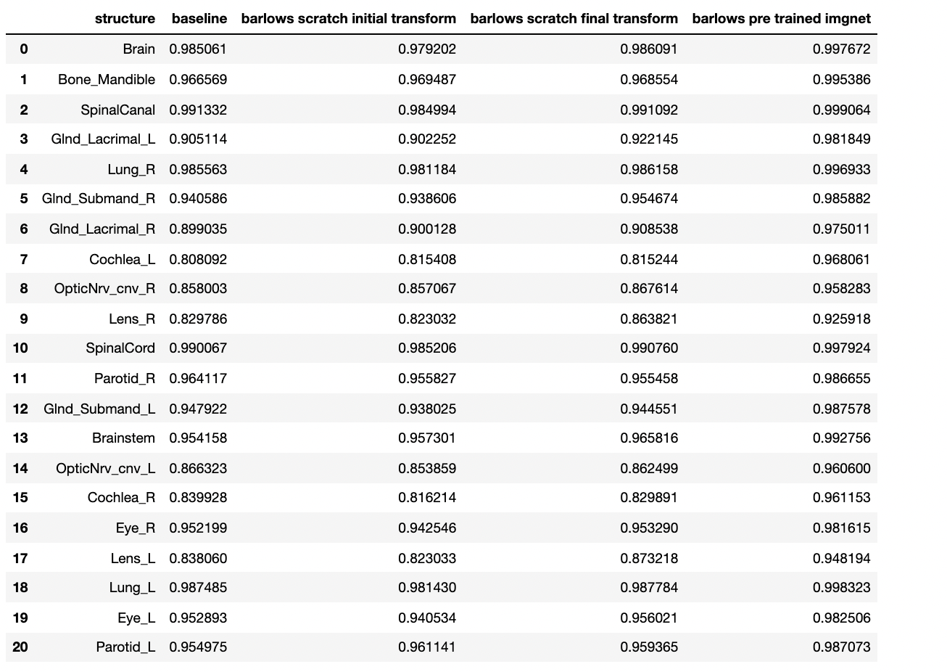
Results of the experiments
We also tested the final model without freezing the layers and it improved the performance over random initialization though it is still not as good as imgnet pretrained model.

Slide 17
Links to project code
Barlow twins : https://github.com/sborar/barlowtwins
Resnet classification: https://github.com/sborar/resnet_multilabel_image_classification

