Slide 1
Automation Testing.
Selenium WebDriver
Python for ATQC
IT Academy
27/03/2017

Slide 2
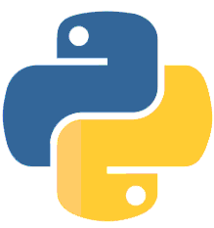
Agenda
What is Test Automation
Developer Tools
Selenium Overview
Selenium WebDriver
Case Studies. Simple Tests

Slide 3
What is Test Automation

Slide 4
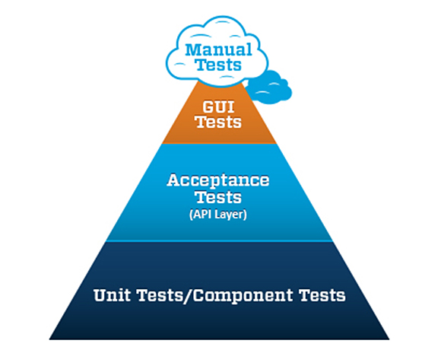
Test Automation
A process of writing a computer program to do testing that would otherwise need to be done manually
Use of software to control the execution of tests
Two types of test automation:
  Code-driven testing
  Graphical user interface testing

Slide 5
Advantages of Automation
Reliable: Tests perform precisely the same operations each time they are run, thereby eliminating human error.
Repeatable: You can test how the software reacts under repeated execution of the same operations.
Reusable: You can reuse tests on different versions of an application, even if the user interface changes.
Speed: Run tests significantly faster than human users.
Cost Reduction: As the number of resources for regression test are reduced.
Better Quality Software: Rapid feedback to developers during the development process as a result of frequent regression testing.

Slide 6
Disadvantages of Automation
Proficiency is required to write the automation test script.
Debugging the test script is major issue. If any error is present in the test script, sometimes it may lead to dadly consequences.
Test maintenance is costly in case of playback methods. Even though a minor changes occurs in the GUI, the test script has to be rewritten.
Maintenance of test data files is difficult, if the test script tests more screens or web-pages.
Short iteration or very tight deadline, there is not enough time to build test automation.

Slide 7
Developer Tools

Slide 8
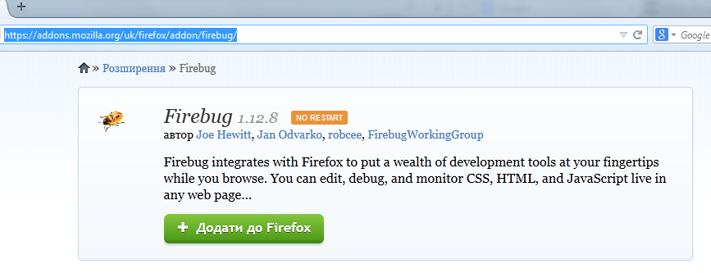
FireBug (Deprecated)
One of the first developer/debugging tools
Used as an extension to Firefox
Today, developer tools are integrated into most web browsers (Firefox, Chrome, even Internet Explorer)

Slide 9
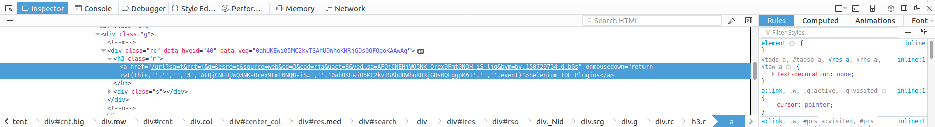
Tools Examples: Firefox

Slide 10
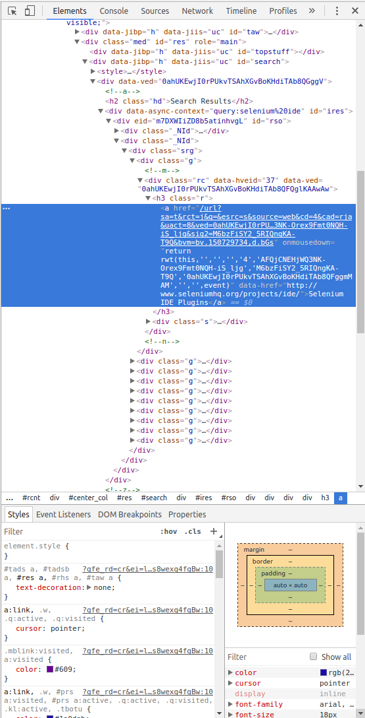
Tools Examples: Chrome

Slide 11
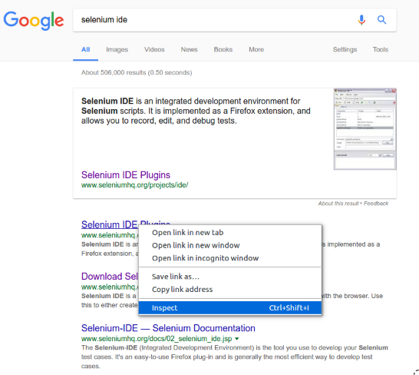
Inspect Web Element

Slide 12
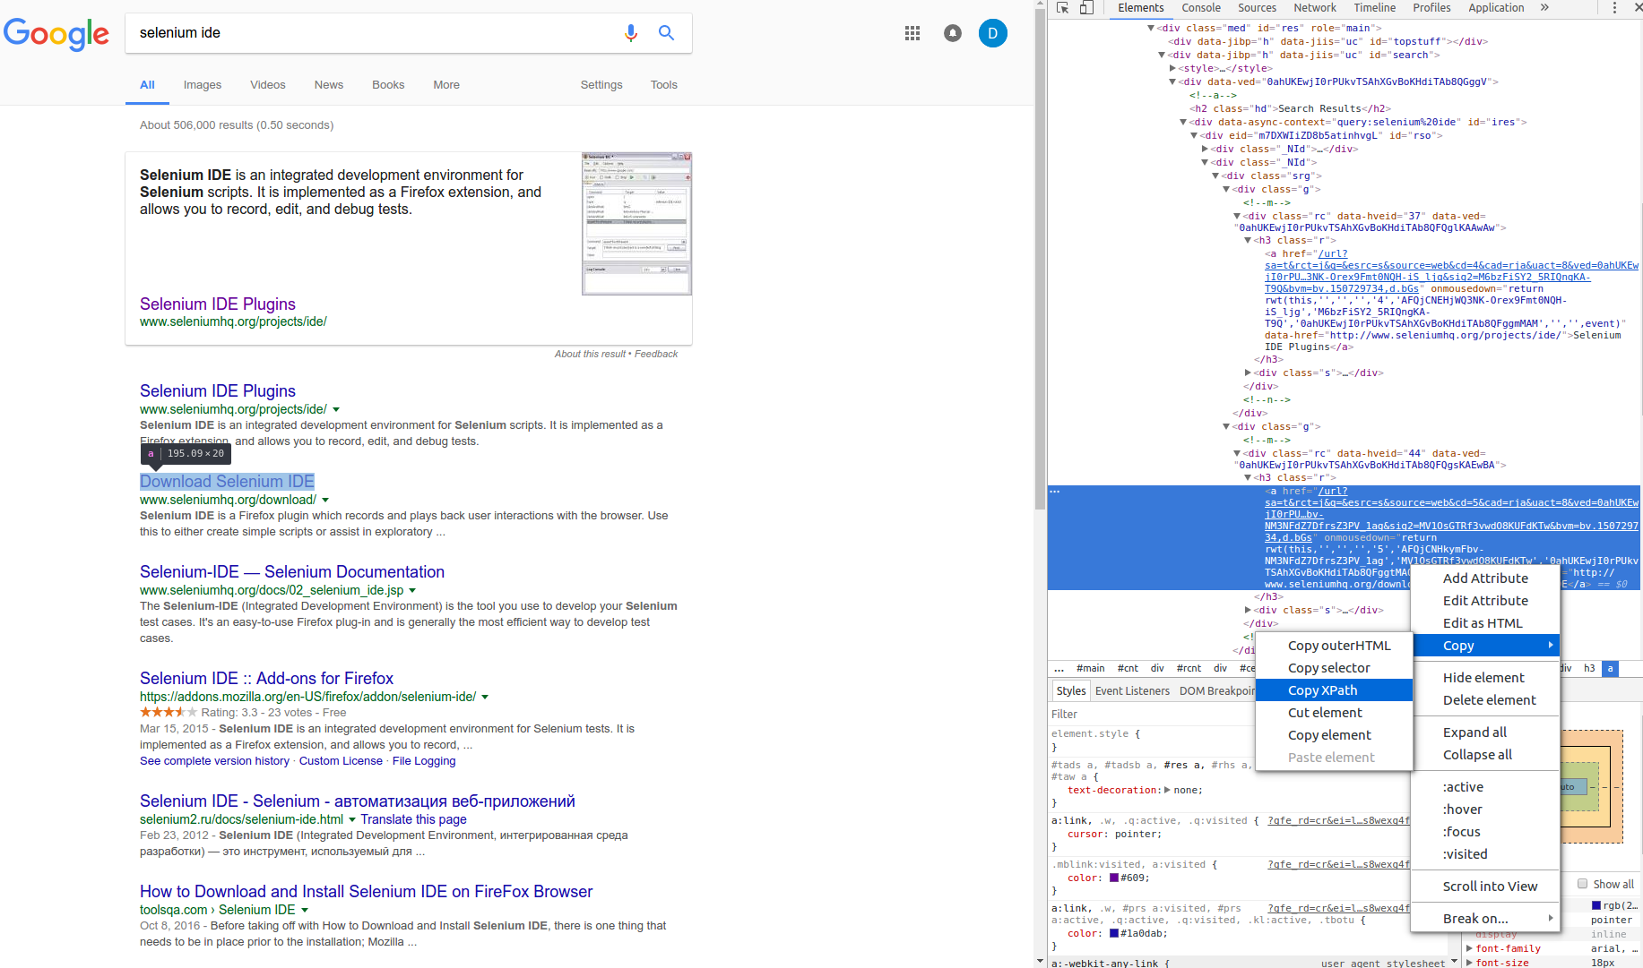
Analyze Web Element

Slide 13
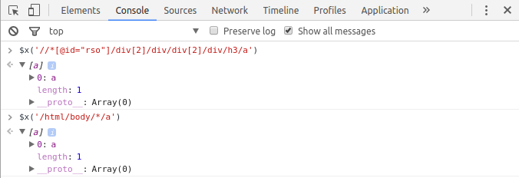
Running Xpath Expression

Slide 14
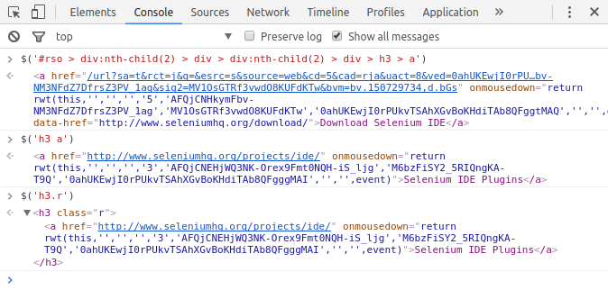
Css Selector

Slide 15
Selenium Overview

Slide 16
What is Selenium
An open source set of testing tools to automate web applications across many platforms.
Support for a number of programming languages:
  Java, C#, Perl, PHP, Python, Ruby
Cross browsers support:
  IE, Firefox, Opera, Safari, Google Chrome, etc.
Cross platform support:
  Windows, Linux, and Macintosh.

Slide 17
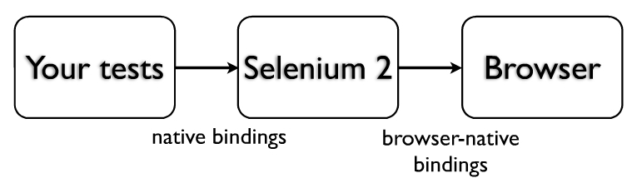
Selenium Background
Invented in 2004 by Jason R. Huggins and team.
Originally named JavaScript Functional Tester [JSFT].
100% Javascript and HTML.
Designed to make test writing easy.
Open source browser based integration test framework built originally by ThoughtWorks.
Selenium is open source software, released under the Apache 2.0 license and can be downloaded and used without charge.

Slide 18
Selenium
Selenium IDE is a Firefox add-on that makes it easy to record and playback tests in Firefox 2+. You can even use it generate code to run the tests with Selenium RC/WebDriver.
Selenium Remote Control is a client/server system that allows you to control web browsers locally or on other computers, using almost any programming language and testing framework.
Selenium WebDriver can drive a browser natively either locally or on remote machines.
Selenium Grid takes Selenium Remote Control to another level by running tests on many servers at the same time, cutting down on the time it takes to test multiple browsers or operating systems.

Slide 19
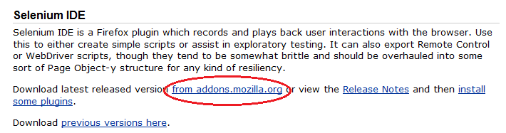
Installing Selenium IDE
Open the Firefox browser window
In the navigation tool bar type the below URL
http://seleniumhq.org/download/
Click the Download link next to Selenium IDE project name.

Slide 20
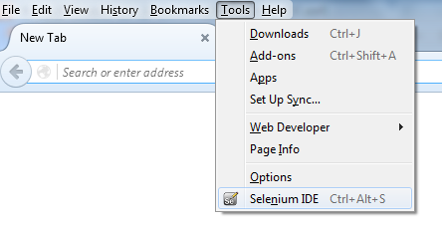
Is Selenium IDE Installed?
Open the Firefox browser window
Go to Tools, Check whether Selenium IDE already exist there
If you see “Selenium IDE” then you already having Selenium IDE plug-in installed in Firefox browser.

Slide 21
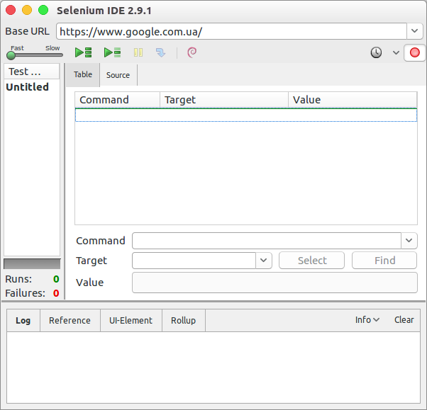
Selenium IDE
Selenium IDE is an integrated development environment for Selenium tests.
It also serves as a starting point for automation.

Slide 22

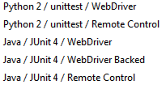

Selenium IDE
Development Environment (IDE) for building Selenium test case.
Firefox add-on that makes it easy to record, edit, and debug tests.
Provides an easy-to-use interface for developing and running individual test cases or entire test suites.
Can be used to generate code to run the tests with Selenium WebDriver, Selenium Server (Remote Control), etc.

Slide 23
Selenium IDE Features
Record, playback, edit.
Intelligent component identification will use object IDs, names, or XPath as needed.
Auto complete for all common Selenium commands
Walk through test cases and test suites.
Debug and set breakpoints.
Save tests as HTML, or export as other supported programming languages.
Support for Selenium user extensions.

Slide 24
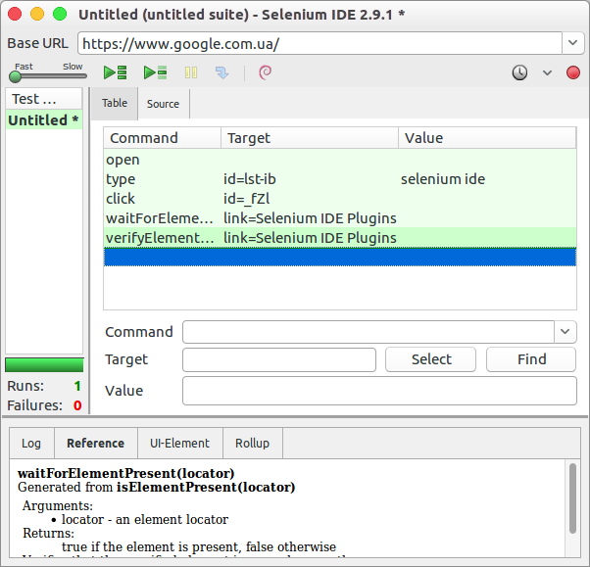
Selenium IDE
Record test actions
Execution Commands
Try the test in the Web based TestRunner
Reference of the currently selected command
Specify commands, including asserts

Slide 25
Selenium IDE
Selenium IDE is mainly used for record and play back.
Base URL in the IDE is used to specify the URL which is going to test.
Toolbar next to the base URL is used to record and play back the test.
The red circle in the toolbar is used to record the actions which are taken place in the web page.
Then the recorded test can be played using either "run current test" or "run entire test suite".
Test suite can also be played using Test runner, but it can play only html test.
Selenium speed can be controlled using slider of Selenium IDE.

Slide 26
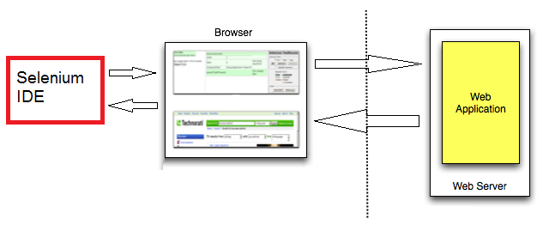
Selenium IDE
Simplified architecture diagram

Slide 27
Selenium WebDriver

Slide 28
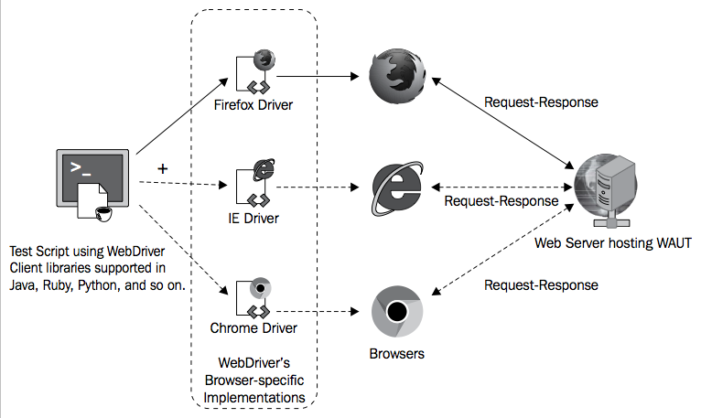
Selenium WebDriver Architecture

Slide 29
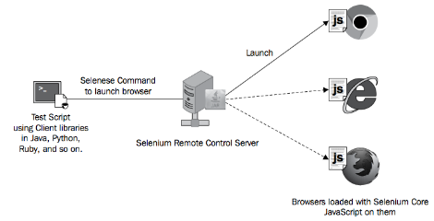
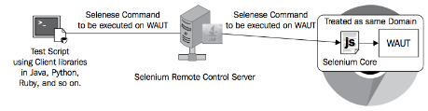
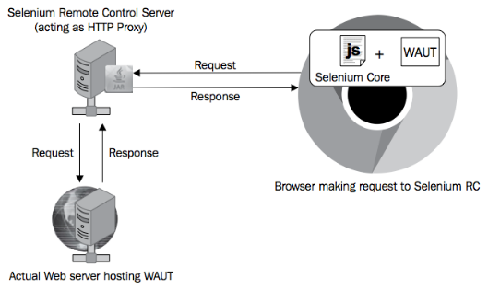
Selenium RC Architecture
1.
2.
3.

Slide 30
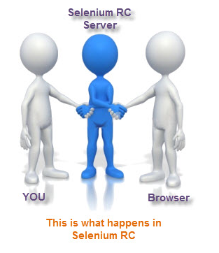

Illustration of Differences

Slide 31
Selenium Grid
Selenium Grid is a tool that speeds up functional testing of web-apps. It allows running multiple tests in parallel, on multiple machines, in a heterogeneous environment.
Selenium Grid coordinates multiple selenium remote control servers, so that test can be run on different platforms concurrently, which saves time and allows wider testing.
Scripts running too slow or want to run them against multiple browser types and versions?
  Selenium Grid can help distribute script execution for either parallelization or browser variation.

Slide 32
Selenium Web Driver Pros&Cons
+
Simpler installation than Selenium RC
Communicates directly to the browser
Browser interaction is more realistic
No need in separate component such as a RC Server
Faster execution time than IDE and RC
-
Installation is more complicated than Selenium IDE
Requires programming knowledge
Cannot readily support new browsers
Has no built-in mechanism for logging runtime messages and generating test results

Slide 33
What can you do with it?
FirefoxDriver
InternetExplorerDriver
ChromeDriver
SafariDriver
OperaDriver
HtmlUnitDriver
PhantomJSDriver
AndroidDriver
IphoneDriver
Appium
Selendroid
over +100500 different wrappers
Java
C#
Python ♥
Ruby
JavaScript (Node.js)
headlesss
mobile browsers
mobile applications

Slide 34
Installation: Manual
Create and activate Virtual Environment
Use pip to install selenium and html-testRunner modules:
  pip install selenium html-testRunner

Slide 35
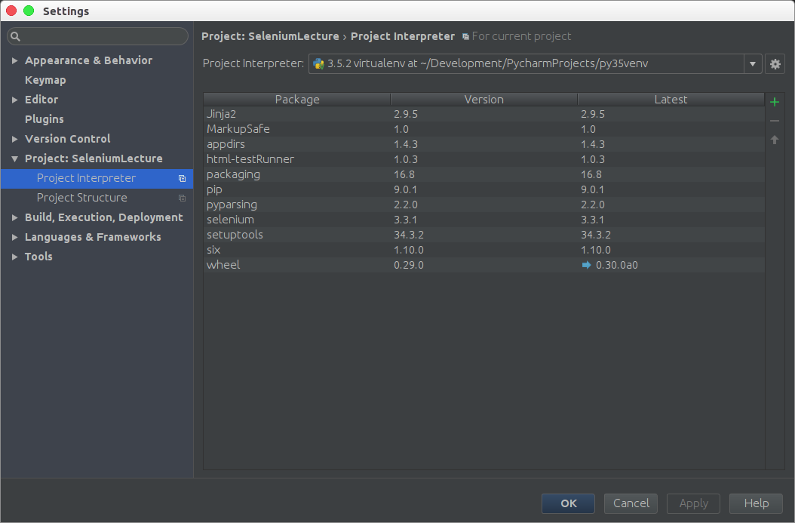
Installation: PyCharm

Slide 36
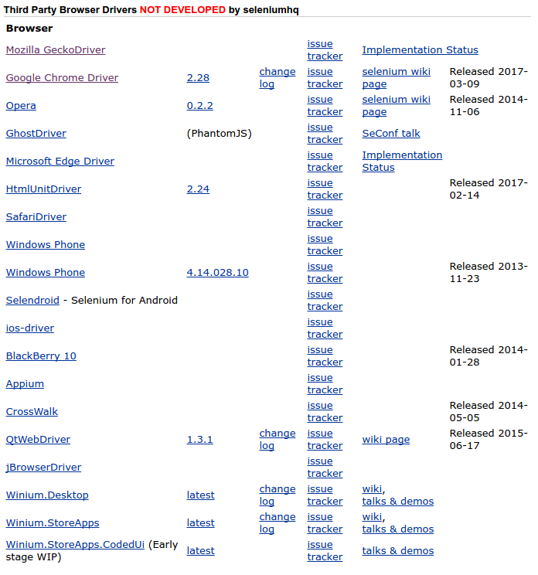
Download Browser Driver 1/2
http://www.seleniumhq.org/download/

Slide 37
Download Browser Driver 2/2
After download:
  Include the ChromeDriver binary location in your PATH environment variable
  Specify path to ChromeDriver in the script (as in examples)

Slide 38
Create Instance
The python which you are running should have the selenium module installed.
  The selenium.webdriver module provides all the WebDriver implementations.
  Currently supported WebDriver implementations are Firefox, Chrome, IE and Remote. The Keys class provide keyboard keys like RETURN, F1, ALT etc.
from selenium import webdriver
from selenium.webdriver.common.keys import Keys
Next, the instance of Firefox WebDriver is created.
driver = webdriver.Firefox()

Slide 39
Navigate
The driver.get method will navigate to a page given by the URL.
WebDriver will wait until the page has fully loaded (that is, the “onload” event has fired) before returning control to your test or script.
  NOTE: It’s worth noting that if your page uses a lot of AJAX on load then WebDriver may not know when it has completely loaded.
driver.get("http://www.google.com.ua")
Use assertion to confirm that title has “Python” word in it:
assert “Google" in driver.title

Slide 40
Find Elements
WebDriver offers a number of ways to find elements using one of the find_element_by_* methods.
  For example, the input text element can be located by its name attribute using find_element_by_name method.
elem = driver.find_element_by_name("q")
We are sending keys, this is similar to entering keys using your keyboard.
Special keys can be send using Keys class imported from selenium.webdriver.common.keys
elem.send_keys(“selenium ide")
elem.send_keys(Keys.RETURN)

Slide 41
Check
After submission of the page, you should get the result if there is any.
  To ensure that some results are found, make an assertion
assert "No results found." not in driver.page_source
Finally, the browser window is closed.
  You can also call quit method instead of close.
  The quit will exit entire browser whereas close` will close one tab, but if just one tab was open, by default most browser will exit entirely.
driver.close()

Slide 42
Useful Attributes
http://selenium-python.readthedocs.io/api.html
Useful for verifying the page:
  driver.current_url
  driver.title
  driver.page_source
Useful for verifying the driver instance:
  driver.name
  driver.orientation
  driver.window_handles
  driver.current_window_handle
  driver.desired_capabilities

Slide 43
Case Studies. Simple Tests

Slide 44
Case Studies
Selenium is mostly used for writing test cases.
  The selenium package itself doesn’t provide a testing tool/framework.
  You can write test cases using Python’s unittest module.
  The other options for a tool/framework are py.test and nose.
We use unittest as the framework of choice.
  Here is the modified example which uses unittest module.
  This is a test for python.org search functionality.
For appealing test result representation we can use html-testRunner:
import HtmlTestRunner
unittest.main(testRunner=HtmlTestRunner.HTMLTestRunner(output=/path/to/reports))

Slide 45
Getting Started
import os
from selenium import webdriver
chrome_driver_path = os.path.dirname(os.path.abspath(__file__)) + "/chromedriver"
driver = webdriver.Chrome(chrome_driver_path)
driver.implicitly_wait(30)
driver.maximize_window()
driver.get("http://www.google.com")
search_field = driver.find_element_by_name("q")
search_field.clear()
search_field.send_keys("Selenium WebDriver")
search_field.submit()
lists = self.driver.find_elements_by_class_name("r")
print("Found " + str(len(lists)) + " searches")
driver.quit()

Slide 46
Simple Tests
import unittest
from selenium import webdriver
from selenium.webdriver.common.keys import Keys
browser = webdriver.Firefox()
browser.get('http://www.yahoo.com')
assert 'Yahoo' in browser.title
# Find the search box
elem = browser.find_element_by_name('p')
elem.send_keys('seleniumhq' + Keys.RETURN)
browser.quit()

Slide 47

Case Studies: WebDriver TestCase
Requires EcoMap Project https://github.com/timbortnik/EcoMap running on Vagrant
cd /path/to/EcoMap && vagrant up

Slide 48


Case Studies: Remote TestCase
Requires Selenium grid running in Vagrant (accessible at 127.0.0.1:4444)
Vagrantfile for Selenium Grid included

Slide 49


