Slide 1
Automation Testing.
Xpath Introduction
IT Academy
23/05/14

Slide 2
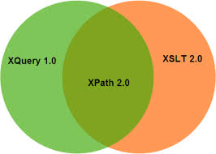
Agenda
Document Object Model
Location Strategies
XPath Tutorial
XPath Syntax
XPath and Webdriver
Case studies

Slide 3
Document Object Model
Back to the DOM

Slide 4
DOM Hierarchy
The basic DOM is a W3C standard and is consistent across various browsers.
  More complex features are browser-dependent.
The highest level element (for the current page) is window, and everything else descends from that
  In the DOM, all variables are assumed to start with “window.”
  All other elements can be reached by working down from there.

Slide 5
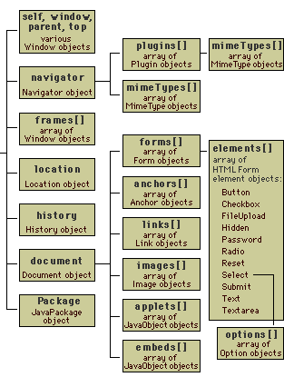

DOM Hierarchy

Slide 6
DOM Hierarchy
<div id="content"></div>
document.getElementById('content').innerHTML='<pre>Hello</pre>';
<html>
<body>
<form action="#">
<div>
<label for="email">Email: l</label>
<input type="input" id="email" name="email" value="" /><br>
<input type="submit" value="Submit" />
</div>
</form>
</body>
</html>
document.getElementById('email).form.action =
'http://www.google.com.ua';

Slide 7
DOM Hierarchy
For example, say you have a text field as follows:
<form name="myForm">
<input type="text" name="foo" id="foo" />
There are many way to access:
1) document.forms[0].elements[0];
2) document.myForm.foo;
3) document.getElementById('foo');
4) document.getElementById('myForm').foo;
Methods [1] and [3] are well documented, but neither are ideal.
[1] is just too general to be useful and [3] requires both an id and a name.
[2] seems to be the most intuitive.

Slide 8
Location Strategies
To find an element

Slide 9
Find Element
IWebDriver driver = new FirefoxDriver();
IWebElement element;
<form name="myForm">
<input type="text" name="foo" id="foo" />
Find WebElement by using:
  ID attribute;
element=driver.FindElement(By.Id("foo"));
  Name attribute;
element=driver.FindElement(By.Name("foo"));
  By XPath expression;
element=driver.FindElement(By.XPath("//input"));

Slide 10
Find Element
<form name="myForm">
<input type="text" name="foo" id="foo" />
<a href="http://www.google.com/search?
q=cheese">cheese</a>>
Find WebElement by using:
  Text links;
element=driver.FindElement(
By.LinkText("cheese"));
  By Partial Link Text
element=driver.FindElement(
By.LinkText("chee"));
  By DOM-model (???)
element=driver.FindElement(By.TagName("input"));

Slide 11
Find Element
Use the search by attribute ID or name most effectively.
Finding items on text links are very quick and easy.
Search the DOM-model is supported for compatibility with older tests. Are not commonly used.
Using XPath (and DOM) you can find an element relative location of the other items on this page. Processing XPath expression requires more time.

Slide 12
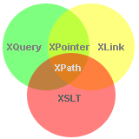
XPath Tutorial
Introduction

Slide 13
XPath Tutorial
XPath, the XML Path Language, is a query language for selecting nodes from an XML document.
XPath may be used to compute values (e.g., strings, numbers, or Boolean values) from the content of an XML document.
XPath was defined by the World Wide Web Consortium (W3C).
The XPath language is based on a tree representation of the XML document, and provides the ability to navigate around the tree, selecting nodes by a variety of criteria.
XPath 2.0 is in fact a subset of XQuery language 1.0. In December 2009, started the development of version 2.1, which uses the XQuery 1.1.

Slide 14
XPath Tutorial
There are currently two versions in use.
  XPath 1.0 became a Recommendation on 16 November 1999 and is widely implemented and used, either on its own (called via an API from languages such as Java, C# or JavaScript), or embedded in languages such as XSLT, XProc, XML Schema or XForms.
  XPath 2.0 is the current version of the language; it became a Recommendation on 23 January 2007. A number of implementations exist but are not as widely used as XPath 1.0. The XPath 2.0 language specification is much larger than XPath 1.0 and changes some of the fundamental concepts of the language such as the type system.

Slide 15
XPath Tutorial
XPath Path Expressions
  XPath uses path expressions to select nodes or node-sets in an XML document.
  These path expressions look very much like the expressions you see when you work with a traditional computer file system.
XPath Standard Functions
  XPath includes over 100 built-in functions.
  There are functions for string values, numeric values, date and time comparison, node and QName manipulation, sequence manipulation, Boolean values, and more.

Slide 16
XPath Tutorial
<html>
<body>
<div>First Layer
<span>Text Block in First Layer</span>
</div>
<div>Second Layer</div>
<div>Third Layer
<span class="text">Text Block Number 1 in Third Layer</span>
<span class="text">Text Block Number 2 in Third Layer</span>
<span>Text Block Number 2 in Third Layer</span>
</div>
<img />
</body>
</html>
Xpath Expressions: /html/body/*/span[@class]
Full syntax is: /child::html/child::body/child::*/child::span[attribute::class]

Slide 17
XPath Syntax
XPath Axes

Slide 18
XPath Syntax
String XPath – is the path to the element in the tree, where each level is separated by a slash "/".
The processing of XPath expressions obtained object, which can be:
  node-set – unordered collection of nodes without duplicates;
  boolean – true or false;
  number – a floating point number;
  string – a sequence of UCS characters.

Slide 19
XPath Syntax
<html>
<body>
<div id="first">
<span>span in div</span>
</div>
<div id="second"></div>
<span>other text</span>
</body>
</html>
The result of the query will be <span>
/html/body/*/span

Slide 20
XPath Syntax
<html>
<body>
<div id="first">
<span>span in div</span>
</div> <div id="second"></div>
<span>other text</span>
</body>
</html>
Query returns multiple items (div#first and div#second)
/html/body/div
* – Any name or character set
/ – Determines the level of the tree

Slide 21
Selecting Nodes
If the first character in the query is "/", it is considered an absolute location path from the root document. Document root is always the default context.
The node is selected by following a path or steps. The most useful path expressions are listed below
  nodename – Selects all nodes with the name "nodename“;
  / – Selects from the root node;
  // – Selects nodes in the document from the current node that match the selection no matter where they are;
  . – Selects the current node;
  .. – Selects the parent of the current node;
  @ – Selects attributes;

Slide 22
Selecting Nodes
Some path expressions
  bookstore – Selects all nodes with the name "bookstore“;
  /bookstore – Selects the root element bookstore;
  bookstore/book – Selects all book elements that are children of bookstore;
  //book – Selects all book elements no matter where they are in the document;
  bookstore//book – Selects all book elements that are descendant of the bookstore element, no matter where they are under the bookstore element;
  //@lang – Selects all attributes that are named lang.

Slide 23
Selecting Nodes
Predicates are used to find a specific node or a node that contains a specific value.
  /bookstore/book[1] – Selects the first book element that is the child of the bookstore element;
  (/bookstore/book)[last()] – Selects the last book element that is the child of the bookstore element;
  (/bookstore/book)[last()-1] – Selects the last but one book element that is the child of the bookstore element
  (/bookstore/book)[position()<3] – Selects the first two book elements that are children of the bookstore element;
  //title[@lang] – Selects all the title elements that have an attribute named lang;
  //title[@lang='eng'] – Selects all the title elements that have an attribute named lang with a value of 'eng‘.

Slide 24
Selecting Nodes
Selecting Unknown Nodes
  * – Matches any element node;
  @* – Matches any attribute node;
  node() – Matches any node of any kind;
  /bookstore/* – Selects all the child nodes of the bookstore element;
  //* – Selects all elements in the document;
  //title[@*] – Selects all title elements which have any attribute.

Slide 25
Selecting Nodes
Selecting Several Paths.
By using the | operator in an XPath expression you can select several paths.
  //book/title | //book/price – Selects all the title AND price elements of all book elements;
  //title | //price – Selects all the title AND price elements in the document;
  /bookstore/book/title | //price – Selects all the title elements of the book element of the bookstore element AND all the price elements in the document.

Slide 26
XPath Axes
An axis defines a node-set relative to the current node.
  ancestor – Selects all ancestors (parent, grandparent, etc.) of the current node;
  ancestor-or-self – Selects all ancestors (parent, grandparent, etc.) of the current node and the current node itself;
  attribute – Selects all attributes of the current node;
  child – Selects all children of the current node;
  descendant – Selects all descendants (children, grandchildren, etc.) of the current node;
  descendant-or-self – Selects all descendants (children, grandchildren, etc.) of the current node and the current node itself;

Slide 27
XPath Axes
  following – Selects everything in the document after the closing tag of the current node;
  following-sibling – Selects all siblings after the current node;
  namespace – Selects all namespace nodes of the current node (xmlns);
  parent – Selects the parent of the current node;
  preceding – Selects all nodes that appear before the current node in the document, except ancestors, attribute nodes and namespace nodes;
  preceding-sibling – Selects all siblings before the current node;
  self – Selects the current node.

Slide 28
XPath Axes
The syntax for a location step is:
axisname::nodetest[predicate]
Example
  child::book – Selects all book nodes that are children of the current node;
  child::* – Selects all element children of the current node;
  attribute::* – Selects all attributes of the current node;
  child::text() – Selects all text node children of the current node.

Slide 29
XPath Axes
There abbreviations:
  attribute:: – may be replaced by @;
  child:: – often simply omitted;
  descendant:: – can be replaced .//;
  parent:: – can be replaced by ".."
  self:: – can be replaced by "."
Example:
/html/body/*/span
The full syntax
/child::html/child::body/child::*/child::span

Slide 30
XPath Axes
<html> <body>
<div id="first">
<span>span in div</span> </div>
<div id="second"></div>
<span>text</span>
</body> </html>
Example
/html/body/*/span
.//div/span
xpath-query returns both the span
.//span
Point at the beginning of the query can be omitted, because the root element is already context.

Slide 31
XPath Axes
<html> <body>
<div id="first">
<span>span in div</span>
</div>
<div id="second"></div>
<span>text</span>
</body> </html>
element span, inside the element with id = first
.//*[@id="first"]/span
following-sibling::
.//*[@id="first"]/following-sibling::span
.//*[@id="second"]/following-sibling::*[1]
parent::
.//span[1]/..

Slide 32
XPath and Webdriver
Case studies

Slide 33
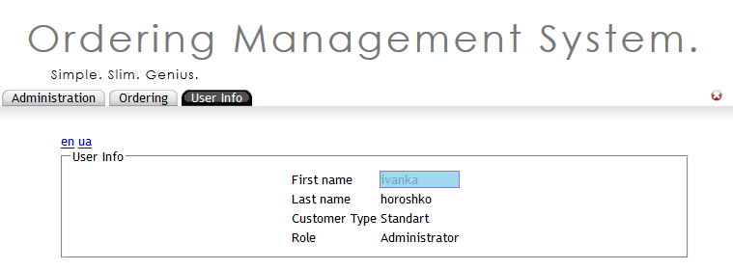
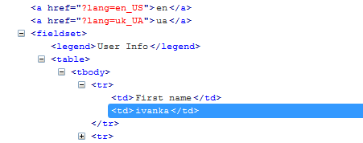
Check User Logged
$x('//tbody/tr/td[text()="First name"]')
$x('//tbody/tr/td[text()="First name"]/following-sibling::td')

Slide 34
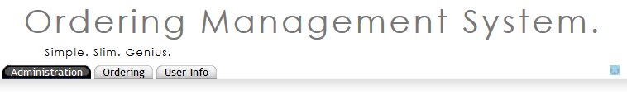
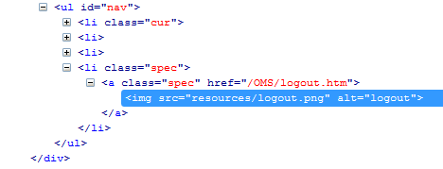
Logout
$x('//a[@href="addUser.htm"]')
$x('//a[@class="spec"]') ???

Slide 35
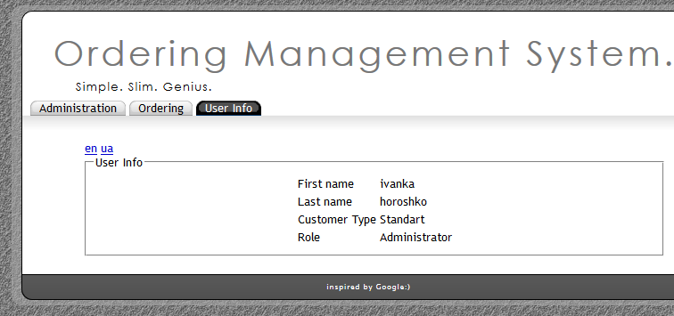
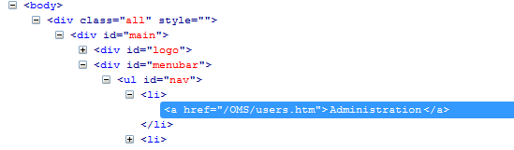
Choose Administration
$x('//a[@href="/OMS/users.htm"]')
$x('//a[text()="Administration"]')

Slide 36
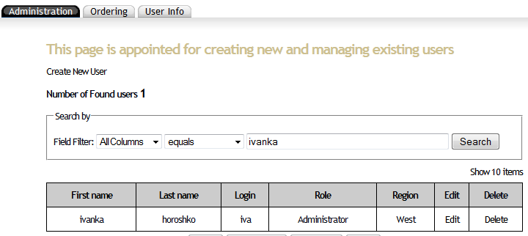
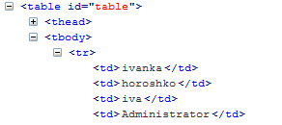
Find User
$x('//tbody/tr/td[text()="iva"]')

Slide 37
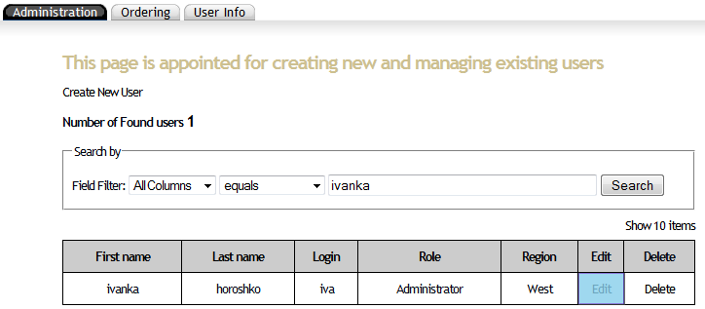
Choose Button
$x('//tbody/tr/td[text()="iva"]/following-sibling::td[*]
/a[text()="Edit"]')
$x('//tbody/tr/td[text()="iva"]/following-sibling::td[*]
/a[text()="Delete"]')

Slide 38

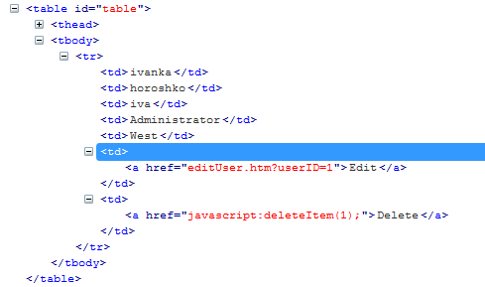
Choose Button
$x('//tbody/tr/td[text()="iva"]/following-sibling::td[*]/a[text()="Edit"]')
$x('//tbody/tr/td[text()="iva"]/following-sibling::td[*]/a[text()="Delete"]')

Slide 39
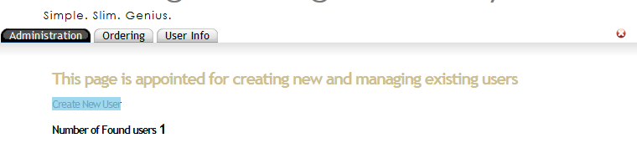
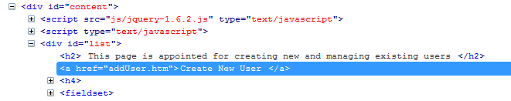
Create New User
$x('//a[@href="addUser.htm"]')

Slide 40
Example
using System;
using System.Collections.Generic;
using System.Linq;
using System.Text;
using System.Threading;
using System.Threading.Tasks;
using NUnit.Framework;
using OpenQA.Selenium;
using OpenQA.Selenium.Firefox;
using OpenQA.Selenium.Support.UI;
namespace ClassLibrary3
{
[TestFixture]
public class Class1
{

Slide 41
Example
[Test]
public void CheckLogin()
{
IWebDriver driver = new FirefoxDriver();
driver.Navigate().GoToUrl("http://class86:8080/OMS/login.htm");
driver.FindElement(By.Name("j_username")).Clear();
driver.FindElement(By.Name("j_username")).SendKeys("iva");
driver.FindElement(By.Name("j_password")).Clear();
driver.FindElement(By.Name("j_password")).SendKeys("qwerty");
driver.FindElement(By.Name("j_password")).Submit();
Assert.AreEqual("ivanka", driver.FindElement(By.XPath("//tbody/tr/td[text()='First name']/following-sibling::td")).Text);
driver.FindElement(By.XPath("//a[@href='/OMS/logout.htm']")).Click();
driver.Close();
}

Slide 42
Example
[Test]
public void CreateUser()
{
IWebDriver driver = new FirefoxDriver();
driver.Navigate().GoToUrl("http://class86:8080/OMS/login.htm");
driver.FindElement(By.Name("j_username")).Clear();
driver.FindElement(By.Name("j_username")).SendKeys("iva");
driver.FindElement(By.Name("j_password")).Clear();
driver.FindElement(By.Name("j_password")).SendKeys("qwerty");
driver.FindElement(By.Name("j_password")).Submit();
driver.FindElement(By.XPath("//a[text()='Administration']")).Click();
driver.FindElement(By.XPath("//a[@href='addUser.htm']")).Click();
driver.FindElement(By.Id("login")).Clear();
driver.FindElement(By.Id("login")).SendKeys("aaaa");
driver.FindElement(By.Id("firstName")).Clear();
driver.FindElement(By.Id("firstName")).SendKeys("aaaa");
driver.FindElement(By.Id("lastName")).Clear();

Slide 43
Example
driver.FindElement(By.Id("lastName")).SendKeys("aaaa");
driver.FindElement(By.Id("password")).Clear();
driver.FindElement(By.Id("password")).SendKeys("aaaa");
driver.FindElement(By.Id("confirmPassword")).Clear();
driver.FindElement(By.Id("confirmPassword")).SendKeys("aaaa");
driver.FindElement(By.Id("email")).Clear();
driver.FindElement(By.Id("email")).SendKeys("a.a@gmail.com");
Thread.Sleep(1000);
driver.FindElement(By.Id("roleID1")).Click();
driver.FindElement(By.Id("email")).Submit();
SelectElement select = new
SelectElement(driver.FindElement(By.Id("field")));
select.SelectByText("Login Name");
(new SelectElement(driver.FindElement(By.Id("condition")))).
SelectByText("equals");
driver.FindElement(By.Id("searchField")).Clear();
driver.FindElement(By.Id("searchField")).SendKeys("aaaa");

Slide 44
Example
Thread.Sleep(1000);
//
Assert.AreEqual("aaaa",
driver.FindElement(By.XPath("//tbody/tr/td[text()='aaaa']")).Text);
driver.FindElement(
By.XPath("//tbody/tr/td[text()='aaaa']
/following-sibling::td[*]/a[text()='Delete']")).Click();
//
driver.SwitchTo().Alert().Accept();
//driver.SwitchTo().Alert().Dismiss();
//
driver.FindElement(By.XPath("//a[@href='/OMS/logout.htm']")).Click();
driver.Close();
}
}
}

Slide 45
References
XPath Tutorial
http://www.w3schools.com/XPath/
XPath Syntax
http://www.w3schools.com/xpath/xpath_syntax.asp
XPath Tutorial. Basics
http://edutechwiki.unige.ch/en/XPath_tutorial_-_basics
XPath Syntax. MSDN Microsoft
http://msdn.microsoft.com/en-us/library/ms256471(v=vs.110).aspx
http://msdn.microsoft.com/en-us/library/ms256086(v=vs.110).aspx
Location Paths . MSDN Microsoft
http://msdn.microsoft.com/en-us/library/ms256039(v=vs.110).aspx
XPath Expression Syntax
http://www.saxonica.com/documentation/expressions/
XPath from Wikipedia
http://en.wikipedia.org/wiki/XPath

Slide 46


