Slide 1

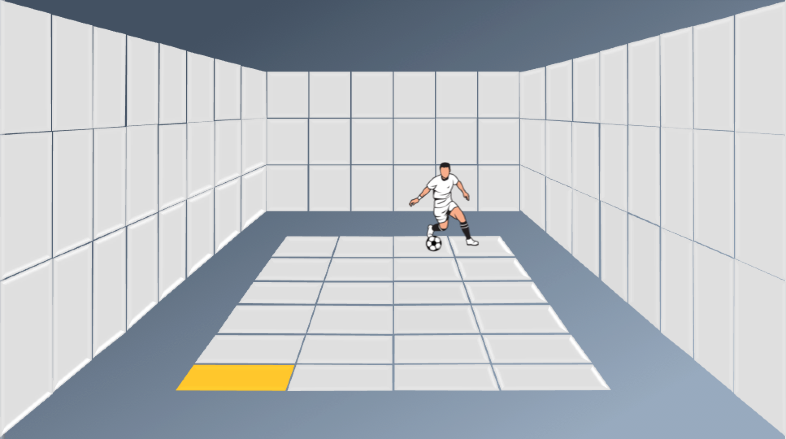
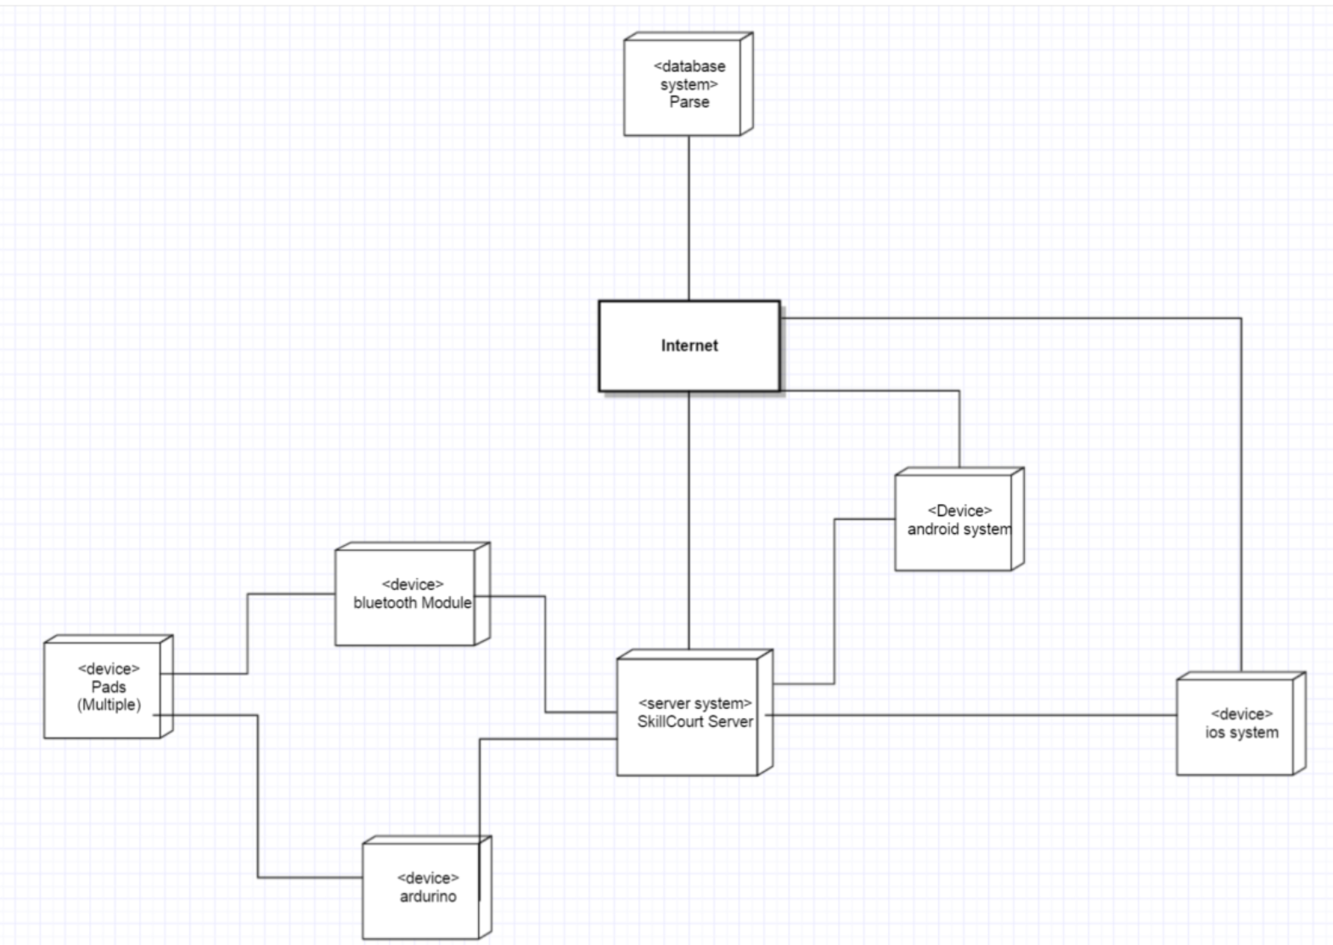
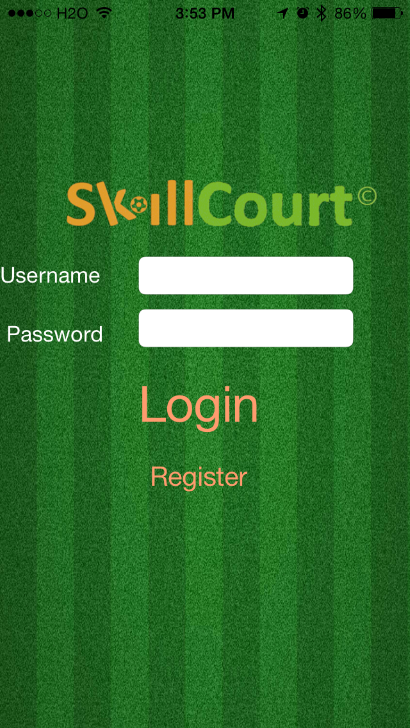
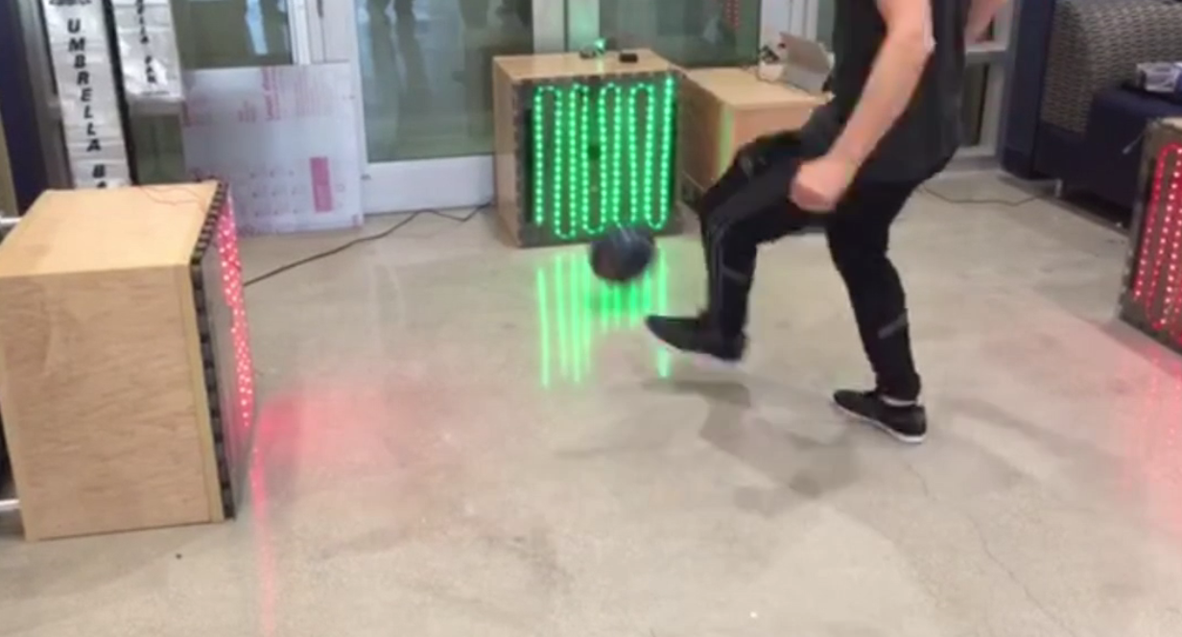
School of Computing & Information Sciences
Senior Project, Spring 2016
SkillCourt 4.0
Student: Sebastien Dolce, Florida International University
Product Owner: Gumi Traustason
Instructor: Masoud Sadjadi, Florida International University
Problem
Current System
Requirements
There is a lot involved with the training of soccer players. The current system for training is primitive, usually involving an instructor and a physical field for playing. The system will be a program with features that will assist players for learning the skills required on their own.
Implementing this system is revolutionary to the way avid players train in the sport.
The current system includes a single physical pad connected to an Arduino. The breadboard uses an HC-06 Bluetooth module (not compatible with any version of iOS). The current system can only run the sequence on one pad. This also means that the encoded sequences also only work with one single pad
It is important to have a portable system, therefore iOS and android applications are a must. In order to create drill sequences, a device must generate an xml file that will be decoded into a SkillCourt drill sequence. In addition, the drill sequences must be able to be run from the mobile devices as well as the local machine. This requires a Bluetooth capable application.
System Design
Summary
The iOS app employs an MVC design pattern. The persistent data design includes a one to many relationship from a SkillCourtUser entity and a Sequence entity, all encrypted with a private key. The application also makes use of a parse database to store users and relationships. The application also uses the CoreBluetooth framework in order to communicate with the SkillCourt server.
In this project, I’ve implemented the entire iOS application which includes all views persistent data storage, database storage, sequence file creation, Bluetooth integration, team management algorithm, settings bundles implementation, authentication, registration and more an iOS device can now perform many necessary processes for SkillCourt to operate properly.

