Slide 1


Micro Auctioning
Click Tac Toe
Veggies at your Door
Sonita Bose
CWID: A20447922

Slide 2

Micro Auctioning
Click Tac Toe
Veggies at your Door
Ever wondered who decides the prices of vegetables?
Or how is the pricing done?

Slide 3
Micro Auctioning
Click Tac Toe
Veggies at your Door
Demand and Supply !!!!!

Slide 4
AIM
Micro Auctioning
Click Tac Toe
Veggies at your Door
The objective of the project is to create a platform for sales and purchase of “PERISHABLE” goods like fruits and vegetables. Currently the process is carried out by traders at district levels and cities with the last mile distribution done by retail vendors. The drawback with this system is that the sales price derived at any point factors in the risk of wastage since it might not be sold and goods being perishable. If the quantity to be sold is confirmed the entire trade system can be operated at lower risk coverage which benefits all stakeholders of the system.

Slide 5
Micro Auctioning
USERS
Click Tac Toe
Veggies at your Door
Buyers
The Buyer places orders for a particular product. Then commit to an offer when available and pay up front.
2. Procurers
The procurers will commit to a price and quantity of a particular product to be sold on the platform based on the demand created by the buyers.

Slide 6
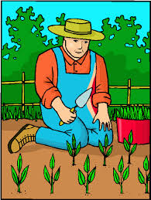
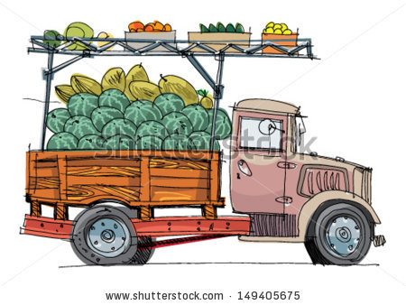
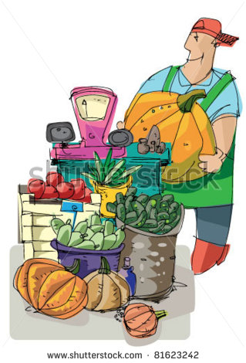
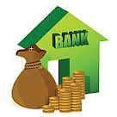
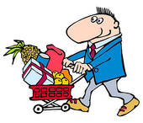
SUPPLY CHAIN – EXISTING PATTERN
WHOLESALER
FARMER
VENDOR
BUYER

Slide 7
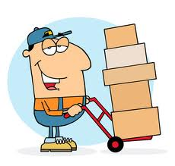
SUPPLY CHAIN – PROPOSED PATTERN
ORDERS
OFFERS
QTY
Max Price
Offer Price
Offer Qty
BUYER
VENDOR
CONFIRMED
ORDERS
DISTRIBUTOR

Slide 8
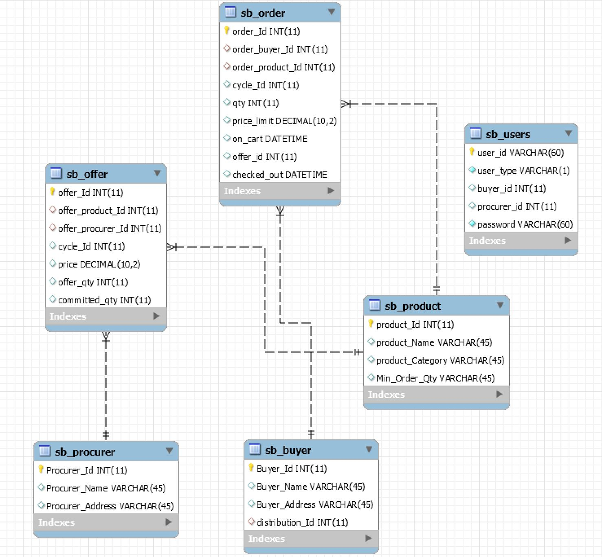
ER DIAGRAM

Slide 9
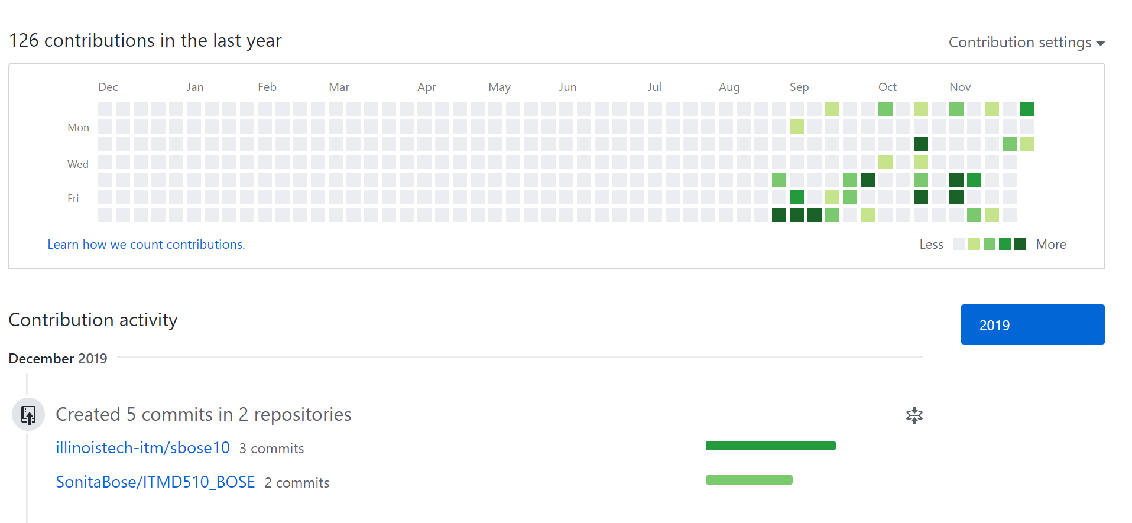
Micro Auctioning
Click Tac Toe
Veggies at your Door
Gantt Chart timeline

Slide 10
Micro Auctioning
Click Tac Toe
Veggies at your Door
Application Features
MVC Module Frameworks
CRUD Application for multi-role users to perform different DML and DDL operations
Interfaces used to show offers for Vendors and Buyers
Admin role available to manage user deletion
Application to achieve and optimize the supply and demand chain where buyers place orders and vendors place offers depending on the supply demand trend.

Slide 11
Micro Auctioning
Click Tac Toe
Veggies at your Door
Benefits
Implementing the above functionality removes the middleman and his associated margins and costs.
Retail Banks get a good quality of debt to sell.
It may be possible to offer Banks to bid for the credit so that we can introduce competition between banks to enable the farmers to avail the cheapest loan.

Slide 12
Micro Auctioning
Click Tac Toe
Veggies at your Door
SCREENSHOTS

Slide 13
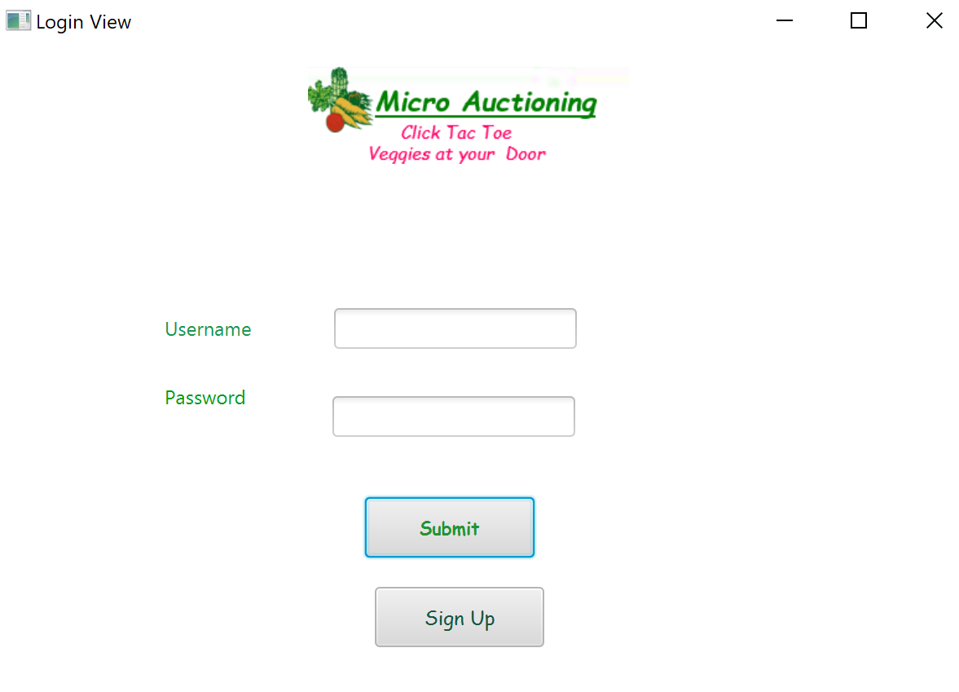
Micro Auctioning
Login
Click Tac Toe
Veggies at your Door

Slide 14
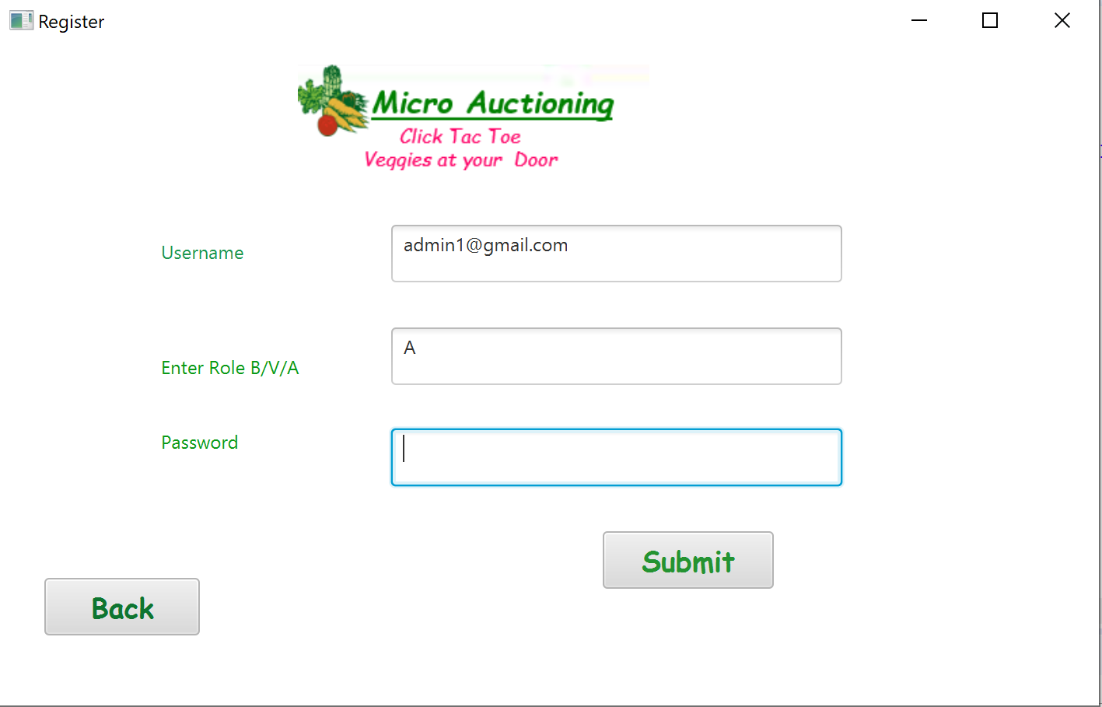
Micro Auctioning
New User Registration
Click Tac Toe
Veggies at your Door

Slide 15
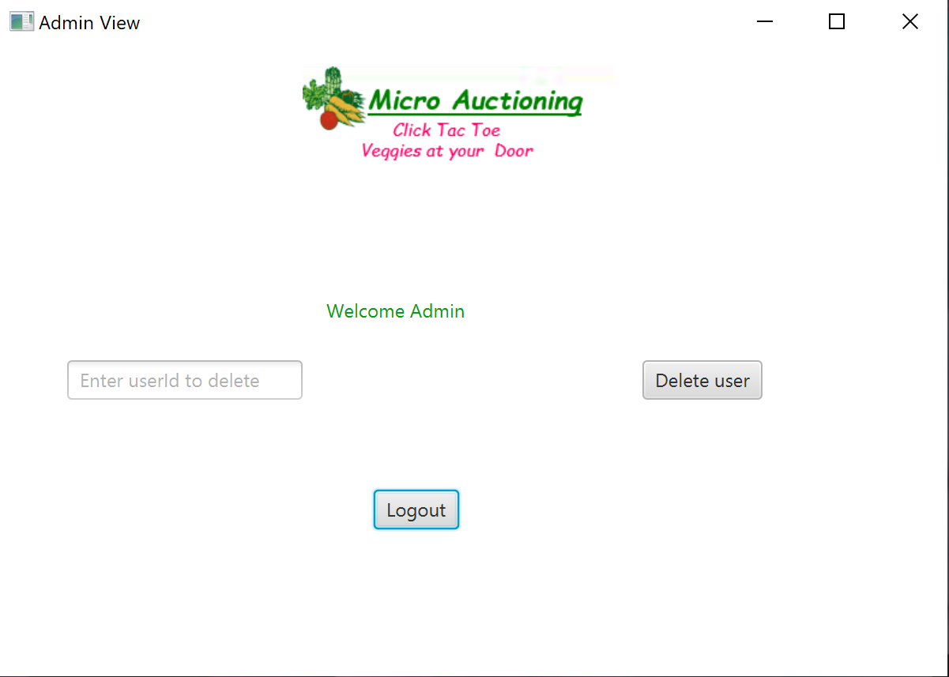
Micro Auctioning
Click Tac Toe
Veggies at your Door
Admin can delete users

Slide 16
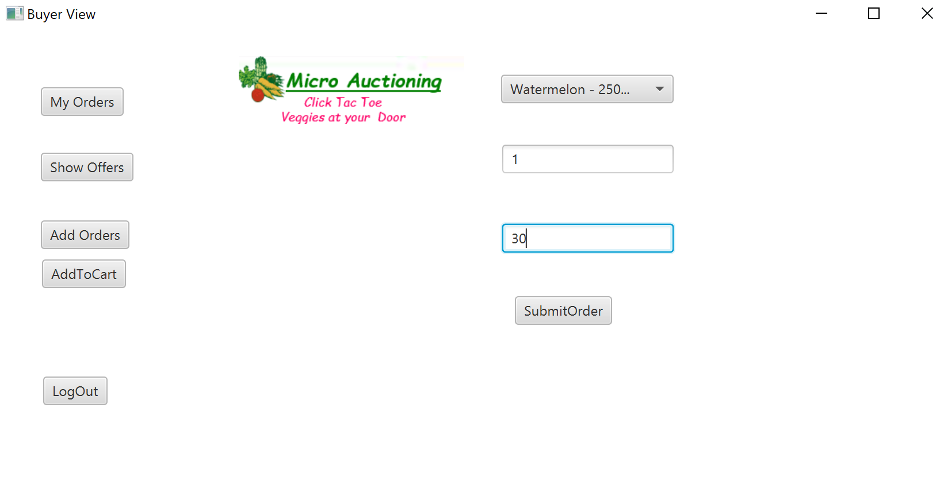
Micro Auctioning
Click Tac Toe
Veggies at your Door
Buyer View

Slide 17
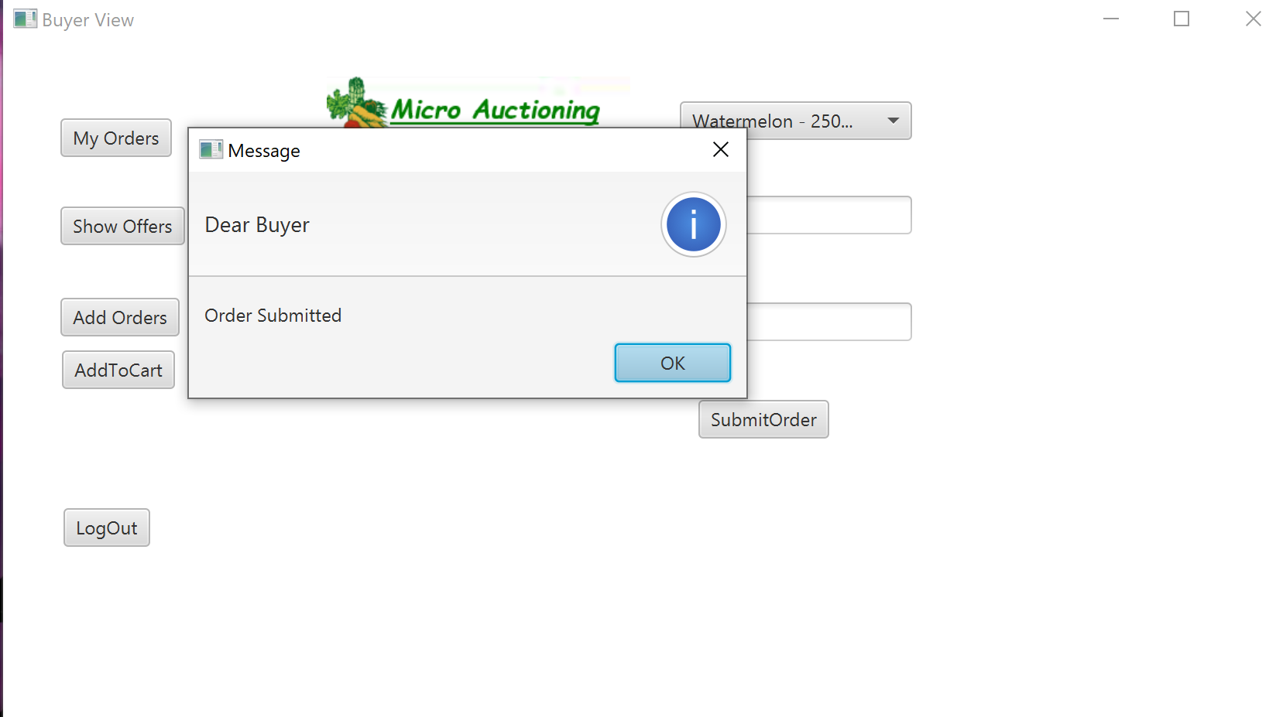
Buyer can place orders for his requirement. He logs out and waits for an offer on his order.
Micro Auctioning
Click Tac Toe
Veggies at your Door

Slide 18
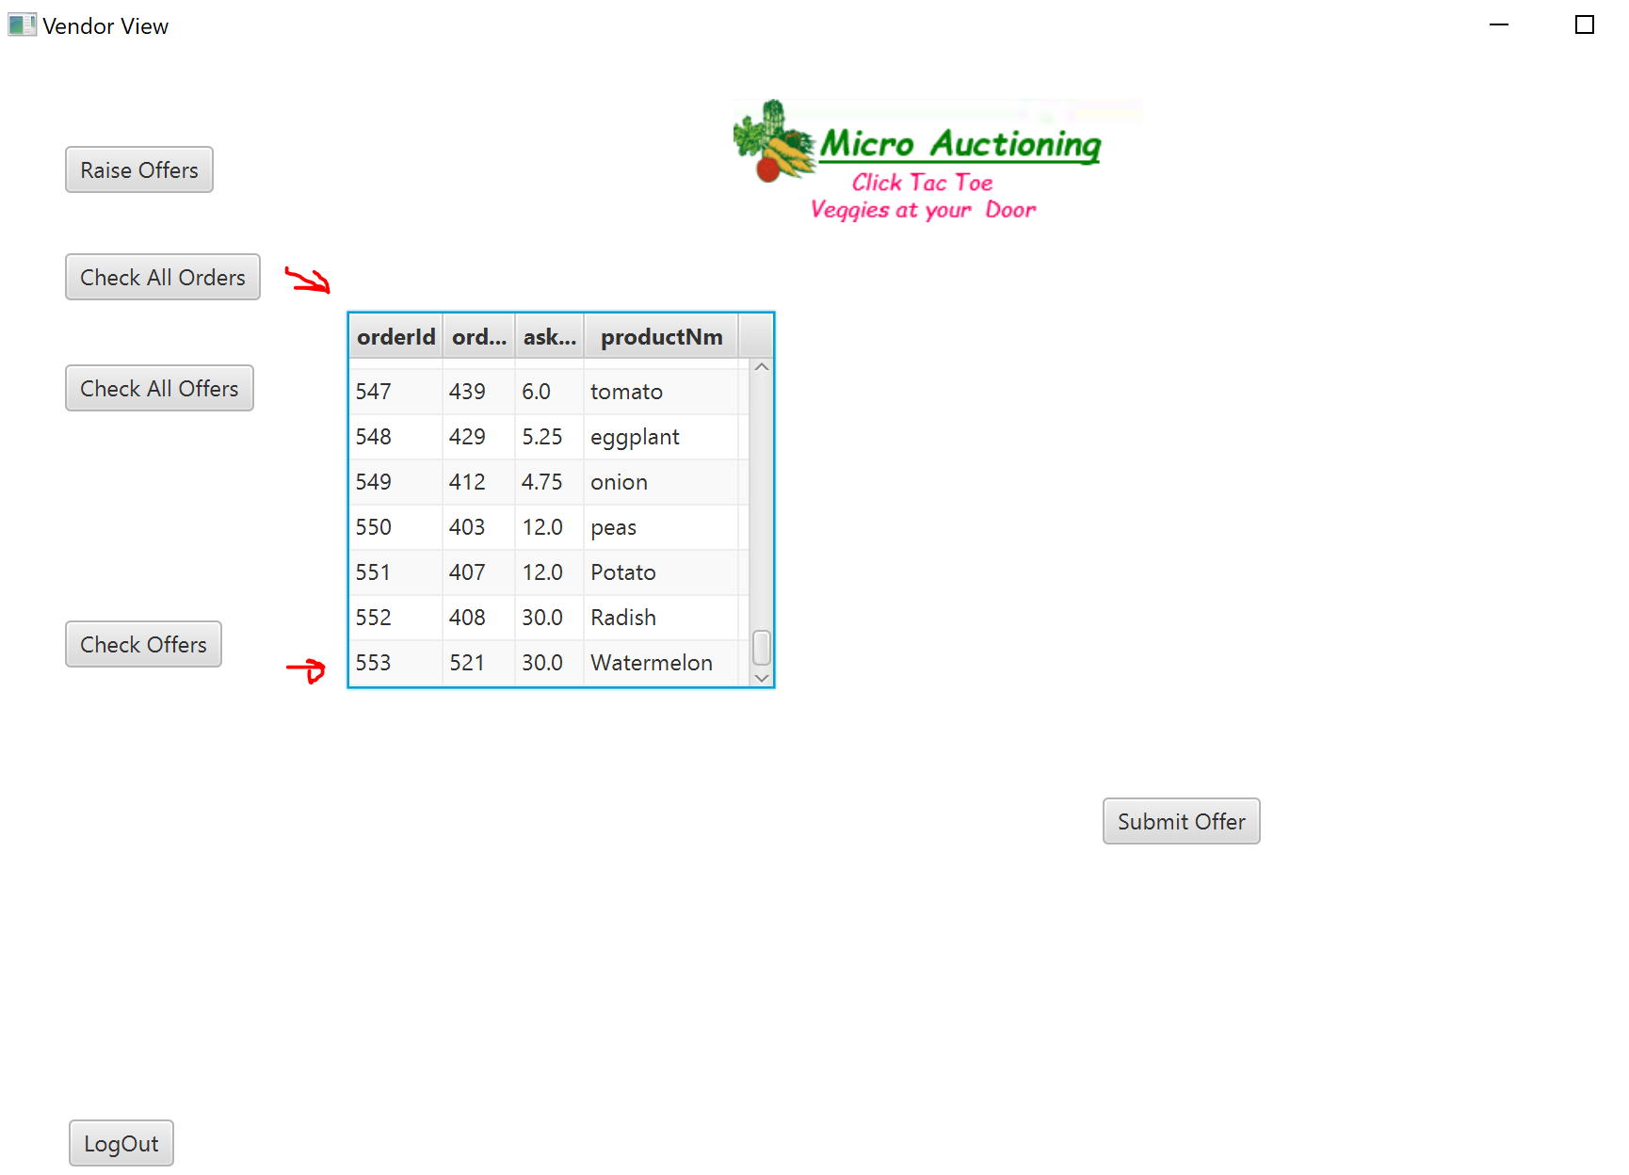
Micro Auctioning
Click Tac Toe
Veggies at your Door
Vendor View
Vendor can now see the buyer’s order and raise an offer against it.

Slide 19
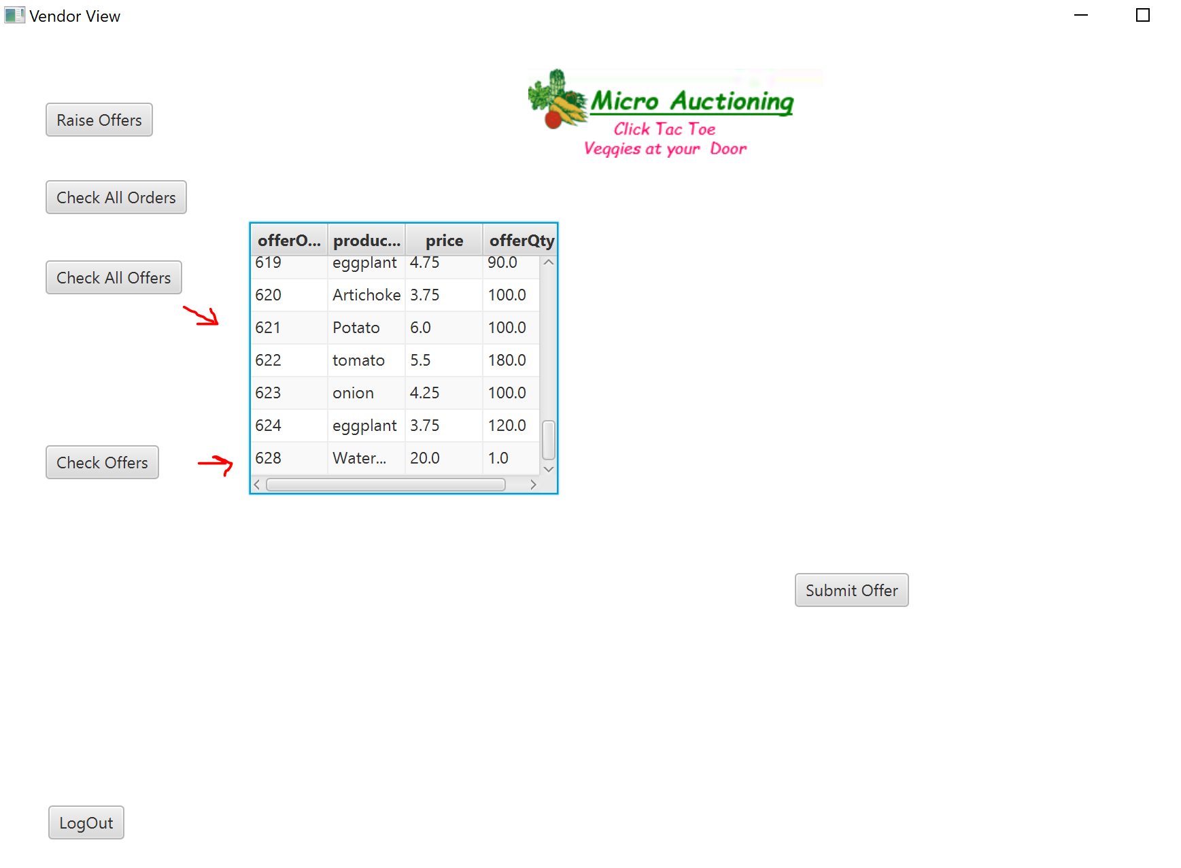
Vendor can see all the offers submitted by different vendors and decide a price depending on his stock.
Micro Auctioning
Click Tac Toe
Veggies at your Door

Slide 20
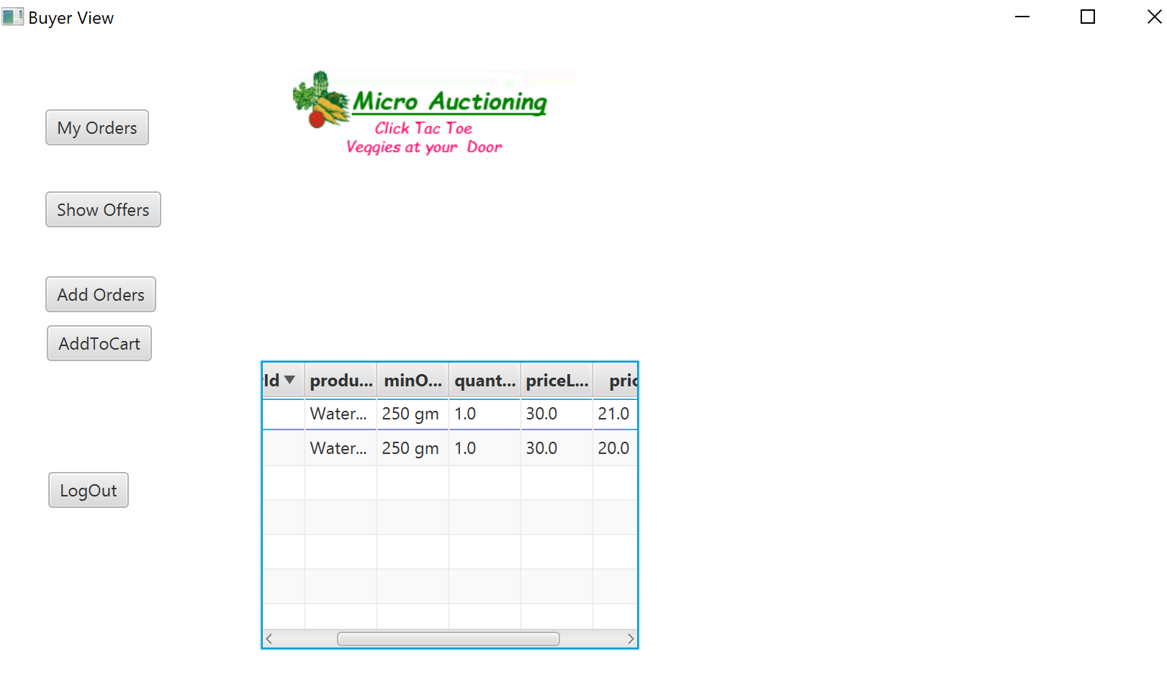
Buyer can see that there are two offers against his orders. He can see that the price limit he had put was $30 dollars and vendors are willing to offer $21 and $20 dollars.
Micro Auctioning
Click Tac Toe
Veggies at your Door

Slide 21
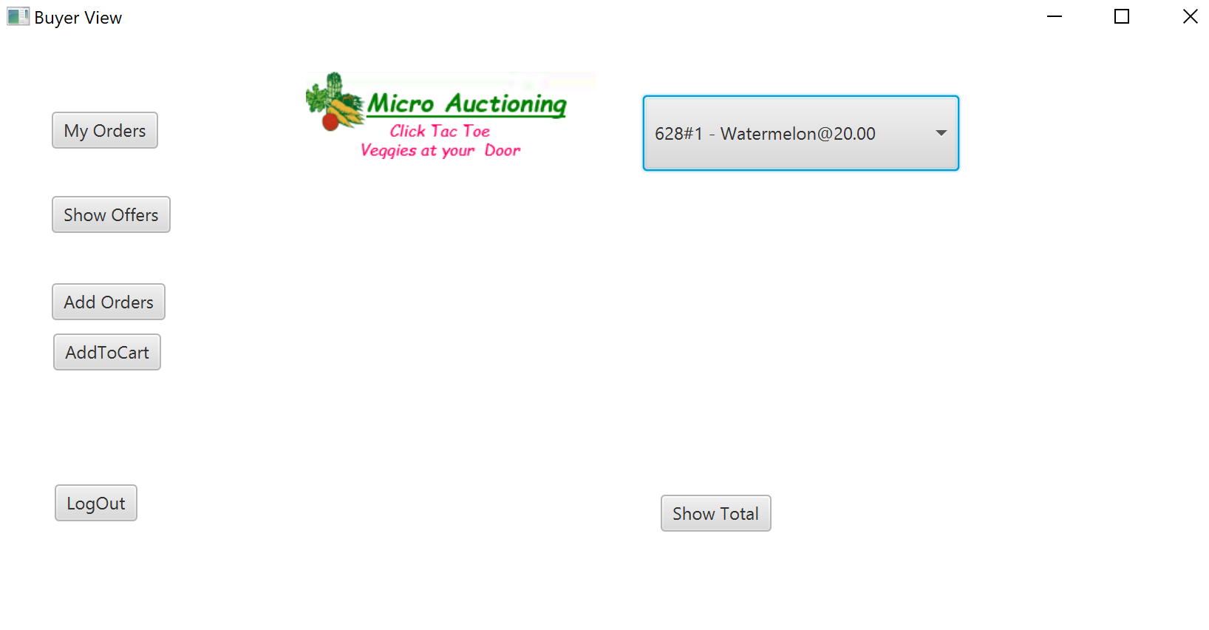
Micro Auctioning
Click Tac Toe
Veggies at your Door
Buyer can select the offers from the drop down and Add to Cart

Slide 22
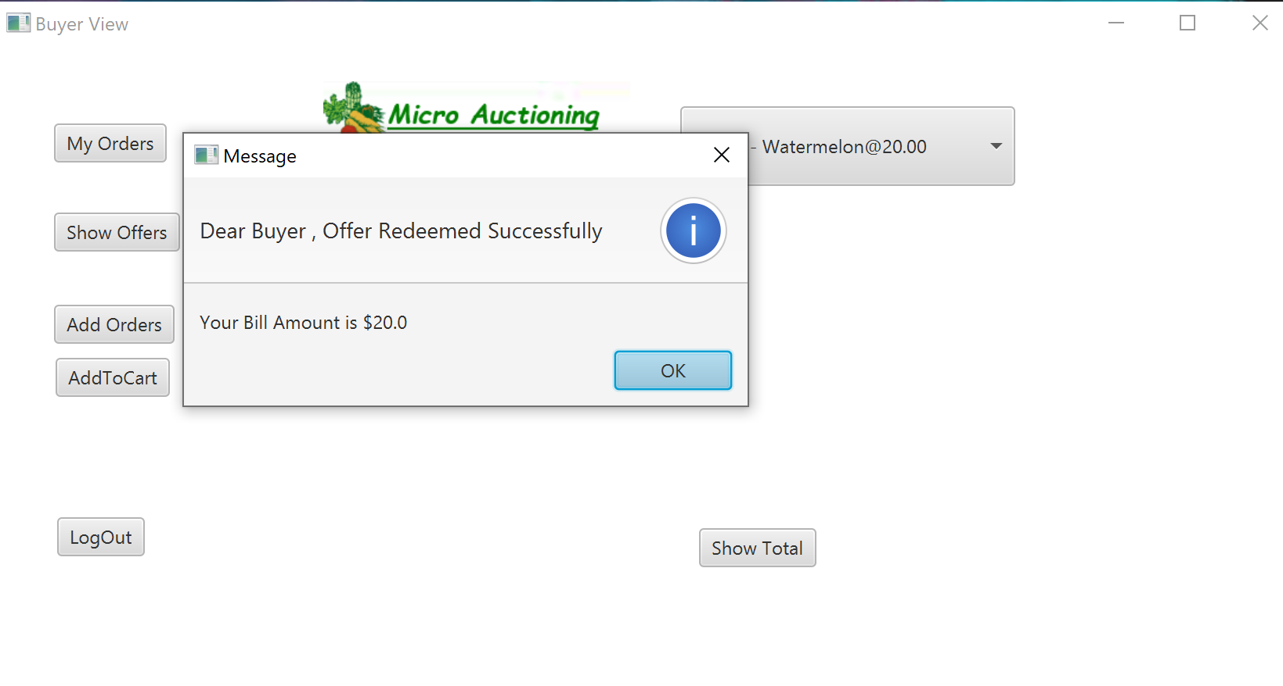
Micro Auctioning
Buyer clicks on show total to see his bill.
Click Tac Toe
Veggies at your Door

Slide 23
Micro Auctioning
Click Tac Toe
Veggies at your Door
Conclusion
This project is a platform where buyers can raise their orders which is the demand of the market.
The Vendors are able to see the demand and optimize the cost accordingly.
Once this application is used on a large scale, we can achieve a better idea of the demand which will help to understand the demand and reduce the wastage of the perishable items like vegetables.
We need to have a middle man distributor from the farmer and this application can directly be used by Farmers in the future.

Slide 24
Micro Auctioning
Click Tac Toe
Veggies at your Door
Future Development
The Future of this application will be to add a functionality where a buyer can place orders for future dates as far as six months or more. Vendors too can place offers for future sales.
This is how it will work
If the buyer and vendor agree they can seal the deal for a sale on a future date. The buyer will pay upfront a percentage of the total bill.
In such cases the vendor can be the actual producer of vegetables or the farmer. The platform can stand guarantee to a bank loan that the farmer can avail with the upfront payment as margin money.
The buyer pays up at a date reasonably near the date of delivery and the farmer gets his margin after the bank recovers its loaned amount plus interest.

Slide 25

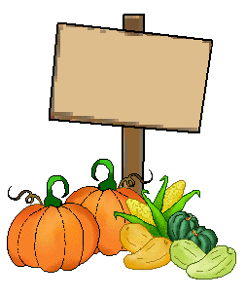
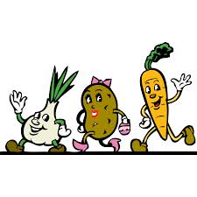
Micro Auctioning
Click Tac Toe
Veggies at your Door
Thank You

