Slide 1
Digital Image Processing
Joydev Hazra
Dept. of CSE
NSEC
BOOK
Digital Image Processing R. C. Gonzalez, R. E. Woods

Slide 2
Introduction
What is Digital Image Processing?
Digital Image
— a two-dimensional function
x and y are spatial coordinates
The amplitude of f is called intensity or gray level at the point (x, y)
Digital Image Processing
  Image processing is a subclass of signal processing concerned specifically with pictures.
  Improve image quality for human perception and/or computer interpretation.
Pixel
— the elements of a digital image
Image
Processing
Better Image

Slide 3
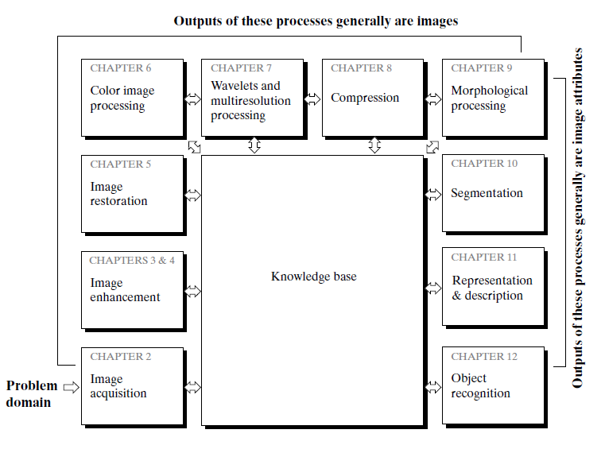
Fundamental steps in digital image processing

Slide 4
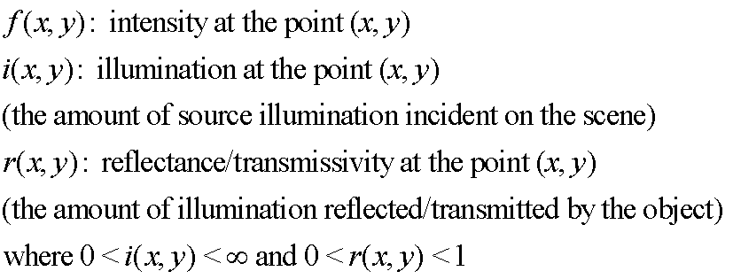
A Simple Image Formation Model
Digital image
0 < f(x,y) < ∞
f(x,y) = i(x,y)r(x,y)

Slide 5
Gray level ( l ) = f(x,y)
Lmin ≤ l ≤ Lmax
Positive
Finite
Lmin = imin rmin
Lmax = imax rmax
[ Lmin, Lmin ] -----gray scale

Slide 6
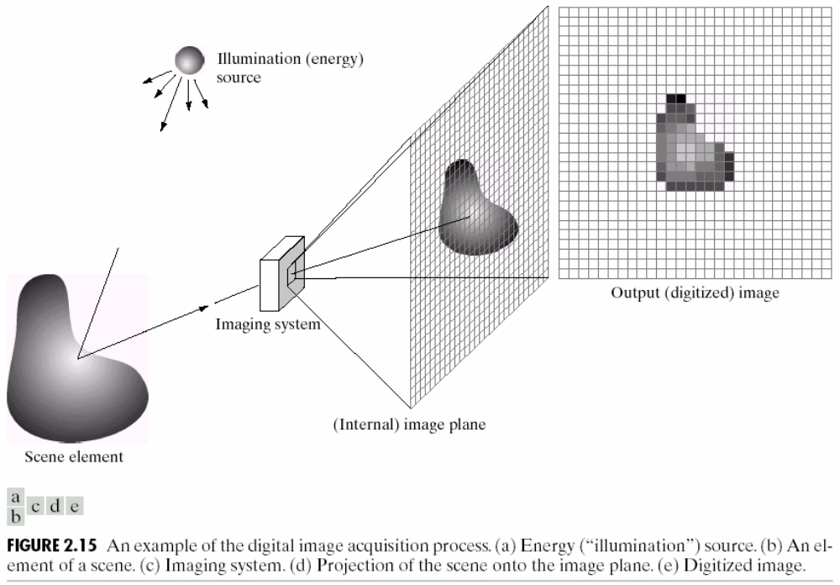
Sampling and Quantization

Slide 7

Sampling and Quantization

Slide 8

Sampling and Quantization

Slide 9
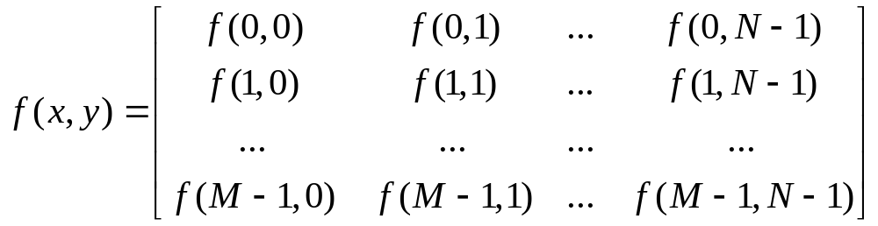
Representing Digital Images
The representation of an M×N numerical array as

Slide 10
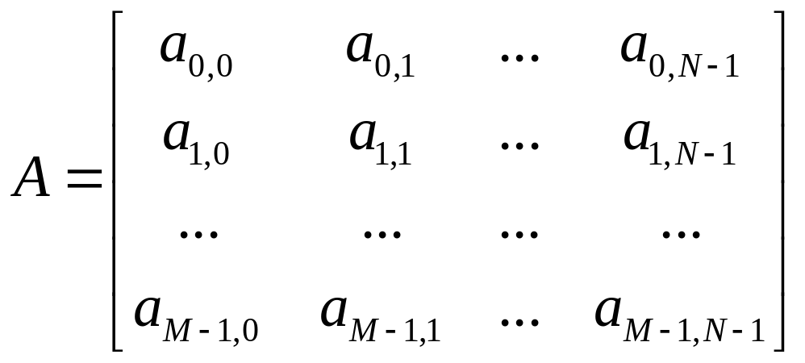
Representing Digital Images
The representation of an M×N numerical array as

Slide 11
Representing Digital Images
Discrete intensity interval [0, L-1], L=2^{k}
The number b of bits required to store a M × N digitized image
b = M × N × k

Slide 12
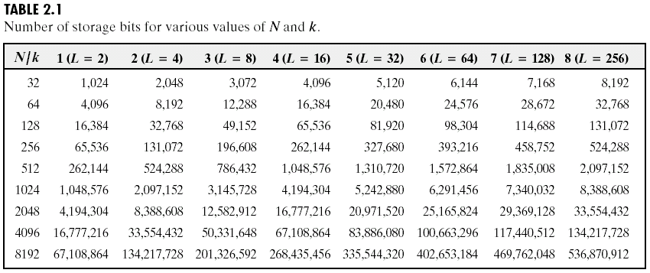
Representing Digital Images

Slide 13
Spatial and Intensity Resolution
Spatial resolution
— A measure of the smallest discernible detail in an image
— stated with line pairs per unit distance, dots (pixels) per unit distance, dots per inch (dpi)
Intensity resolution
— The smallest discernible change in intensity level
— stated with 8 bits, 12 bits, 16 bits, etc.

Slide 14
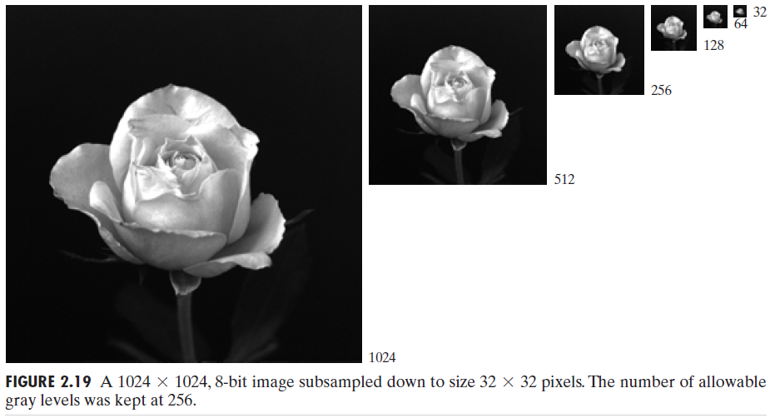
Spatial resolution

Slide 15
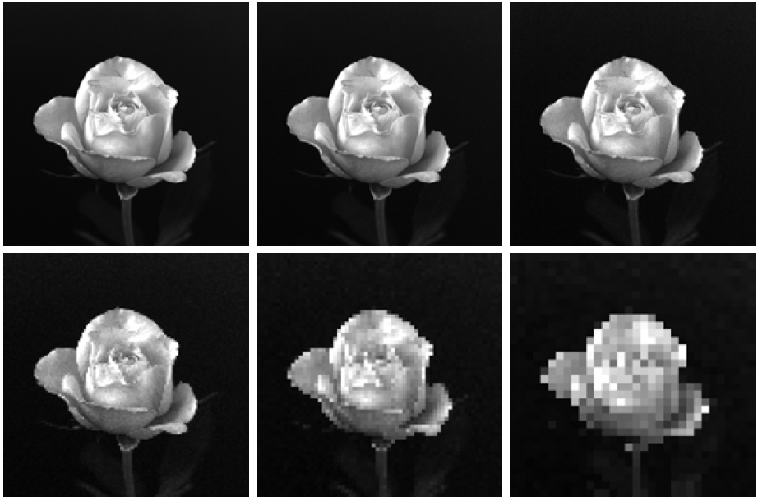
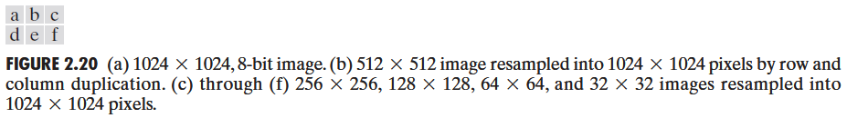

Slide 16

Gray-level resolution

Slide 17

Gray-level resolution

Slide 18
Basic Relationships Between Pixels
Neighborhood
Adjacency
Connectivity
Paths
Regions and boundaries

Slide 19
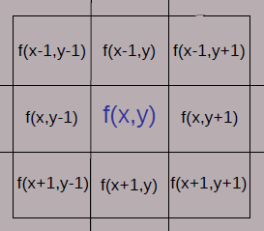
Basic Relationships Between Pixels
Neighbors of a pixel p at coordinates (x,y)
4-neighbors of p, denoted by N₄(p):
(x-1, y), (x+1, y), (x,y-1), and (x, y+1).

Slide 20
Neighbors of a pixel p at coordinates (x,y)
4 diagonal neighbors of p, denoted by N_{D}(p):
(x-1, y-1), (x+1, y+1), (x+1,y-1), and (x-1, y+1).

Slide 21
Neighbors of a pixel p at coordinates (x,y)
8 neighbors of p, denoted N₈(p)
N₈(p) = N₄(p) U N_{D}(p)

Slide 22
Basic Relationships Between Pixels
Adjacency
Let V be the set of intensity values
4-adjacency: Two pixels p and q with values from V are 4-adjacent if q is in the set N₄(p).
8-adjacency: Two pixels p and q with values from V are 8-adjacent if q is in the set N₈(p).

Slide 23
Basic Relationships Between Pixels
Adjacency
Let V be the set of intensity values
m-adjacency: Two pixels p and q with values from V are m-adjacent if
(i) q is in the set N₄(p), or
(ii) q is in the set N_{D}(p) and the set N₄(p) ∩ N₄(q) has no pixels whose values are from V.

Slide 24
Examples: Adjacency
V = {1, 2}
0 1 1 0 1 1 0 1 1
0 2 0 0 2 0 0 2 0
0 0 1 0 0 1 0 0 1

Slide 25
Examples: Adjacency
V = {1, 2}
0 1 1 0 1 1 0 1 1
0 2 0 0 2 0 0 2 0
0 0 1 0 0 1 0 0 1
8-adjacent

Slide 26
Examples: Adjacency
V = {1, 2}
0 1 1 0 1 1 0 1 1
0 2 0 0 2 0 0 2 0
0 0 1 0 0 1 0 0 1
8-adjacent
m-adjacent

Slide 27
Basic Relationships Between Pixels
Path
A (digital) path (or curve) from pixel p with coordinates (x₀, y₀) to pixel q with coordinates (x_{n}, y_{n}) is a sequence of distinct pixels with coordinates
(x₀, y₀), (x₁, y₁), …, (x_{n}, y_{n})
Where (x_{i}, y_{i}) and (x_{i-1}, y_{i-1}) are adjacent for 1 ≤ i ≤ n.
Here n is the length of the path.
If (x₀, y₀) = (x_{n}, y_{n}), the path is closed path.
We can define 4-, 8-, and m-paths based on the type of adjacency used.

Slide 28
Examples: Adjacency and Path
V = {1, 2}
01,1 11,2 11,3 0 1 1 0 1 1
02,1 22,2 02,3 0 2 0 0 2 0
03,1 03,2 13,3 0 0 1 0 0 1
8-adjacent
m-adjacent
The 8-path from (1,3) to (3,3):
(1,3), (1,2), (2,2), (3,3)
(1,3), (2,2), (3,3)
The m-path from (1,3) to (3,3):
(1,3), (1,2), (2,2), (3,3)

Slide 29
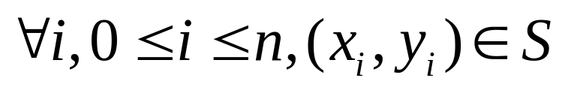
Basic Relationships Between Pixels
Connected in S
Let S represent a subset of pixels in an image. Two pixels p with coordinates (x₀, y₀) and q with coordinates (x_{n}, y_{n}) are said to be connected in S if there exists a path
(x₀, y₀), (x₁, y₁), …, (x_{n}, y_{n})
Where

Slide 30
Basic Relationships Between Pixels
Let S represent a subset of pixels in an image
For every pixel p in S, the set of pixels in S that are connected to p is called a connected component of S.
If S has only one connected component, then S is called Connected Set.
We call R a region of the image if R is a connected set
Two regions, R_{i} and R_{j} are said to be adjacent if their union forms a connected set.
Regions that are not to be adjacent are said to be disjoint.

Slide 31
Basic Relationships Between Pixels
Boundary (or border)
The boundary of the region R is the set of pixels in the region that have one or more neighbors that are not in R.
If R happens to be an entire image, then its boundary is defined as the set of pixels in the first and last rows and columns of the image.
Foreground and background
An image contains K disjoint regions, R_{k}, k = 1, 2, …, K. Let R_{u} denote the union of all the K regions, and let (R_{u})^{c} denote its complement.
All the points in R_{u} is called foreground;
All the points in (R_{u})^{c} is called background.

Slide 32

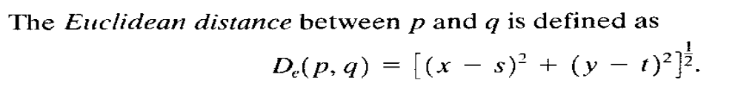
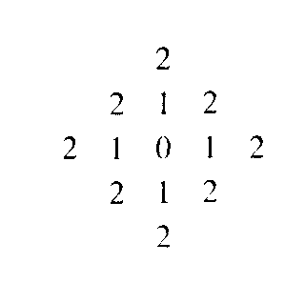


<= 2

Slide 33
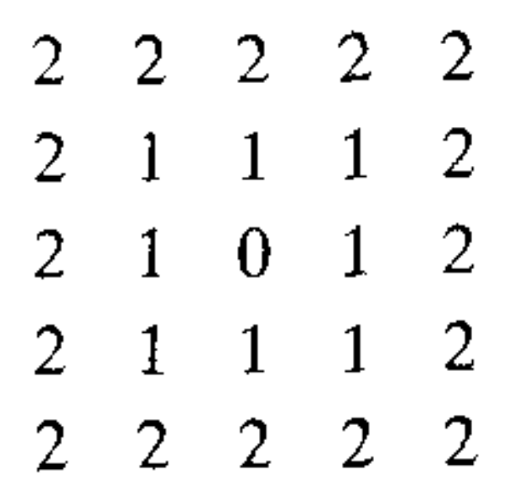
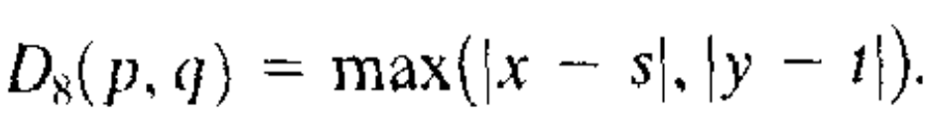
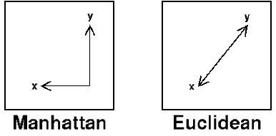
The following figure illustrates the difference between Manhattan distance (city block distance ) and Euclidean distance:
D8 <= 2

Slide 34
END
&
?

