Slide 1
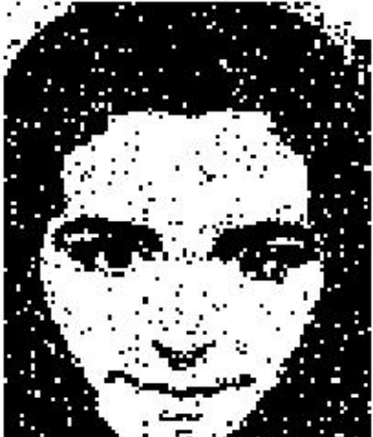
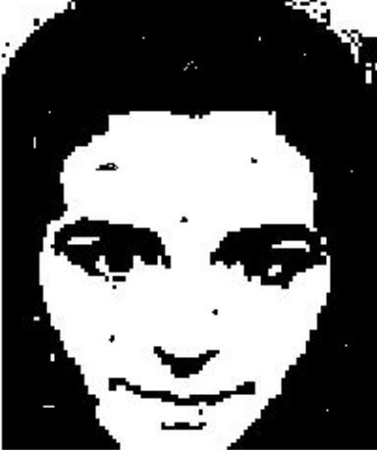
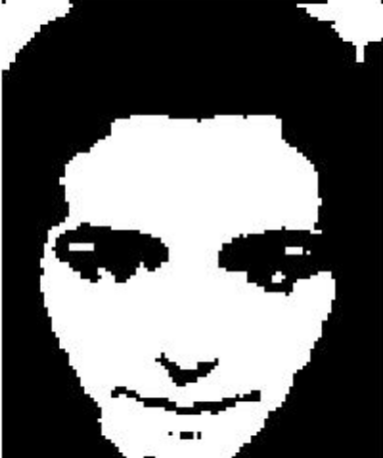
Image Enhancement
Processing the image so that the results is more suitable than the original image for a specific application
Fig. 1 Fig. 2 Fig. 3

Slide 2


Spatial domain processing
  Point processing :
    E.g., contrast stretching
  Mask processing : and its neighbors covered by mask)
    E.g., spatial filters
Origin
x
(x, y)
y
Image f (x, y)

Slide 3
Point processing
Simple intensity transforms
  Image negatives
  Log and power-low transforms
  Contrast stretching
  Gray-level slicing
  Bit-plane slicing
Histogram methods
  Histogram equalization
  Histogram specification
Image subtraction
Image averaging

Slide 4
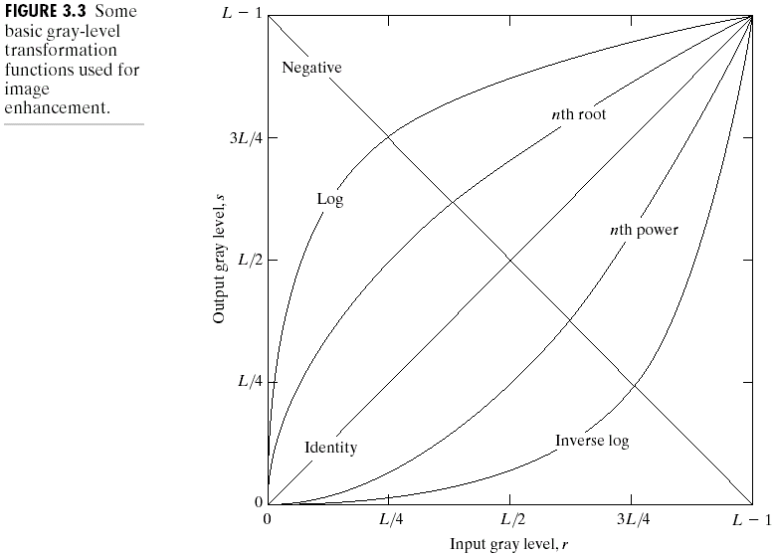

Slide 5
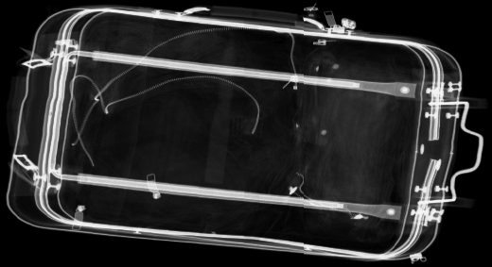
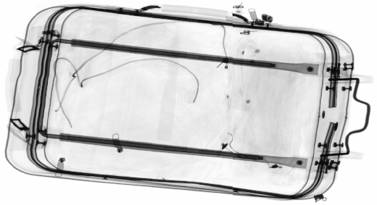
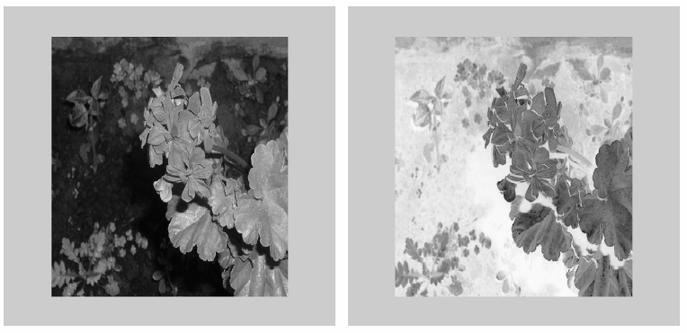
Image Negative: s = L – 1 – r

Slide 6
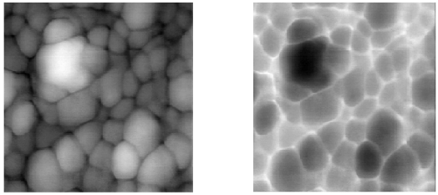
Example

Slide 7
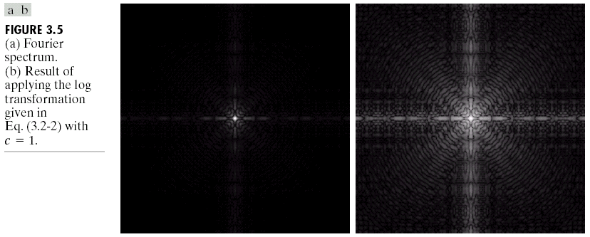
Log Transformation
s = c log(1+r)
c: constant
Compresses the dynamic range of images with large variations in pixel values

Slide 8

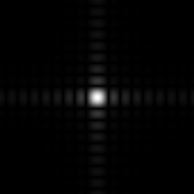
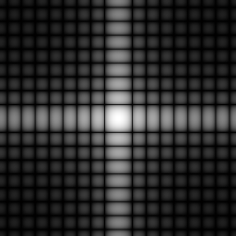
Log transforms
Original image
Fourier transform
Log transform of FT

Slide 9
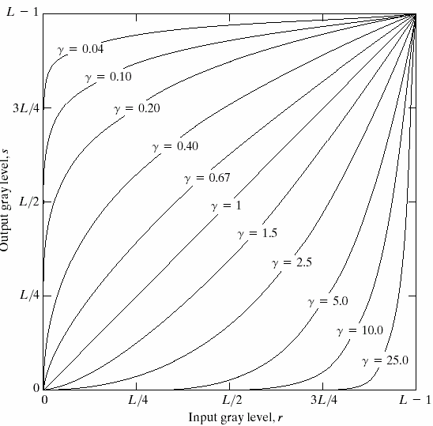
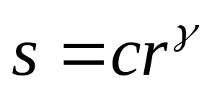
Power-Law transformation
• If γ <1: maps a narrow range of dark input values into a wider range of output values. (gamma encoding/compression)
• If γ >1:opposite of the above effect. (gamma decoding/ decompression)

Slide 10
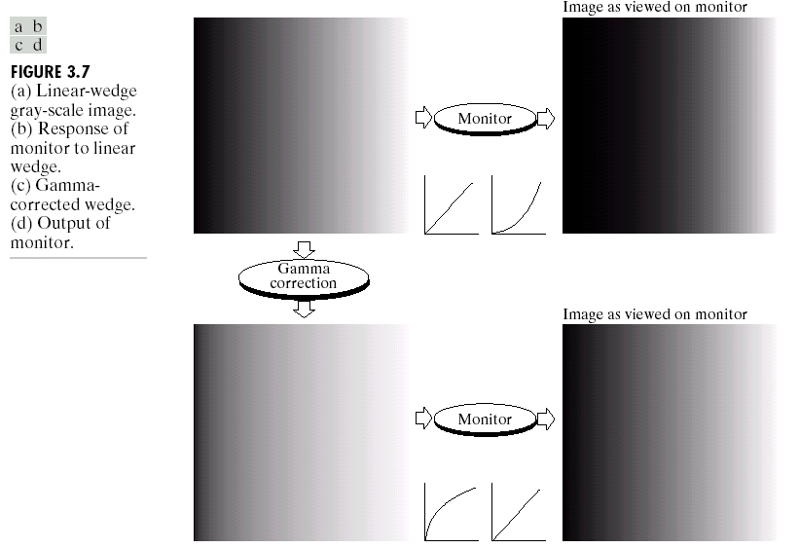
Gamma correction

Slide 11
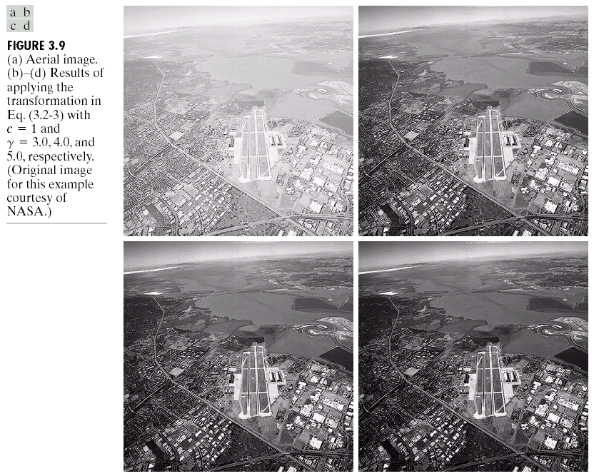
Example

Slide 12

Contrast stretching

Slide 13
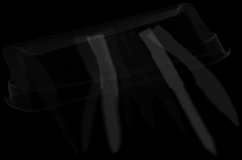

Contrast stretching
Original image
Stretched image

Slide 14

Thresholding
0 | 250 | 250 | 250
0 | 250 | 250 | 250
0 | 250 | 250 | 250
0 | 250 | 250 | 250

Slide 15
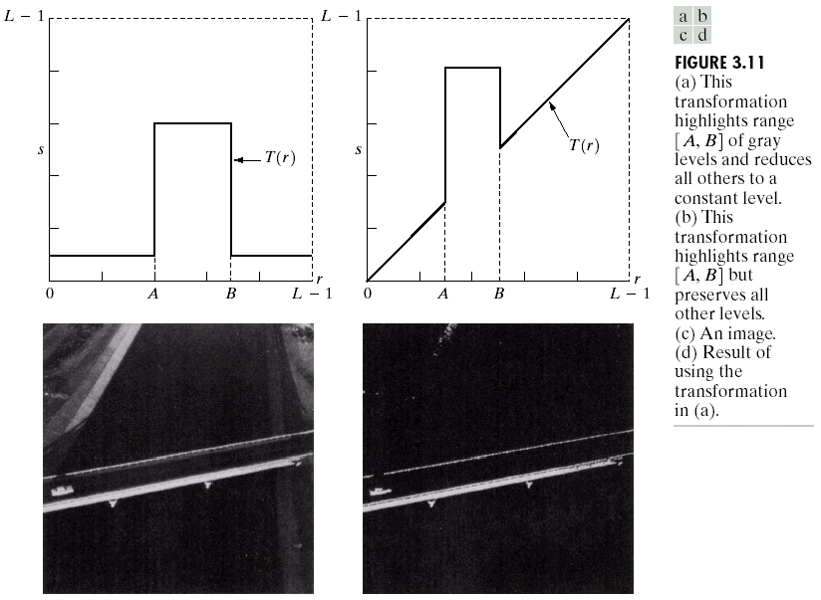
Gray-level slicing

Slide 16
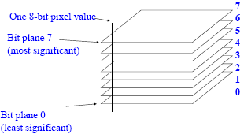
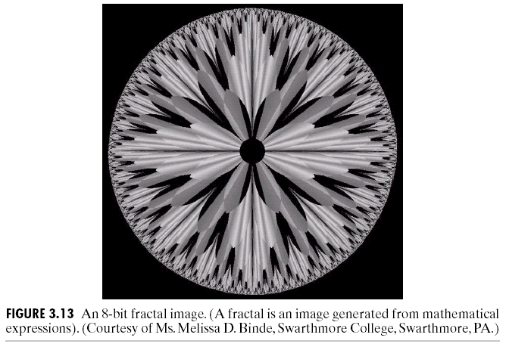
Bit-plane slicing

Slide 17
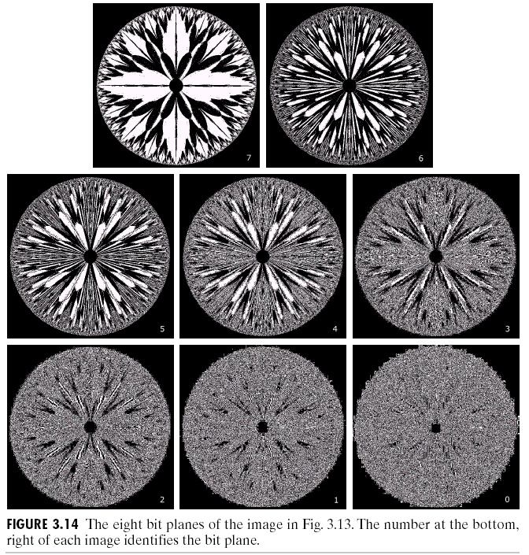

Slide 18
Enhancement Using
Arithmetic/Logic Operations
• Pixel-by-pixel between 2 or more images (NOT: 1 image)
• Logic operations: AND, OR, NOT
• When dealing with logic operations on gray-scale images, pixel values are processed as strings of binary numbers.
• NOT: performs negative transformation
• AND, OR: masking, region of interest (ROI) processing

Slide 19
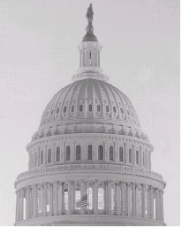

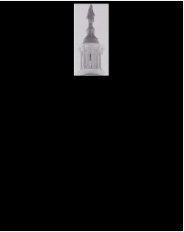
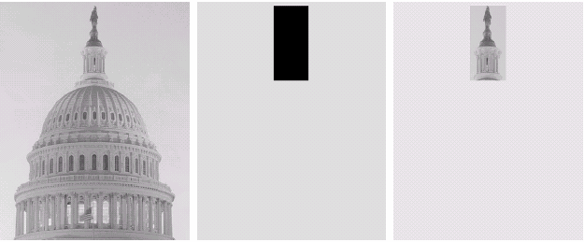
Original image.
AND image mask.
Result of the AND operation
Original image.
OR image mask.
Result of operation OR

Slide 20
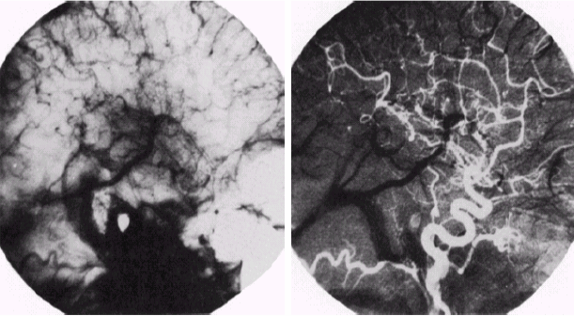
Image Subtraction

Slide 21

Image Averaging

Slide 22
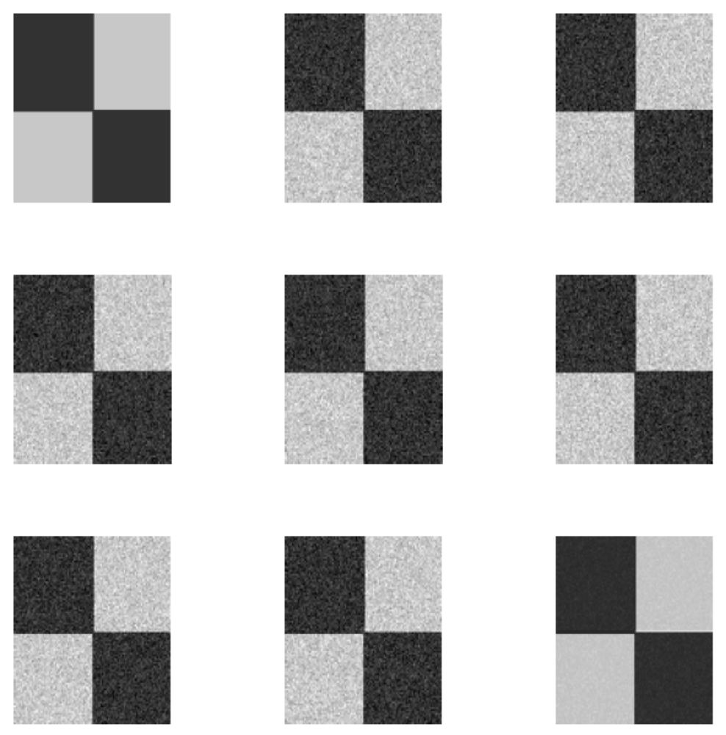

Slide 23
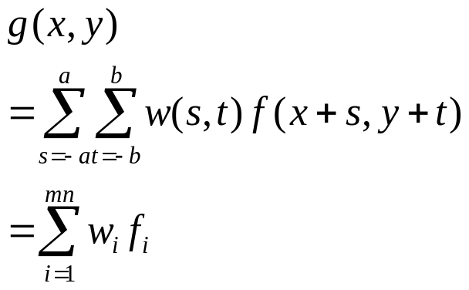
Spatial filtering
origin
y
mask
W(-1,-1)
W(-1,0)
W(-1,1)
W(0,-1)
W(0,0)
W(0,1)
W(1,-1)
W(1,0)
W(1,1)
f(x-1,y-1)
f(x-1,y)
f(x-1,y+1)
Mask coefficients
x
f(x,y-1)
f(x,y)
f(x,y+1)
f(x+1,y-1)
f(x+1,y)
f(x+1,y+1)
Image section under mask

Slide 24
Spatial filtering (cont’)
Operation Steps
  Select a single pixel.
  Determine the pixel’s neighborhood.
  Apply a function to the values of the pixels in the neighborhood. This function must return a scalar.
  Find the pixel in the output image whose position corresponds to that of the center pixel in the input image. Set this output pixel to the value returned by the function.
  Repeat steps 1 through 4 for each pixel in the input image.

Slide 25
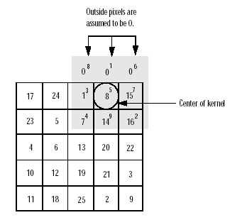
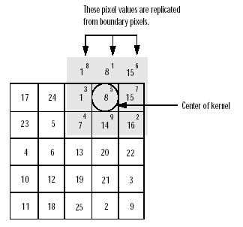
Spatial filtering (cont’)
Padding of borders

Slide 26
Spatial filtering
Smoothing filters
        Purpose: blurring or noise reduction
Sharpening filters
  Purpose: Highlight fine details
  Enhance details that have been blurred

Slide 27
Smoothing filters
Smoothing Linear filters
    Averaging filter
Order-Statistics filters
    Median filter
    Max filter
    Min filter

Slide 28
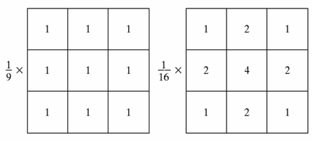
Averaging filter
Box filter
Weighted average filter

Slide 29
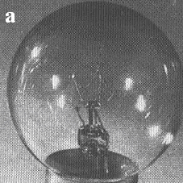
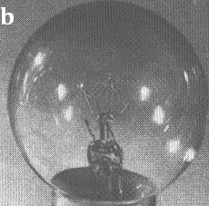
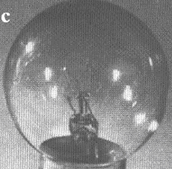
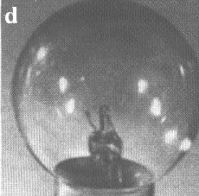
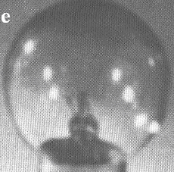
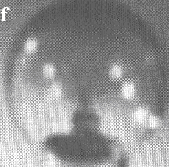
Example (Box filter)
a)Original image; (b)-(f)results of box filtering with a mask of size
n x n , n=3, 5, 7, 15, 25

Slide 30
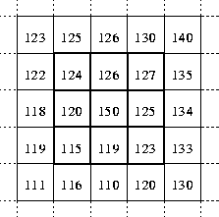
Median filters
The median filter is normally used to reduce noise in an image, somewhat like the mean filter. However, it often does a better job than the mean filter of preserving useful detail in the image.
R = median{ z_{k} | k = 1, 2, 3,…….,mn}
Sort the pixel values in z_{k} and
take the one in position (mn+1)/2.
Neighborhood values:
115, 119, 120, 123, 124,
125, 126, 127 & 150
Median value: 124

Slide 31
Max and Min filter
Max filter: Brightest points in an image
R = max{ z_{k} | k = 1, 2, 3,…….,9}
Min filter: Darkest points in an image
R = min{ z_{k} | k = 1, 2, 3,…….,9}
Neighborhood values:
115, 119, 120, 123, 124,
125, 126, 127 & 150
Max value: 150
Min value: 115

Slide 32
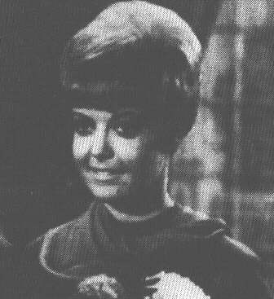
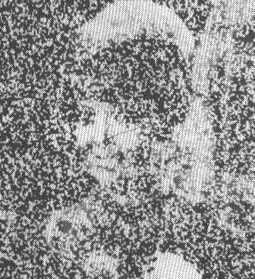
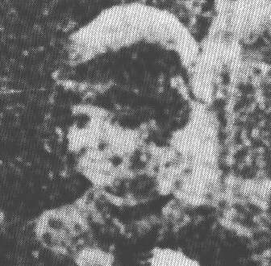
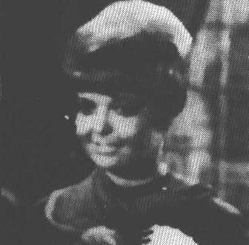
Example
(a) original image
(b) image corrupted by noise
(c) result of 5 x 5 averaging filtering
(d) result of 5 x 5 median filtering

Slide 33
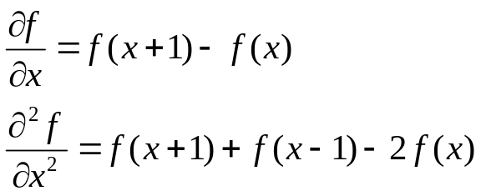
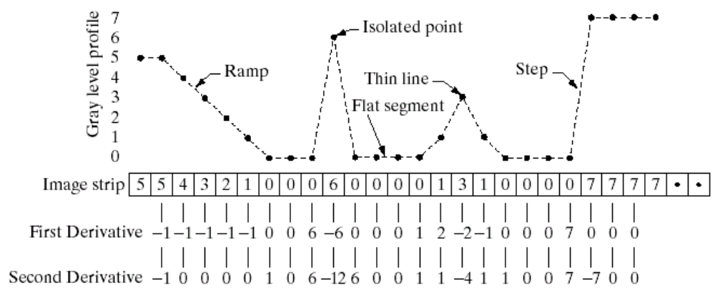
Sharpening filters
  Visual effect : enhanced edges on a dark background
Sharpening filters: Based on first- and second-order derivatives
  First-order derivative
  Second-order derivative
Measuring the derivatives of a signal:

