Slide 1
DATA COMPRESSION
SHOUBHIK BOSE,
DEPT. OF CSE , ( CLASS ROLL:113)
NETAJI SUBHASH ENGINEERING COLLEGE.

Slide 2

INTRODUCTION -
DATA COMPRESSION
To save TIME when transmitting it.
_x0001_ To save SPACE when storing it.

Slide 3
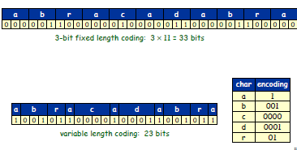
FIXED and VARIABLE length encoding.

Slide 4
RUN-LENGTH ENCODING (RLE)
1) Exploit long runs of repeated characters.
2) Replace run by count followed by repeated character, but don't bother if run is less than 3.
INPUT– AAAABBBAABBBBBCCCCCCCCDABCBAAABBBBCCCD
OUTPUT– 4A3BAA5B8CDABCB3A4B3CD

Slide 5
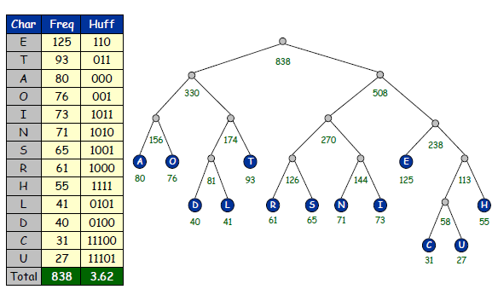
HUFFMAN CODING

Slide 6
JPEG compression
Web Applications:
1) Flickr by Yahoo.
2) Facebook Photos.
3) Picassa by Google.

Slide 7
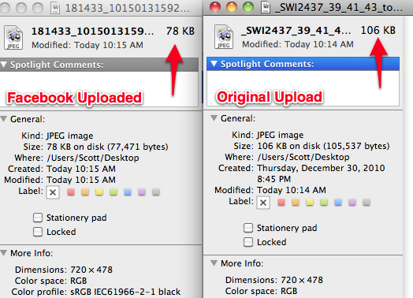
Facebook photos

Slide 8
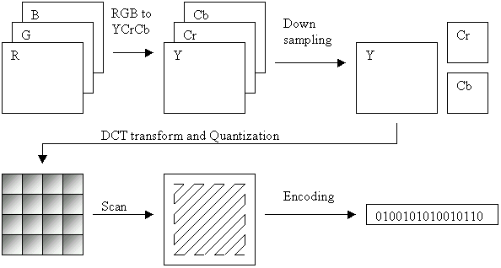
The JPEG compression ( LOSSY )

Slide 9
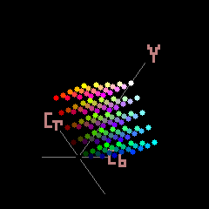
RGB encoded to Y-Cb-Cr.
Y – the grayscale component or brightness.
Cb – blue-difference.
Cr – red-difference.
luma signal (Y′) that can be stored with high resolution or transmitted at high bandwidth,
(CB and CR), the chroma components can be bandwidth-reduced, subsampled, compressed, or otherwise treated separately for improved system efficiency.

Slide 10
Down-sampling
Reduce the spatial resolution of the Cb and Cr Components .
Human eye perceives the Luma (Y) component better.

Slide 11

Discrete cosine transform
Each 8×8 block of each component (Y, Cb, Cr) is converted to a frequency-domain representation.

Slide 12
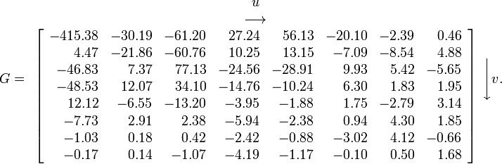
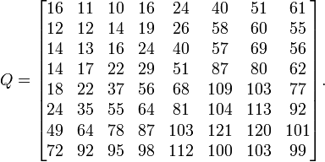
Quantization

Slide 13
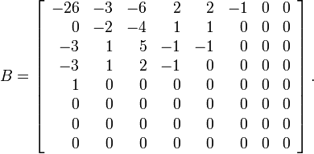
QUANTIZED MATRIX
The advantage of the DCT is its tendency to aggregate most of the signal in one corner of the result.

Slide 14
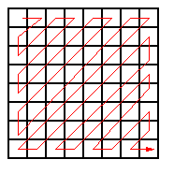
ENTROPY ENCODING
1) Involves arranging the image components in a "zigzag" order employing run-length encoding (RLE) algorithm that groups similar frequencies together, inserting length coding zeros.

Slide 15
JPEG LOSSLESS
simple predictive coding model called differential pulse code modulation (DPCM).
predictions of the sample values are estimated from the neighboring samples that are already coded in the image.
DPCM encodes the differences between the predicted samples instead of encoding each sample independently.

Slide 16
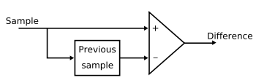
JPEG LOSSLESS

Slide 17
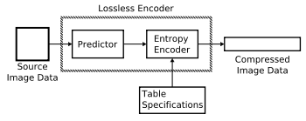
JPEG LOSSLESS

Slide 18
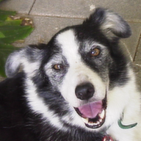
STEP 1
Original image (Lossless PNG ) 60.1 kb
uncompressed is 108.5 KB

Slide 19

STEP 2
Low compression (84% less information than uncompressed PNG, 9.37 KB)

Slide 20
STEP 2
Low compression (84% less information than uncompressed PNG, 9.37 KB)

Slide 21
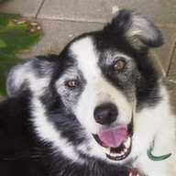
STEP 3
Medium compression (92% less information than uncompressed PNG, 4.82 KB)

Slide 22
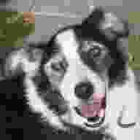
STEP 4
High compression (98% less information than uncompressed PNG, 1.14 KB)

Slide 23
Perceptual noise shaping
There are certain sounds that the human ear cannot hear.
There are certain sounds that the human ear hears much better than others.
If there are two sounds playing simultaneously, we hear the louder one but cannot hear the softer one.

Slide 24
AUDIO COMPRESSION
MP3
1)Patented digital audio encoding format.
2)A form of lossy data compression.
Applications:
Playback of music on digital audio players.

Slide 25
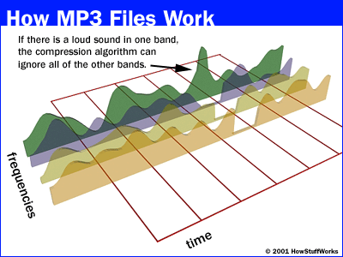

Slide 26
THE 2-PASS COMPRESSION
Run all of the psycho-acoustic models, discarding data in the process.
Compress what's left to shrink the storage space required by any redundancies.
-------------------------------------------------------------------------------------------
The second step, the Huffman coding.

Slide 27
VIDEO COMPRESSION CONCEPTS
A motion picture is a rapid sequence of a set of frames which each frame is a picture.
A frame is a spatial combination of pixels, and
A video is a temporal combination of frames that are sent one after another.

Slide 28
1) SPATIAL COMPRESSION.
Each frame is independently compressed.
2) TEMPORAL COMPRESSION.
Redundant frames are removed.

Slide 29
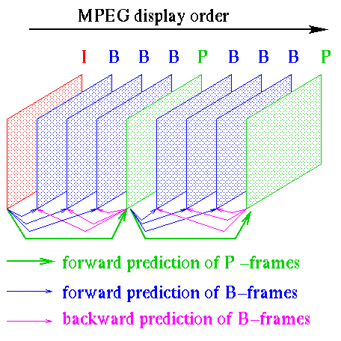

Slide 30
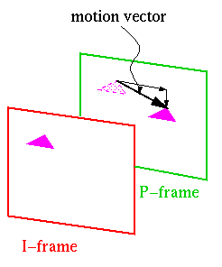
What does "prediction" mean?

Slide 31
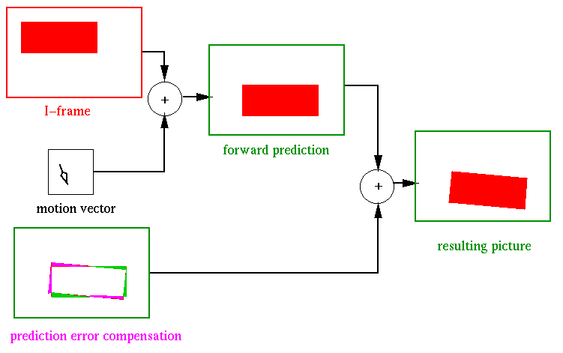

Slide 32
VIDEO COMPRESSION:
H.264/MPEG-4 AVC
STORAGE:
Blu-ray Discs.
STREAMING:
Metacafe, YouTube, iTunes.
WEB SOFTWARES:
Adobe Flash Player and Microsoft Silverlight.
BROADCAST SERVICES:
DVB and SBTVD

Slide 33
H.264/MPEG-4 AVC
THE PROCESS
• Motion Estimation and Intra Estimation
• Transform (and Inverse Transform)
• Quantization (and Inverse Quantization)
• Loop Filter
• Entropy Coding

Slide 34
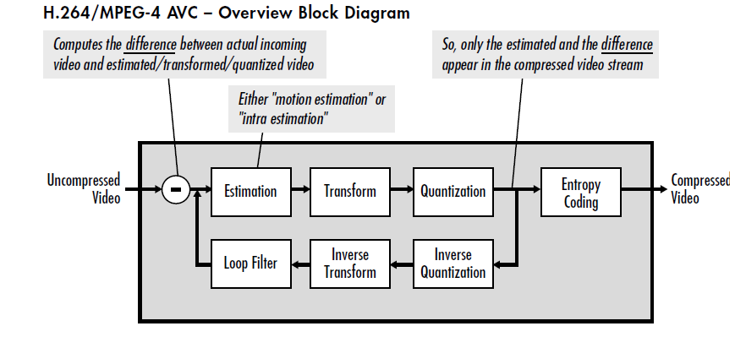

Slide 35
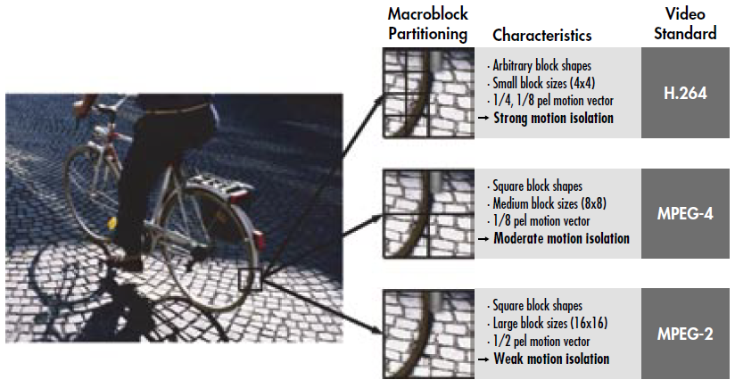
Superior Motion Estimation

Slide 36
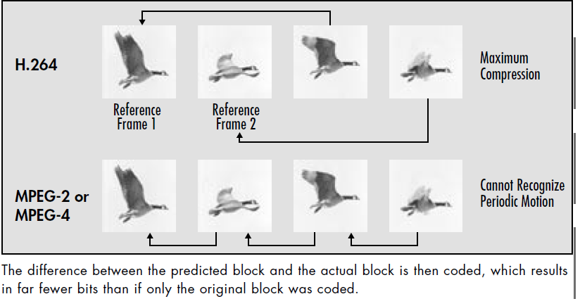
Multiple Reference Frames

Slide 37
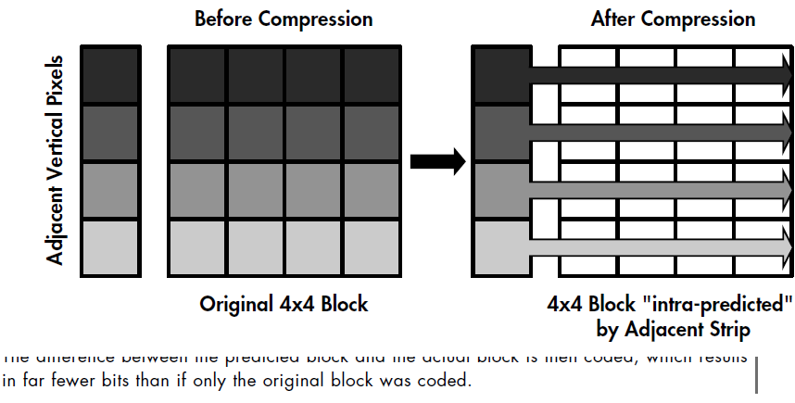
INTRA-ESTIMATION

Slide 38
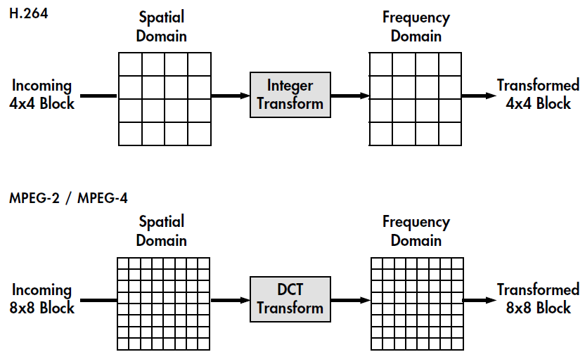
INTEGER transform

Slide 39
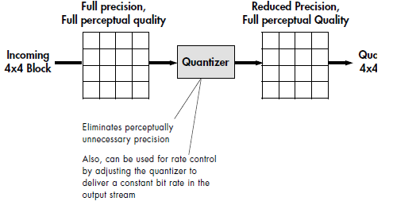
QUANTIZATION

Slide 40
LOOP FILTER
The de-blocking filter that operates on both 16x16 macroblocks and 4x4 block boundaries.
In the case of macroblocks,
Remove artifacts that may result from adjacent macroblocks having different estimation types
(e.g. motion vs. intra estimation), and/or different quantizer scale.
In the case of blocks,
Remove artifacts that may be caused by transform/quantization and from motion vector differences between adjacent blocks.

Slide 41
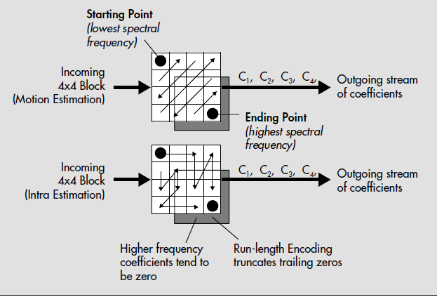
ENTROPY ecoding – serialization of components

Slide 42
CONCLUSION
Most people know that a compressed ZIP file is smaller than the original file, but repeatedly compressing the file will in fact usually increase in size.
Lossless data compression must be applied for text files.
Audio-Visual data may be compressed with lossy data compression, thanks to the limitations in human sensory perceptions.
Compression of data is inevitable for transferring data over networks to minimise network usage and therefore, costs.
The trade-offs between information is completely scenario-dependent.

Slide 43
REFERENCES
http://scottwyden.com/facebooks-photo-upload-compression/
http://oreilly.com/catalog/mp3/chapter/ch02.html
http://www.cs.auckland.ac.nz/~jmor159/PLDS210/huffman.html
MP3: The Definitive Guide ( O'Reilly).
www.winzip.com/wz_jpg_comp.pdf
http://dvd-hq.info/data_compression.php

Slide 44
THANK YOU

