Slide 1
Capstone Project
Machine Learning Fundamentals
Samuel Bosshardt
12/15/2018

Slide 2
Questions
Can the sex of the users be predicted by analyzing their essays?
What machine learning models are most effective? (accurate and efficient)
Although this is a classification task, how well can the regression models do?

Slide 3
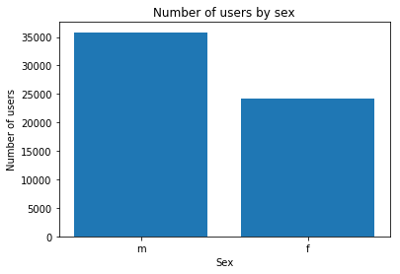
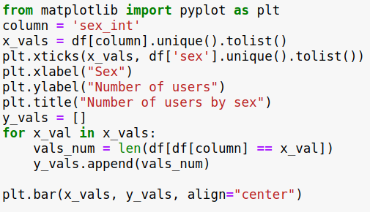
Dataset Exploration
Graph of number of males vs females.
About 40% of the users are female.
M: 35,829
F: 24,117

Slide 4
Dataset Exploration
Exploration mostly consisted of looking at various essays and sentence structure.
The essays themselves don't really lend themselves to graphing. There are many words that are used frequently.
Still, we can look at the most frequently used words for all essays to see if there are differences.
We can also look at the most frequently used words for “The 6 Things I could never do without” to see if there are differences.

Slide 5
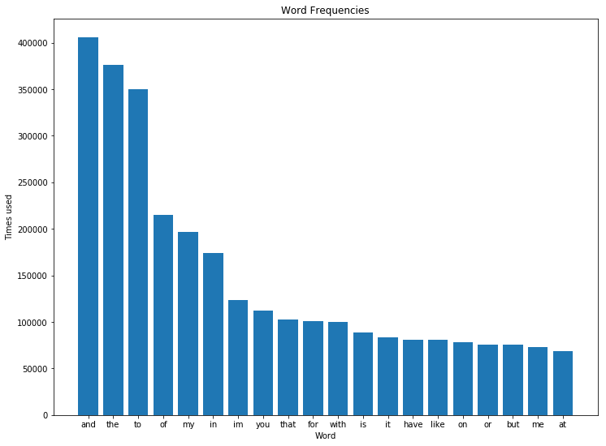
Dataset Exploration
Male Essays - Top 20 Words
and: 405802
the: 376457
to: 349619
of: 214668
my: 196876
in: 173726
im: 123128
you: 111904
that: 102256
for: 100777
with: 99767
is: 88254
it: 83044
have: 81248
like: 80891
on: 77953
or: 75931
but: 75450
me: 72790
at: 68850

Slide 6
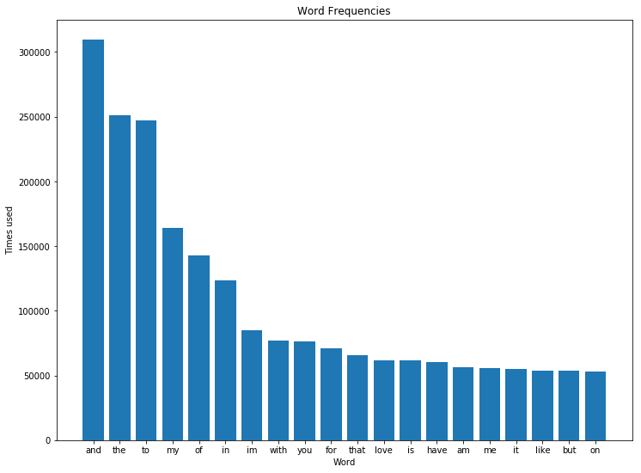
Dataset Exploration
Female Essays - Top 20 Words
and: 309731
the: 250885
to: 246979
my: 164225
of: 142478
in: 123662
im: 84644
with: 77272
you: 76550
for: 70929
that: 65892
love: 61920
is: 61637
have: 60416
am: 56310
me: 55464
it: 55274
like: 54019
but: 53973
on: 52845

Slide 7
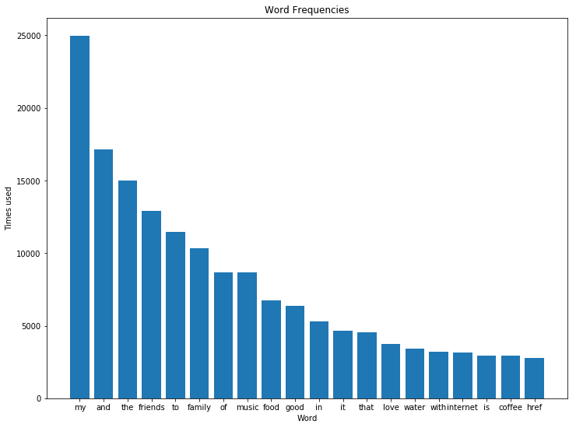
Dataset Exploration
Male “6 things I could never do without” Top 20 Words
my: 24979
and: 17170
the: 15020
friends: 12887
to: 11446
family: 10326
of: 8668
music: 8660
food: 6732
good: 6344
in: 5310
it: 4662
that: 4520
love: 3724
water: 3406
with: 3190
internet: 3160
is: 2959
coffee: 2950
href: 2779

Slide 8
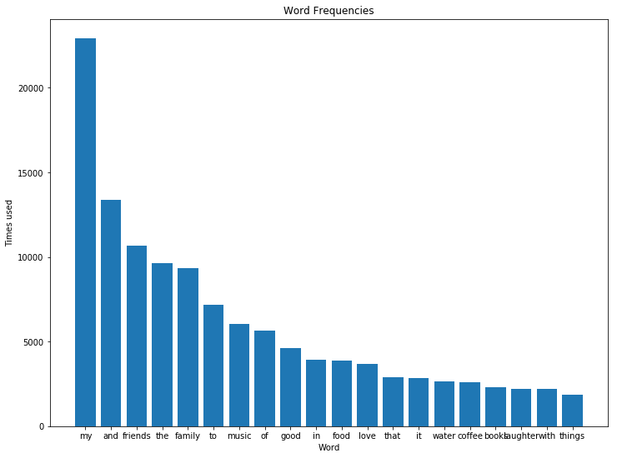
Dataset Exploration
Female “6 things I could never do without” Top 20 Words
my: 22927
and: 13374
friends: 10657
the: 9618
family: 9359
to: 7184
music: 6058
of: 5668
good: 4621
in: 3946
food: 3901
love: 3662
that: 2872
it: 2859
water: 2631
coffee: 2603
books: 2312
laughter: 2217
with: 2199
things: 1869

Slide 9
Additional Columns
Concatenated/Filtered essay text
  There was junk data in the essay text (html like <br />, &quot;). Apostrophes, commas, and parenthesis seemed like they could also be problematic. I wrote functions to get rid of the junk, normalize the essays into lower case words with all special characters filtered out. Regular expressions were used for this.
Sex as 0 or 1 instead of “m” or “f”
  This is useful for using regression models.
Count vectors based on the concatenated and filtered essay text.
  from sklearn.feature_extraction.text import CountVectorizer

Slide 10
Classification Approaches
Naive Bayes
  Best performance and accuracy of all models tested.
K-Nearest Neighbors
  Not too slow, somewhat accurate. But it often classifies females as males.
Support Vector Machines
  Very slow, least accurate. Rarely classifies essays as female.

Slide 11
Naive Bayes Classifier
Run time (for fitting & predicting the model) is under 1 second on my machine.
Accuracy: 75.9%
Precision: 75.7%
Recall: 83.1%
F1: 79.2%
Confusion Matrix
 | Guessed M | Guessed F
User is M | 5505 | 1765
User is F | 1122 | 3598

Slide 12
K-Nearest Neighbors Classifier
Accuracy: 65.5%
Precision: 82.7%
Recall: 67.6%
F1: 74.4%
Guesses male 74% of the time even though males represent 60% of the users.
Confusion Matrix
 | Guessed M | Guessed F
User is M | 6012 | 1258
User is F | 2880 | 1840

Slide 13
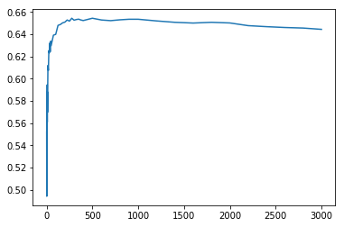
K-Nearest Neighbors Classifier
Optimal num_neighbors is around 500.
Run time for fitting the model and making predictions is 2 minutes 20 seconds on my machine.

Slide 14
Support Vector Machines Classifier
Run time (for fitting & predicting the model) is 1 hour and 15 minutes on my machine.
Accuracy: 62.0%
Precision: 99.1%
Recall: 61.6%
F1: 75.9%
Although females make up 40% of the users, only 2.4% of users were classified as female!
Confusion Matrix
 | Guessed M | Guessed F
User is M | 7205 | 65
User is F | 4497 | 223

Slide 15
Learned Bias
Support Vector Machines (and to a lesser extent K-Nearest Neighbors) seems to have learned males are more likely to be in the dataset than females.
Of the female users in the test set, SVM guessed they were male 95.3% of the time!
This could potentially be worked around by creating a training set with an equal number of males and females.

Slide 16
Regression Approaches
K-Nearest Neighbors Regressor
  Running time and accuracy similar to the K-Nearest Neighbors Classifier.
Multiple Linear Regression
  Very slow, Least accurate.

Slide 17
K-Nearest Neighbors Regressor
Accuracy: 65.5%
Precision: 82.3%
Recall: 67.7%
F1: 74.3%
Guesses male 74% of the time even though males represent 60% of the users.
Similar results to K-Nearest Neighbors Classifier.
Confusion Matrix
 | Guessed M | Guessed F
User is M | 5981 | 1289
User is F | 2853 | 1867

Slide 18
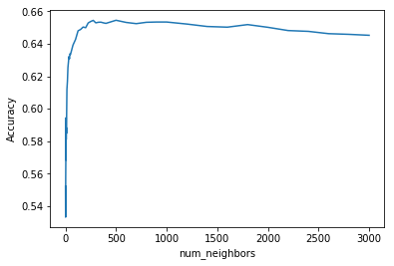
K-Nearest Neighbors Regressor
Optimal num_neighbors is around 500. Again, similar to K-Nearest Neighbors Classifier.
Run time for fitting the model and making predictions is just under 2 minutes on my machine.

Slide 19
Multiple Linear Regression
Run time (for fitting & predicting the model) is 2 hours 20 minutes on my machine.
The model is multi-threaded. Unlike all other models tested, this utilized my 8 CPU cores.
Accuracy: 52.7%
Precision: 53.8%
Recall: 62.9%
F1: 58.0%
Confusion Matrix
 | Guessed M | Guessed F
User is M | 3912 | 3358
User is F | 2312 | 2408

Slide 20
Conclusions to Questions
Q: Can the sex of the users be predicted by analyzing their essays?
A: Yes. The Naive Bayes classifier did the best overall (F1 score of 79.2%).
All five machine learning models that were tested were more accurate than using a coin toss to predict.

Slide 21
Conclusions to Questions
Q: What machine learning models are most effective? (accurate for the task of predicting sex from essay text)
A: Of the models tried, the Naive Bayes classifier worked the best (accurate around . The K-Nearest Neighbors models were accurate about 65% of the time.

Slide 22
Conclusions to Questions
Q: Although this is a classification task, how well can the regression models do?
A: K-Nearest Neighbors Regressor did as well as the K-Nearest Neighbors Classifier. Multiple Linear Regression did poorly (barely above 50% accuracy, very slow to fit).

Slide 23
Next Steps
There are many possible ways to further improve the recognition.
  Identifying phrases rather than relying only on word counts.
  Discarding the most frequently used words (e.g. “and”, “the”, “to”).
  Performing analysis on each essay column individually, rather than the concatenation.
  Using multiple models in conjunction with each other.

