Slide 1

Indicative DIRAC Development Plan & Roadmap
Challenges, considerations and risk
For internal discussion
25.11.2022 | Oliver Bosshard
Picture Source: Security Magazine (here)

Slide 2
Introduction &
Setting the Scene

Slide 3
CTO DIRAC Assessment - Readiness & Killer Criteria
Status of the DIRAC solution and critical capabilities that define the viability of the DIRAC approach
Upon better understanding of the DIRAC development status, some critical product items/features are not as “ready” as anticipated:
5G SA was tested in a very rough format only, limited to FDD (no TDD yet) and is subject to ETH code
Geo-Fencing is at a very early stage (few ideas and concepts only), the strategy is in development and will require substantial testing
IMSI catching works as a concept but needs much more development time than anticipated [DIRAC team statement]
There are some development and project items that could be defined as “killer criteria”:
Multi-Cell and Multi-MNO capability, addressing and processing all band and sub-channels on one card (hardware platform):
    In DL: Ability to decode, read, process, analyse and manage all bands, channels and sectors on one card (one unit)
    In UL: Ability to detect (measure), analyse and correlate all UL transmissions for geo-fencing for all MNOs and cells
Geo-Fencing Accuracy of +/-5m (first release more likely 20 – 50m)
Localisation Accuracy in a 3D space, to determine the offenders device (additional equipment needed, approach and volume tbd)
Financial Viability of the solution based on prison type, requirements and factors above (# equipment x cost of kit + SW)
→ These criteria need to be assessed and validated for better understanding as quick as possible

Slide 4
DIRAC Development and the Pioneering Challenges
The DIRAC Approach is Novel and based on Cutting Edge Technologies → WE ARE PIONEERING THIS SPACE
The problem space that we try to address is massive and extremely complex:
The fundamentally difficulties and challenges:
    Re-creating all the mobile operators cells, technologies and network capability in one card (hardware platform)
    Lots of cells to deal with (e.g. 4 MNOs x 3 sites x 2 cells x 7 frequency bands x 4 technologies) plus many phone implementations
    Monitoring nearly all the commonly-used radio spectrum at once (~ 5 GHz) and decoding it
    Complex system with cutting-edge technology, so it takes a lot of time to engineer
    Busy urban environments with dynamic conditions, mobility, weather effects
    Need to be resistant to cell-tower changes, different network settings, specialist ‘test’ phones
A very simple approach is possible, based on the demo seen in Paris
    This technically meets the needs
    But the hardware use is inefficient and expensive (few 100 SDRs @ €2k) – this harms the business case
Several major engineering tasks to be done
    Refinement of attacks for reliable production use
    Geofencing is required for UL (and can help DL too)
    An optimised hardware platform is needed to make it economical

Slide 5
KEAS vs DIRAC Downlink & Uplink
DIRAC solution attributes, compared to the current KEAS solutions
[text – explanation - tbd]
Attribute | Downlink (DL) | Uplink (UL)
Device Count | Fewer devices needed | Far fewer devices needed
White-Spots & Overspill | Reduced | Heavily reduced
Device Cost | TBC (small increase?) | TBC (large increase?)
Network & Cabling | Potentially no change (subject to BusBoost) | Requires fast, low-latency network
Transmission Power | Reduced | Heavily reduced
Range | Increased | Heavily increased
Coverage Area Control | Improved | Greatly improved
Technology Support | 4G & 5G only in first release | 4G & 5G only in first release

Slide 6
DIRAC Downlink vs Uplink Comparison
DIRAC solution attributes, compared to each other
[text – explanation - tbd]
Attribute | Downlink (DL) | Uplink (UL)
Device Count | Larger | Smaller
GeoFencing | Not required | Required
Coverage Area Control | Using power levels, antennas & placement | Using digital geofencing model
Architecture | Self-contained devices | Interconnected system
Development Time | Long | Longer
Requirements | Tracking cell downlinks | Tracking cell downlinks & phone uplinks
Technology Support | 4G & 5G first, 2G & 3G not clear yet | 4G & 5G first, 2G & 3G not clear yet

Slide 7
DIRAC Downlink and Uplink Risk Assessment
tbd
Attribute | Affects | Downlink (DL) | Uplink (UL)
White Spots and Overspill | System | Still possible, but more accurate refinements to coverage area than now. Small fixes require remote configuration, big fixes require hardware deployments. | Still possible, but very precise refinements to coverage area possible. Small fixes require remote configuration, big fixes require hardware deployments.
Engineering Effort | Development | Oli & Richard to complete | Oli & Richard to complete
Legality | System | Oli & Richard to complete | Oli & Richard to complete
Reception Quality | System | Depends on highly-effective receiver, in order to monitor all surrounding cells. If this is ineffective, or fails, the system performance is degraded. | Depends on highly-effective receiver, in order to monitor all surrounding cells. If this is ineffective, or fails, the system performance is degraded.
Networking Dependence | System | Oli & Richard to complete | Oli & Richard to complete

Slide 8
DIRAC Architectures
Tbd
[Richard – unit types, GPS, decoding antenna etc.]

Slide 9
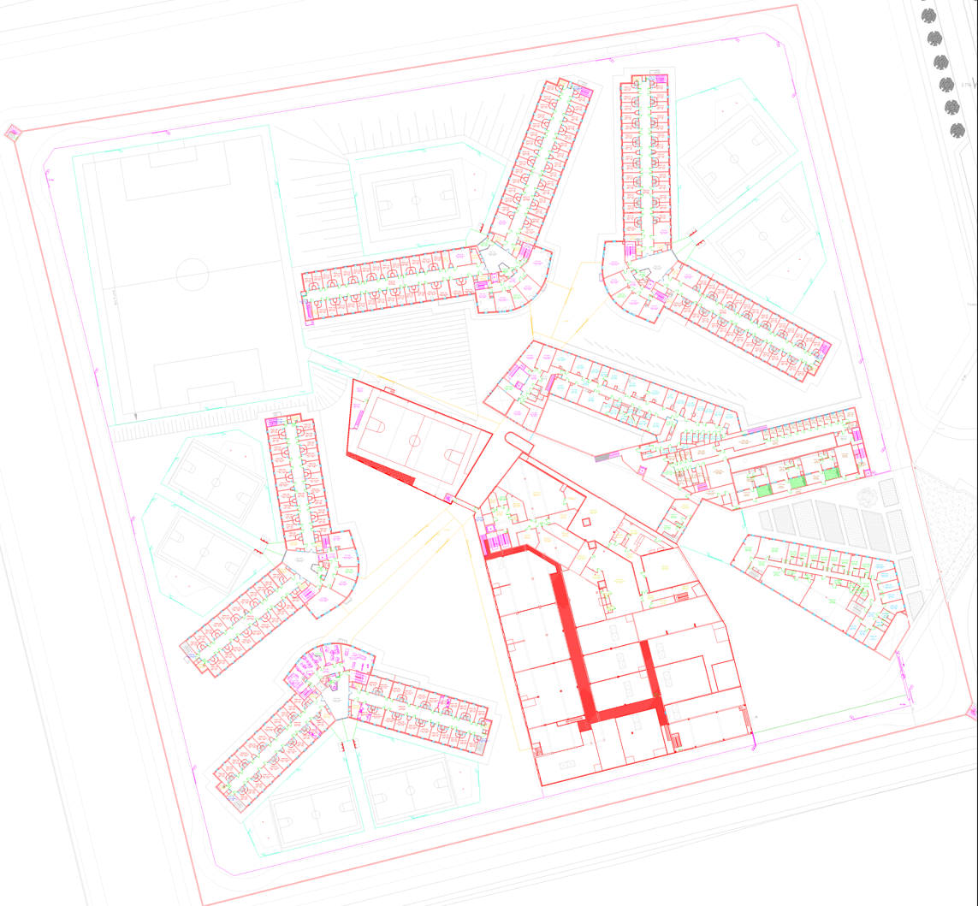
Envisaged Solution Architectures and Installations
Indicative UL and DL DIRAC approach installations, for illustration purpose only (dimension factors yet to be defined)
Downlink (DL) Architecture Concept
Deployment
    Receivers positioned throughout buildings
Operation
    Each device tracks all cells (MNO, Band, PCI)
    Phone detected → phone is attacked
    Similar principle to existing approach but sophisticated
    (more control, less power, fewer devices and potential to add future attacks)
Uplink (UL) Architecture Concept
Deployment
    Receivers for geofencing positioned around edge of facility
    Monitor & attacker placed in ideal position (e.g. main building roof)
Operation
    Central monitor tracks all cells (MNO, Band, PCI)
    Phone detected → geofencing based in/out → inside only attack

Slide 10
Roadmap Planning Considerations

Slide 11
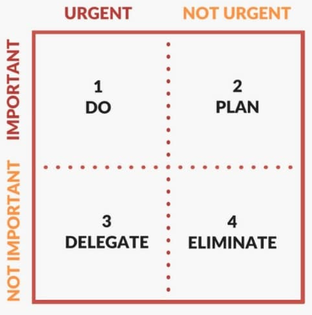
Approach to DIRAC Development
Planned and controlled; Learning form the past mistakes
Our recent approach to DIRAC is not well planned & controlled, which usually leads to inefficiencies and “uninformed” decisions. We are at risk of making mistakes in fundamental architectural decisions that can’t be changed easily and may limit future development and features. And these decisions can come at a high longer-term cost.
Historically, the Telio D&N development started before product development Gate 1 – 3 were passed (approved) and rushed the product delivery. Product launch was often based on proto-type equipment → hence products that have not completed development, industrialisation and validation. As a result, the D&J business spends a substantial amount of time rectifying historic mistakes and is often in firefighting mode.
Whilst we can’t wait for a product to be 100% (= loss of time & go-to-market advantage), we can’t rush it too much either. There needs to be a product plan and new products require validation before a product is released.
Let’s not repeat previous mistakes
A Product Manager is a minimum requirement
Telio D&N: 80% in ”firefighting” mode

Slide 12
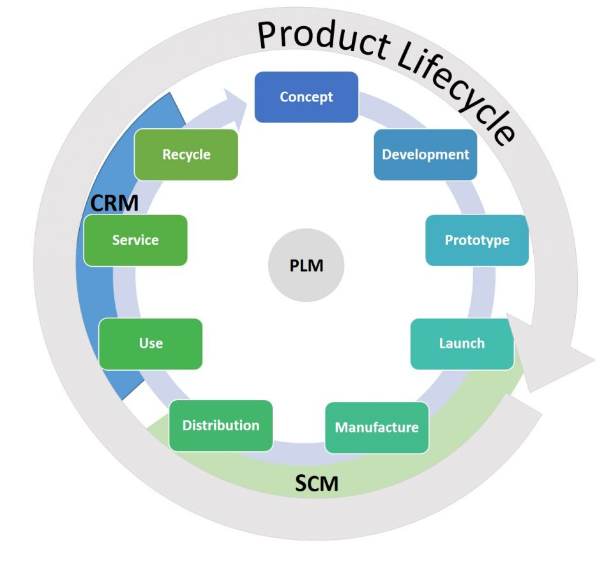
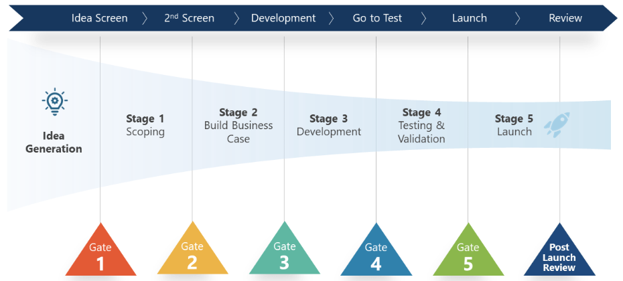
Approach to DIRAC Roadmap and Product Management
Roadmap based on limited knowledge and in absence of the 3 stages before development are risky and indicative at best!
Ideally, a product roadmap is create after the product requirements definition, product specification and solution architecture. At the moment we’re going straight to “Development”, focused on “Launch” and are neglecting the other stages to a certain extent.
The first 3 stages can easily take 3 months. But with the current business (client) risks, we need to find a way to address the first three stages retrospectively (in parallel to development). It’s not ideal, but it has to be done.
Illustrations of a typical “Product Lifecycle” and the “Stage-Gate Process” used for professional product management

Slide 13
Typical Development Timelines
Evidence based timelines, from internal and external projects
Pioneering and development of complex systems, to have a first prototype, can easily take 12 – 18 months. Then you need to go from prototype to a final product, design and produce new industrialised hardware, get production going, create test benches, validate and certify → the timeline between idea and product launch can easily take 2-3 years.
Project | Description | Hardware details | Start | End | Dev Time
Digital PoC | Digital jamming Proof of Concept, demonstration on 1 band (700 MHz) | Electronic boards available on shelf. No custom hardware designed | Feb-20 | Jun-20 | 5 mth
ProPoC | Same digital solution as the PoC but with all phone bands (700, 800, 900, 1800, 2100, 2600) | Multiplied the PoC architecture x 5. No custom hardware | Jul-20 | Nov-20 | 4 mth
DETBLK | Overall jamming / detection solution (on hold now) | 1 board designed from an existing board, project approximately 70% to completion | Mar-20 | Jul-22 | 2 yr 5 mth
FNC | Industrialised digital jamming solution or all bands including 5G TDD (missing the detector part) | Mixed of custom and on off-the-shelf boards : - CUSTOM-ST1 (partly outsourced, 80% done, 5 months) - PREAMP-RX-TX (from scratch 5 months) - INTERCOM (from scratch 3 months) | Jan-21 | Ongoing | 1 yr 11 mth
SA5G Demo | Jamming (+ operator synchronization) and uplink detection of 3.4-3.8 GHz (5G in TDD) | On shelf boards - Pluto (used also for UL detection) - Analog jamming boards | Dec-21 | Apr-22 | 5 mth
SA5G | Industrial SA5G product (standalone 3.6 GHz TDD detector, sync and jammer) – one band only! | Mixed of custom and on shelf boards : - Pluto : on shelf - PREAMP-RX-TX : adaptation from FNC project. 2 months - DETJAM5G (from scratch 5 months) | Dec-21 | Mar-23 | 1 yr 4 mth

Slide 14
Indicative DIRAC Roadmap

Slide 15
Envisaged D&N Roadmap (indicative and early stage approximation)
Phasing in the DIRAC solution as an addition to the current KEAS Solution (short term, 3.6 GHz addition where needed)
2022
2023
2024
Q3 2022 | Q4 2022 | Q1 2023 | Q2 2023 | Q3 2023 | Q4 2023 | Q1 2024 | Q2 2024 | Q3 2024 | Q4 2024
DETA, JAM3W, JAM15W
Ongoing Support & Maintenance
KEAS
SA5G add-on and 1250D (for 3.6 GHz TDD)
Support & Maintenance
DIRAC Acquisition
New MoJ/DAP Tender
New Contract Start Date
(based on 2023 Tender)
Start of full DIRAC
Soution Delivery
Demos & Tests
4G & 5G UL Capability (in SW)
2G - 5G UL Capability (in SW)
DIRAC
Capability Demos:
4G/5G Demos
Geo-Fencing tests
DIRAC Proto Development
DIRAC v1.0 Proto: 4G & 5G (COTS Assembly)
DIRAC v2.0 Development
DIRAC v2.0 Platform (2G-5G)
Supervisor v1.0
Beta Release
V2.1 Release
D&N O&M
Supervisor v2.0
Supervisor v2.1 (incl SA5G & 1250D)
Supervisor v3.0 Development (to include DIRAC solution with DTN*)
Supervisor v3.0
Hypervisor V1.0
Hypervisor V2.0 & 2.1 (KEAS)
Hypervisor 3.0
Timing
KEAS only
KEAS/DIRAC hybrid
DIRAC standalone
* DTN = Detection, Tracking and Neutralisation

Slide 16
Suggested DAP Messages

Slide 17
Suggested DAP Messages
Selection of points that should resonate with the client
  We are committed:
    We take our obligations seriously and invested into a digital platform and the DETBLK solutions to improve cost and coverage
  We aim to be market leaders and are pioneering novel DoS attack technologies:
    We acquired a cutting edge technology (DIRAC) and aim to be the pioneers (first to market) with a protocol based DoS attack
    We increased our team size, improved our expertise and aim to re-use our IP (i.e. DETBL detector) in the digital & DIRAC solutions
  We are 5G ready:
    The installed KEAS solutions are technology agnostic and therefore 5G ready (in the deployed 700 – 2600 MHz bands)
    5G NSA at 3.6 GHz is currently addressed by the nature of the technology (relying on signalling in the jammed LTE bands)
    KEAS was one of the first to develop a TDD sync jammer and can neutralise 5G SA at 3.6 GHz efficiently with:
      our new SA5G detection and neutralisation unit, a 3.6 GHz TDD add-on kit to upgrade existing prison installations
      our new (smarter) digital jammer, with power optimisation feature, addressing all technologies and bands (incl. 3.6 GHz TDD)
  White-spot and overspilling challenges:
    High power jamming is usually needed in a dense environment with many MNO sites, but there are physical and DREP limitations
    There is a trade-off between overspilling management (e.g. power reduction) and white-spots (requiring more power or hardware)
    The DIRAC solution, based on its geofencing feature, aims to address white-spots and resolve the overspilling challenge
  Indicative roadmap timelines:
    Our 5G SA solutions (the SA5G 3.6 GHz add-on) and the digital jammer (1250D) are ready for delivery from Q1 2023.
    A prototype version of the 4G and 5G UL DIRAC attack (with rough geofencing) is expected to be available early Q4 2023
    2G and 3G will be software-ready early Q2 2024, and the fully industrialised 2G – 5G DIRAC solution is expected start of Q3 2024.

Slide 18
KEAS, a Telio Group Company
Detection, Tracking and Neutralisation Business Unit
    23 Rue Paul Héroult
    38190 Villard-Bonnot
    France
    +33 (0) 4 76 52 13 30

Slide 19

Backup Slides
DIRAC Demo Info/Plan (focused on DIRAC inside the prison, addressing white spots)

Slide 20
Roadmap Acceleration & Outsourcing Opportunities
Tbd
Assessing the usability of the DETBLK detector
Quick decision on the hardware platform
Outsourcing of 2G & 3G solution research
On-site test & validation team (off-loading DIRAC team, e.g. by Sagi team)
Syrtem involvement & Benoit as Solution/Hardware Architect
ETH & Offord Universities → mainly for exploratory research (less useful for development & industrialisation)
Umlaut? Others?

Slide 21
Internal Messages
What can be done now and in future
5G SA is not limited to 3.6 GHz and will also be introduced in their other spectrum bands, which are already neutralised
3.6 GHz based 5G SA is unlikely to be deployed in residential areas
The 3.6 GHz TDD addition should be focused on prisons in urban environments, where 5G SA (at 3.6 GHz) is expected first
We have a 3.6 GHz addition for the existing prisons (SA5G) and a new digital jammer for all bands, including 3.6 GHz (1250D)
5G based on DIRAC is under development and prototypes focused on 3.6 GHz (5G SA TDD) are expected earliest in Q4 2023
Industrialised DIRAC solutions for 4G & 5G, for all bands, are expected as of Q3 2024
Single white-spots solutions are not a focus (for now) as they don’t address overspilling and would delay the suggested timelines
White spots and overspilling will be addressed by the UL attack with geofencing
Projects vary and no solution is 100%; hence there will be some optimisation to be done for most prisons

Slide 22
Reminder: Indicative D&N Roadmap from DIRAC Kick-Off
Phasing in the DIRAC solution over the next quarters (indicative) → as proposed on the DIRAC kick-off on the 5th October 2022
2022
2023
2024
Q1 2022 | Q2 2022 | Q3 2022 | Q4 2022 | Q1 2023 | Q2 2023 | Q3 2023 | Q4 2023 | Q1 2024 | Q2 2024
DETA, JAM3W, JAM15W
Ongoing Support & Maintenance
KEAS
SA5G (add-on) and 1250D
Ongoing Support & Maintenance
4G/5GSA Orange Labs demo
4G & 5G NSA prison demo
Geofencing demo
2G/3G (just the approaches)
Demo Releases
New MoJ/DAP Tender (FR)!
DIRAC
DIRAC v1.0 DTN* (rough assembly of COTS)
DIRAC v2.0 Platform (optimised, compact)
Supervisor v1.0 (DETA, JAM3/15W)
Beta Release
Official V2.0 Release
D&N O&M
Supervisor v2.0
Supervisor v2.1 (incl SA5G & 1250D)
Supervisor v3.0 to include DIRAC solution with DTN*
Hypervisor V1.0
Hypervisor V2.0 (KEAS)
Hypervisor V3.0 + ongoing evolution (to include DIRAC)
Timing
KEAS only
KEAS/DIRAC hybrid
DIRAC standalone
* DTN = Detection, Tracking and Neutralisation

Slide 23
DIRAC Realities in relation to the BeB Demo & Roadmap
The DIRAC team started to work with us on the 12th October (just a bit over a month)
The theoretical (contractual/agreement) DIRAC team timelines are:
    Milestone 1 – 4G and 5G TDD SW ready (Oct 2023)
    Milestone 2 – 2G, 3G, Wi-Fi and Sat SW ready (Oct 2024)
We have now a proposal for ETH labs & code access, but legals & commercials not completed yet
The DIRAC office in Zurich is not fully operational (temp IT network delivery tomorrow, Amarisoft deliver in 2-3 weeks)
The last weeks were focused on the DAP BeB demonstration in November (due to commercial needs), hence little roadmap progress
The proposed BeB demo is not impressive (one White Spot in a prison for 4G at 1800 MHz only for all MNOs using 12 cards)
There are still some technical challenges that need to be addressed before the demo
The kit still needs assembly and re-testing
The proposed prison access granted (12 – 15 Dec) is also a challenge:
    Does not give us early access (12th - 14th Dec only with demo on the 15th Dec), hence no time to react → high risk
    The DAP also scheduled the DCNI/DCND test & acceptance on the 14th Dec in another prison → KEAS resource issue
    We are using valuable development time for a demo that is still risky and that won’t be impressive
    There is a risk of DAP asking themselves why they travelled to BeB

Slide 24
DAP Communication & 5G Delivery
There are some communication challenge with the DAP and Internally:
    We speak about 5G SA instead of 3.6 GHz TDD (misconception)
    We have KEAS solutions for 3.6 GHz TDD (hence can do 5G SA – DETJAM5G and 1250D) that can be delivered in 2023!
    5G SA will also migrated to other bands (e.g. 700 MHz) in the next 6-12 months, but that’s covered by existing jammers
    We are not aware of many other suppliers that solved the TDD jamming challenge (sync for TDD transmission in DL)
    The 5G beamforming fear-making statement are on weak foundations, let’s stop this discussion (it is counter productive)
    The existing analogue solutions are technology agnostic (they do any tech as long as it is within the band)
    An industrialised DIRAC development with GeoFencing for an UL attack will be ready earliest end of 2023 (see kick-off slides)
    All DIRAC based quick-win (white spots or 5G only) solutions will be a rough assembly of components without a supervisor (in 2023)
    Even the DIRAC solution will have its limitations (these limitations are yet to be defined, but 100% is not achievable in RF)
    We need to give realistic timeframes and delivery dates, explaining we are developing a cutting-edge high-tech solution (R&D takes time)
    I suggest that we do a reality re-set with the DAP (as we have solutions) and manage expectations
    I suggest also to spend time on customer education (how it works, we are cutting edge, no known alternatives)

Slide 25
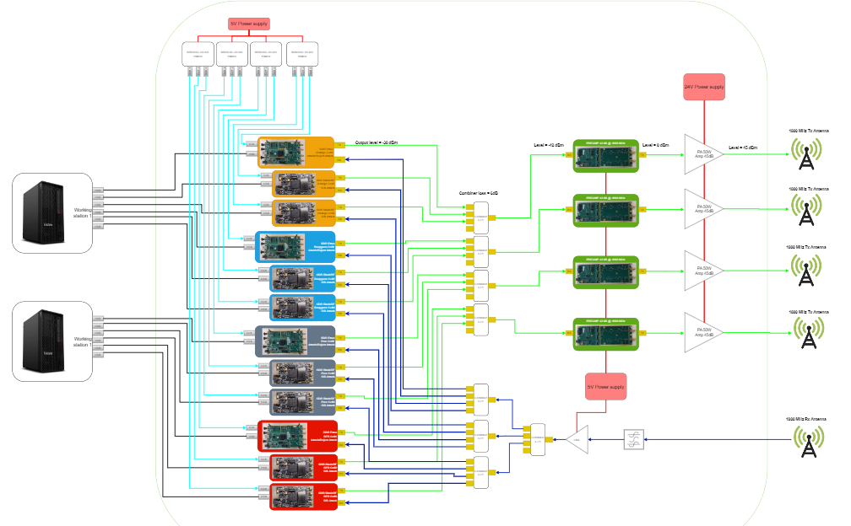
The Envisaged DIRAC Demo Hardware Architecture
Some of the required demo hardware has yet to be procured (mainly the combiners), assembled into a box (cabinet) and then tested as a whole.
We use more 1800 MHz RF amplifiers (3-4 instead of one) and a GPS clock/distributor to synchronise all cards.
The assembled demo hardware has to be tested at KEAS and at the prison/demo site before the demo.

