Slide 1
Analyzing California Counties’ Unemployment Rate VS Income and Population
Project 3
Justin Ho, Sidney Bowe, Scott Alexander, Dennis Chen, Julie Kuo, Nancy Campos

Slide 2
Project Overview / Data Source
We want to research the demographics of California’s counties including the population size, average median income and unemployment rate, and see if there is any correlation between each of the data.
We got our data from government website to insure the integrity of the data and the data ranges from 2020 to 2021. These data was originally in pdf format. We converted the data to excel format so it can be use for our analysis.
We created a web page for each data set that showcases the data with a geomap, a bar graph and a table. We have a separate page for analysis that compares the data with a bubble graph, and two scatter plots.

Slide 3
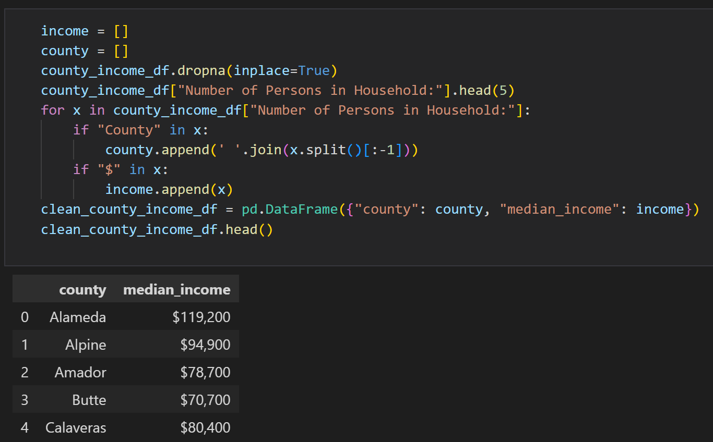
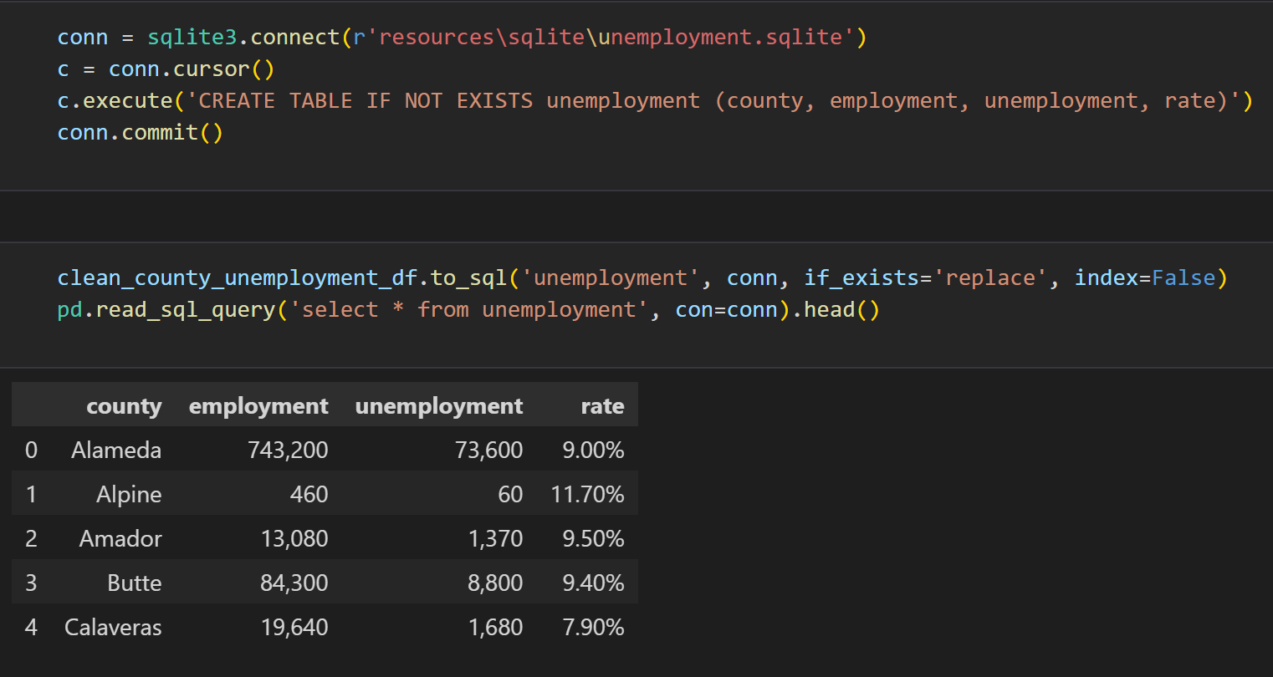
ETL Process
- data cleaning was done to the original data and pass into a data frame
- with the data frame, it can be store into sql database
- the sql databases are then used for data visualization and analysis

Slide 4
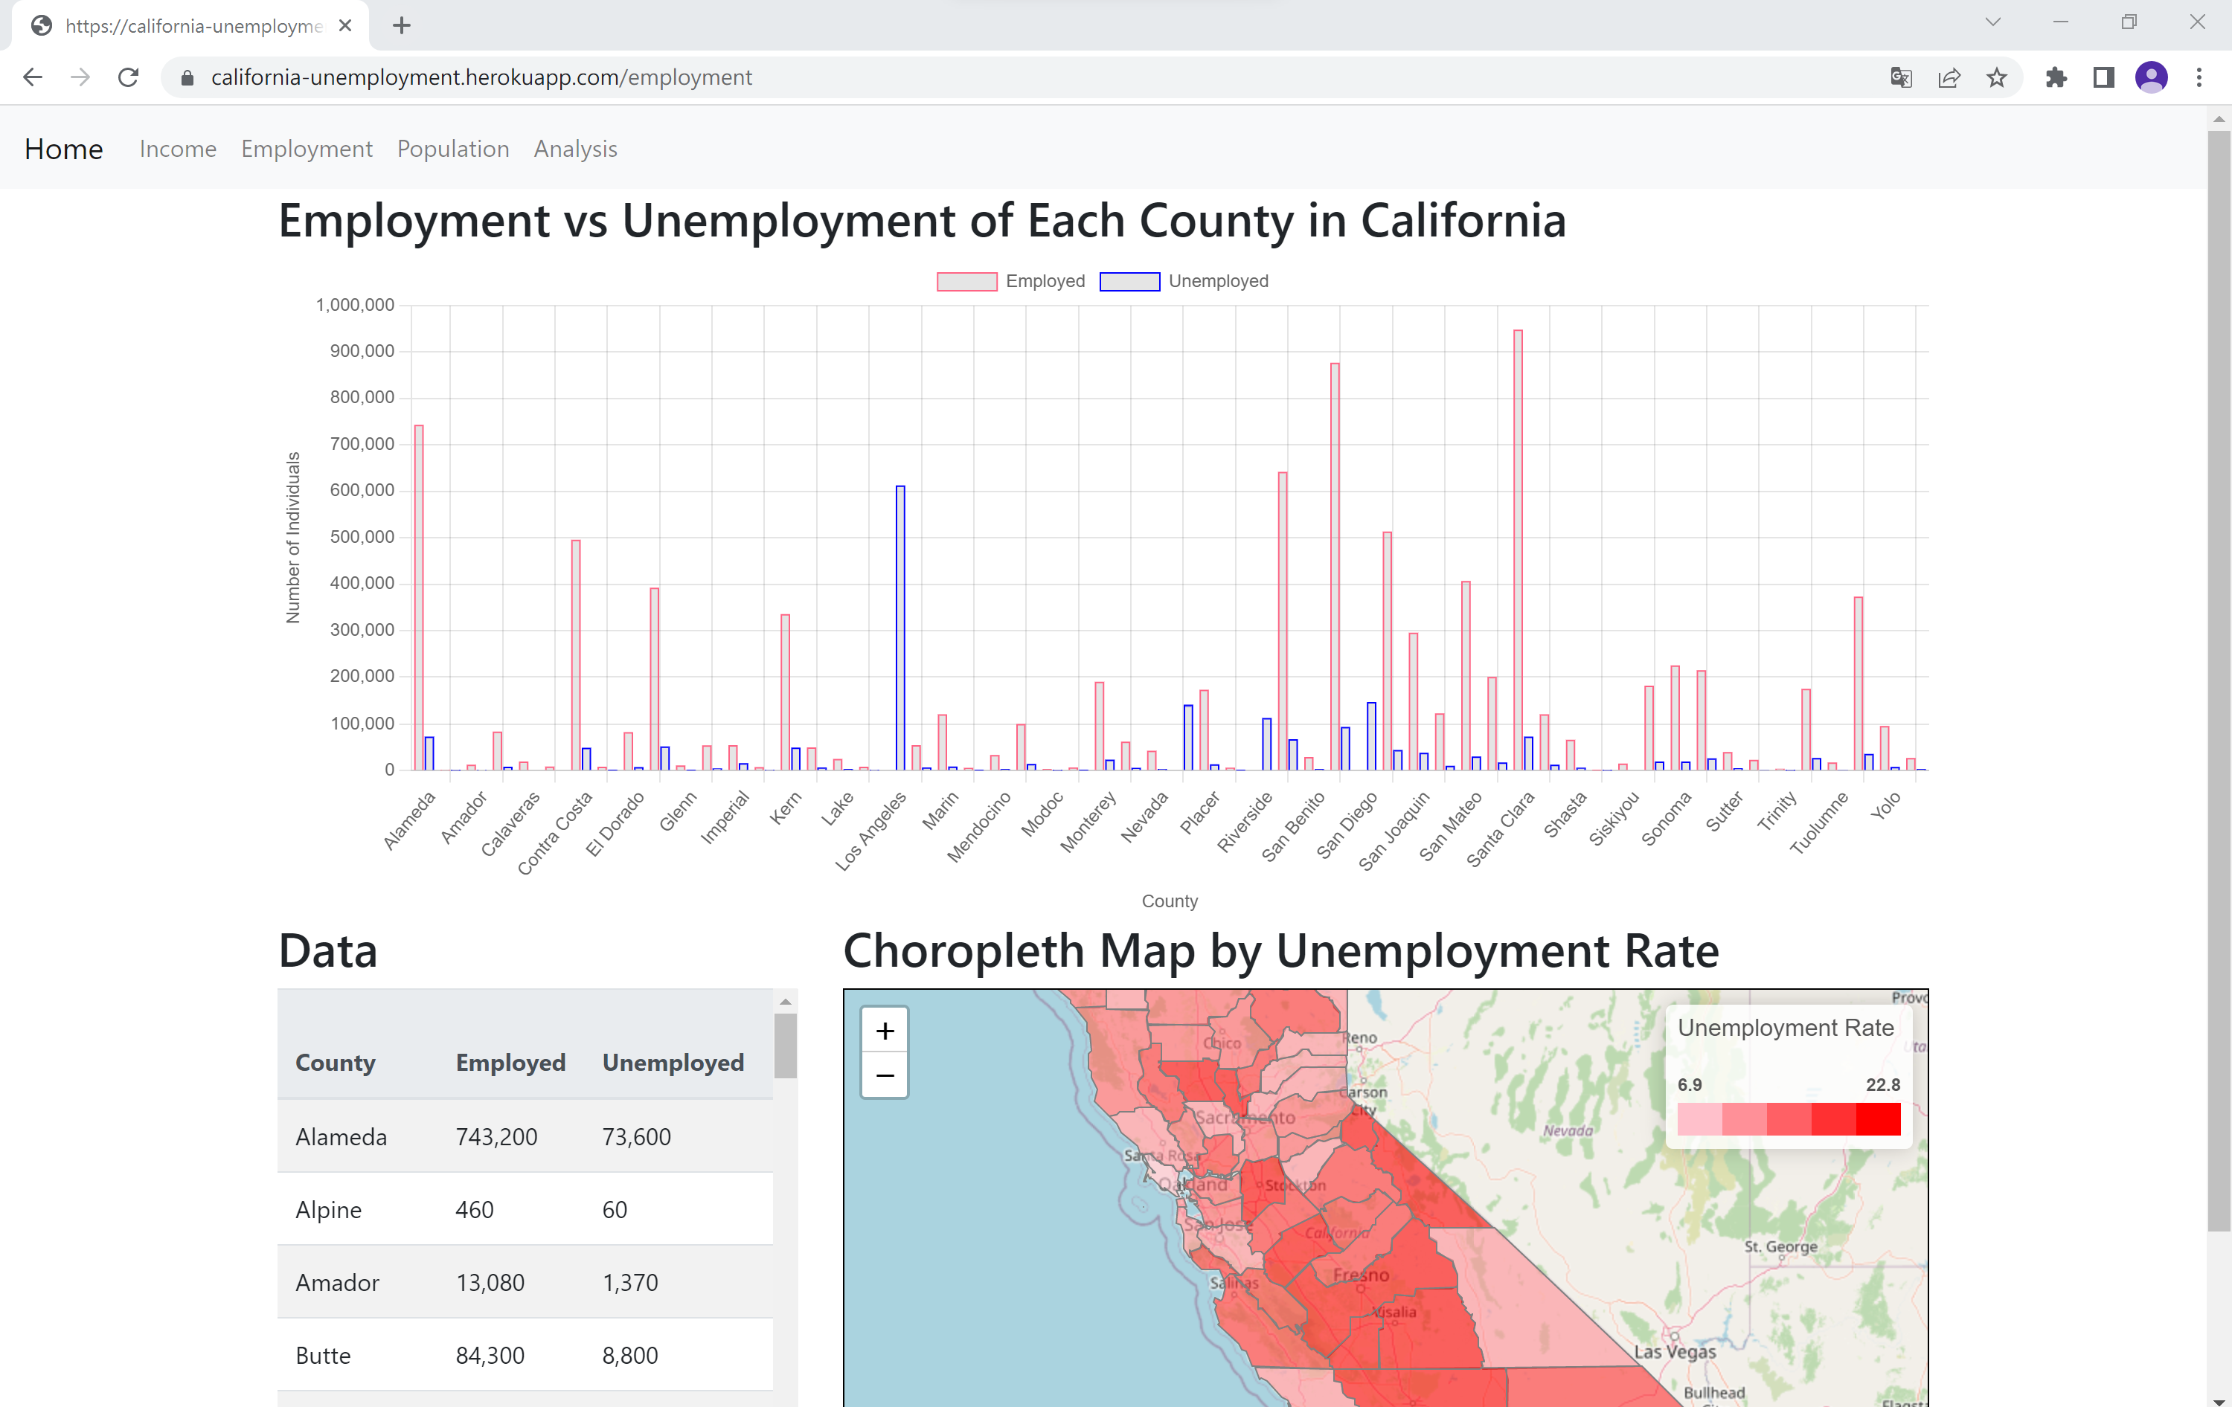
Website Overview
- website is hosted through Heroku
- made bar graph using chart.js with the data in SQLite database
- raw data is also made available so data that is not presented in the graph can be search for
- choropleth map is created for better visual of the entire California, user can see the spread of things like population, unemployment rate, and income level

Slide 5
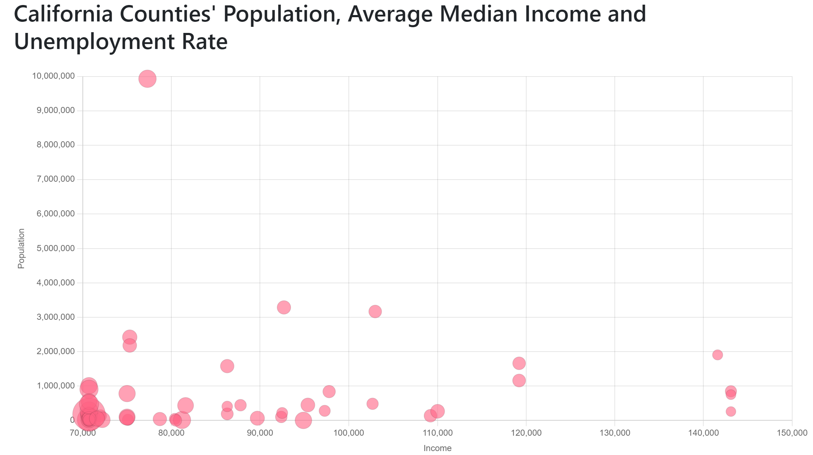
Analysis
Most counties have a population of 1,000,000 or lower. Los Angeles is clear outlier with a population of almost 10,000,000. Lot of counties have a median income around 70,000 or less. There is no strong link between population and median income or between population and
unemployment rate. Some counties, like San Francisco, have a high median income and average population. Some others, like Sacramento, have a lower median income for an average population. It may seems like the employment rate is lower for counties with high income but this tendency is not clear since a lot of counties are grouped in the same area of the graph (1,000,000 population/70,000 median income) making it difficult to read clearly.

Slide 6
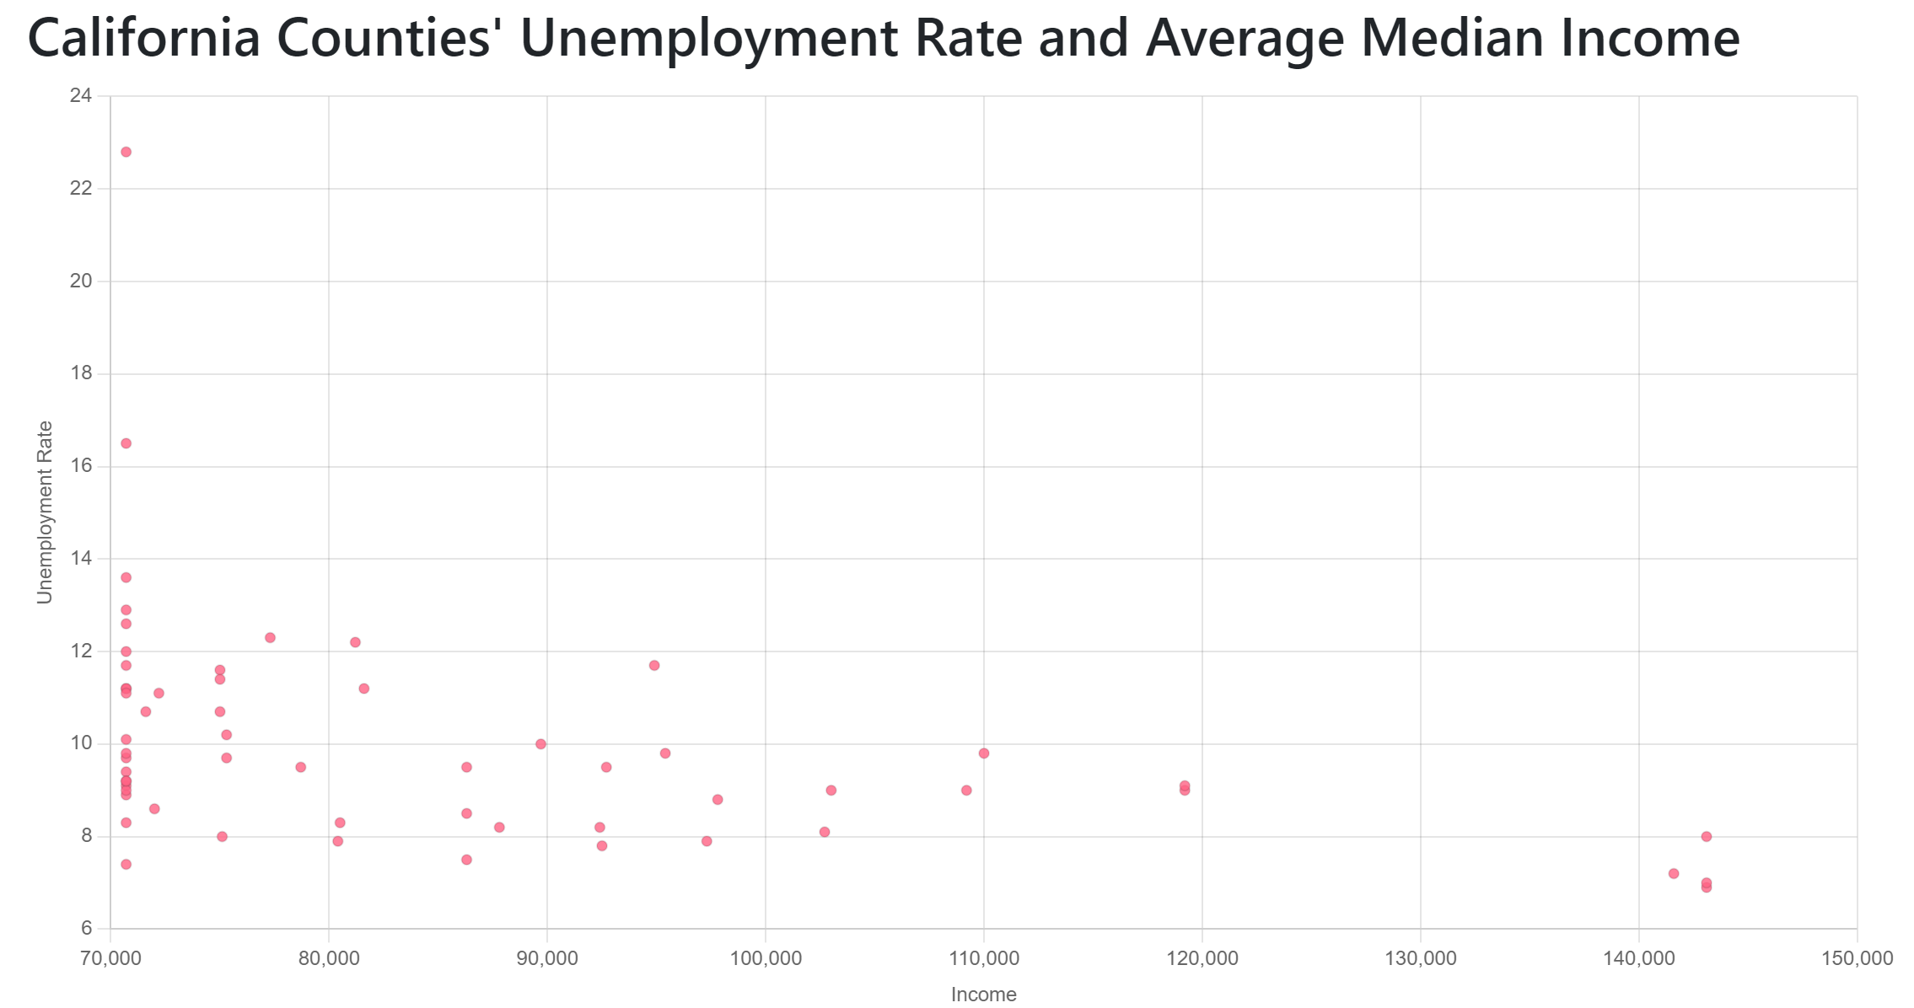
Unemployment Rate and Average Median Income
As on the previous plot, we can see here that a lot of counties have a median income of 70,000 or less. The average unemployment rate seems to be lower than 10%. Imperial county is a clear
outlier with an unemployment rate of 22.8%. We can here see that the 4 counties with the highest median income (Marin, San Francisco, San Mateo, Santa Clara) also have a low unemployment rate (between 6 and 8%), confirming the observation done with the previous plot. It is possible that highest income are associated with lower unemployment rate but it is not really clear with this plot only. The data for county with income lower than 70,000 would be helpful.

Slide 7
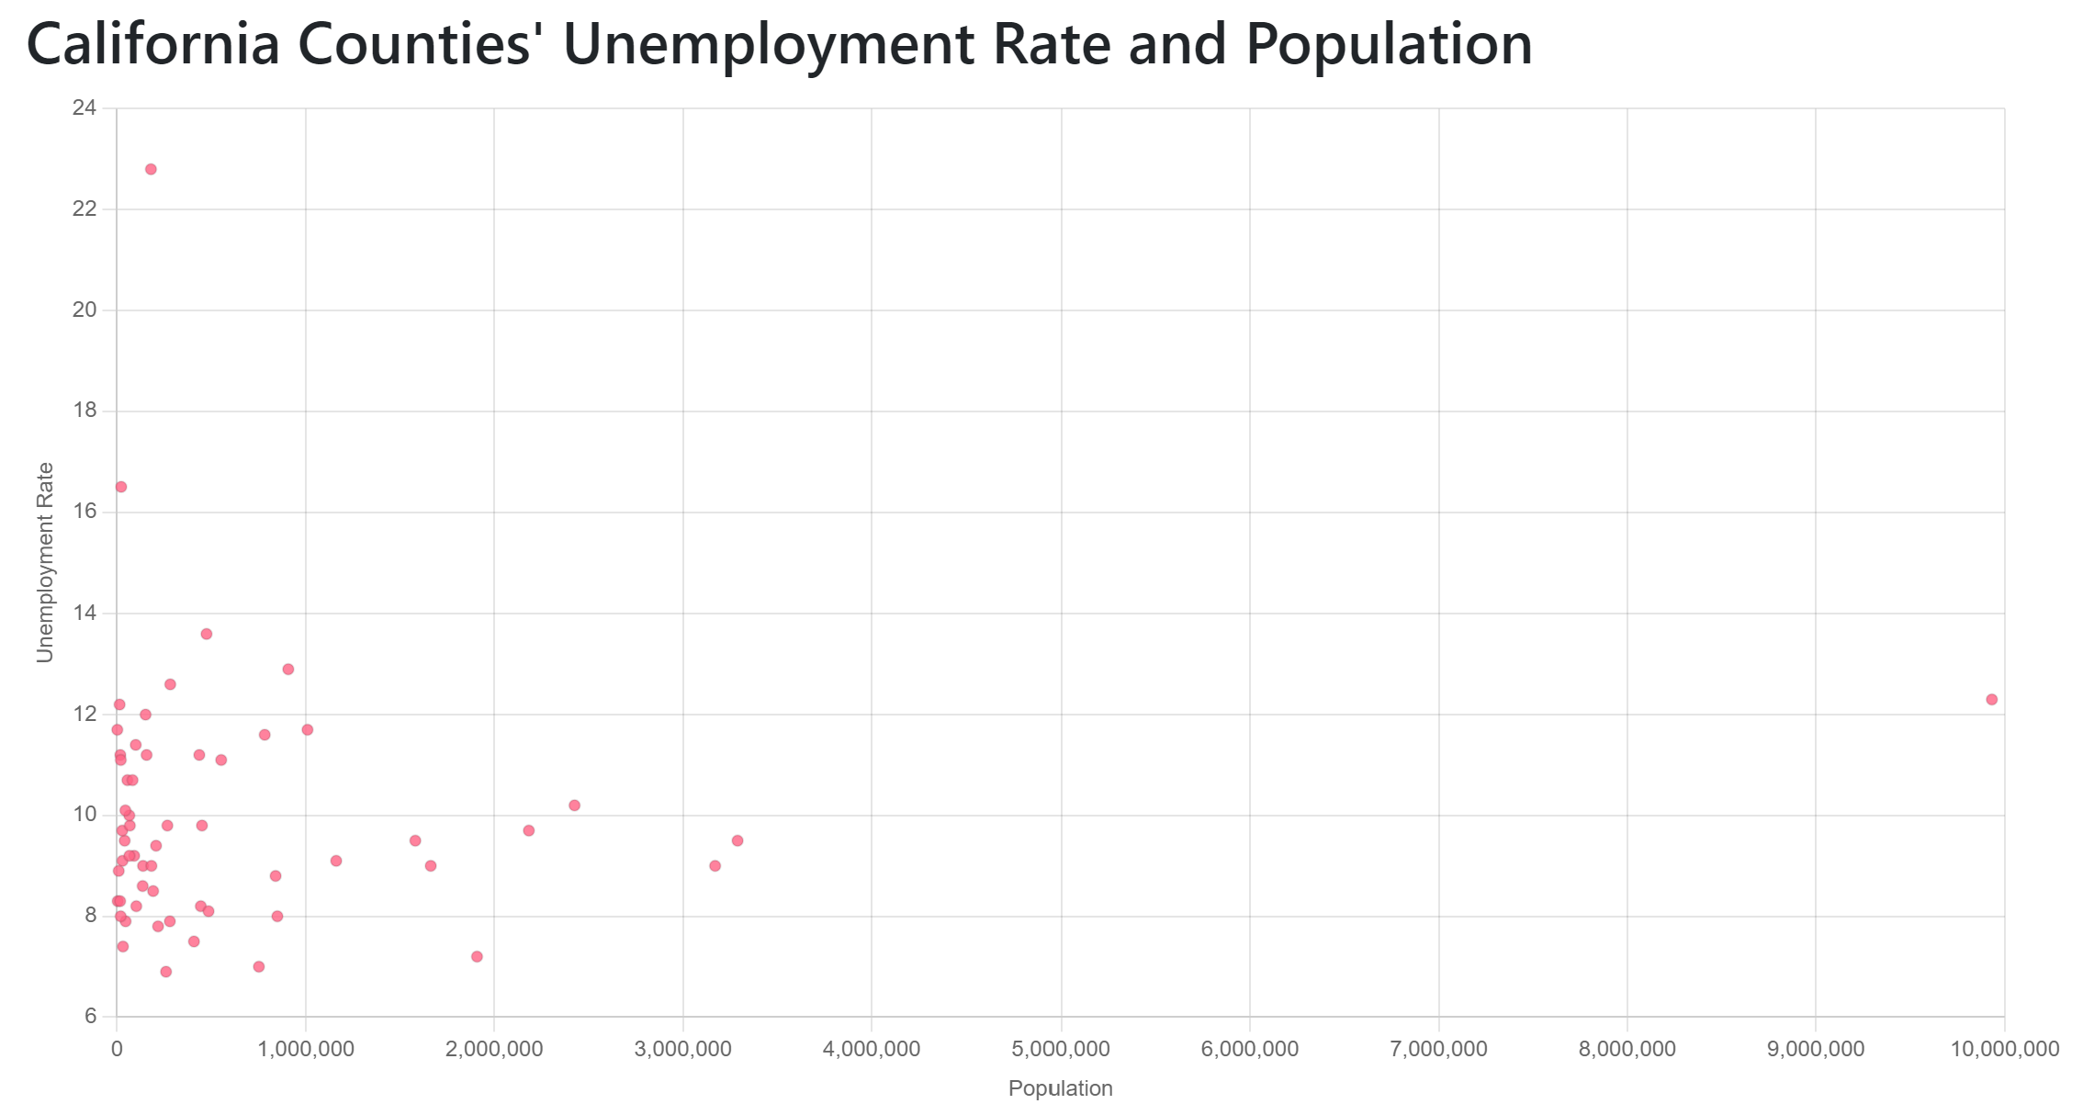
Unemployment Rate and Population
As seen before, we can see that the average population is less than 1 000 000 (Los Angeles county is still visible as a clear outlier here). The average unemployment rate seems to be lower
than 10%. Imperial county is a clear outlier with an unemployment rate of 22.8%. There doesn't seems to be a strong correlation between unemployment rate and population. It may looks like counties with population over 1 000 000 have an unemployment rate slightly lower than the average, but this tendency is not clear. The data for counties with population lower than 1 000 000 would be helpful. Maybe removing Imperial and Los Angeles county could be helpful for readability.

