Slide 1
Calculating Trade in Value
By: Stacy Bowler &
Derrik Miller

Slide 2
Business Problem
A dealership must consistently evaluate customer trade-ins. It needs to know what price range could be offered as a trade in based on many factors like model, odometer, condition, age of vehicle.

Slide 3
Executive Summary
Vehicle age was the strongest continuous predictor of resale value.
Each additional year of age decreases vehicle value by approximately 12.8%
Every additional 10,000 miles reduces value by approximately 5.1%.
Vehicle condition increased value by approximately 0.7% for each one-point improvement in condition rating.
Model type had the largest overall impact on value, with heavy-duty pickup trucks consistently commanding the highest prices.
These results suggest that dealerships should prioritize younger vehicles and high-demand truck models when acquiring inventory because those factors have the greatest influence on resale value.
Notes:
The model estimates that each additional year of age decreases vehicle value by approximately 13.8%, while every additional 10,000 miles reduces value by approximately 2.2%. Vehicle condition had a smaller but statistically significant effect, increasing value by approximately 2.0% for each one-point improvement in condition rating.

Slide 4
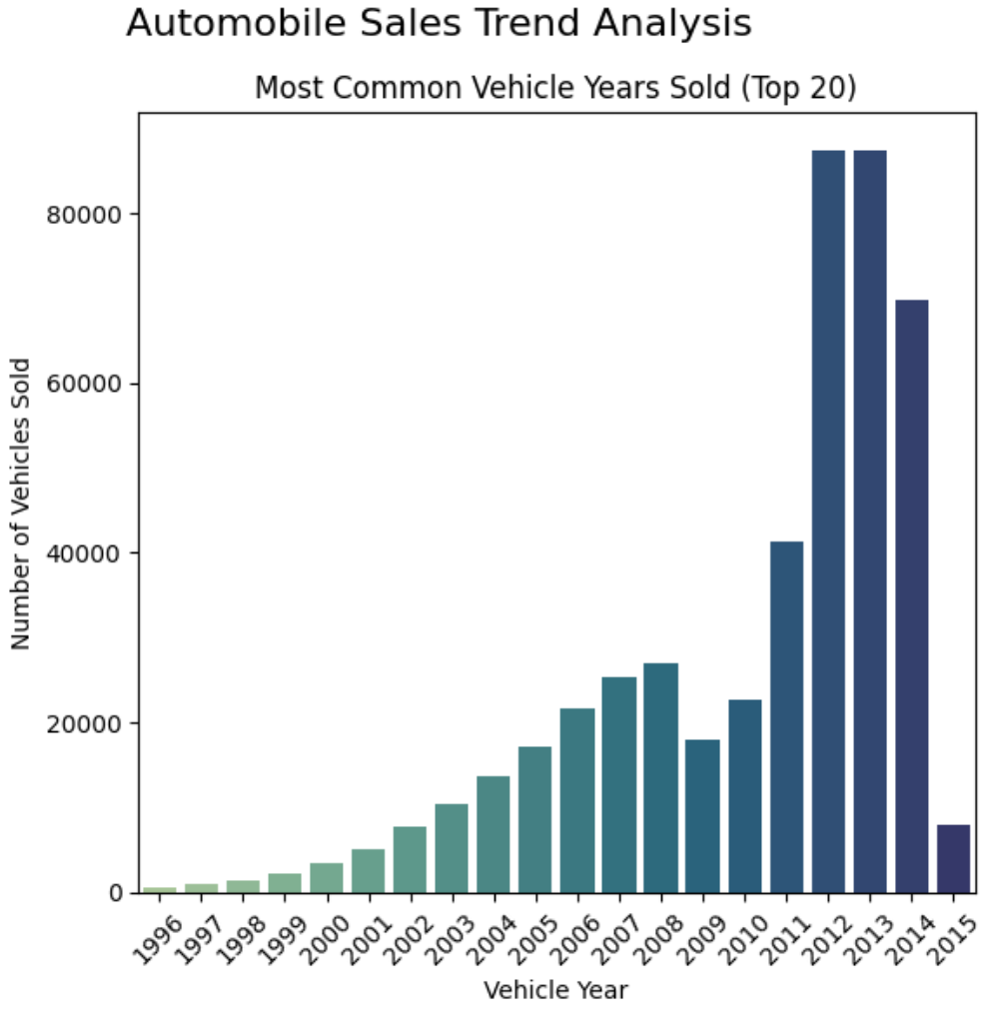
Data Summary
Data used was from the website Kaggle.com.
The data was compiled from multiple dealerships.
Nearly all used car sales data from 2015
Vehicle years range from 1996 to 2015
Contains sales data from 34 different states in the US
Main data points were vehicle age, odometer, condition, model
Cleaned data contained over 470,000 transactions

Slide 5
Data Preparation
Normalized make: ‘ford truck’, ‘ford tk’ changed to ‘ford’
Normalized body: model specifies bodies such as ‘cts coupe’ and ‘g37 convertible’ changed to ‘coupe’ and ‘convertible’
Dropped nulls, removed extra spacing/characters, and lowercased various columns for consistency
Normalized colors to consistent values and converted any values like ‘-’ to ‘unknown’
Calculated age of vehicle at time of sale by pulling the sale year out of the sell date and manufacture year of vehicle
Transmission and color were ignored due to insignificance
MMR (Manheim Market Report) was dropped as it was essentially an estimate of the value that we are modeling
After cleaning the data, our analysis and conclusions were based on 5000 observations of a stratified sample of the data

Slide 6
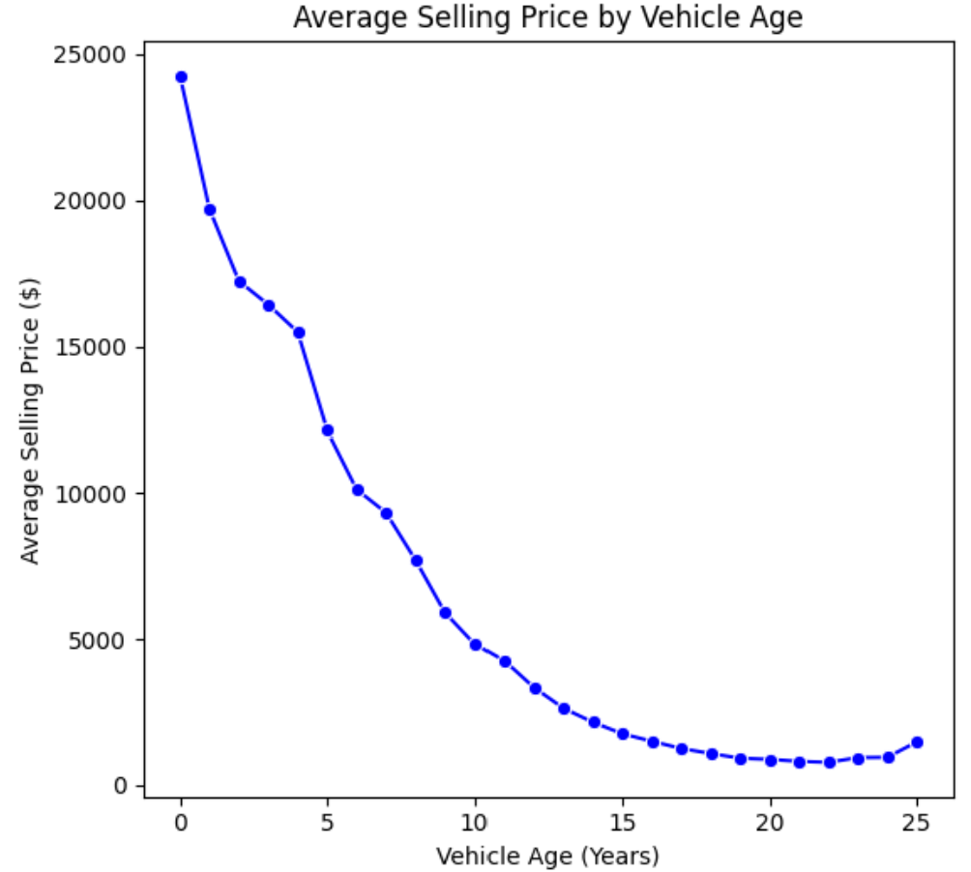
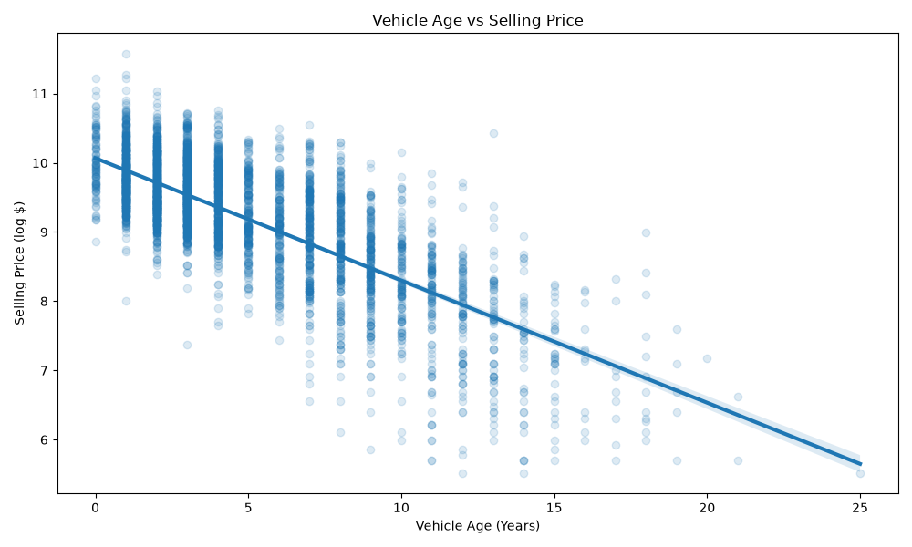
Price vs Vehicle Age

Slide 7
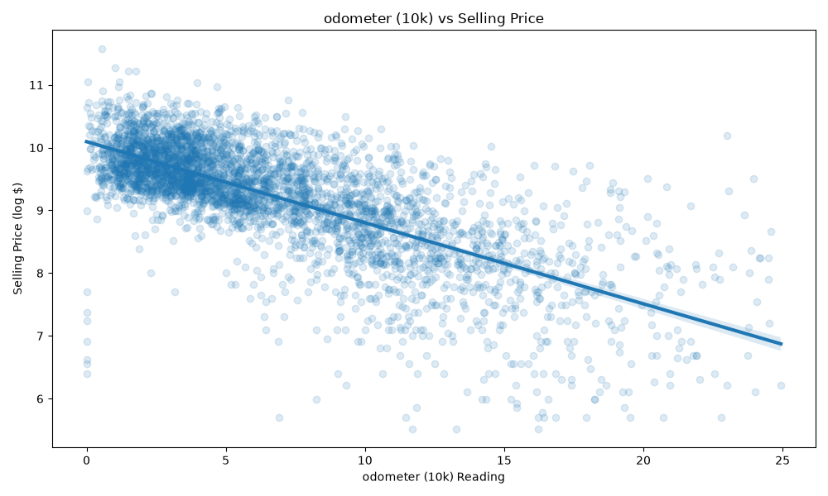
Price vs Odometer

Slide 8
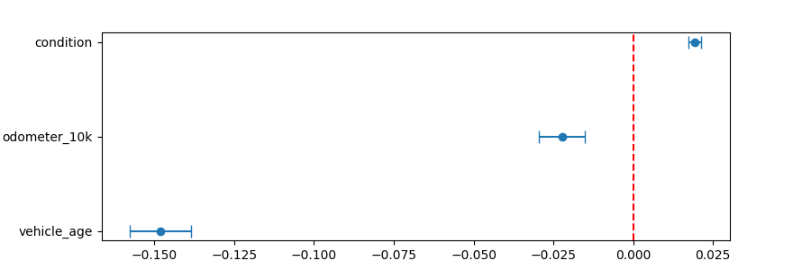
Non-Model Predictors

Slide 9
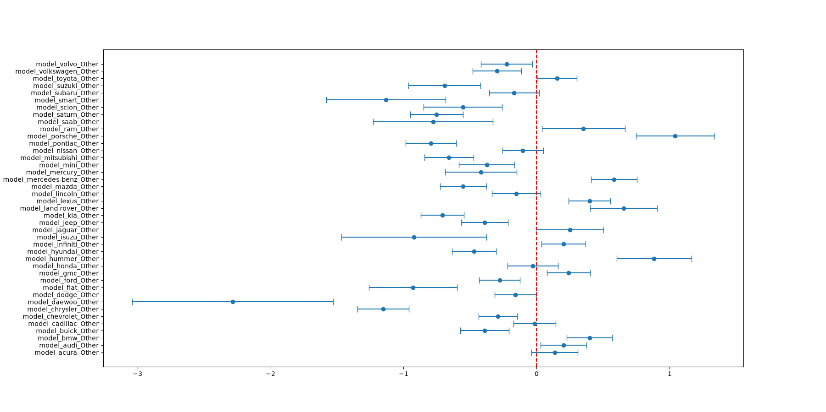
Other Models < 10

Slide 10
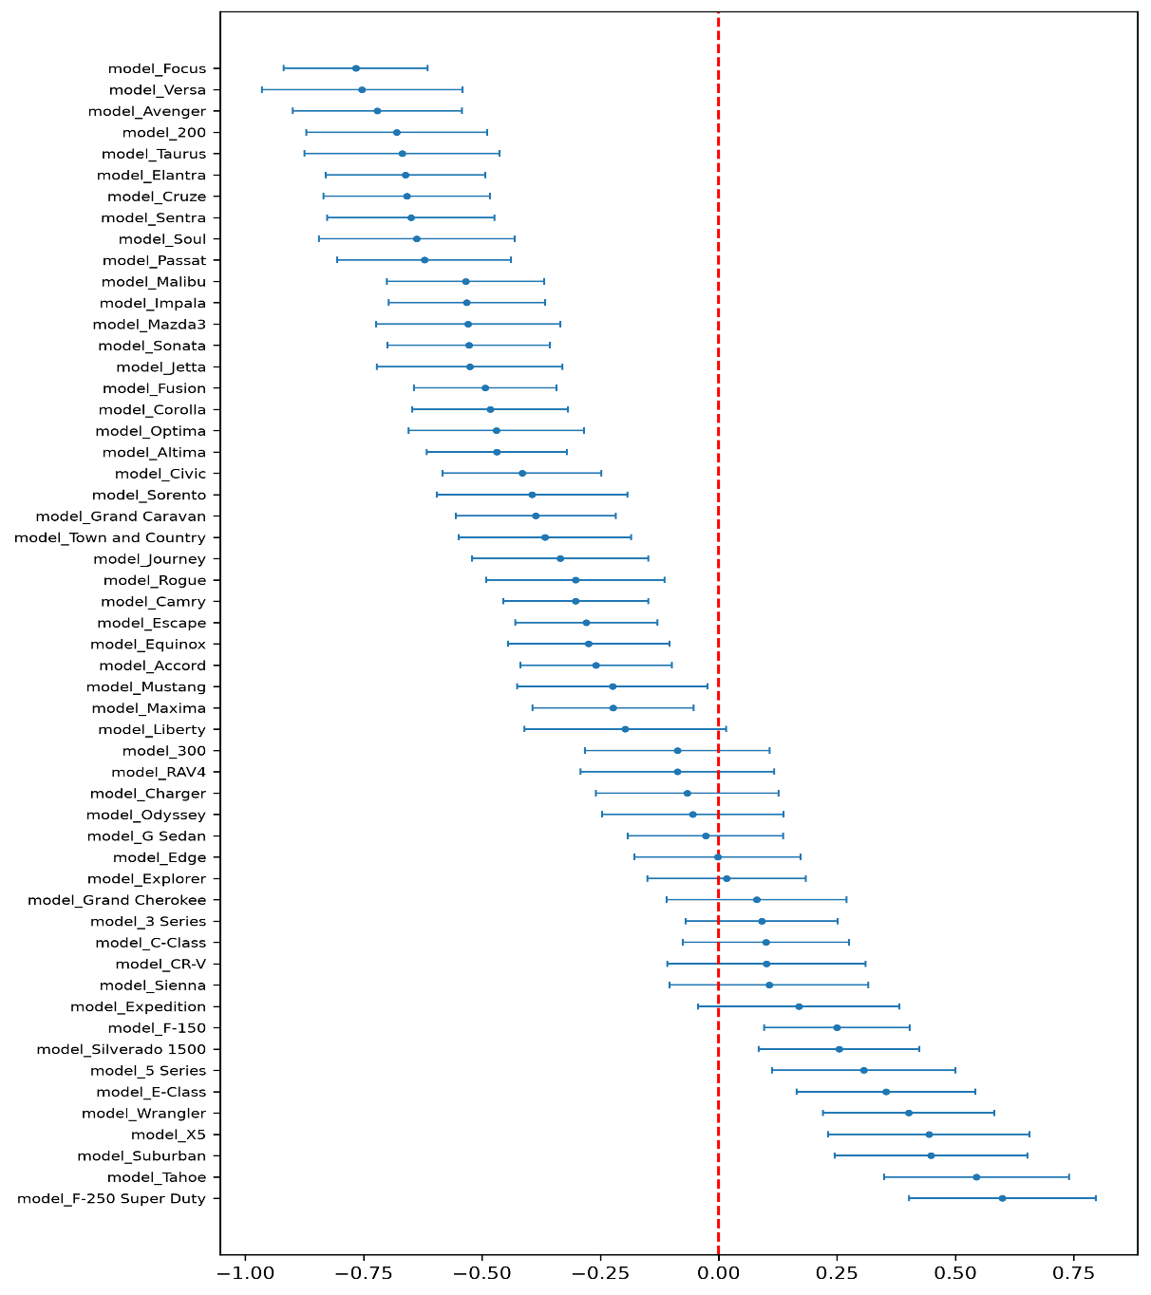
Model Predictors

Slide 11
Ram 1500 Example (Derrik’s truck)
=== Vehicle Valuation Prediction ===
Input Vehicle: Ram 1500
State: UT | Age: 7.0 years | Odometer: 115,000.0 miles | Condition: 30.0
Canonical Model Representation: 1500
------------------------------------
Predicted Log Selling Price: 9.1918
Predicted Median Value (naive): $9,815.95
Predicted Expected Value (mean): $11,028.72
Predicted for sale in: UT
Trade-in offer for 10-15% profit: $9,374.41 to $9,925.85
====================================

Slide 12
Honda Accord Example
=== Vehicle Valuation Prediction ===
Input Vehicle: Honda Accord
State: UT | Age: 3.0 years | Odometer: 65,000.0 miles | Condition: 40.0
Canonical Model Representation: Accord
------------------------------------
Predicted Log Selling Price: 9.5440
Predicted Median Value (naive): $13,961.09
Predicted Expected Value (mean): $15,685.99
Predicted for sale in: UT
Trade-in offer for 10-15% profit: $13,333.09 to $14,117.39
====================================

Slide 13
Toyota Tacoma Example
=== Vehicle Valuation Prediction ===
Input Vehicle: Toyota Tacoma
State: UT | Age: 13.0 years | Odometer: 200,000.0 miles | Condition: 15.0
Canonical Model Representation: toyota_Other
------------------------------------
Predicted Log Selling Price: 7.8247
Predicted Median Value (naive): $2,501.65
Predicted Expected Value (mean): $2,810.73
Predicted for sale in: UT
Trade-in offer for 10-15% profit: $2,389.12 to $2,529.66
====================================

Slide 14
Conclusion
Based on the model, we recommend the following:
Don’t sit on your inventory for too long for newer models. They depreciate a lot faster than vehicles 10+ years old.
Consider what it would take to raise the condition a few points and if it would be worth any monetary investment.
Heavy duty pickup trucks are typically safe investments. They hold onto their value far better than other categories.
Vehicle model captures differences in vehicle type, original MSRP, market demand, towing capability, luxury features, and brand perception that are not explained by age, mileage, or condition alone.

Slide 15
Next Steps
Investigate adding original MSRP, accident history, and local/other economic data for each vehicle model

Slide 16
Questions?

Slide 17
Appendix

Slide 18
All Data Fields
Year - The manufacturing year of the vehicle.
Make - The brand or manufacturer of the vehicle.
Model - The specific model of the vehicle.
Trim - Additional designation for the vehicle model.
Body - The body type of the vehicle (e.g., SUV, Sedan).
Transmission - The type of transmission in the vehicle (e.g., automatic).
Vin - Vehicle Identification Number, a unique code for each vehicle.
State - The state where the vehicle is registered.
Condition - Condition of the vehicle, possibly rated on a scale of 1 - 50.
Odometer - The mileage or distance traveled by the vehicle.
Color - Exterior color of the vehicle.
Interior - Interior color of the vehicle.
Seller - The entity selling the vehicle.
MMR - Manheim Market Report, possibly indicating the estimated market value of the vehicle.
Selling Price - The price at which the vehicle was sold.

