Slide 1
Calculating Trade in Value
By: Stacy Bowler &
Derrik Miller

Slide 2
Business Problem
A dealership must consistently evaluate customer trade-ins. It needs to know what price range could be offered as a trade in based on many factors like model, odometer, condition, age of vehicle.

Slide 3
Executive Summary
The most valuable vehicles for trade-in are nearly all trucks.
Model and age are two most important factors in determining trade-in value.

Slide 4
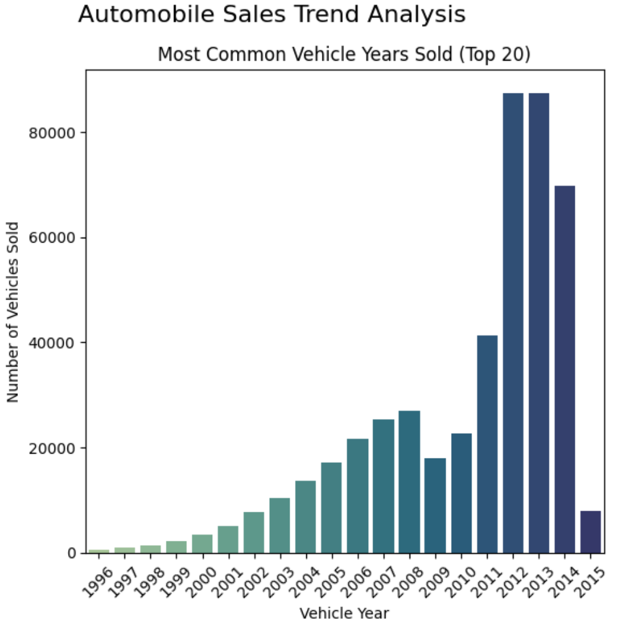
Data Summary
Nearly all used car sales data from 2015
Vehicle years range from 1996 to 2015
Contains sales data from 34 different states in the US
Main data points were vehicle age, odometer, condition, model
Cleaned data contained over 470,000 transactions

Slide 5
Data Preparation
Normalized make – ford truck, ford tk changed to ford
Normalized body – model specific bodies such as cts coupe and g37 convertible changed to just coupe and convertible
Dropped nulls from many columns
Removed extra characters and spacing from values
Lowercased many of the values for consistency
Normalized colors to consistent values and converted any values like ‘-’ to ‘unknown’
Pulled the sale year out of the sell date and calculated age of vehicle at time of sale
Dropped redundant features for multicollinearity – make, body
Transmission and color were dropped due to insignificance.
MMR (Manheim Market Report) was dropped since it was essentially an estimate of the value that we are modeling

Slide 6
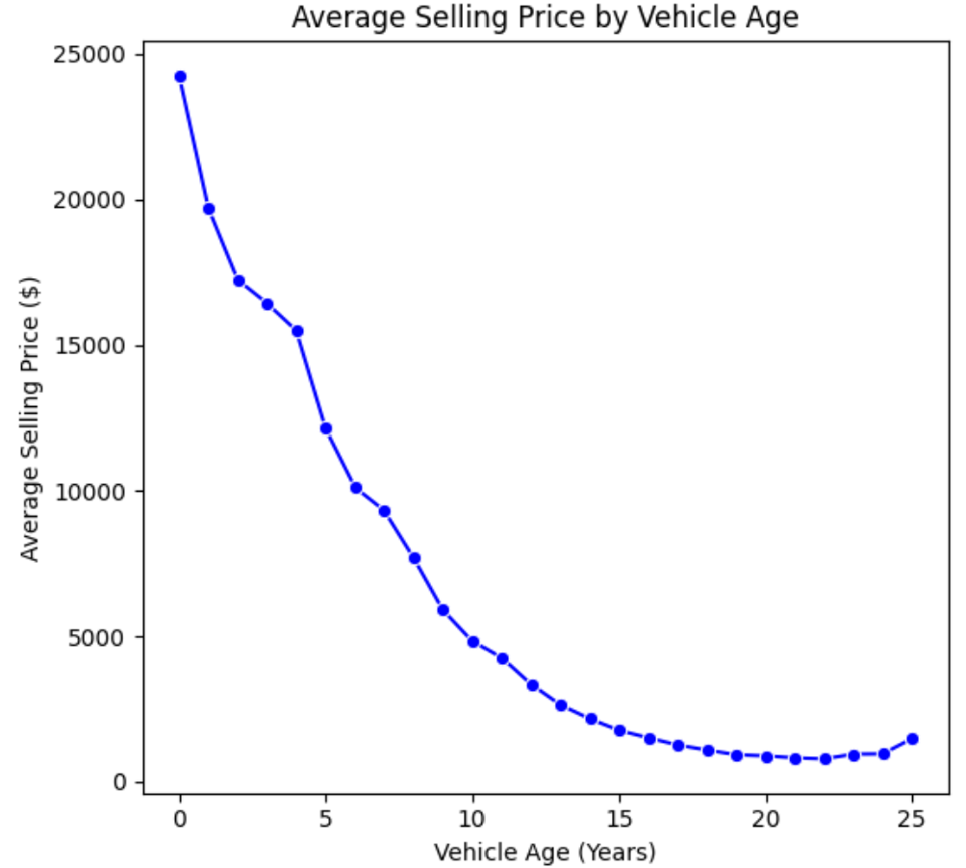
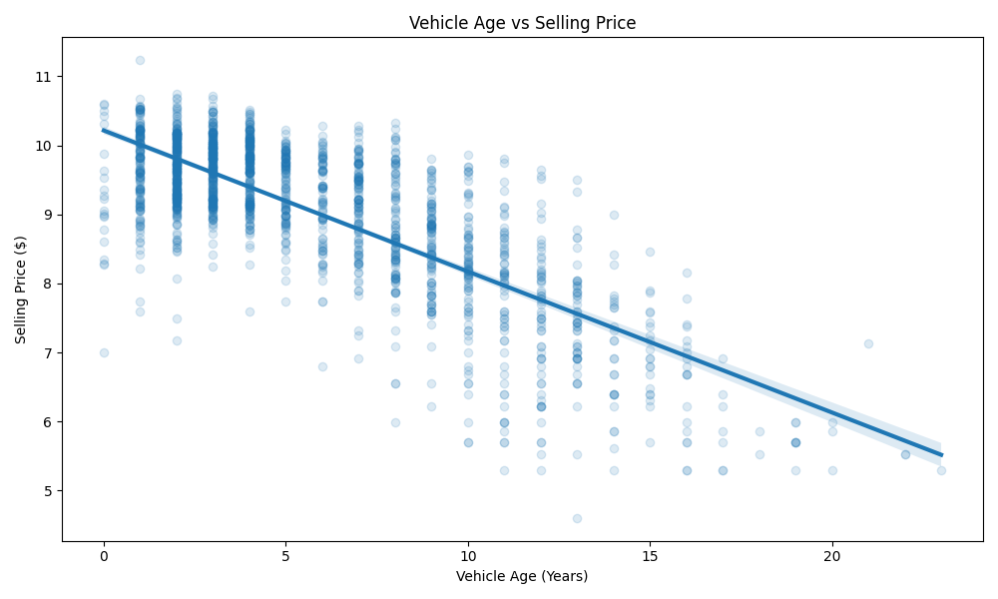
Price vs Vehicle Age

Slide 7
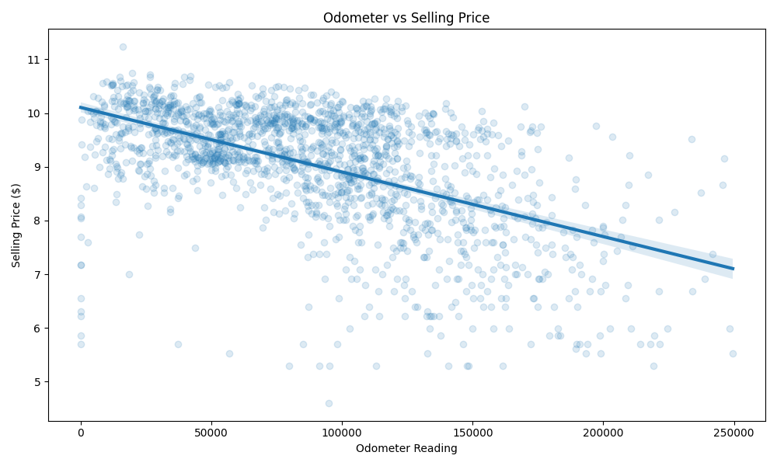
Price vs Odometer

Slide 8
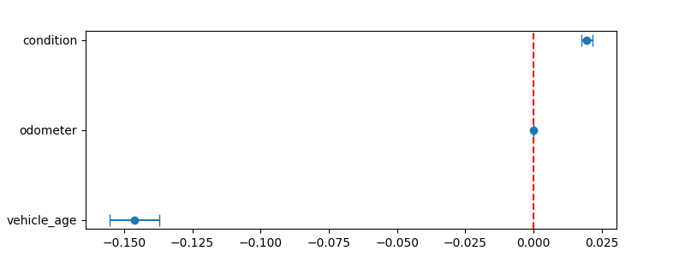
Non-Model Predictors

Slide 9
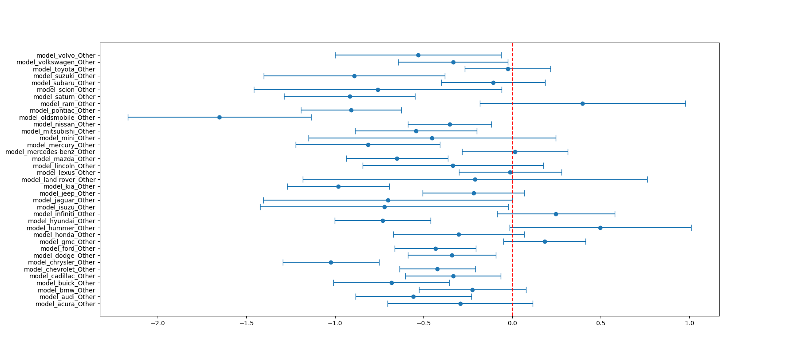
Other Models < 10

Slide 10
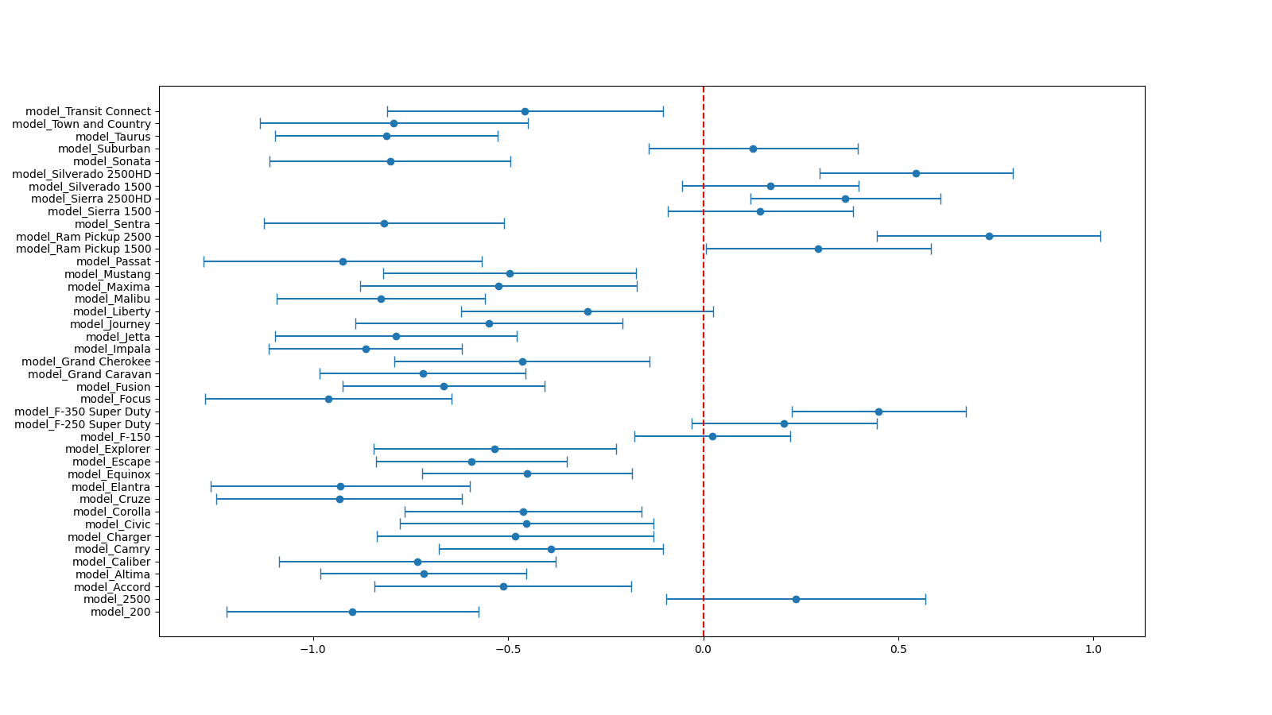
Model Predictors

Slide 11
Conclusion
Odometer has minimal or no impact on price
Vehicle age has largest impact on price between it, odometer, and condition
Models (inherently include make and body) can have largest impact. Possibly due to original higher/lower than average new price
Most valuable vehicles are almost all trucks

Slide 12
Questions?

Slide 13
Appendix

Slide 14
Data Fields
Year - The manufacturing year of the vehicle.
Make - The brand or manufacturer of the vehicle.
Model - The specific model of the vehicle.
Trim - Additional designation for the vehicle model.
Body - The body type of the vehicle (e.g., SUV, Sedan).
Transmission - The type of transmission in the vehicle (e.g., automatic).
Vin - Vehicle Identification Number, a unique code for each vehicle.
State - The state where the vehicle is registered.
Condition - Condition of the vehicle, possibly rated on a scale of 1 - 50.
Odometer - The mileage or distance traveled by the vehicle.
Color - Exterior color of the vehicle.
Interior - Interior color of the vehicle.
Seller - The entity selling the vehicle.
MMR - Manheim Market Report, possibly indicating the estimated market value of the vehicle.
Selling Price - The price at which the vehicle was sold.

